Slide 1
POWER BI ENDCAPSTONE-2
SUPERMARKET_SALES
A.Sai Akhilesh

Slide 2
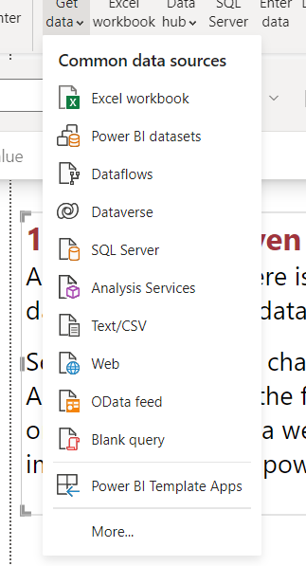
1)Import the given data into power BI?
Ans) In the home there is a ribbion Get
data then select the data source type which type of file you importing .
Select Text/CSV then change textfiles to
All files then we get the files to import then select the file and if we click
on the transform data we can edit the data or if we click load then we directly
import the data into power BI.

Slide 3
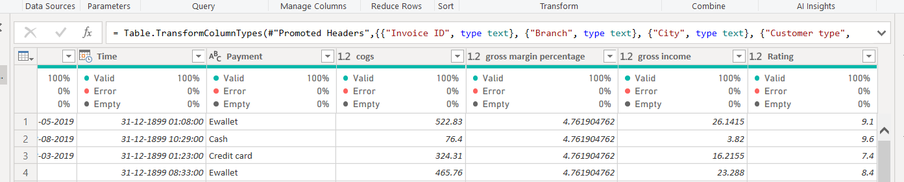
2.
Transforming the data into the power query .
Check for the errors and null values.
In the given data the date column was not in good format ,I changed the data type.

Slide 4
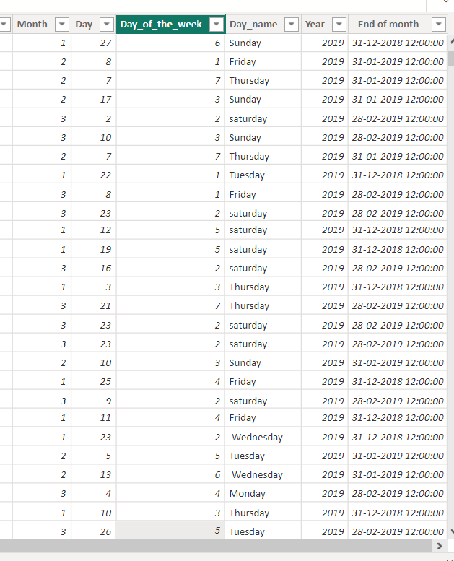
3. Preprocessing the data ?
I have created some columns based on the date column
Month
Year
Day
Day of the week
Day name
End of the month

Slide 5
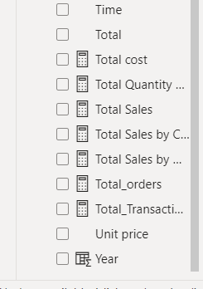
4. Creating measures ?
Make some analysis from the data using measures.
Total transactions
Weekend transactions
Total sales by customer type
Total Quantity sold
Total sales
Total sales by Gender
We can see the measures in the fields with the symbol of calculator type of symbol.

Slide 6
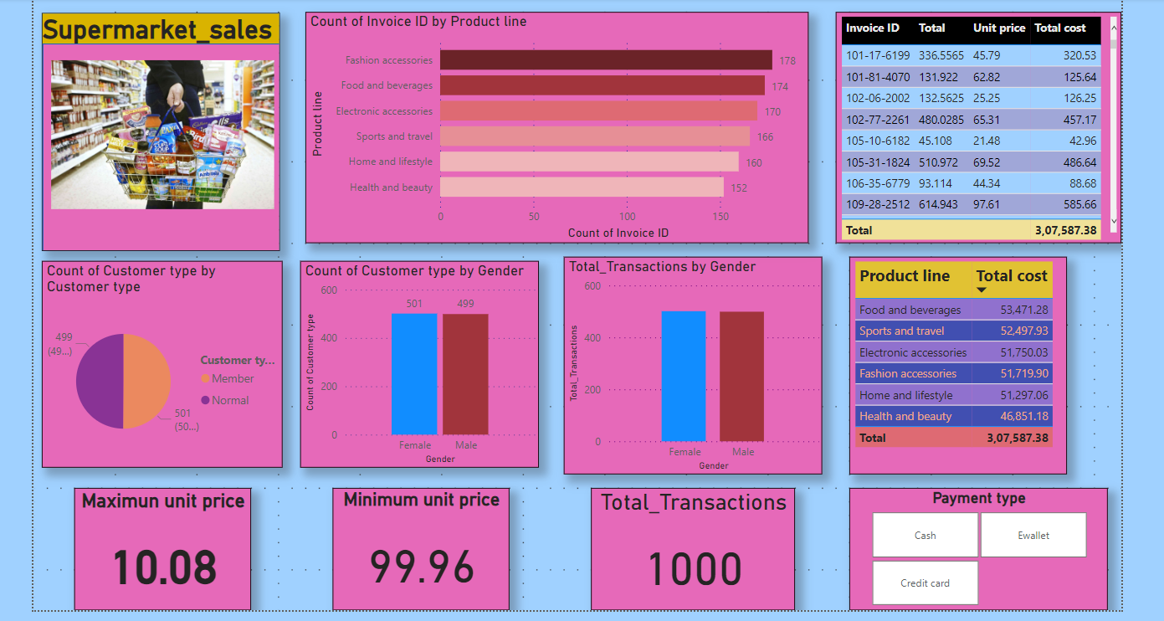
5. Create a attractive dashboard ?

Slide 7
Thank You!

