Slide 1
EXCEL ENDCAPSTONE-2
A.SAI AKHILESH

Slide 2
Supermarket_sales

Slide 3
1 . Import the data
1.Check the extension of the file which you want to import.
2.Go to data ribbion and click on getdata>from excel>select the file.
3.Load the data it directly loads or click transform if we want any changes in data.
4.Import the data in Power Pivot in Excel.
5.After changes on the top left select close and import

Slide 4
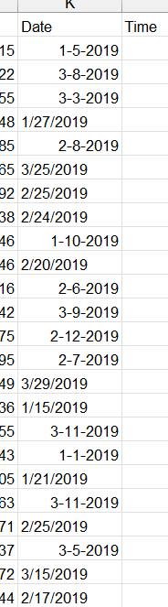
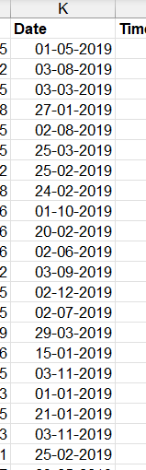
2. Convert the date column in correct format?
From the sales data we are facing some problem with date column we convert it into correct format by following the steps
Select the date column and it separate with d-limitor
then make the column names and apply the another column using DATE function with If condition then copy that column and select it click on the smart date on the ribbions.
Then we get the correct date format.

Slide 5
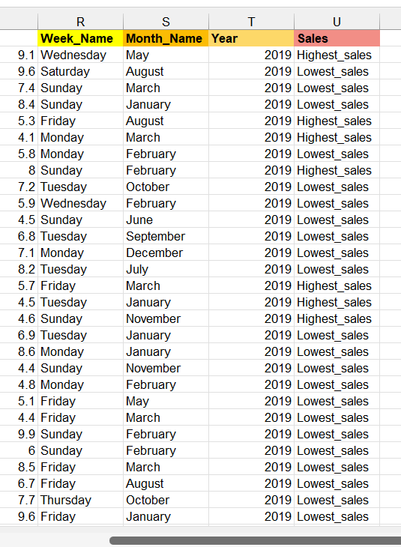
3. Adding some new columns using some functions.
Adding some new columns using the DATE column.
Week_name ,Month_name,Year and Sales
Week_name =TEXT(K2,"dddd") gets like Wednesday
Month_name =TEXT(K2,"mmmm") gets like May
Year =YEAR(K2) gets like 2019
Sales =IF(J2>500,"Highest_sales","Lowest_sales")

Slide 6
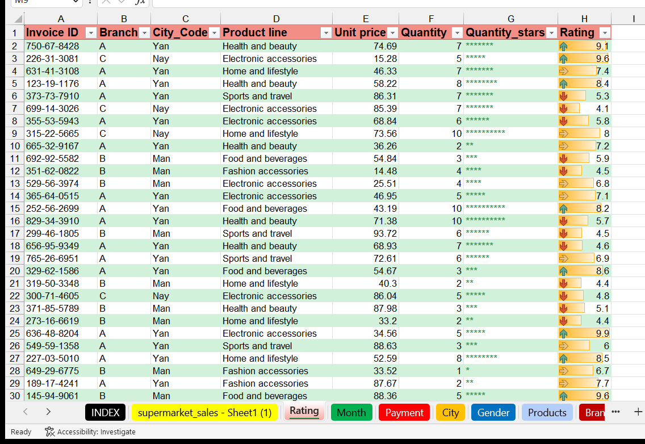
4. Giving the rating.
On the next sheet copy and paste sone columns like Invoice id,
Branch,City_code,Product_line,Quantity from the salesmarketing and add some columns like Quantity_starts and Rating.
Quantity_starts =REPT("*",F2)
Rating is also from the sales sheet by using conditional formatting we get rating for that column.

Slide 7
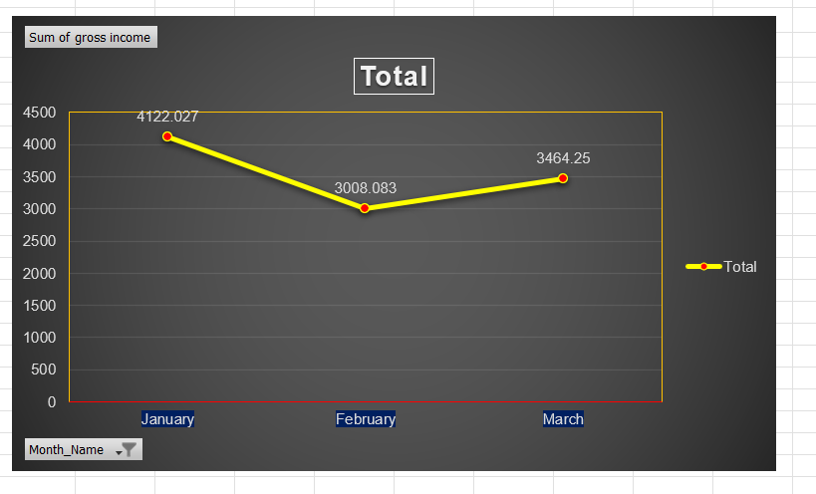
5. Which month has high gross income ?
January month has the more gross income compared to all the months.
Create the pivot table for Months and Gross income columns
and apply the filter,top 3 months then we get the top 3 months with high gross income.

Slide 8
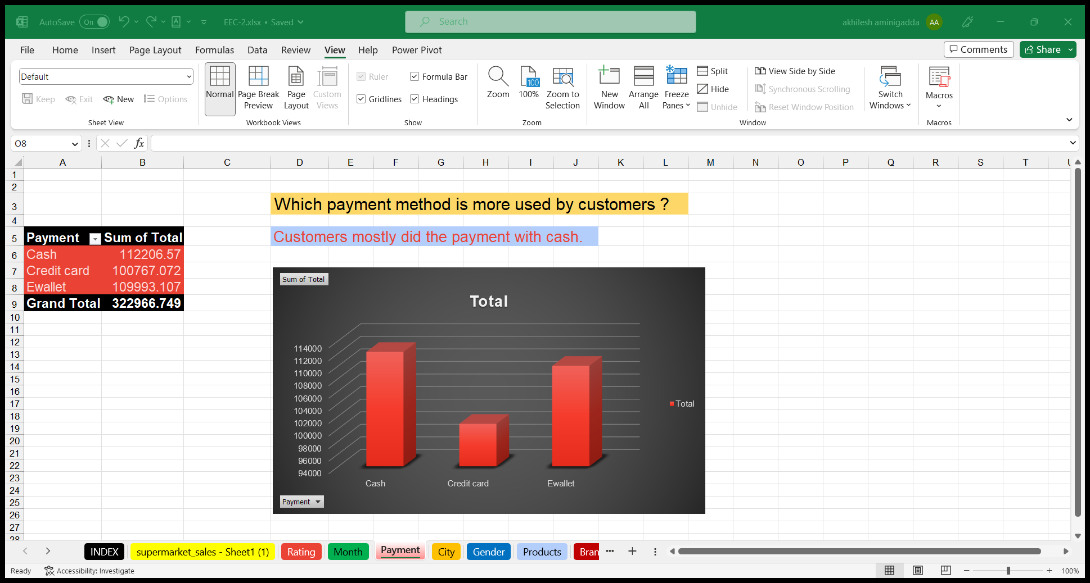
6. Which payment method is more used by customers ?
Customers mostly did the payment with cash.
Create the pivot table for paymentmode and total.
Then we get the method more used by customers.

Slide 9
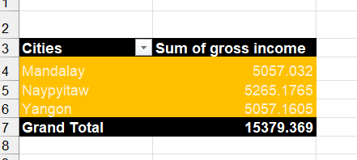

7. Which city has high gross income?
Naypyitaw city has the high gross income.
Create the pivot table for cities and gross income.

Slide 10
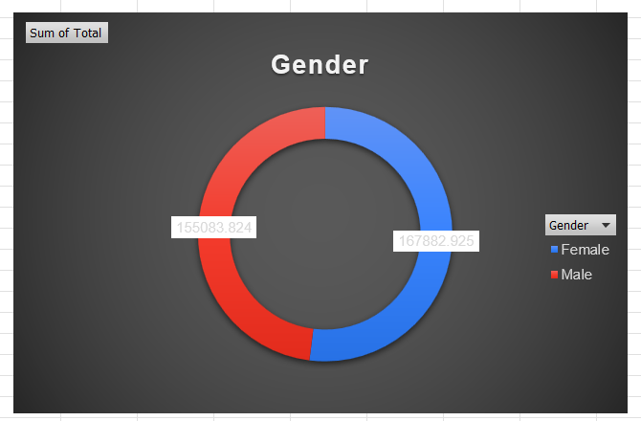
8. Percentage of males and females and represent it with donut chart.
52% of Female and 48% of Male are their in the data

Slide 11
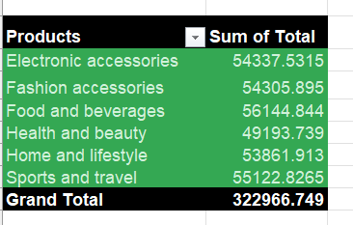

9. Which product have the highest and least sales & represent it with suitable chart ?
Food and beverages has highest sales, Health and beauty has least sales.
Create the pivot table for products and sales columns then we get it.

Slide 12
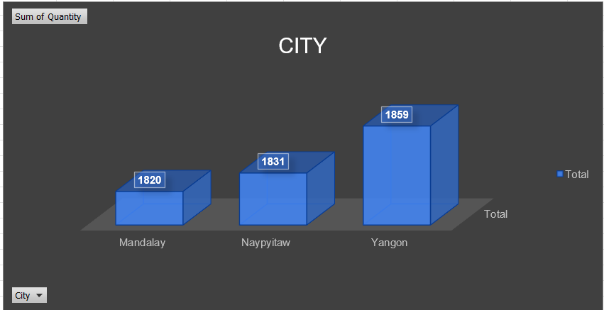
10. Which city has highest quantity ?
Yangon has the highest quantity compared to all the cities.

Slide 13

T
a
k
y
u
h
n
o

