Slide 1
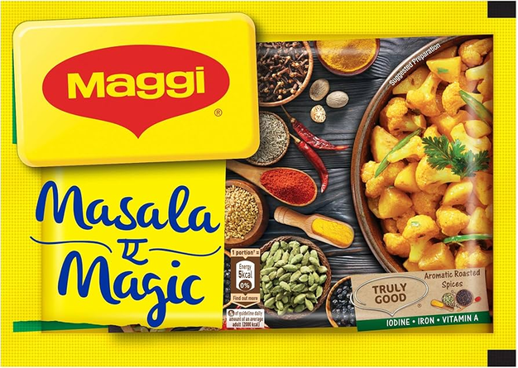


1 March, 2025
Factors Influencing Consumer Purchase Decision for
Maggi Masala
Akhilesh 924
Bagish 930
Raj 920
Swayam 911
Prepared by Group 12
1

Slide 2


Agenda
  Objective
  Questionairre
  Factor Analysis
  Regression Analysis
  Conclusion

Slide 3




Project Objectives
Data Preparation
Factor Analysis
Regression Analysis
  To design and administer a structured survey using a 1–5 Likert scale across 25–30 variables to capture consumer attitudes and perceptions toward Maggi Masala.
  To conduct factor analysis on the survey data, reduce the variables into a smaller set of latent constructs, and derive factor scores
  Factor scores used to examine the relationship between these constructs and the likelihood of repurchasing Maggi Masala through regression analysis.
Forms Link
3

Slide 4

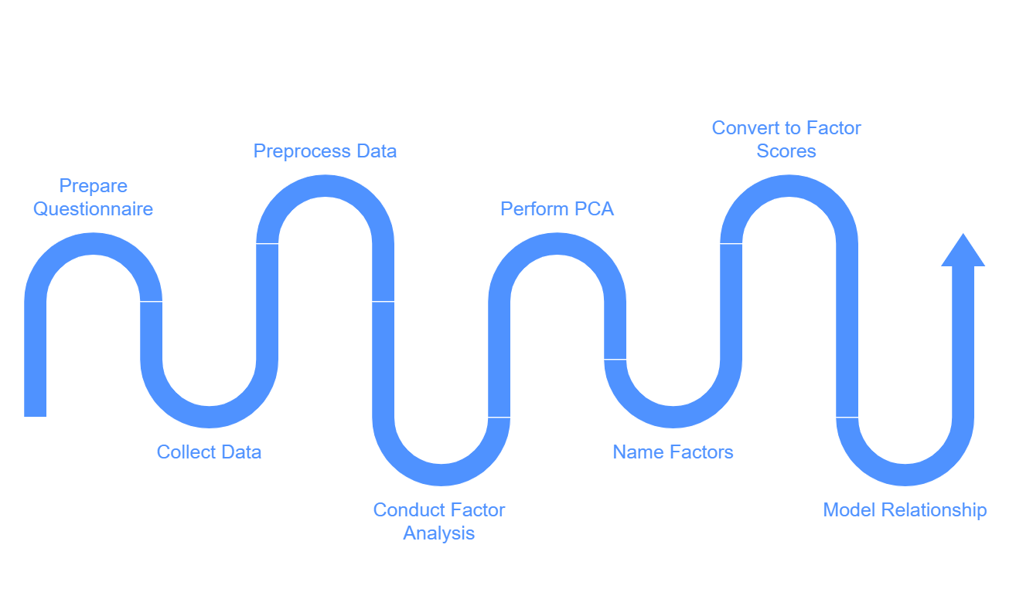
Methodology
4

Slide 5
Factor Analysis
Assumption Checking
KMO Measure
Bartlett Test
Ho: Correlation matrix is an identity matrix
V/S
H1: Correlation matrix is not an identity matrix
KMO value >=0.5 – Acceptable
KMO value <0.5 – Unacceptable
KMO Value: 0.933351
Chi Square Value: 3239.5418913488033
P Values: 0.0
5

Slide 6

Factor Analysis
  We have applied factor analysis on 29 variables collected from the questionnaire
  Total Cumulative variance explained is 63 %
  Factor Analysis uses PCA for reducing dimensions into 6 Factors and Varimax rotation is used for making stable factors
  The Factor Analysis has reduced these 29 variables into 6 major factor’s namely : Brand, Taste, Emotional Connect, Affordability, Availability & Advertisement
6

Slide 7
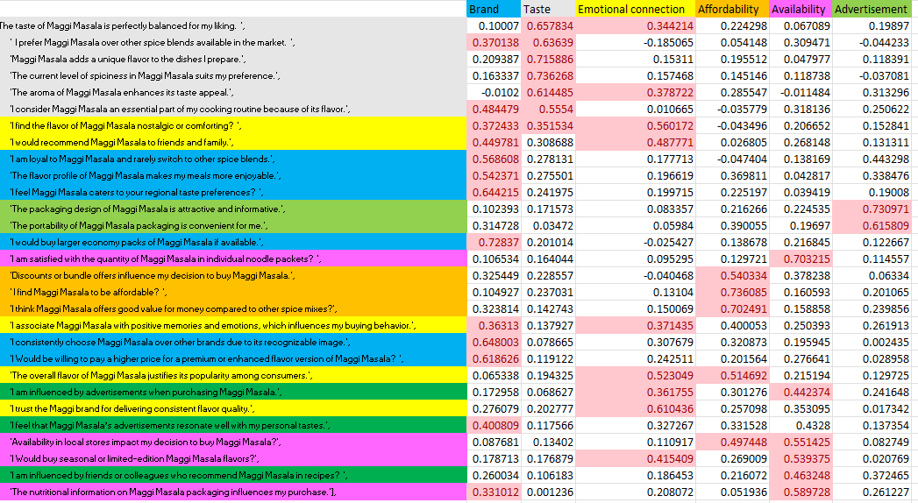
Loading Matrix
7

Slide 8
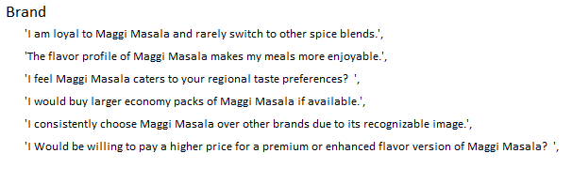
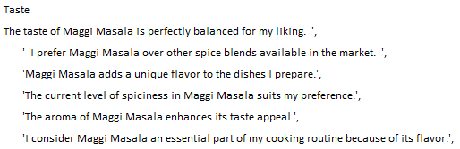
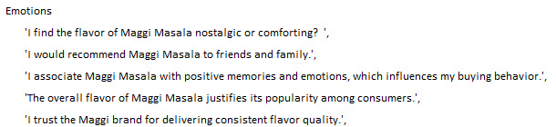
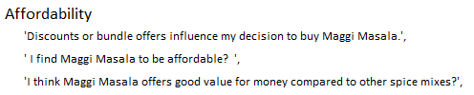
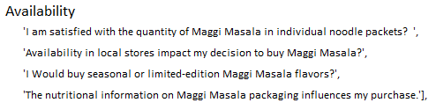
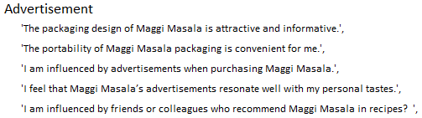
Factors Derived from Original Variables
*Now we will convert this loading matrix into factor scores
8

Slide 9
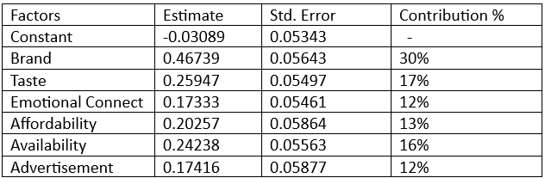
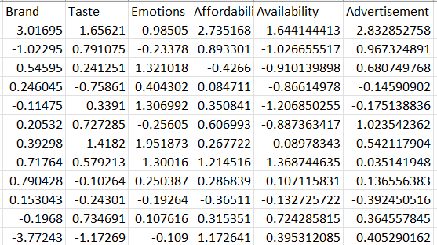
Regression Analysis
We will check the relationship between our Dependent variable (On a scale from 1 to 10, how likely are you to buy Maggi Masala again and recommend it to others? Using Factor scores generated with linear regression
Regression Analysis Output:
Factor Score Overview:
Model Summary:
  R-squared: 44.31%, Adjusted R-squared: 42.54%, p-value: 2.2e-16
9

Slide 10

Conclusion
  We have successfully reduced 29 variables into 6 factors that contributes in repurchasing the Maggi Masala.
  Using this comprehensive analysis stakeholders can Improve their Sales strategy and Branding strategy for repositioning Maggi Masala as a major spice mix brand in a very competitive market.
10

Slide 11
Thank you
For your attention
Prepared by group 12
11

