Slide 1
OFS (OPEN FINANCIAL SERVICES)
Day 1 & 2 – Sessions 1-4 OFS
Dates DD/MM/YYYY
Venue xxxx

Slide 2
Day-wise Plan
Session - I
What is OFS
Why OFS
Functionality of OFS
Architecture of OFS
Components of OFS
Processing modes of OFS
Session - II
Applications involved in OFS
Message Structure
Messages Types

Slide 3
Day-wise Plan
Session - III
Online OFS sample
Batch OFS sample
ENQUIRY using OFS
Session - IV
Subroutine call using OFS sample
Data capture using OFS sample
Error Messages in OFS

Slide 4
Objective & Agenda

Slide 5
Objective
At the end of this session, participants will
Understand the message structure in OFS
Usage of OFS in various applications like TC connector and for Interfaces

Slide 6
Agenda
What is OFS?
Why OFS?
Functionality of OFS
Architecture of OFS
Components of OFS
Agenda cont….

Slide 7
Agenda
Processing Modes
Applications involved in OFS
Message structure
Message Types
Common variables in OFS
Agenda cont….

Slide 8
Agenda
Online OFS sample
Batch OFS sample
ENQUIRY using OFS
Subroutine call using OFS sample
Data capture using OFS sample
Error Messages in OFS

Slide 9
Introduction

Slide 10
Introduction
What is OFS?
The Open Financial Service module (OFS) provides an interface to allow the update and interrogation of T24 applications
Any file can be updated using OFS
OFS is an interface that allows transactions and queries request to be processed by T24

Slide 11
Introduction
Data available in external source can be processed
Also enquiries related application can be retrieved using OFS
Can be used in various external applications like ATM, Internet Banking

Slide 12
Why OFS?
OFS is the only standard gateway to Temenos database
OFS syntax are understandable by Temenos database
Request for enquiries and updation of tables are done through the OFS formatted messages
Interface takes care of running any OFS business function which helps to avoid direct user intervention

Slide 13
Functionality of OFS
Supports multi-company processing
Error messages handling
Platform independent
Support for sub-values
The incoming messages can be customized by user
defined routines

Slide 14
Architecture

Slide 15
Architecture
Messages from T24 Applications/subroutines
Globus Manager
Request Manager
Enquiry Manager
OPEN FINANCIAL SERVICE
Applications/versions,Enquires
T24 Database
Notes:
GLOBUS MANAGER – is used by Temenos24 application to perform OFS module functions like update and
Querying between them.
GLOBUS MANAGER – Receives messages from some TEMENOS T24 application / subroutine through a subroutine call.
GLOBUS MANAGER - Performs checks to see if the call is from another OFS interface.

Slide 16
Architecture
External Feed
OFS ONLINE
MANAGER
OFS QUEUE
MANAGER
OFS REQUEST
MANAGER
OFS OFFLINE QUEUE
OFS DETAILS
OFS ENQUIRY
MANAGER
GLOBUS TRANSACTION

Slide 17
Components of OFS

Slide 18
Components of OFS
OFS QUEUE MANAGER
OFS ONLINE MANAGER
OFS REQUEST MANAGER
OFS CONNECTION MANAGER
OFS SESSION MANAGER

Slide 19
Components of OFS – OFS QUEUE MANAGER
OFS.QUEUE.MANAGER – is used for Batch communication with the OFS module
It also supports processing of offline messages (in batch mode)
Writes the reply for the processed message to a file or directory depending on the configuration done in the related OFS.SOURCE record
It also performs message logging depending on the level setup in related OFS.SOURCE record
Notes:
Checks for the processing functionality i.e. normal BATCH or OFFLINE batch.
If OFFLINE batch is set it reads the messages from the offline queue.
If normal BATCH mode is set it reads the OFS request messages from a file or from a directory depending on the configuration done in the related OFS.SOURCE record

Slide 20
Components of OFS – OFS ONLINE MANAGER
OFS ONLINE MANAGER – Receives messages from the external application (e.g. ATM Switch software) or user via a TELNET link
Passes the request message to the OFS.REQUEST.MANAGER to perform the required processing
Passes the reply message returned to the external application

Slide 21
Components of OFS – OFS REQUEST MANAGER
Receives the request message from one of the OFS module routines (subroutine call)
Calls the appropriate message parser based on the format of the message
Validate syntax structure of OFS
Notes:
The OFS.REQUEST.MANAGER is the main processing routine of the OFS
module. It is the heart of the OFS module and has a generic logic to
work across various TEMENOS T24 applications and enquiries. The
actual processing of the message including updating / querying the T24
database is handled by this routine. Almost all the OFS processing of
requests end here.
Also responsible to identify the type of function appearing on the message.

Slide 22
Components of OFS – OFS REQUEST MANAGER
Identifies the type of request (Application/enquiry)
Calls the subroutine given in the request if it is found to be a Subroutine request
Also passes the reply message to the caller application/subroutine

Slide 23
Components of OFS – OFS CONNECTION MANAGER
Connector uses Connection manager to send and receive messages from Temenos 24
Reads the records from OFS.SOURCE
Notes:
OFS.CONNECTION.MANAGER can also be used from a Temenos to post request messages to T24.
Initializes the Temenos t24 environment & common variable for processing applications/subroutines to work correctly.

Slide 24
Components of OFS – OFS SESSION MANAGER
Handles OFS requests coming from Temenos T24 Browser clients, forwards them to Temenos T24 server for processing and send back the response
Handles Browser sessions create/destroy and manage operations
Parses xml messages

Slide 25
Processing Modes

Slide 26
Processing Modes in OFS
The following are various processing modes in OFS
BATCH MODE
ONLINE MODE
GLOBUS MODE

Slide 27
BATCH MODE
FILES
Globus Manager
Request Manager
Enquiry Manager
OPEN FINANCIAL SERVICE
Applications/versions,Enquires
T24 Database
Notes:
GLOBUS MANAGER – is used by Temenos24 application to perform OFS module functions like update and
Querying between them.
GLOBUS MANAGER – Receives messages from some TEMENOS T24 application / subroutine through a subroutine call.
GLOBUS MANAGER - Performs checks to see if the call is from another OFS interface.

Slide 28
BATCH MODE
Files contain Batch of data
In case of Offline processing messages are picked up from queue files
In OFS Batch mode the OFS Queue manager runs the phantom process
Batch mode is controlled by both OFS.SOURCE and EB.PHANTOM

Slide 29
ONLINE MODE
MESSAGES
Globus Manager
Request Manager
Enquiry Manager
OPEN FINANCIAL SERVICE
Applications/versions,Enquires
T24 Database
Notes:
GLOBUS MANAGER – is used by Temenos24 application to perform OFS module functions like update and
Querying between them.
GLOBUS MANAGER – Receives messages from some TEMENOS T24 application / subroutine through a subroutine call.
GLOBUS MANAGER - Performs checks to see if the call is from another OFS interface.

Slide 30
ONLINE MODE
OFS online mode allow real time update to Temenos 24 via a live TELNET
Messages are accepted and processed individually
When OFS is set to work in online mode, the program EB.AUTO.INIT.PROCESS is executed upon login
When EB.AUTO.INIT.PROCESS is launched it looks for a record on the EB.AUTO.PROCESS file with an id equal to the UNIX / Windows login id of the user logging in.

Slide 31
GLOBUS MODE
MESSAGES FROM T24 APPLICATION/ROUTINES
Globus Manager
Request Manager
Enquiry Manager
OPEN FINANCIAL SERVICE
Applications/versions,Enquires
T24 Database
Notes:
GLOBUS MANAGER – is used by Temenos24 application to perform OFS module functions like update and
Querying between them.
GLOBUS MANAGER – Receives messages from some TEMENOS T24 application / subroutine through a subroutine call.
GLOBUS MANAGER - Performs checks to see if the call is from another OFS interface.

Slide 32
GLOBUS MODE
To setup Globus mode an OFS.SOURCE record has to be created
Globus mode does not make use of phantom
Request and responses are shared using subroutine call
For releases T24 and below, this call can be made from a version/version control subroutine or an application if you are building the application or from a custom-built T24 routine

Slide 33
GLOBUS MODE
From TEMENOS T24 R5 release onward, OFS.GLOBUS.MANAGER routine cannot be called from a VERSION / VERSION.CONTROL routine
A check has been made in EB.CALL.API to prevent this call, with a view to ensure integrity of the updates

Slide 34
Applications in OFS

Slide 35
Applications in OFS
OFS.SOURCE
EB.PHANTOM
OFS.REQUEST.DETAIL
Notes:
The applications are the three main applications in OFS. By setting up these applications various functionalities of
OFS can be done.

Slide 36
Applications of OFS - OFS.SOURCE
This is required to be set up for OFS processing for TELNET
Before passing the message through telnet, we have to ensure whether OFS.SOURCE is set up or not.
To set up OFS.SOURCE
Open OFS.SOURCE application
Create an id in OFS.SOURCE application
Fill up all the required fields in the OFS.SOURCE application.
OFS.SOURCE cont …..

Slide 37
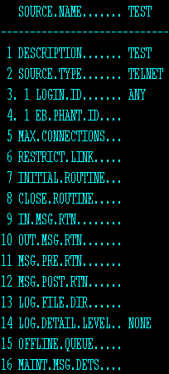
OFS.SOURCE – FOR ONLINE
Notes:
DESCRIPTION : Description of ofs service defined in record.
SOURCE.TYPE : Defined the type of communication used to exchange data with this service.
LOGIN.ID : Specifies the UNIX or NT login that will automatically initiate the communication with the external source. The external source will initiate communications by issuing a login using the specified id. The system will automatically begin the communication process when this login is detect.
LOG.DETAIL.LEVEL : Specifies the type of OFS message logging to be performed by OFS.

Slide 38
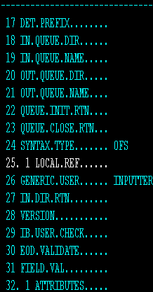
OFS.SOURCE – FOR ONLINE

Slide 39
OFS.SOURCE
DESCRIPTION :
This is a mandatory input field.
Which specifies the description of OFS.SERVICE record defined in this record
SOURCE.TYPE :
ONLINE/TELNET is another source type
This is not most widely used by our consultants
Mostly we are using for testing purpose to test the messages that we built is working fine or not

Slide 40
OFS.SOURCE - FIELDS
LOGIN ID :
Specifies the UNIX/NT login
This is a mandatory input if the SOURCE.TYPE is TELNET
EB.PHANTOM :
We need to create a Phantom record and attach that id in this field
Notes:
For online EB.PHANTOM need not be created.

Slide 41
OFS.SOURCE
MAX CONNECTION:
Specifies the maximum no of online OFS connections for the specified service which can be active at any one time (min input:1, max input: 99,999)
LOG DETAIL LEVEL :
FULL means all the log details will stored in the log directory
Notes:
LOG.DETAIL.LEVEL has got options like NONE, OPEN,EXCEPT and FULL
NONE- No message logging
OPEN – Only initial start and stop for processes are logged
EXCEPT – Only exceptions such as incorrect message syntax, invalid user details are reported
FULL – All message communication are fully logged.

Slide 42
OFS.SOURCE
DET PREFIX :
The details will be prefixed with the value given in this field. SAMPLE
The details of the record processed will be in OFS.REQUEST.DETAIL with the id prefixed with SAMPLE
INQUEUE DIR :
The data to be processed will be stored in IN (OFSTEMPIN) directory

Slide 43
OFS.SOURCE
OUT.QUEUE.DIR :
When u verify the EB.PHANTOM record the record from OFSTEMPIN will be moved to OFSTEMPOUT and the record will be created in FT File in INAU status
SYNTAX TYPE : OFS

Slide 44
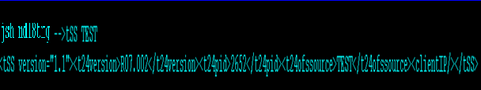
PASSING MESSAGE USING ONLINE MODE
After setting up the OFS.SOURCE for online, We have to pass the OFS message from the jshell prompt
In the shell prompt pass the below command
Then follow the below OFS message structure to update the application

Slide 45
Message structure
OFS Message Structure has got 5 parameters each separated by ‘,’
Operation
Options (VersionName/Functions/Operation)
Userid/password
Transaction id
Message to be passed

Slide 46
Message structure
OPERATION
Operation specifies the Temenos application to be run by OFS E.g. ACCOUNT,FUNDSTRANSFER
OFS transaction cannot be used update live files
OPTIONS
T24 function to be used with the application (e.g. Input-I/Authorize-A/Delete-D/Reverse-R)
If the function is not supplied then it is assumed as input

Slide 47
Message structure
USER INFORMATION
User sign on name – Valid sign on name available in T24 database
Password – Password of the sign name
Company – In case of multicompany setup

Slide 48
Message structure
TRANSACTION ID
The transaction id portion of the message structure contains the transaction number/key for the application that are run
The transaction id technically the ID of record in the file used in the transaction
MESSAGE DATA
The message data portion of the message structure contains the data required to create or update the transaction

Slide 49

Example of sample OFS Message
Application name
Version Name
Message to be passed
Username/password
Notes:
:: - used to assign value to a field

Slide 50
Return message
Message is passed in OFS Format, the response is returned back to user to acknowledge the message
The Return message consists of two return codes
1 – Success
-1 – Failure

Slide 51
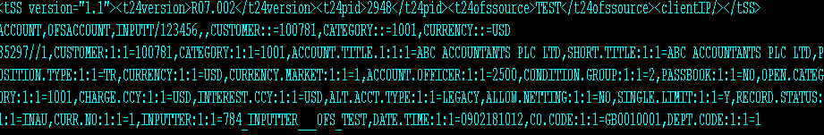
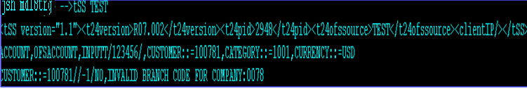
Sample return message
SUCCESS
FAILURE
success
failure

Slide 52
Workshop - I
Set up an OFS for ONLINE mode
Create a OFS.SOURCE record
Create a version for SECTOR
Update the DESCRIPTION field of the SECTOR through OFS

Slide 53
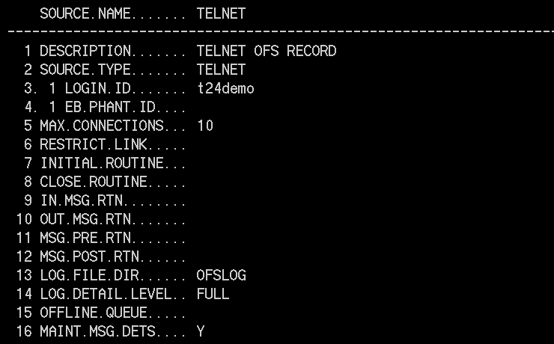
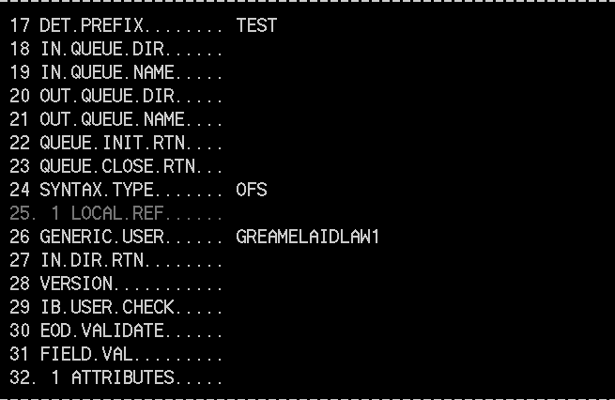
Solution – Step 1 : OFS ONLINE SETUP

Slide 54
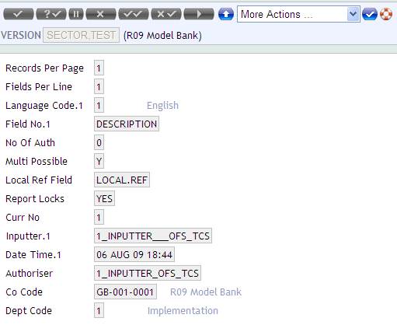
Solution – Step 2 : SECTOR-VERSION

Slide 55

Solution – Step 3 : OFS.CONNECTION.MANAGER
After setting up ‘OFS.SOURCE’ for Online updates, Initiate ‘OFS.CONNECTION.MANAGER’ from jsh prompt.
Syntax : OFS.CONNECTION.MANAGER <source name>
System prompts to enter OFS message
Enter OFS messages to be processed.

Slide 56
Solution - Return Message
After processing message , system will return a message from which we can identify that updates are successful or not.
In the above message, Transaction is updated successfully and Transaction details also returned.

Slide 57
EB.PHANTOM - FOR BATCH MODE
EB.PHANTOM to be set up when the OFS messages are to be processed using Batch mode
For OFS processing OFS.SOURCE and EB.PHANTOM has to be set up
Notes:
When collection of request for updation or insertion or deletion or an enquiry which is to be processed from
T24, all the data’s can be put and file and the file is termed as Batch file.
Batch mode is used when the messages are received in flat files.

Slide 58
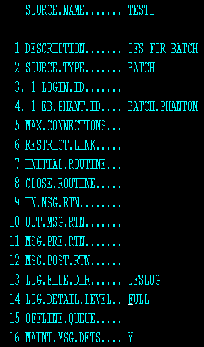
OFS.SOURCE – FOR BATCH MODE

Slide 59
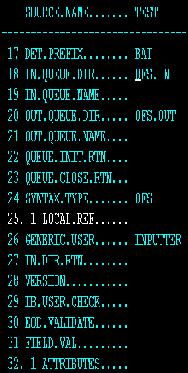
OFS.SOURCE – FOR BATCH MODE
Notes:
When you set up the EB.PHANTOM we have to give the id of OFS.SOURCE to OFS.SOURCE field in EB.PHANTOM.

Slide 60
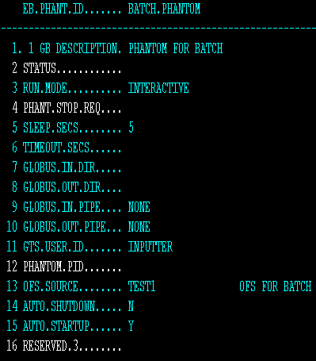
EB.PHANTOM – FOR BATCH MODE
Notes:
RUN.MODE – COULD BE EITHER INTERACTIVE OR PHANTOM
INTERACTIVE – PROCESS WILL BE RUN FROM CURRENT TERMINAL
PHANTOM – PROCESS WILL RUN IN BACKGROUND

Slide 61
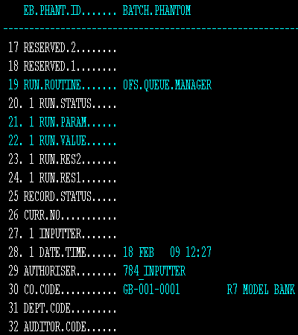
EB.PHANTOM – FOR BATCH MODE

Slide 62
BATCH RUNNING PROCESS
After setting up OFS.SOURCE and EB.PHANTOM for Batch
Input message is passed in INQUEUE dir of OFS.SOURCE
From shell prompt type
jsh>JED OFS.IN MSG1

Slide 63
EB.PHANTOM
Enter into Globus
Verify EB.PHANTOM Record
EB.PHANTOM V BATCH.PHANTOM
Check the out Queue Dir using

Slide 64
OFS.REQUEST.DETAIL
OFS.REQUEST.DETAIL
Is an application where all the details of the record will be stored
The message key will be prefixed with the id which we have given in DET.PREFIX = BAT

Slide 65
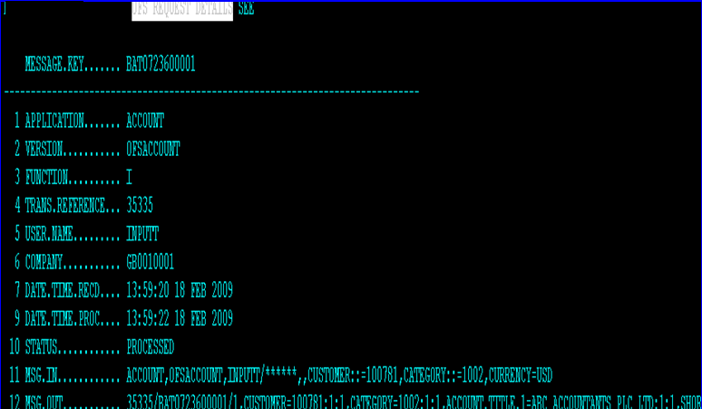
OFS.REQUEST.DETAIL

Slide 66
Workshop - II
Set up OFS for Batch
Create EB.PHANTOM
Pass the OFS message in the INFILE for updating a sector version

Slide 67
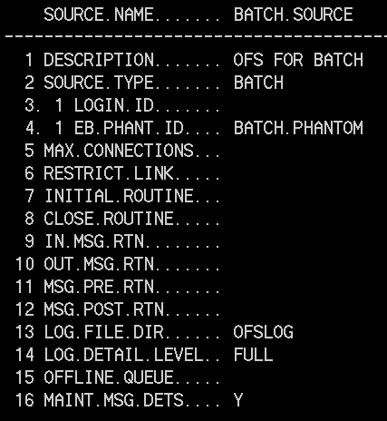
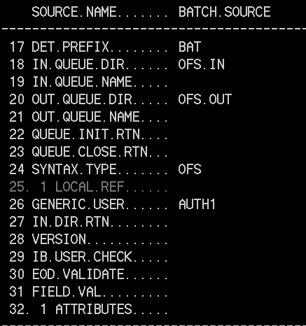
Solution – Step 1: Setup BATCH

Slide 68
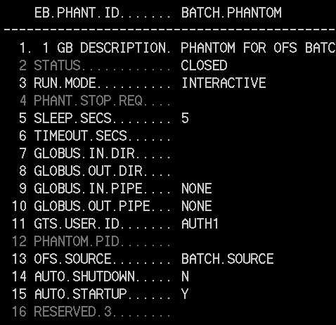
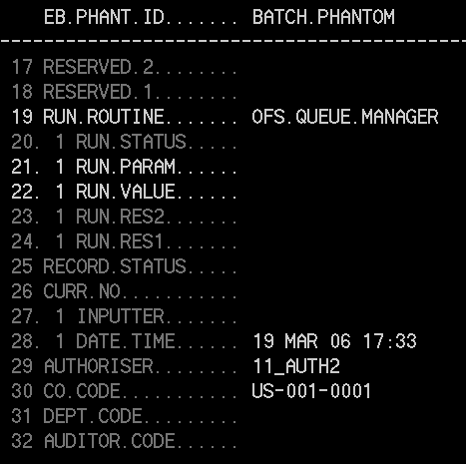
Solution – Step 2 : EB.PHANTOM

Slide 69
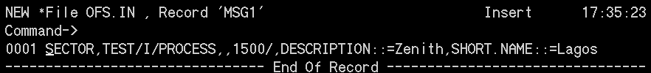
Solution – Step 3: Create a Record
After setting OFS.SOURCE and EB.PHANTOM for Batch then pass the OFS message to be processed through the In Queue Directory specified in your OFS.SOURCE record.
Here In Queue Dir is OFS.IN
From the jbase prompt : JED OFS.IN <record>
Save the record

Slide 70
Solution – Step 4: Verify EB.PHANTOM
Enter INTO GLOBUS/T24
From the Globus Application using ‘COMMITT’ the created EB.PHANTOM record (BATCH.PHANTOM) with Function “V”
Example : EB.PHANTOM V BATCH.PHANTOM
Check the Out Queue Dir using JED OFS.OUT MSG1
Indicates success

Slide 71
ENQUIRY using OFS

Slide 72
ENQUIRY – USING OFS
ENQUIRY CAN BE DONE USING OFS MESSAGE STRUCTURE
OPERATIONS should always be ENQUIRY.SELECT
TRANSACTION – ID SHOULD BE NAME OF THE ENQUIRY
MESSAGE DATA CAN BE SPECIFIED BY SELECTION FIELD

Slide 73
ENQUIRY - OFS
Enquiry can either be passed through online or Batch
Steps to be followed are the same as that of Transaction
Message structure of Enquiry
ENQUIRY.SELECT,,USERINFORMATION,ENQUIRYNAME,MESSAGEDATA

Slide 74
ENQUIRY - OFS
ENQUIRY.SELECT
The ENQUIRY.SELECT is actually a TEMENOS T24 application that is used to run queries and return the data
The first portion of an enquiry type request must always be ENQUIRY.SELECT
USER INFORMATION
The user information portion of the message structure is same as that in the transaction type request

Slide 75
ENQUIRY - OFS
ENQUIRY.NAME
The enquiry name portion of the message structure must contain the name of the TEMENOS T24 Enquiry that will be run
The Enquiry name supplied here must be a valid TEMENOS T24 enquiry
ENQUIRY.DATA
The message data portion of the enquiry message structure contains the selection criteria passed to the enquiry

Slide 76
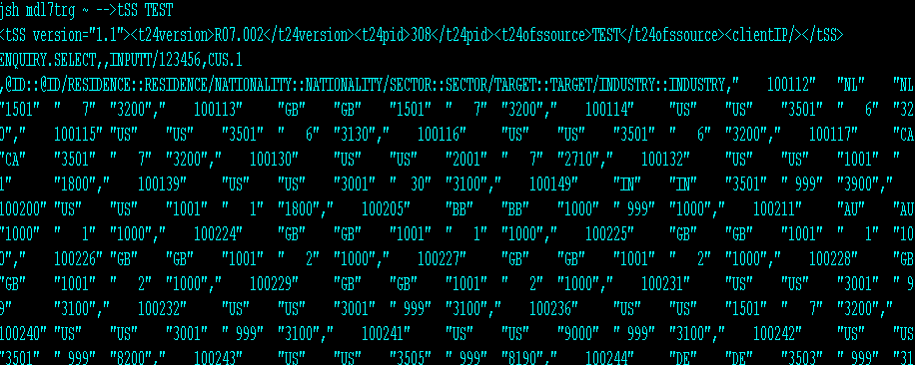
ENQUIRY – OFS (SYNTAX)
Type the following command in shell prompt

Slide 77
Workshop - III
Create a enquiry type request to find the list of SECTOR found in T24

Slide 78
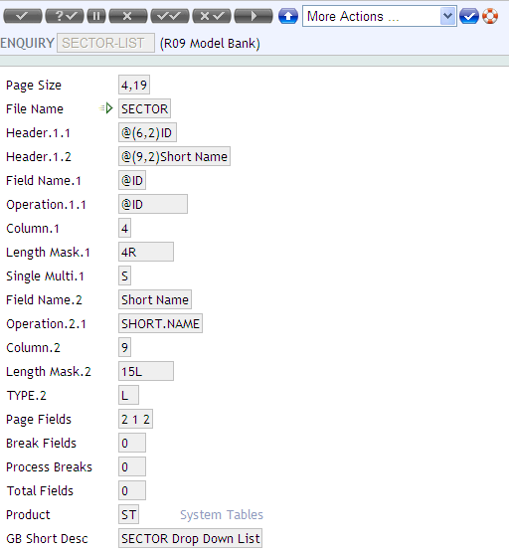
Solution – Step 1 : Enquiry for sector
Enquiry for sector contains the following fields

Slide 79
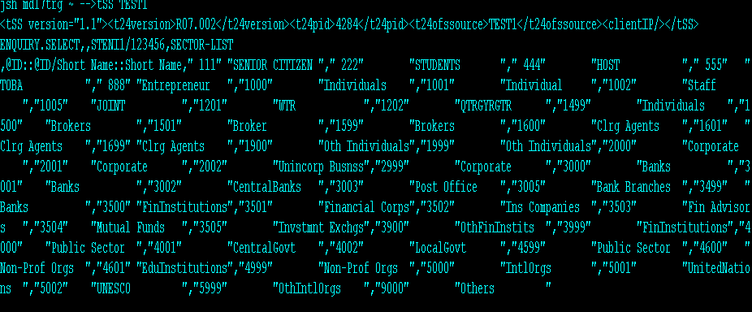
Solution – Step 2 : OFS MESSAGE

Slide 80
Workshop IV
Create a enquiry type request to find the Customer whose WORKING.BALANCE > 10000

Slide 81
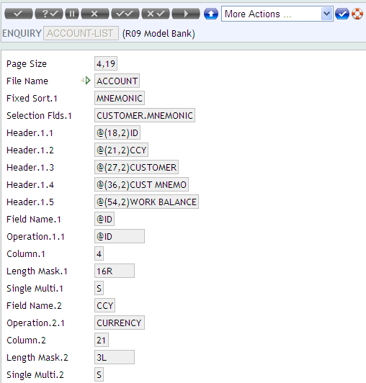
Solution – Step 1 : Enquiry for Account
The enquiry Account-list contains the following fields for display.

Slide 82
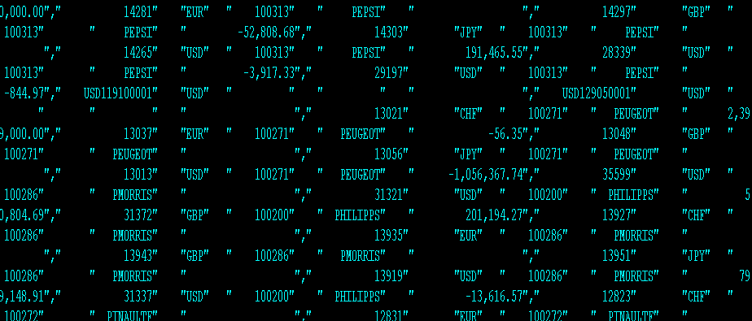
Solution – Step 2 : OFS MESSAGE

Slide 83
ROUTINE REQUEST – OFS
OFS messages can be passed to the routine
Data received from OFS can be formatted according to the user requirement and the value can be returned

Slide 84
Message format for calling ROUTINE
Custom Routine Name
,
,
User Input
Routine
Custom Build Routine
,
,

Slide 85
Message format for calling ROUTINE
CUSTOM ROUTINE NAME
Name of the routine to be called by OFS
Should be a valid subroutine
Routine name should have a PGM.FILE entry
USER INFORMATION
Valid User name and password
CUSTOM DATA
String that is to be passed to the routine

Slide 86
Program
The program will pass the OFS format message to T24. If the message is successfully passed then it will return a message as VALID ACCOUNT

Slide 87
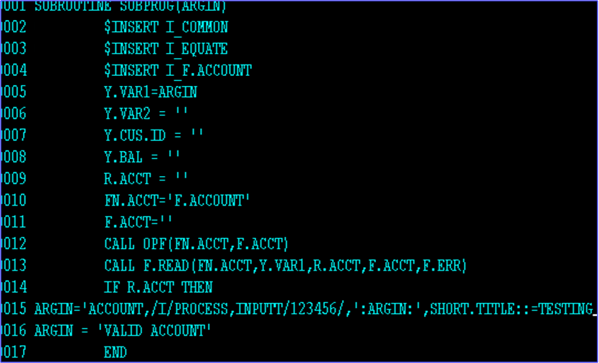
SAMPLE PROGRAM FOR OFS ROUTINE CALL
Notes:
More than one argument can be used. If more than one argument is used and other could be used to out message purpose

Slide 88
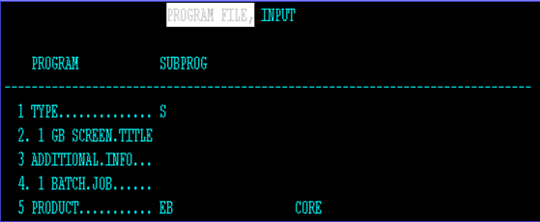
PGM.FILE

Slide 89
Steps for execution
Compile the subroutine SUBPROG
Create a OFS.SOURCE
Specify the name of the compiled subroutine in the IN.MSG.RTN

Slide 90
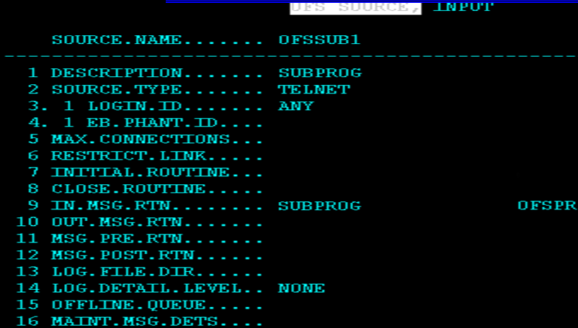
OFS.SOURCE FOR SUBROUTINE CALL
Sub Routine Attached

Slide 91

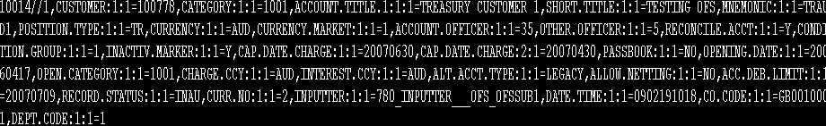
SAMPLE SCREEN OF OFS MESSAGE
After setting up the OFS
Pass the a/c no through OFS message

Slide 92
Workshop - V
Write a Subroutine to count the number of characters received in the input string and return back a string “The length of Request message is:” followed by the actual count characters in the request message. If the request message is empty then a string “The length of Request message is: EMPTY” must be returned..

Slide 93
Workshop - V
Now, use the OFS Online mode you created in the previous workshop to upload your transaction type messages and see the results. If you were to receive any errors, check the request message to see if everything is correct about the syntax. Also check if the setup is correct

Slide 94
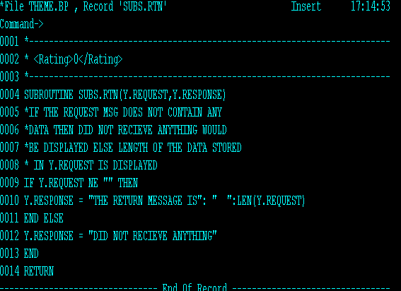
Solution – Step 1 : Write the Routine

Slide 95
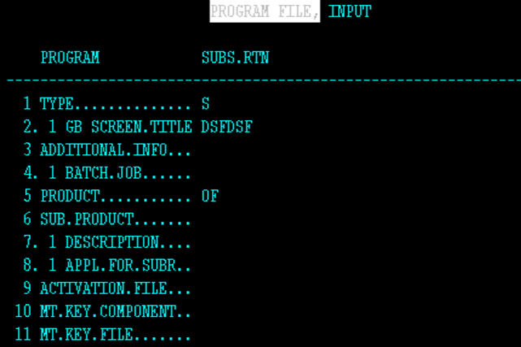
Solution – Step 2 : PGM.FILE

Slide 96
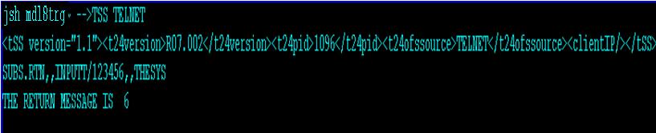
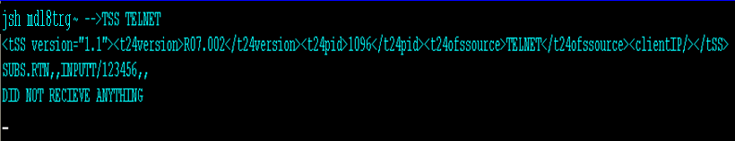
Solution – Step 3 : Output

Slide 97
I_GTS.COMMON – OFS Common variables
The I_GTS.COMMON contains the common variables of the OFS module
Inserting this in the programs makes them available for use during the OFS processing
A subroutine attached in MSG.PRE.RTN field of OFS.SOURCE can make use of the common variables of the OFS module by inserting the I_GTS.COMMON file
Notes:
MSG.PRE.RTN – Allows a user defined routine to be specified for a particular service. The routine specified here will be executed within the OFS processing prior to application update or execution of enquiry.
Arguments : OFS.MESSAGE

Slide 98
OFS Common variables
GTSACTIVE | Flag to indicate if OFS is used for the message being processed
OFS$SOURCE.ID | ID of the OFS.SOURCE record that is currently being used
OFS$SOURCE.REC | Dynamic array containing the OFS.SOURCE record that is currently being used
OFS$GLOBMAN.ACTIVE | Flag to indicate if OFS Globus mode (OFS.GLOBUS.MANAGER) is used for the message being processed

Slide 99
DATA CAPTURE

Slide 100
DATA CAPTURE - Introduction
Data capture is the most basic method of creating accounting entries in T24
Data capture items are grouped in batches and each batch must have balancing debits and credits in local currency
Data capture application supports input of Cr and Dr entries in individual legs grouped under a Batch item
It can be used to refund money in case of a contract – say Miscellaneous fees collection or refund of excess charges collected etc.

Slide 101
DATA CAPTURE - Introduction
Data capture is an Account Based application which is used to pass entries to any type of account within T24
Data capture record which generates one accounting entry,
E.g.: To debit one customer a/c and credit P/L a/c (it may be commission on Demand Draft)

Slide 102
Feature of Data Capture
A Data Capture record generates one accounting entry – either a debit or a credit only
While in other applications a single transaction may create multiple accounting entries
DC items are grouped in batches and each batch must have balancing debits and credits in local currency

Slide 103
Batch - Introduction
Combination of debit and credit entries are called ‘Batch’
Batch must have at least two entries i.e. one debit and one credit
Batch – Groups into which items are separated for control purposes
E.g.: Single debit to a Nostro a/c, balanced by many credits to varying client a/c.

Slide 104
Batch - Introduction
Data capture applies most of its accounting entries online
Only where a batch has not been fully authorized, or does not balance, will any entries to be generated during end of the day

Slide 105
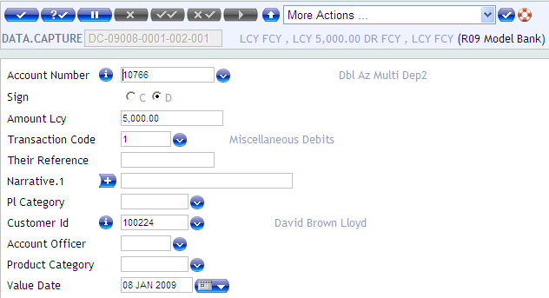
OFS – DATA CAPTURE STEPS INVOLVED
Open “DC” application and pass the Debit leg for a particular a/c
Notes:
Id is a 10 digit reference number used in DATA.CAPTURE record which generates one accounting entry,
The 10 digit reference nuumber is comprised of Department code; Batch number; and Item number
The Department code is derived from the DEPT.ACCT.OFFICER system table,

Slide 106
ID OF DATA CAPTURE
Id is a 10 digit reference number used in DATA.CAPTURE record which generates one accounting entry,
The 10 digit reference nuumber is comprised of Department code; Batch number; and Item number
The Department code is derived from the DEPT.ACCT.OFFICER system table, the reference is as follows:
Department code: Value 0001-9999
Batch Number : Value 001-999
Item Number : Value 001-998

Slide 107
OFS – DATA CAPTURE STEPS INVOLVED
Open “DC” application and pass the Debit leg for a particular a/c

Slide 108
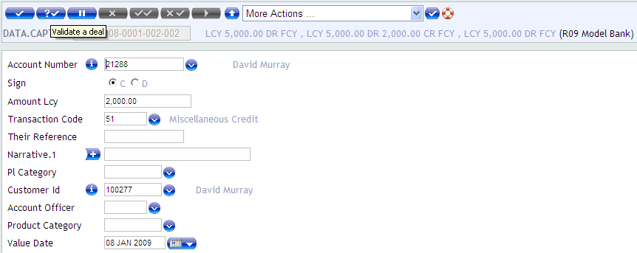
CREDIT LEG FOR 1ST A/C
After passing the debit leg, pass the credit leg for multiple accounts
Notes:
Debit leg and credit leg are nothing but credit entry and debit entry repectively.

Slide 109
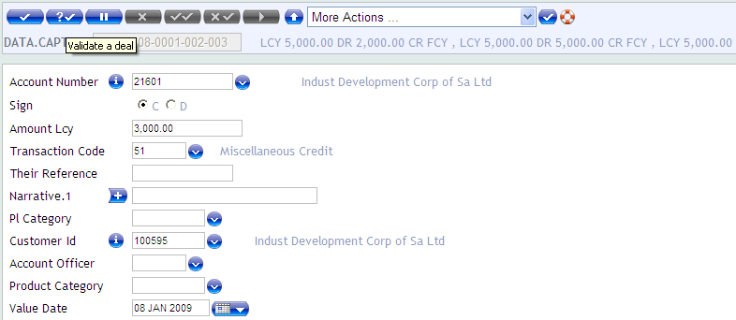
CREDIT LEG FOR SECOND A/C

Slide 110
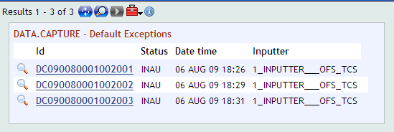
DATA CAPTURE
After passing both the debit and credit legs
The Batch is now available in INAU

Slide 111
DATA CAPTURE
Now OFS Message is used to authorize the Batch
To pass an OFS message to authorize or Delete a DC Batch, the Transaction ID part of the message must be ‘DC Department Code : DC Batch Code ALL’
Assuming 2 DC legs DC072360001017001 & DC072360001017002, DC072360001017003 need to be authorized, then the Transaction ID part of the OFS message must be ‘DC072360001017 ALL’ and the Function would be A or D as appropriate

Slide 112
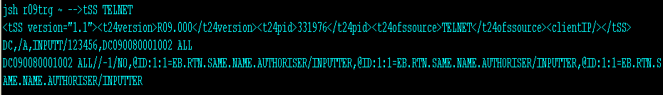
SAMPLE SCREEN - DC
From the shell prompt pass the following OFS format

Slide 113
Workshop - VI
Create a file with following details – Debit Account Number, Debit Currency, Debit Amount, Credit Currency and Credit Account Number, separated by a comma
Write a Subroutine to read the details from the file created in the above step and create FUNDS.TRANSFER messages in OFS format
Like in the previous exercise the version, user name and password can be put in a file and read

Slide 114
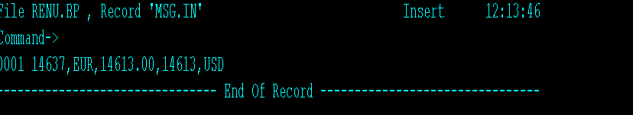
Solution – Step 1: Creating a file

Slide 115
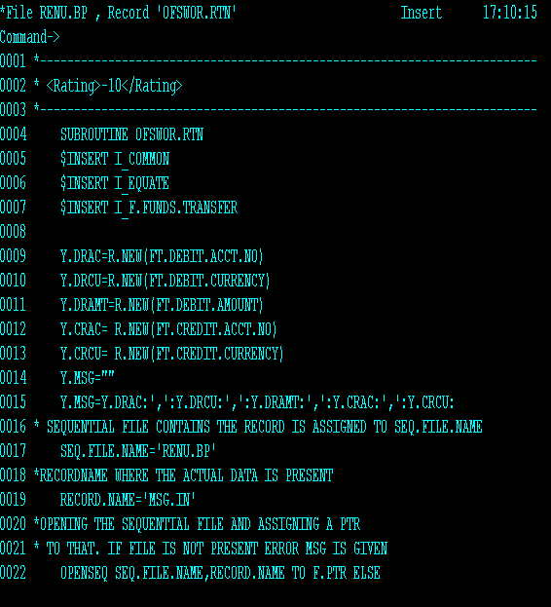
Solution – Step 2: Routine

Slide 116
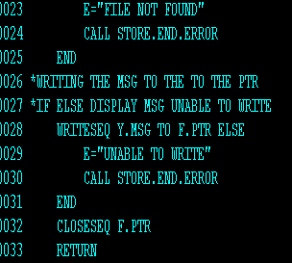
Solution – Step 2 : Routine (Contd)

Slide 117
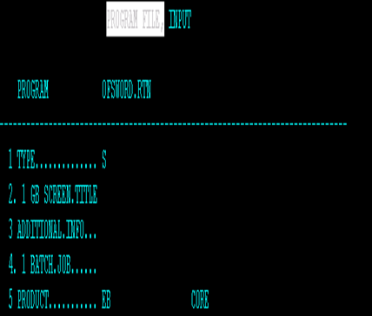
Solution – Step 3 : PGM.FILE

Slide 118
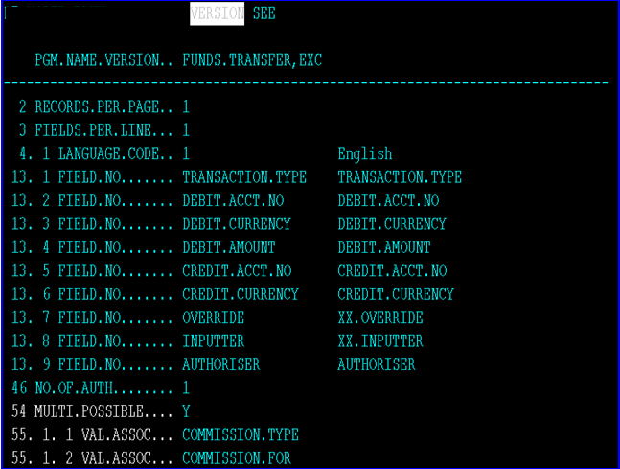
Solution – Step 4 : Create Version

Slide 119
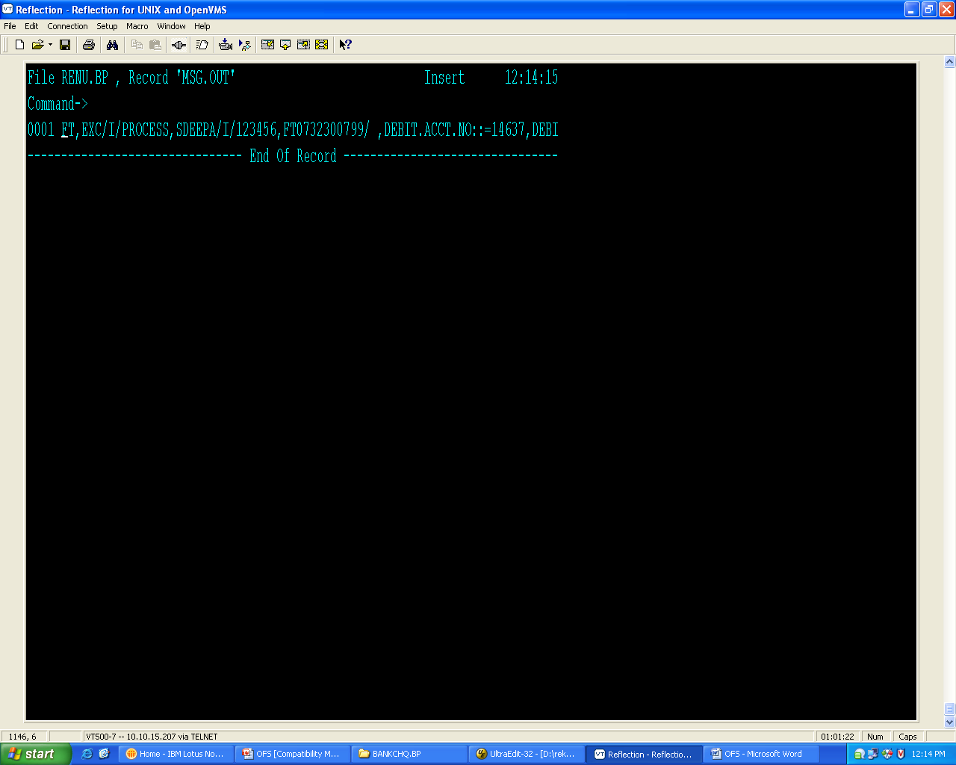
Solution – Output

Slide 120
Workshop VII
Create OFS for Batch Mode
Then subroutine should write the formatted OFS messages to the in directory defined in this OFS.SOURCE record
If you were to receive any errors, check the request message to see if everything is correct about the syntax

Slide 121
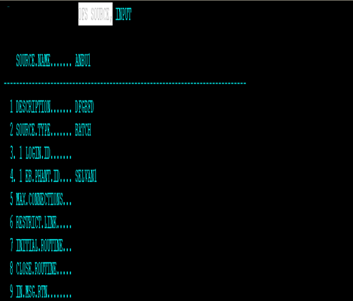
Solution – Step 1: OFS.SOURCE

Slide 122
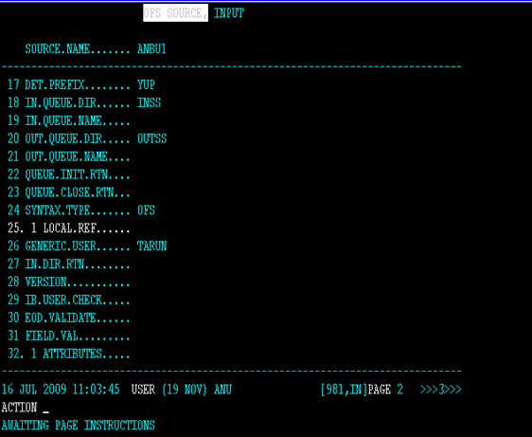
Solution – Step 1: OFS.SOURCE

Slide 123
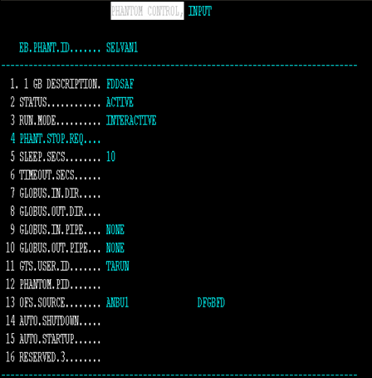
Solution – Step 2 : EB.PHANTOM

Slide 124
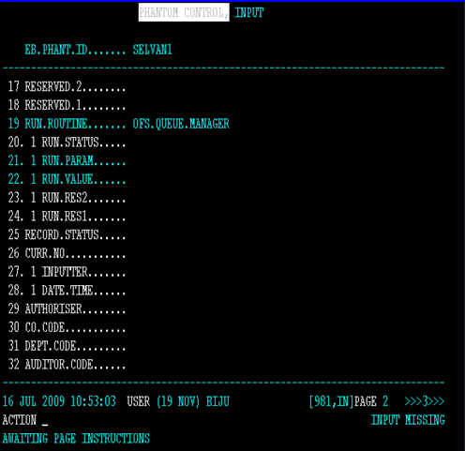
Solution – Step 2 : EB.PHANTOM

Slide 125
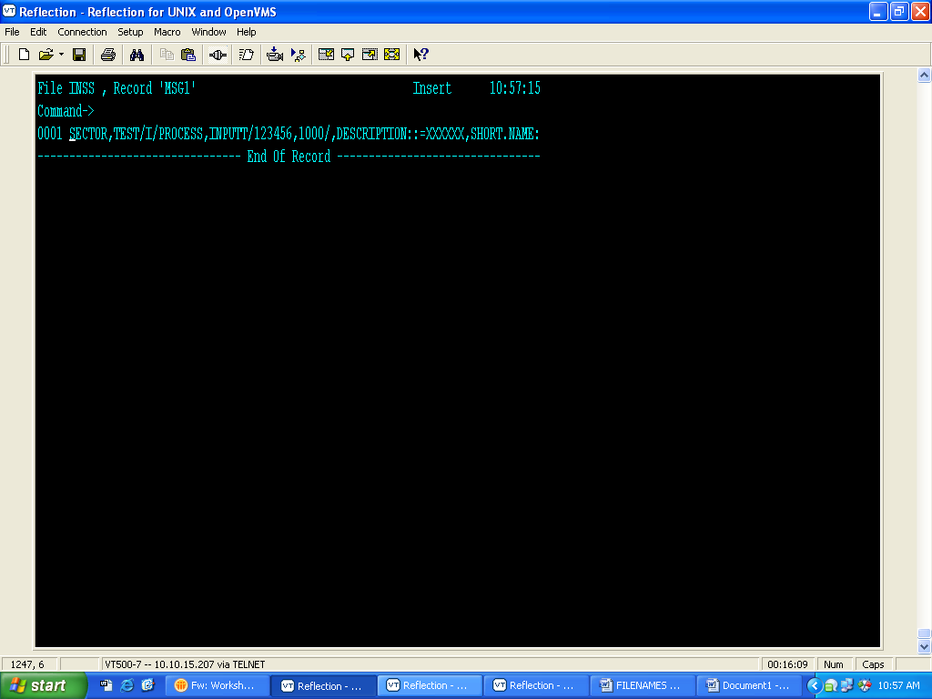
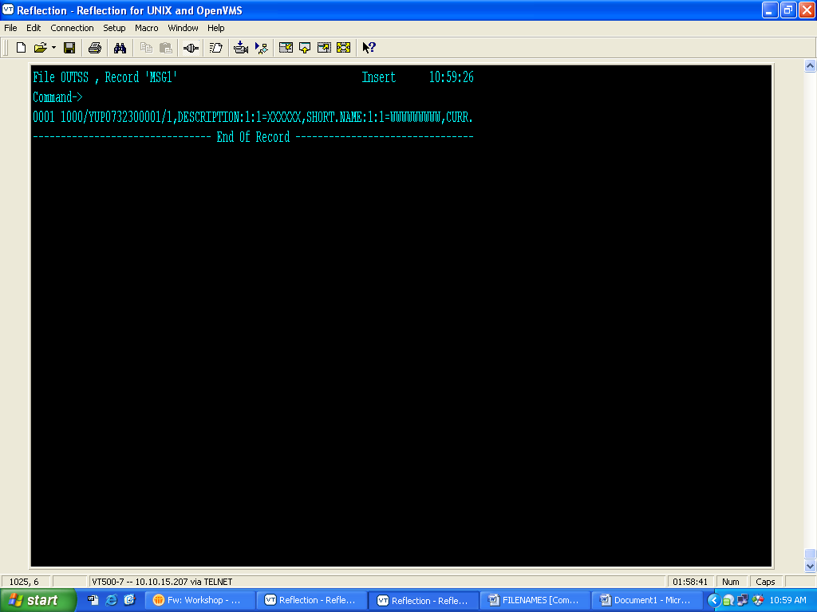
Solution – Step 3 : Input IN File

Slide 126
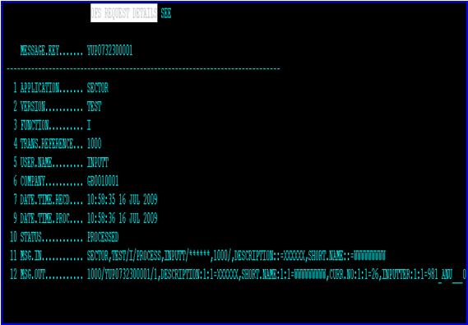
Solution – OFS.REQUEST.DETAILS

Slide 127
ERROR HANDLING
Error messages related to the OFS module could be broadly classified in to three categories
Message related
System related
File related

Slide 128
Message related
These error messages are encountered with the format of request messages
To overcome this ofs messages have to analyzed and corrected before we pass the message

Slide 129
Message related
APPLICATION / OPERATION MISSING
This error message is encountered when the request message is either empty or does not contain the name of the application / subroutine / Enquiry select (in case of enquiry messages), in the first portion of the request message
To overcome this, supply the required name in the first portion of the request message

Slide 130
Message related
NO SIGN ON NAME SUPPLIED DURING SIGN ON PROCESS
This error message is encountered when the request message does not contain the TEMENOS T24 user sign on name / password in the User information portion of the request message
To overcome this, supply a valid TEMENOS T24 user name and password in the User information portion of the request message

Slide 131
SYSTEM RELATED ERROR MESSAGE
These error messages happen when the server is offline or when the restriction in the application used in the transaction
The following is the list of common system related error messages
<Message ID>/<Transaction ID>/-3/OFFLINE
This error message is encountered when the TEMENOS T24 Server is in offline status at the time the request message is received by it
In this stage inputs / updates to the database will not be allowed

Slide 132
File I/O related errors
The errors are encountered when there are problems related to files
File cannot be opened
This error message when the open operation on the file is failed
To avoid this ensure that whether permission to access the file is given

Slide 133
File I/O related errors
Missing Standard Selection on the Application
This error message is displayed when the Standard selection entry for this application is not done
To overcome this ensure whether standard selection record for this application is available
Else create SS for this application

Slide 134
NOINPUT Fields
In normal T24 application a field in a application will be defined as NOINPUT field
If values to such fields are passed through OFS we will get these errors
To overcome this ensure that the field is enabled as INPUT field

Slide 135
Summary
Functionality of OFS.
Architecture of OFS.
Message Structure of OFS.
Components of OFS.
Passing Message through OFS.
To display enquiry data using OFS.
OFS message to access Routine.
Data capture using OFS.

Slide 136
All product names and other company names used herein are for identification purposes only and may be trademarks or registered trademarks of their respective owners. Errors and omissions excepted, all specifications are subject to change without notice.
© 2009 Thesys Technologies Incorporated. All rights reserved.
FOR MORE INFORMATION
Visit : www.thesys.co.in
email : marketing@thesys.co.in

