Slide 1
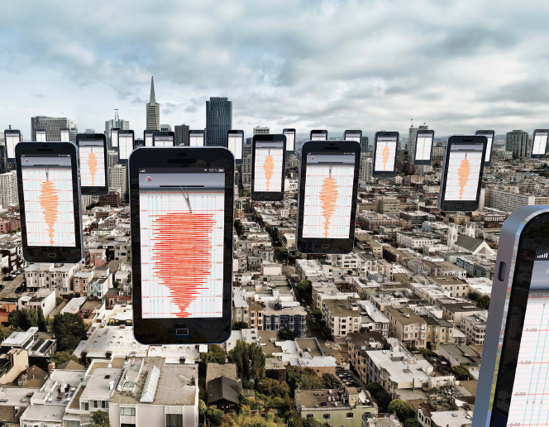
The Community Sense and Response systems: Your Phone as Quake Detector
Patel, Marmikkumar (43)
Gattu, Akhilesh (13)
Luke, Joseph Mcduff (27)

Slide 2
Community sense and Response System
Community Sense and Response system gather, share and act on sensor data from users Internet-enabled devices like smartphones
These systems are distinguished from standard from web-application which uses specialized hardware.
These systems are useful for understanding traffic flows, monitoring public health and responding to natural disasters like hurricanes, flood and earthquakes.
These systems are made possible through volunteer sensors and low-cost web solutions for data collection and storage.

Slide 3
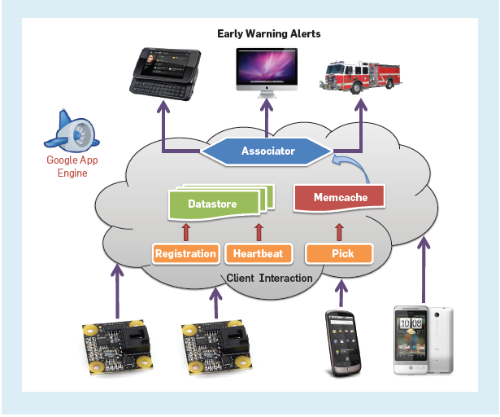
Community sense and Response System

Slide 4
From Data Collection to Action
These system collects sensor data from community owned sensor hardware like smartphones and consumer electronics.
But acting on community sensor data is different form acting on data in standard web applications.
As smartphones have multiple sensors and all sensors can produce continuous stream of GPS positions, acceleration and many data, a CSR network can produce a large volume of raw data.
Data recorded by community sensors also includes signal produced by the people operating them.
CSR system must simultaneously learn about phenomena they are built to act on and they should be able to make reliable decisions in real time with guaranteed performance.

Slide 5
Caltech Community Seismic Network
The Caltech CSN project collects sensor data from thousands of personal devices for real time response to dangerous earthquakes.
Aims to quickly detect earthquakes and provide real-time estimates of their effects through community-operated sensor and also gives early warning of string shaking.
CSN collects accelerometer data from personal devices to produce information needed for real-time response to earthquakes.
CSN project is based on community participation.

Slide 6
Caltech Community Seismic Network
The several reason for Community Participation are:
Community participation makes possible the densely distributed sensors needed to accurately measure shaking throughout a city.
Community participation also make it cheap than traditional seismometer which are very costly.
Furthermore, Community sensors are also help for assisting the population in emergency.
In addition to collecting accelerometer data, community-sensing application, represent a way for people to stay informed about areas and people they care.

Slide 7
Caltech Community Seismic Network
CSN makes easy for volunteers to participate without costing any extra charge other than internet connection because it uses low-cost accelerometers and the sensors already in their smartphones.
CSN team have developed android app called CrowdShake, which makes volunteering data as easy as installing a new app.
They have also partners with Los Angeles-area schools and civic organizations to freely distribute 3000 low cost accelerometers from Phidgets, Inc.
These accelerometers can be connected to PC or Tablet using USB and they are also installed in several high-rise buildings in the Los Angeles to measure structural responses to earthquakes.

Slide 8
Classical Approach
This approach is to collect all data centrally and declare an event has occurred or not based on the likelihood ration of the test is true.
P(all measurements| strong quake)
-------------------------------------------------- > T
P(all measurements| no-quake)
Each community sensor is unique, so modeling these distributions requires modeling each sensor individually.

Slide 9
Decentralized Approach
In this approach the server performs a hypothesis test on the "pick message" instead of the entire central data.
Each sensor performs the hypothesis test and is picked if the probability of the each case is known and is greater than the threshold.
At the same time server also performs a hypothesis tests on the picks message received and declare the a detection when
Bin(S; rT,N)
------------------- > T
Bin(S; rF,N)

Slide 10
Limitations
Likelihood ratio tests - How can likelihood ratio tests be performed on each sensor’s data when the data needed to accurately model sensor behavior during an event.
Modeling each sensor – Server side modeling scales poorly, and on-device learning involves computational and storage limits.
Spatial dependencies - How to calculate spatial dependencies on independent sensors.

Slide 11
Core Sets
The CSN system models accelerometer data as a Gaussian mixture model(GMM).
Single Gaussian, which is specified by the mean and variance of the data.
Learning the optimal GMM requires access to all the data; GMMs do not admit finite sufficient statistics.
A tool from computational geometry, called a “coreset,” makes such approximations possible.
A “coreset” for an algorithm is roughly a subset of the input, such that running the algorithm on the “coreset” gives a approximation to run the algorithm on the full input.

Slide 12
Building CSN
The CSN network is built on Google App Engine.
First, CSN writes client registration and heartbeat messages to multiple datacenters via App Engine’s high replication data store.
Next, incoming picks are spatially aggregated by geographic hashing into memcache, a distributed in-memory data cache.
Finally, the CSN cloud performs event detection on the aggregated picks.

Slide 13
Advantages of Building CSN
Dynamic Scaling.
Robust Data.
Easy Deployment.

Slide 14
Experimental Evaluation (testing)
Shake Table: Simulated large historic earthquakes detected by USB sensors and phones, proved that P-waves (initial) and S-waves (secondary) could be detected
Eccentric Weights (motion of buildings): Campus library was oscillated at 1.7Hz, both sensor types were able to measure this
Normal Background Data: Volunteers carried phones during daily routines, this allowed for device “normal operating behavior” to be learned
Historical Picks: 128 sensors simulated picks from 1,000 simulated quakes to evaluate algorithm ability to correctly choose “picks”

Slide 15
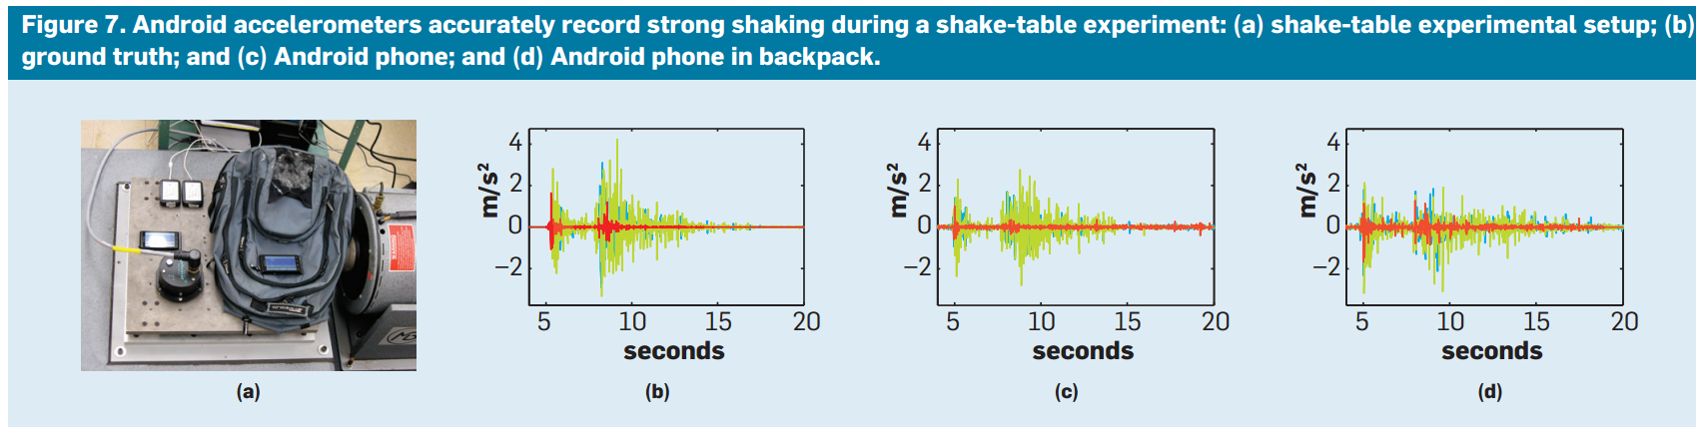
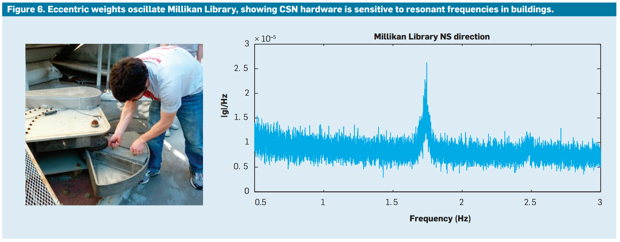
Shake Table
Eccentric Weights
Source: http://cacm.acm.org.proxy.library.umkc.edu/magazines/2014/7/176219-community-sense-and-response-systems/pdf

Slide 16
Conclusion
With such large quantities of data being collected at each stage of the architecture, employing effective machine learning strategies allows for efficient use of sensor-level and cloud-level resources
Community sensing is applicable to a variety of application domains including: fires, floods, radiation, epidemics, traffic accidents, and pollution
CSR systems for these domains will require a similar blueprint for machine learning and scalable systems

Slide 17
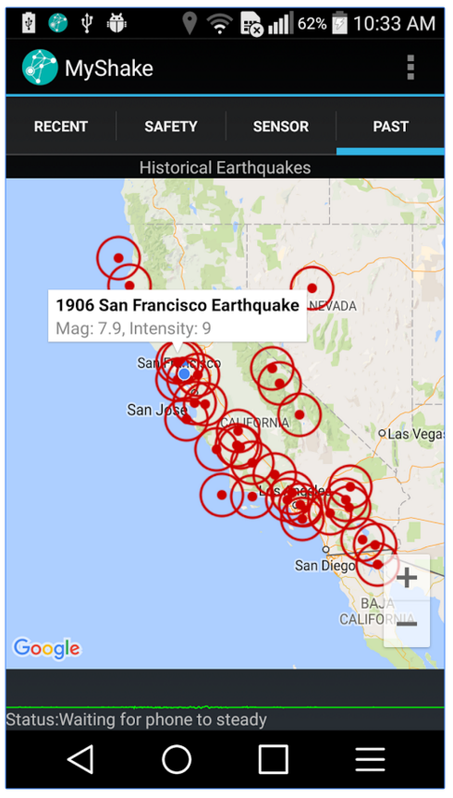
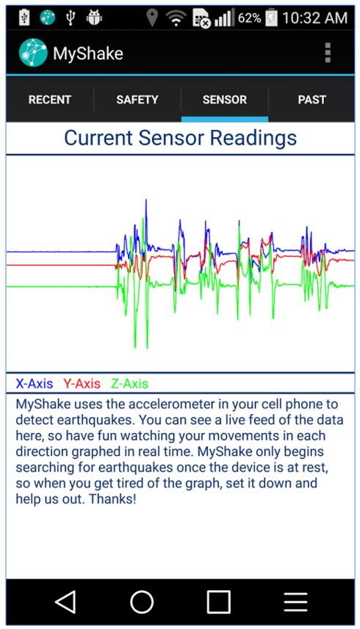
Further Developments
On February 12, 2016, the authors released a new research paper along with a new updated app MyShake available at the Google Play Store

Slide 18
Further Developments continued
Sensors in phones have been improving: all phones are sensitive to magnitude 5 earthquakes, newer phones are sensitive to magnitude 3.5 earthquakes
98% of earthquake records within 10km of events are recognized
93% of everyday motions are correctly recognized (false triggers)
Estimating the exact magnitude of the earthquake has still proven difficult, incorporating data from a traditional seismic station could make a significant difference
Further research will be into using phone GPS for GPS-based ground displacements, it is more accurate at predicting magnitude of earthquakes

Slide 19
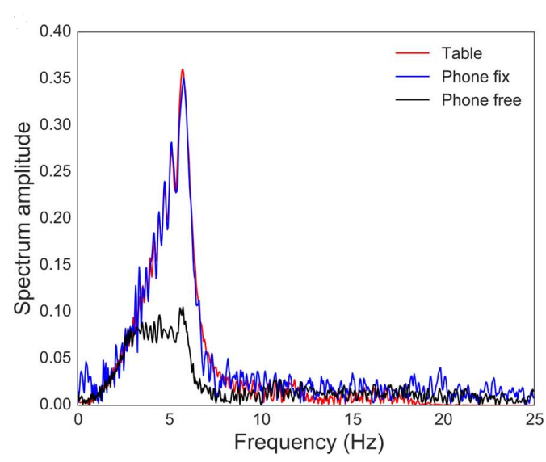
Further Developments continued
One area of improvement still needed is amplitude, phones that are fixed or sitting on a table can sense seismic events at a much greater level

Slide 20
Thank you. Any questions?
References
Original Article (July 2014)
http://cacm.acm.org.proxy.library.umkc.edu/magazines/2014/7/176219-community-sense-and-response-systems/pdf
New Article (February 2016)
http://advances.sciencemag.org/content/advances/2/2/e1501055.full.pdf
MyShake Android Application
https://play.google.com/store/apps/details?id=edu.berkeley.bsl.myshake&hl=en

