Slide 1
CS5551 Advanced Software Engineering
Structural Pattern: Adapter

Slide 2
Adapter
Adapter pattern is a software design pattern that allows the interface of an existing class to be used from another interface.
It works as a bridge between two incompatible interfaces.
It is often used to make existing classes work with others without modifying their source code.
There are two types of adapter patterns
Object Adapter Pattern
Class Adapter Pattern

Slide 3
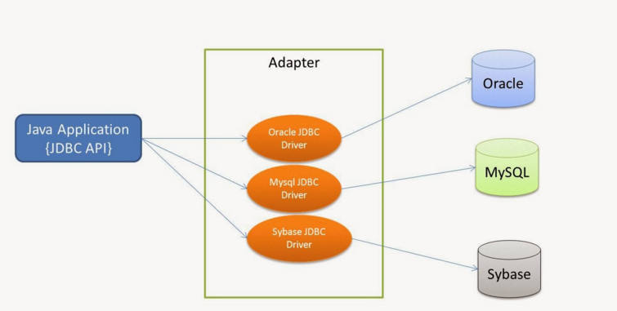
Adapter

Slide 4
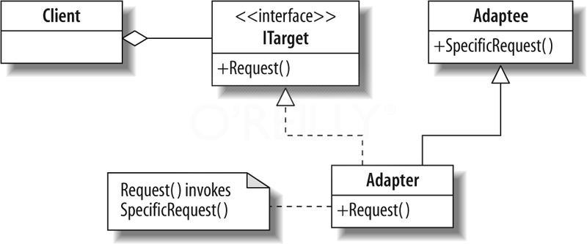
UML Class Diagram

Slide 5
UML Class Diagram
The UML class diagram describes an implementation of the adapter design pattern. The items in the diagram are described below:
Client. The client class is that which requires the use of an incompatible type. It expects to interact with a type that implements the ITarget interface. However, the class that we wish to use is the incompatible Adaptee.
ITarget. This is the expected interface for the client class. Although shown in the diagram as an interface, it may be a class that the adapter inherits. If a class is used, the adapter must override its members.
Adaptee. This class contains the functionality that is required by the client. However, its interface is not compatible with that which is expected.
Adapter. This class provides the link between the incompatible Client and Adaptee classes. The adapter implements the ITarget interface and contains a private instance of the Adaptee class. When the client executes Request( ) on the ITarget interface, Request( ) in the adapter translates this request to a call to SpecificRequest( ) on the internal Adaptee instance.

Slide 6
Code
CelciusReporter.java
TemperatureInfo.java
TemperatureClassReporter.java
TemperatureObjectReporter.java
AdapterDemo.java

Slide 7
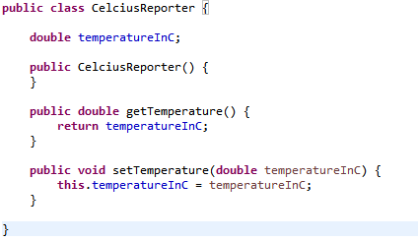
CelciusReporter.java

Slide 8
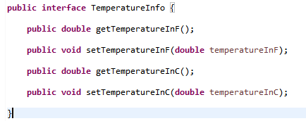
TemperatureInfo.java

Slide 9
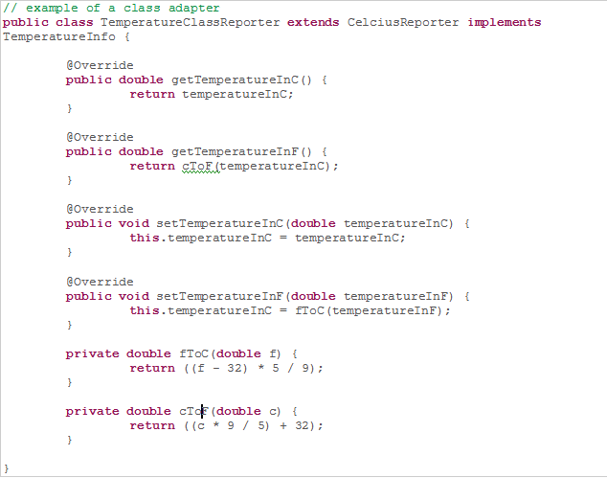
TemperatureClassReporter.java

Slide 10
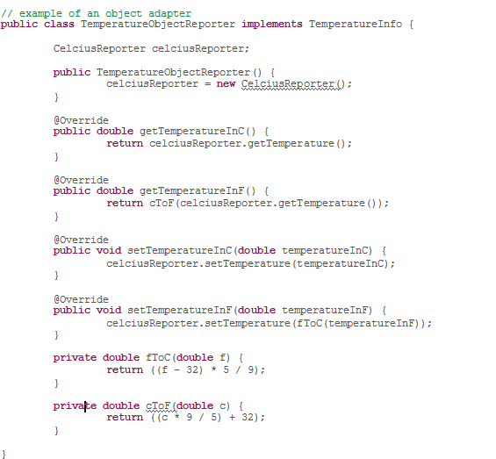
TemperatureObjectReporter.java

Slide 11
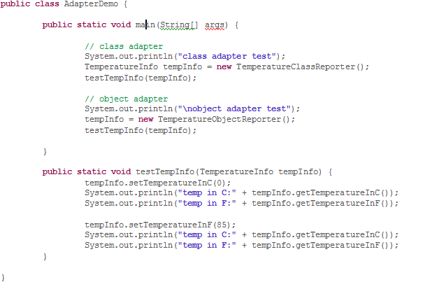
AdapterDemo.java

Slide 12
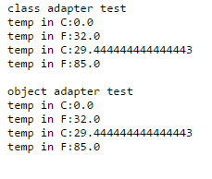
Output

