Slide 1
A glycaemic digital twin that warns of highs and lows two hours ahead
HAPPIEST HEALTH DIGITAL TWIN CHALLENGE 2026
Research prototype · not for clinical use
Type 2 diabetes · health record + wearables · explained, personalised, tested on real patients
Team name · College / incubator name
Notes:
Introduce the team. One sentence: we built a digital twin of a person with Type 2 diabetes that combines their health record with wearable data, predicts dangerous high and low glucose two hours ahead, explains why, and lets a clinician test 'what if' safely on the twin. Then we checked every claim on real patient data.

Slide 2





Highs and lows happen between clinic visits
01 · THE PROBLEM
101 M
3 months
At night
people with diabetes in India, mostly Type 2 (ICMR-INDIAB, Lancet Diabetes & Endocrinology 2023)
between HbA1c tests, while dangerous highs and lows happen within hours
lows from sulfonylureas or insulin strike while the patient sleeps and cannot react
Health record
diagnoses, labs, medicines
Wearable sensor
glucose every 5 minutes
So nobody turns them into an early warning a doctor can act on.
never combined
Notes:
Frame the problem in India: about 101 million people with diabetes. Post-meal spikes from carbohydrate-heavy meals, and lows from cheap, widely used sulfonylureas and insulin, especially at night. The clinician sees an HbA1c every few months; the events happen within hours. The data to see them coming exists, but in two separate places.

Slide 3




A digital twin of each patient
02 · OUR ANSWER
01
02
03
04
Predict
Alert
Explain
Simulate
Risk of glucose above 180 or below 70 mg/dL in the next 2 hours, every 30 minutes
One alert per risk episode, tuned so clinicians are not flooded with alarms
The top reasons behind every risk: falling glucose, a sulfonylurea dose, the time of day
A twin fitted to the patient's own data answers 'what if?' with an honest uncertainty band
Inputs: the last 6 hours of CGM, steps, heart rate and sleep, plus the health record. Output: an explained 2-hour early warning.
Notes:
Four capabilities. Predict both events two hours ahead. Alert in a way a clinic can live with. Explain every alert. Simulate changes on a personalised twin before trying them on the patient.

Slide 4
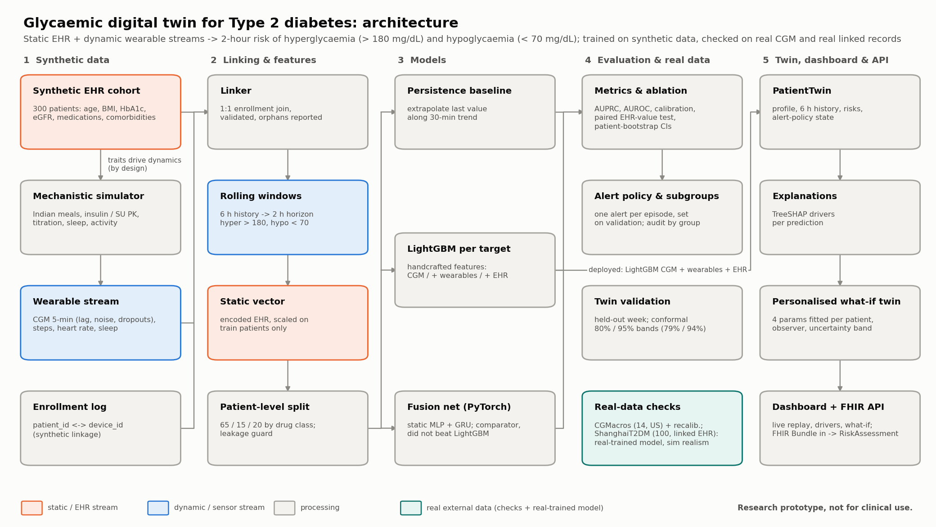
Five layers, from data to dashboard and API
03 · HOW IT WORKS
Notes:
Walk left to right. Synthetic EHR cohort and a physiology simulator generate the data; a linker joins records to devices; rolling 6-hour windows and a static EHR vector feed the models; we evaluate with patient-level rigour and on real data; the models power the twin, the Streamlit dashboard and a FHIR API. The teal box marks real external data, used to check us and to train the real-patient model.

Slide 5



A physiology simulator, honestly labelled
04 · DATA
What we generate
300 patients × 14 days
5-minute CGM with sensor lag, noise and dropouts
Synthetic by design, and labelled
A full health record
age, BMI, HbA1c, eGFR, lipids, comorbidities, drug doses
No public dataset links hospital records and wearables for the same Indian patients, so we simulate both.
The simulator makes EHR traits drive glucose, so any EHR gain on this data is partly built in. That is why we went on to test the EHR on real linked records.
Indian-context physiology
rice, roti, idli, poha; drug pharmacokinetics; sleep, activity, dawn effect
Split by patient
194 train / 46 validation / 60 test, stratified by drug class
Notes:
Be upfront: real linked EHR plus wearable data for Indian patients is not publicly available, so we built a physiology simulator. It is labelled synthetic in the code, the docs and on the dashboard banner. Because the simulator wires EHR traits into glucose, we treated any EHR benefit here as unproven until tested on real data.

Slide 6



Built so the numbers can be trusted
05 · RIGOUR
01
02
03
04
05
Patient-level split
Onset windows
Paired bootstrap
Choices on validation
Reproducible
No patient in both training and test; the code raises an error if one appears
Predictions are scored before the event starts, never once glucose is already low
Every comparison has a 95% confidence interval over patients
Alert thresholds and policy never see the test patients
Fixed seeds, one command rebuilds everything, 140 tests on every push
Splitting by patient and scoring only onset windows remove the two most common ways glucose models look better than they are.
Notes:
These five habits are why we trust our own numbers. In particular, splitting by patient and scoring only onset windows removes the two most common ways glucose models look better than they are.

Slide 7



The model predicts both events well
06 · RESULTS ON SYNTHETIC PATIENTS
Precision-recall (AUPRC) on 60 test patients
0.93
0.99
Higher is better. For rare lows, chance is about 0.02.
AUROC for highs
AUROC for lows
A deep GRU fusion network did not beat LightGBM
Steps, heart rate and sleep added nothing measurable
Well calibrated (hypo ECE 0.004), so LightGBM is deployed
Optimistic: simulated lows drift in slowly
Notes:
Headline metric for rare lows is AUPRC, where chance is about 0.02. Trend extrapolation 0.19, LightGBM on CGM 0.65, with wearables and EHR 0.71. Highs 0.38, 0.72, 0.74. The deep GRU model did not beat LightGBM and wearables added nothing, so we chose the simpler, explainable, calibrated model. Say clearly: synthetic numbers are optimistic.

Slide 8


Alerts a clinic can live with, tested on real patients
07 · ALERTING
60 synthetic test patients · synthetic-trained model
100 real patients (ShanghaiT2DM) · real-trained model
Lows warned at least 30 minutes ahead
53% at 15 minutes on real patients
76%
35%
Median warning before a low
65 min
25 min
Alerts per patient per day
about one every two days
0.49
0.61
Alerts followed by a real low
66%
44%
Real lows arrive faster than simulated ones, so the synthetic figure is an upper bound. The real-patient numbers are the honest baseline to improve.
Notes:
Accuracy is not enough; alarm fatigue kills alerting systems. One alert per episode, a 90-minute refractory period, never while the CGM already reads low, thresholds chosen on validation patients. Synthetic test patients: 76% of lows warned 30 minutes ahead at about one alert every two days. Then the honest part: the same policy on 100 real patients, with a model trained on real data, warns of 35% of lows 30 minutes ahead (53% at 15 minutes) at 0.6 alerts a day. Real lows arrive faster than simulated ones; the synthetic figure is an upper bound.

Slide 9
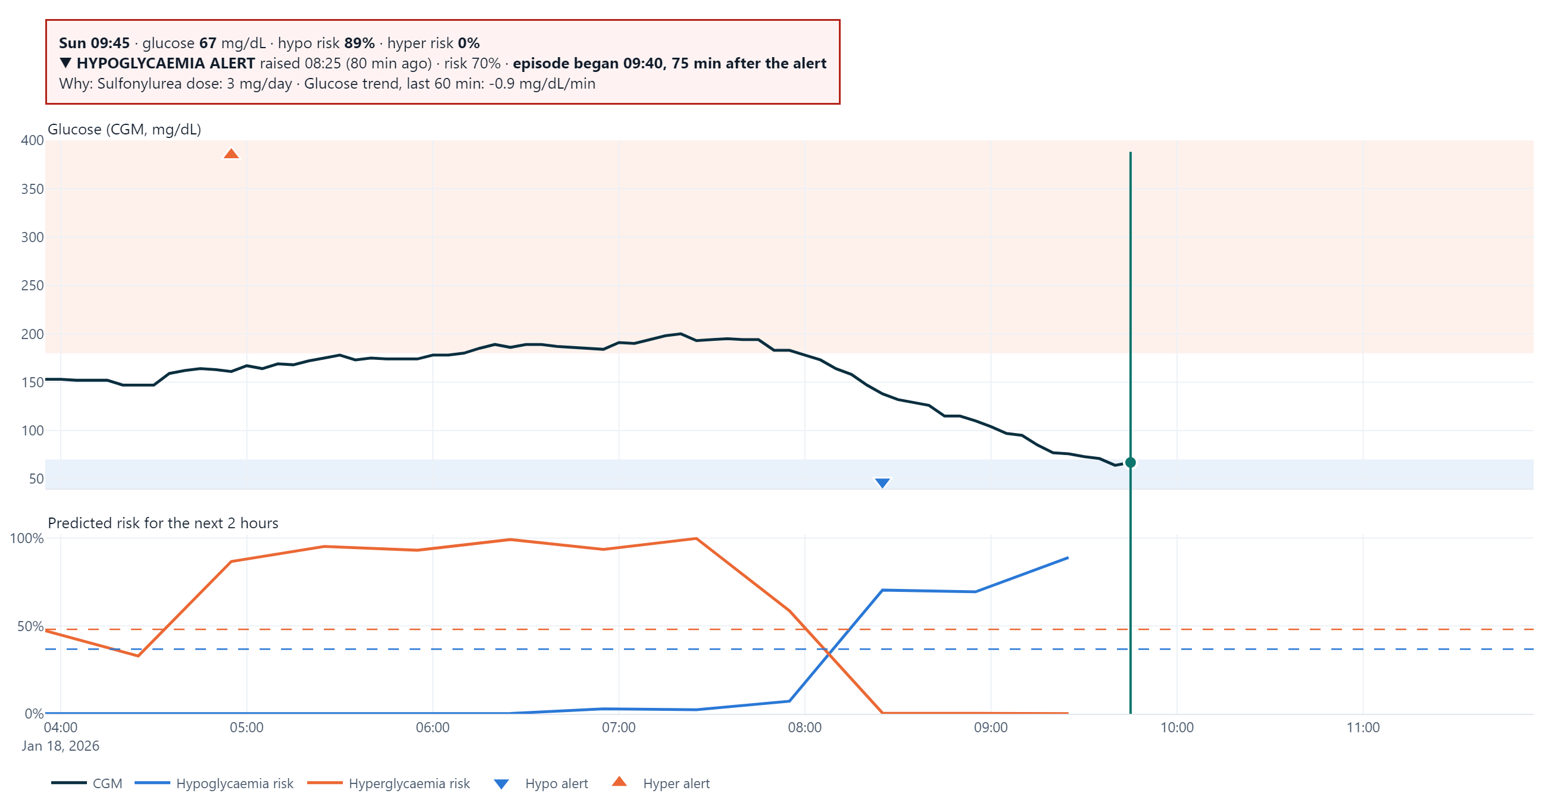

The alert arrives 75 minutes before the low
08 · LIVE REPLAY
08:25
Hypo alert at 70% risk
75 min warning
Why: sulfonylurea dose; glucose falling 0.9 mg/dL per minute
09:40
Glucose falls below 70
Synthetic patient P0014. The model sees only data up to the moving line.
Notes:
Show the live replay tab in the video. The record plays forward; the model only ever sees data up to the moving line. At 08:25 the hypo risk crosses the threshold and the alert pops up with its two main reasons. The low arrives at 09:40: 75 minutes of warning. The summary below the chart also lists false alerts and missed episodes.

Slide 10
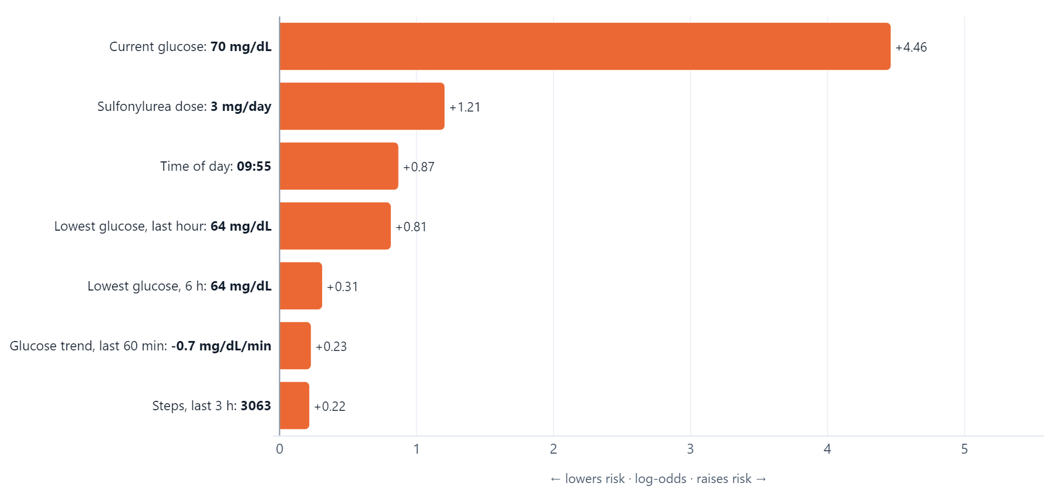


Every alert explains itself
09 · EXPLANATIONS
TreeSHAP drivers
Exact contribution of each input, for this patient at this moment
Grouped by data stream: CGM, time, activity and sleep, EHR
Written as plain sentences for the clinician
They explain the model, not the physiology, and the dashboard says so
Hypoglycaemia risk 95% for synthetic patient P0014: current glucose, the sulfonylurea dose and the time of day push it up.
Notes:
Clinicians will not act on a black box. Each risk is decomposed with TreeSHAP into contributions from each input, grouped by data stream. Here: current glucose 70, a sulfonylurea dose, and the time of day drive a 95% hypo risk.

Slide 11
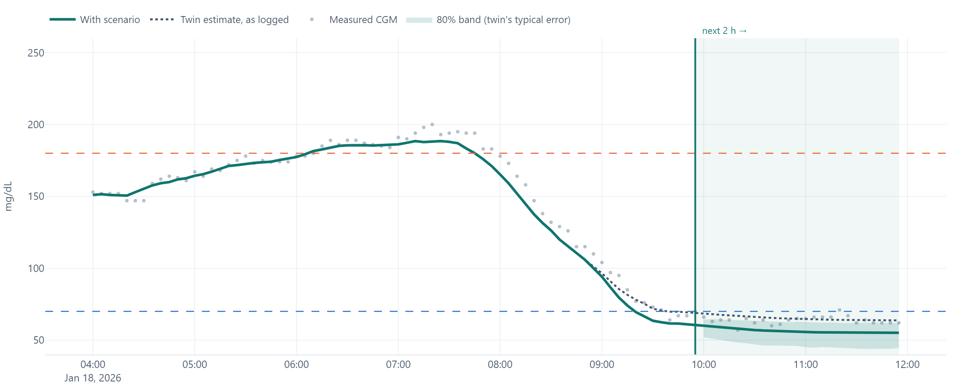
Ask the twin 'what if?'
10 · THE PERSONALISED TWIN
5.9 vs 12.1
mg/dL error on a held-out week: fitted twin vs EHR defaults
79%
How it works: four physiology parameters are fitted to the patient's first week (basal glucose, carb sensitivity, clearance, drug sensitivity); a state observer tracks the CGM up to now; scenarios are re-simulated with a calibrated band. Shown: an extra 8 U insulin dose pushes the projected low from 64 to 55 mg/dL.
of readings inside the 80% band, on patients the band never saw
Notes:
The twin is not just the classifier. It is a physiology model fitted to each patient's own first week, which halves the error on the following week (5.9 versus 12.1 mg/dL). The clinician can try a late dinner, a skipped meal, poor sleep or an extra dose. The shaded band is a conformal 80% interval: on unseen test patients the real CGM fell inside it 79% of the time.

Slide 12


Then we tested it on real people
PART TWO
Two public datasets of real patients. Both stay outside the repository.
CGMacros · 14 US adults with T2D
ShanghaiT2DM · 100 patients, CGM + their own records
Notes:
This is the part most teams will skip. Synthetic results are only as good as the simulator, so we checked on two public real datasets: CGMacros from PhysioNet and ShanghaiT2DM, the first with real linked EHR and CGM for the same people.

Slide 13

Performance drops on real CGM, and we show it
11 · REAL CGM
Predicting highs: AUROC
Calibration error
CGMacros, 14 adults with T2D. 0.5 is chance.
Lower is better
Honest gap
Real lows fall about twice as fast as simulated ones, and real swings are bigger
Fixable
Recalibrating on other real patients makes the probabilities trustworthy, without retraining
Notes:
On 14 real adults with T2D, our synthetic-trained model still ranks risk better than chance (AUROC 0.70) and beats simple trend extrapolation, but far below the 0.93 on synthetic data. We report that openly. Its probabilities were off; Platt recalibration fitted on the other participants cuts the calibration error from 0.136 to 0.024.

Slide 14


The CGM model predicts real lows well
12 · REAL LINKED RECORDS
Predicting real lows: AUPRC
0.89
ShanghaiT2DM, 100 patients, patient-grouped cross-validation. Chance is 0.027.
AUROC for real lows; 0.91 at night; well calibrated
+0.07
the synthetic-trained model beats trend extrapolation on real lows
No gain
from the health record, logged doses or the full clinical record
Notes:
ShanghaiT2DM: 100 real patients, CGM plus their own records and logged insulin and tablets. Trained with patient-grouped cross-validation, the CGM model predicts real lows with AUROC 0.89, nocturnal 0.91. Our synthetic-trained model, applied unchanged, still beats trend extrapolation on lows. But adding the EHR did not help: not the 24 fields, not logged doses, not the full clinical record.

Slide 15


The health record helps only before the sensor starts
13 · WHAT THE RECORD IS FOR
Predicting real lows, by hours of CGM available: AUROC
No CGM yet
ShanghaiT2DM. CGM alone vs CGM + 8 core record fields (low-capacity model).
0.41 → 0.54
The record carries a weak but real signal: enough to decide who to watch
30 minutes of CGM
0.88
Almost as good as 6 hours, and from then on the record adds nothing
So the record is a prior, not a forecaster
Notes:
We asked where the record should matter most: a new patient with little or no CGM. With no CGM at all, the EHR carries a small real signal, AUROC 0.54 instead of chance. With just 30 minutes of CGM the CGM model reaches 0.88 and the EHR adds nothing. The EHR is useful for stratifying who to watch and personalising the twin, not for the 2-hour forecast.

Slide 16
What we claim, and what we no longer claim
14 · INTEGRITY
We claim
We no longer claim
A CGM-based twin predicts real lows 2 hours ahead (AUROC 0.89 on 100 real patients)
That adding the health record improves the 2-hour forecast: true on synthetic data only
On real patients, alerts warn of 35% of lows 30 minutes ahead at 0.6 a day: an honest baseline
That synthetic accuracy (0.93) is what real patients would see
Recalibration on local data fixes the probabilities
Any clinical validity: this is a research prototype
A personalised twin halves projection error, with honest bands
The product ships a model trained on real patients
We changed our own headline claim when real data disagreed with the simulator.
Notes:
This is the integrity slide. We changed our own headline claim when real data disagreed with the simulator. That is exactly what a clinical team needs to see before trusting a model.

Slide 17





Path to real use in India
15 · PATH FORWARD
STEP 1
STEP 2
STEP 3
STEP 4
Real-data study
Recalibrate
Silent pilot
Clinician pilot
Linked records and CGM from Indian T2D clinics, with ethics approval (ICMR AI guidelines)
Fit probabilities and alert thresholds to the local population
The model scores in the background; outcomes are compared afterwards
Diabetologists judge usefulness, workload and safety
DPDP Act 2023 & Rules 2025: consent, purpose limits, security
ABDM / ABHA consent flows to link a record to a device
CDSCO medical device software rules (risk class to confirm)
CGM alarms stay on; the twin never replaces them
Notes:
Nothing here is ready for patients. The deployment path is four evidence steps and a compliance frame: DPDP Act and Rules for consent and security, ABDM consent flows to link a patient's record to their device, CDSCO software-as-a-medical-device classification, ICMR AI ethics. Our real-data result means step 1 must test the EHR's value, not assume it.

Slide 18



Built to be checked, not just demoed
16 · ENGINEERING
140
1
2
Live
automated tests, run by CI on every push
command rebuilds data, models and reports
public real datasets checked
dashboard on Streamlit Cloud
Interoperable: a FHIR R4 API takes a patient's record and CGM and returns standard RiskAssessment resources, checked to reproduce the dashboard exactly. Also: a measured comparison of the simulator with real CGM, MIT licence, model card, deployment path.
Python
LightGBM
PyTorch
SHAP
SciPy
scikit-learn
Plotly
Streamlit
FastAPI
FHIR R4
Notes:
Judges can rerun everything: one command regenerates the data, trains every model and rewrites every report. 140 tests cover leakage, metrics, the simulator, the twin, the dashboard and the FHIR API, and run on every push. The dashboard is deployed, and a FHIR API lets a hospital system send a record and get a standard risk assessment back.

Slide 19

Limitations we know about
17 · LIMITATIONS
Little real training data
Not the target population
The default model is synthetic-trained; the real-trained one has seen only 100 patients
14 US and 100 Chinese patients, not Indian outpatients
Insulin users
Inputs a real twin needs
Their lows are the hardest to predict, on synthetic and real data alike
Planned meals and fresh doses are invisible to the model until glucose moves
Notes:
Name the limits before a judge does. The default model is synthetic-trained and the real-trained one has seen only 100 patients; real checks are not Indian; insulin users' lows remain hard; and a real twin would need meal and dose logging at the moment they happen.

Slide 20

A twin that warns early, explains itself, and is honest about what it knows
THANK YOU
Research prototype · not for clinical use
Next: validate on real linked records from Indian clinics, with clinicians in the loop
github.com/AkhileshNalla11/glycaemic-digital-twin
Live demo and video links in the README
Notes:
Close on the three ideas: early warning, explanations, honesty. Ask: access to real linked records from Indian clinics and a diabetologist partner for the silent pilot.

