Slide 1

Huffman Coding for Image Compression
Akhilesh P - BL.EN.U4AIE21006
Amal Krishna - BL.EN.U4AIE21008
S. Karthick Bharadwaj – BL.EN.U4AIE21112

Slide 2
Introduction to the problem statement
Image compression is the process of reducing the size of an image file without compromising its quality.
This is important because it allows for faster transmission and storage of images, which is especially crucial in today's digital world.
What is Huffman Coding?

Slide 3
Literature Survey
Canonical Huffman Coding for Image Compression by Shree Ram Khaitu and Sanjeeb Prasad Panday :
This paper highlights the fractal image compression method based on the fractal features and searching and finding the best replacement blocks for the original image. Canonical Huffman coding which provides good fractal compression than arithmetic coding is used in this paper. The result obtained depicts that Canonical Huffman coding based fractal compression technique increases the speed of the compression and has better PSNR as well as better compression ratio than standard Huffman coding

Slide 4
Lossless image compression and decompression using Huffman coding by Anitha :
This paper propose a novel Image compression based on the Huffman encoding and decoding technique. Image files contain some redundant and inappropriate information. Image compression addresses the problem of reducing the amount of data required to represent an image. Huffman encoding and decoding is very easy to implement and it reduce the complexity of memory. Major goal of this paper is to provide practical ways of exploring Huffman coding technique.

Slide 5
Canonical Huffman coding based image compression using Wavelet by Rajiv Ranjan :
This paper presents a hybrid image compression technique that combines wavelet transform and canonical Huffman coding. The authors utilize the wavelet transform to decompose the image into different frequency subbands and then apply canonical Huffman coding to each subband. Experimental results show the improved compression performance of the proposed method compared to traditional techniques.

Slide 6
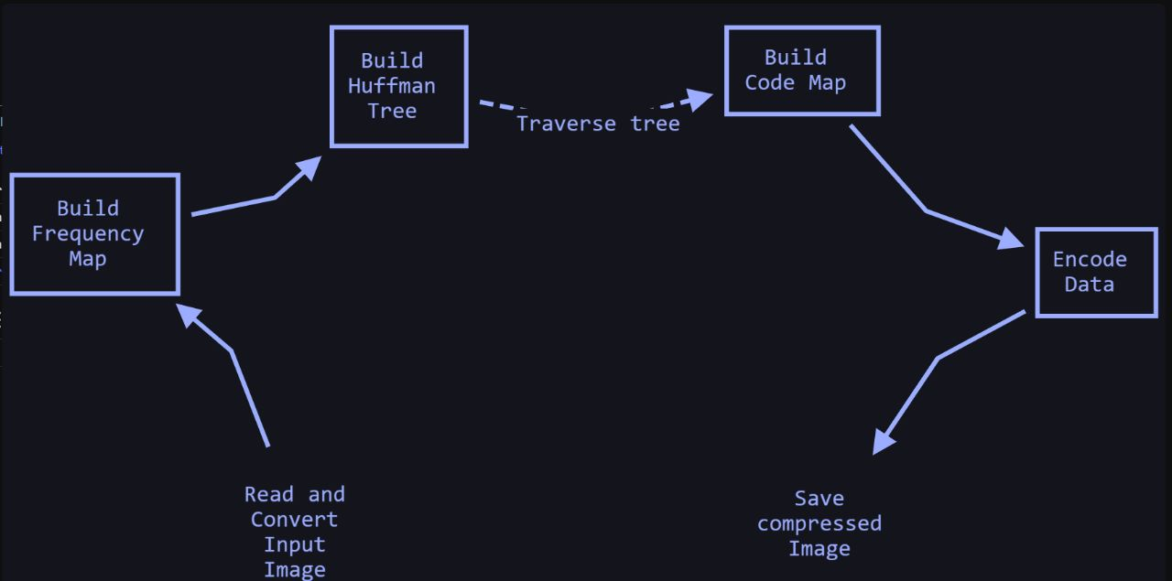
Design

Slide 7
Implementation
The Huffman coding algorithm can be broken down into several steps.
First, the frequency of occurrence of each symbol in the input data is calculated.
Next, a binary tree is constructed with each leaf node representing a symbol and its frequency. The most frequently occurring symbols are placed near the top of the tree, while the least frequently occurring symbols are placed near the bottom.
Once the binary tree has been constructed, the Huffman codes for each symbol can be determined by traversing the tree from the root to the leaf nodes. Each time the algorithm moves left, a '0' is added to the code, and each time it moves right, a '1' is added to the code. The resulting codes are then used to compress the input data.

Slide 8
References
Srikanth, Sukadev Meher, April 3-5, 2013, Compression Efficiency for Combining Different Embedded Image Compression Techniques with Huffman Encoding, International conference on Communication and Signal Processing
Djuned Fernando Djusdek , Hudan Studiawan , and Tohari Ahmad,2016,Adaptive Image Compression Using Adaptive Huffman and LZW, International Conference on Information, Communication Technology and System

Slide 9
Xiaoxiao Liu ,Ping An , Yilei Chen & Xinpeng Huang , 5 May 2021 , An improved lossless image compression algorithm based on Huffman coding , Shanghai Institute for Advanced Communication and Data Science, School of Communication and Information Engineering, Shanghai University, Shanghai 200444, China
Asian Journal of Computer Science And Information Technology, "A Fast Fractal Image Compression Using Huffman Coding", 2:9 (2012) 272-275
Wei-Yi Wei, Graduate Institute of Communication Engineering National Taiwan University, "An Introduction to Image Compression", Taipei, Taiwan, ROC

Slide 10
Conclusion
In summary, Huffman coding is a powerful image compression technique that offers many advantages over other methods.
As we continue to generate and transmit large amounts of digital data, the need for efficient compression methods like Huffman coding will only continue to grow.

