Slide 1

21 BIO 201 INTELLIGENCE OF BIOLOGICAL SYSTEMS II
AKHILESH P - BL.EN.U4AIE21006
AMAL KRISHNA K - BL.EN.U4AIE21008
S KARTHICK BHARADWAJ - BL.EN.U4AIE21112

Slide 2
LACTOSE INTOLERANCE PREDICTION USING ARTIFICIAL NEURAL NETWORKS

Slide 3
CONTENTS
Lactose Intolerance
Artificial Neural Networks
Python Code

Slide 4
LACTOSE INTOLERANCE
Overview
Lactose intolerance is a common digestive problem caused by a decreased ability to digest lactose, a sugar found in dairy products. .
Most people with lactose intolerance can manage the condition without having to give up all dairy foods.
The LCT gene provides instructions for making an enzyme called lactase. This enzyme helps to digest lactose.
Those affected vary in the amount of lactose they can tolerate before symptoms develop
There are four types of lactose intolerance : primary, secondary, developmental, and congenital.

Slide 5
Primary lactose intolerance occurs as the amount of lactase declines as people age.
Secondary lactose intolerance is due to injury to the small intestine . Such injury could be the result of infection, celiac disease, inflammatory bowel disease, or other diseases.
Developmental lactose intolerance may occur in premature babies and usually improves over a short period of time.
Congenital lactose intolerance is an extremely rare genetic disorder in which little or no lactase is made from birth.

Slide 6
Symptoms
The signs and symptoms of lactose intolerance usually begin from 30 minutes to two hours after eating or drinking foods that contain lactose. Common signs and symptoms include:
Diarrhea
Nausea, and sometimes, vomiting
Stomach cramps
Bloating
Gas

Slide 7
Diagnosis
Hydrogen breath test
Lactose tolerance test
Stool acidity test
Treatment
There is no treatment that can help the body to make more lactase. But one can manage the symptoms by changing the diet.

Slide 8
Artificial Neural Networks
Computational models inspired by the human brain:
Massively parallel, distributed system, made up of simple processing units (neurons)
Synaptic connection strengths among neurons are used to store the acquired knowledge.
Knowledge is acquired by the network from its environment through a learning process
Notes:
Artificial neural networks, or ANNs, are a type of machine learning algorithm modeled after the structure and function of the human brain. They are composed of a network of interconnected nodes, called neurons, which are organized into layers.
ANNs are trained to recognize patterns and make decisions based on input data. They are able to process large amounts of data quickly and accurately, and have been successfully applied to a wide range of tasks, including image recognition, natural language processing, and predictive modeling.

Slide 9

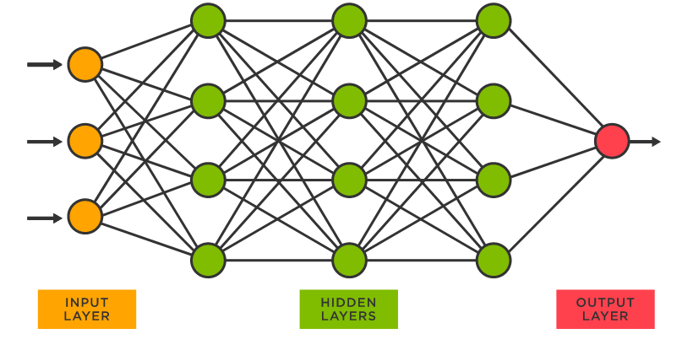
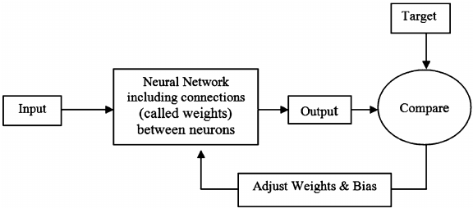
Training ANNs
Adjust in Neural Networks.
Artificial Neural Network model
Notes:
Training process of ANN:
Gather a dataset of input data and corresponding target outputs.
Define the network architecture (number of layers and number of neurons per layer).
Initialize the weights and biases to small random values.
Feed the input data through the network and compute the output.
Calculate the loss (difference between predicted output and true target output).
Adjust the weights and biases to reduce the loss through a process called backpropagation.
Repeat steps 4-6 until the network's predictions are accurate enough for the task at hand.

Slide 10
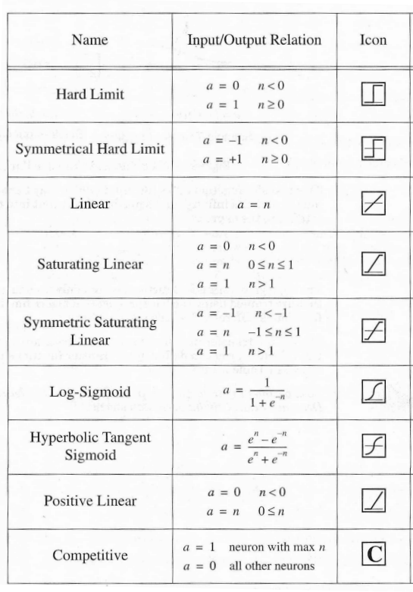
Activation Function
Also called the squashing function as it limits the amplitude of the output of the neuron.
Many types of activations functions are used:
– linear: a = f(n) = n
– threshold: a = {1 if n >= 0
0 if n < 0
– sigmoid: a = 1/(1+e-n)
Notes:
In this project we implement our ANN using the sigmoid activation function
Maps any input value to an output value between 0 and 1
Smooth, S-shaped curve
Often used in the output layer of a binary classification network
Differentiable, which makes it useful for training with gradient descent
Bounded, smooth, and has a clear decision boundary at the midpoint.

Slide 11
Properties of ANNs
Learning from examples
– labeled or unlabeled
Adaptivity
– changing the connection strengths to learn things
Non-linearity
– the non-linear activation functions are essential
Fault tolerance
– if one of the neurons or connections is damaged, the whole network still works quite well
Thus, they might be better alternatives than classical solutions for problems characterized by:
high dimensionality, noisy, imprecise or imperfect data; and
a lack of a clearly stated mathematical solution or algorithm
Notes:
Non-linear: ANNs are capable of modeling complex, non-linear relationships between inputs and outputs.
Adaptive: ANNs are able to learn and adapt to new data over time, allowing them to improve their performance on a given task.
Parallel: ANNs are made up of many simple processing units (neurons) that operate in parallel, allowing them to process large amounts of data quickly.
Generalizing: ANNs are able to generalize from their training data and make predictions or decisions on new, unseen data.
Self-organizing: ANNs are able to spontaneously organize themselves based on the input data, without the need for explicit programming.
Robust: ANNs are able to function even if some of their neurons or connections are damaged or missing, thanks to the redundant nature of their architecture.
Now over to Karthick who will run through the code….

