Slide 1

What's new: Windows x64 paging, live on our site
OPERATING SYSTEMS COURSE PROJECT · REVIEW 3
Only the changes since Review 2: a working model of the real four-level page walk that Windows runs on every memory access, turned into a click-and-watch demo.
Akhilesh Regmi 24BCE2934
Swayam Raj Pandey 24BCE2933
Aamarsh Raj Shakya 24BDS0449
UNDER THE GUIDANCE OF
Prof. Manivannan P
Physical addresses are chosen by the simulator; cycles are modelled, not measured.
Notes:
Review 3 covers only what changed since Review 2. The feedback was that the project read like a case study, so we built something that runs: a model of the exact page walk 64-bit Windows does, as a live page on our site.

Slide 2
From case study to a working demo
REVIEW 3 · OVERVIEW
REVIEW 2 FEEDBACK
WHAT WE BUILT
“It is more like a case study than a project.”
A new page on our site: Windows x64 paging
A working model of the real four-level walk, its entry bits and its faults
One click per scenario; the walk animates level by level
4 levels
3
32 KB
walked on every TLB miss, as on any 64-bit PC
one-click scenarios: page fault, TLB hit, large page
of page tables, against 512 GB for one flat table
Notes:
Our answer to the feedback: instead of describing what Windows does, we model it and show it. The numbers at the bottom are what the demo shows live.

Slide 3
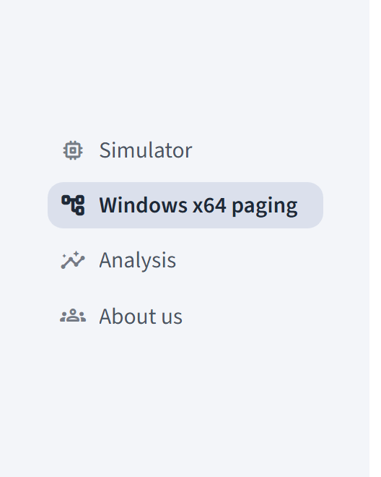
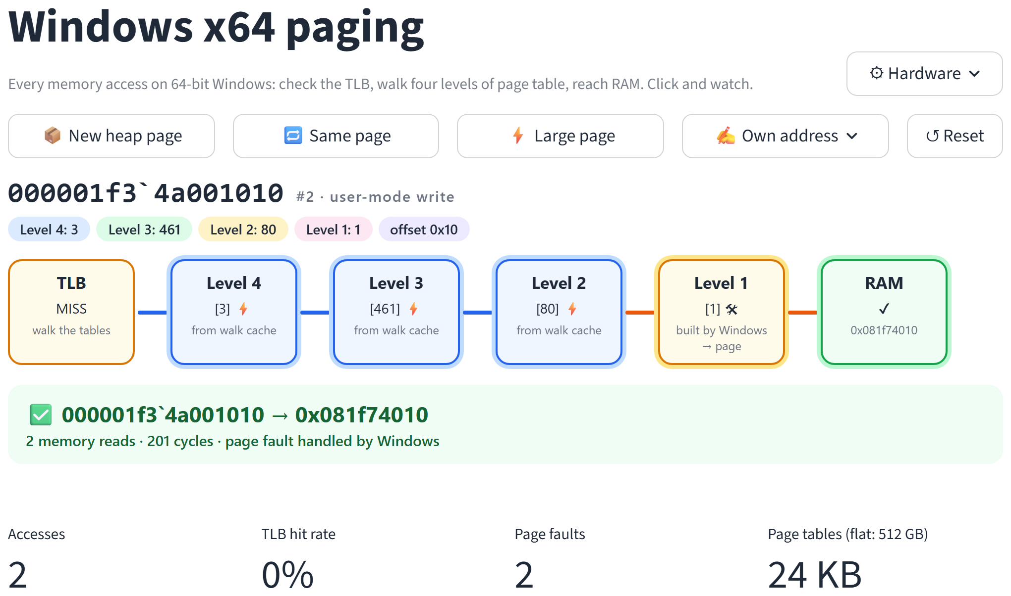
A new page: Windows x64 paging
THE SITE
Our site now has four pages. The new one sits between the Simulator and the Analysis.
Notes:
The page is a demo, not a lesson: three scenario buttons on top, then the animated walk for the latest click. Hardware switches sit behind the gear button.

Slide 4
Every address picks one entry in four tables
HOW IT WORKS
64-bit virtual address
Unused
16 bits
Level 4
9 bits
Level 3
9 bits
Level 2
9 bits
Level 1
9 bits
Offset
12 bits
copies of bit 47
1 of 512
1 of 512
1 of 512
1 of 512
byte in 4 KB page
Each table is 512 entries of 8 bytes: exactly one 4 KB page.
A register (CR3) points to the top table. Windows switches it on every process switch.
Each Level 4 entry covers 512 GB, Level 3 1 GB, Level 2 2 MB, Level 1 one 4 KB page.
Notes:
This is the 64-bit Windows layout on x86-64: 48 usable address bits, four 9-bit table indexes and a 12-bit offset. In the demo we call the tables Level 4 to Level 1 instead of their Intel names (PML4, PDPT, PD, PT).

Slide 5
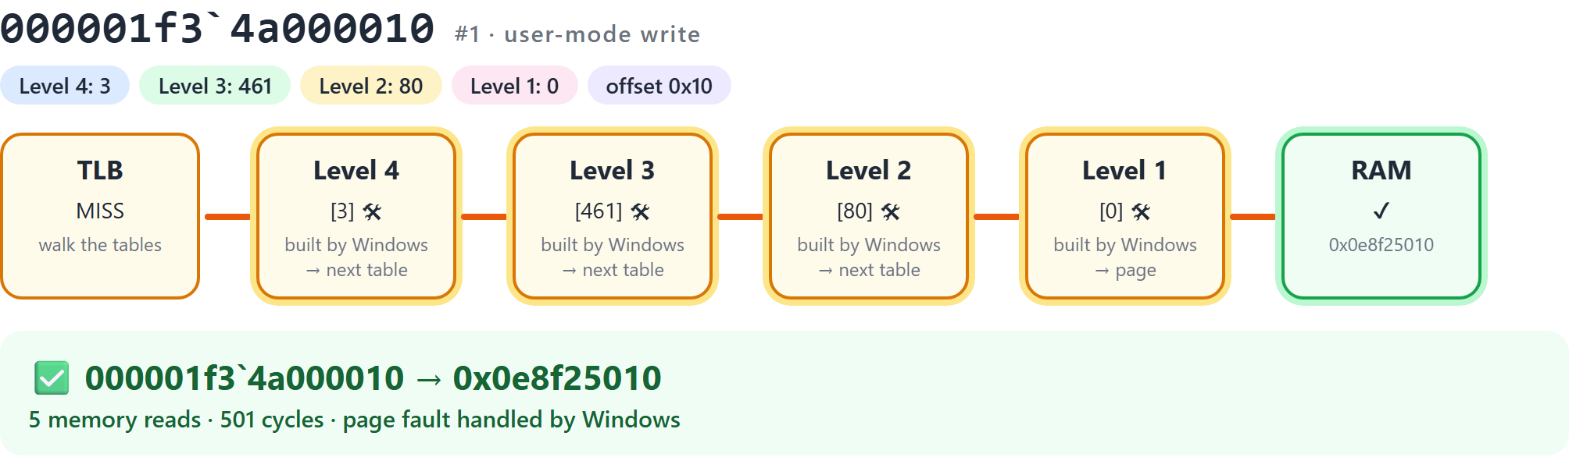
First touch: Windows builds the missing tables
SCENARIO · NEW HEAP PAGE
Amber cards
were empty: the page fault made Windows fill them in.
5 memory reads, 501 cycles
the failed read, then the repeated four-level walk.
Then it is cached
the next access nearby is much cheaper (next slide).
Notes:
Nothing in user space is mapped until it is touched. The first touch faults; Windows finds the address inside the heap, builds the missing tables, and the CPU repeats the walk.

Slide 6
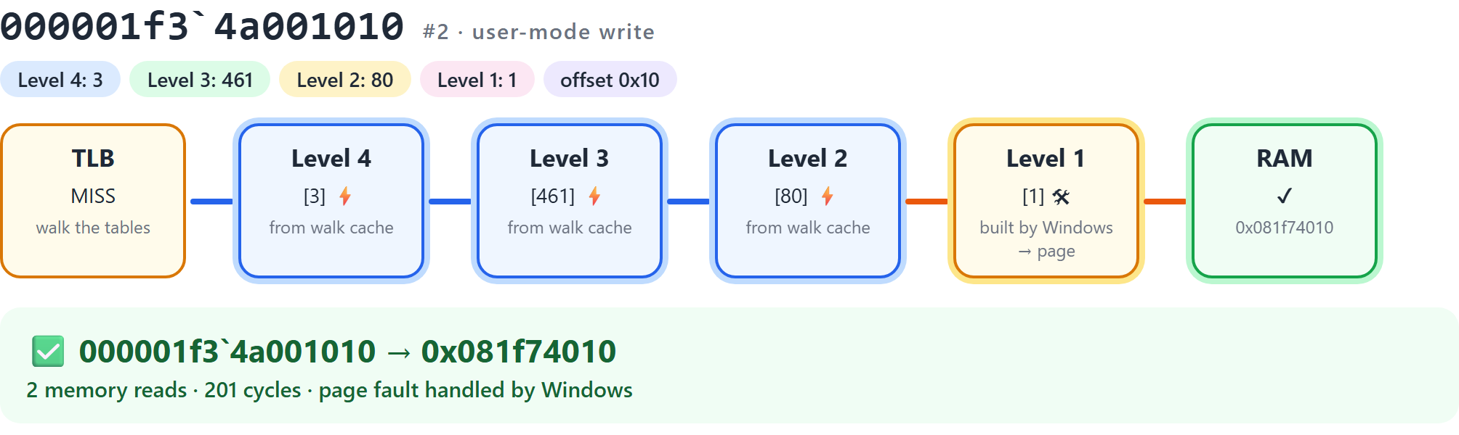
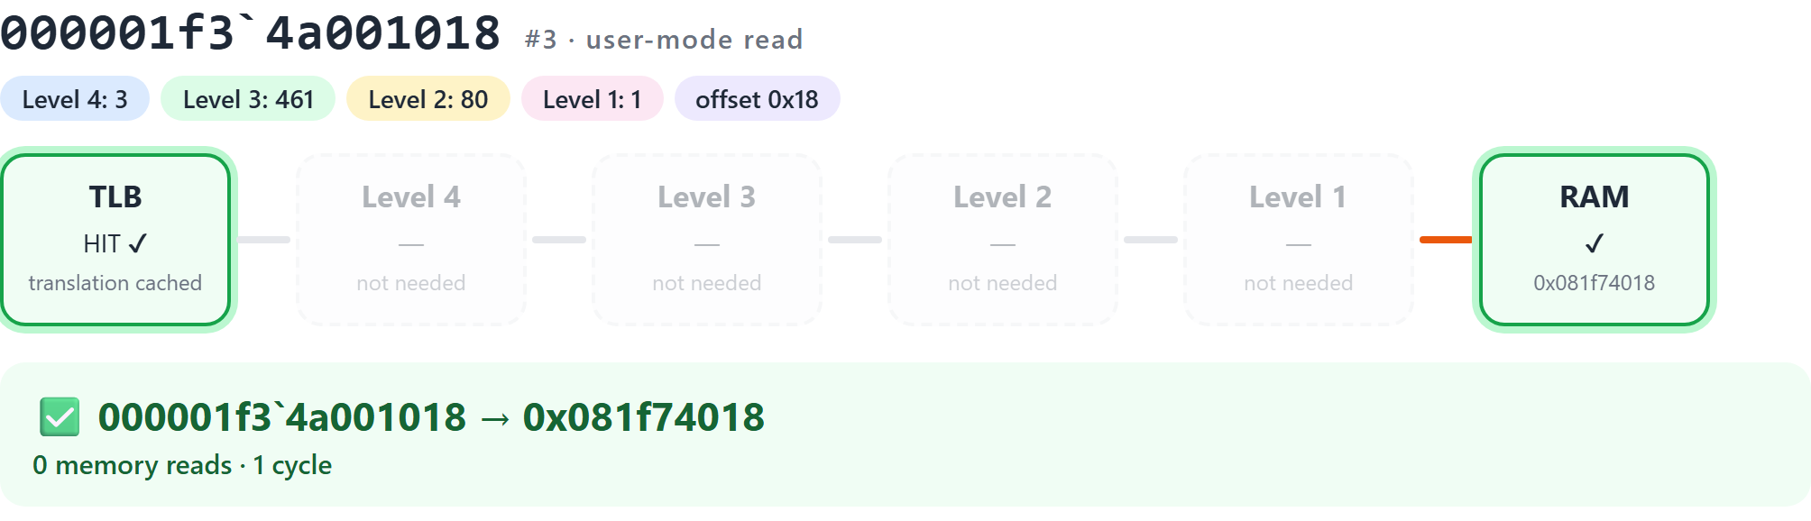
Caches make the next access cheap
SCENARIOS · NEW HEAP PAGE AGAIN, SAME PAGE
2 reads
Page-walk cache (blue) skips Levels 4, 3 and 2
0 reads
TLB hit: the translation itself was cached
Notes:
Top: the next heap page. The page-walk cache remembers the upper levels, so only Level 1 is read. Bottom: the same page again. The TLB already holds the translation, so no table is read at all.

Slide 7
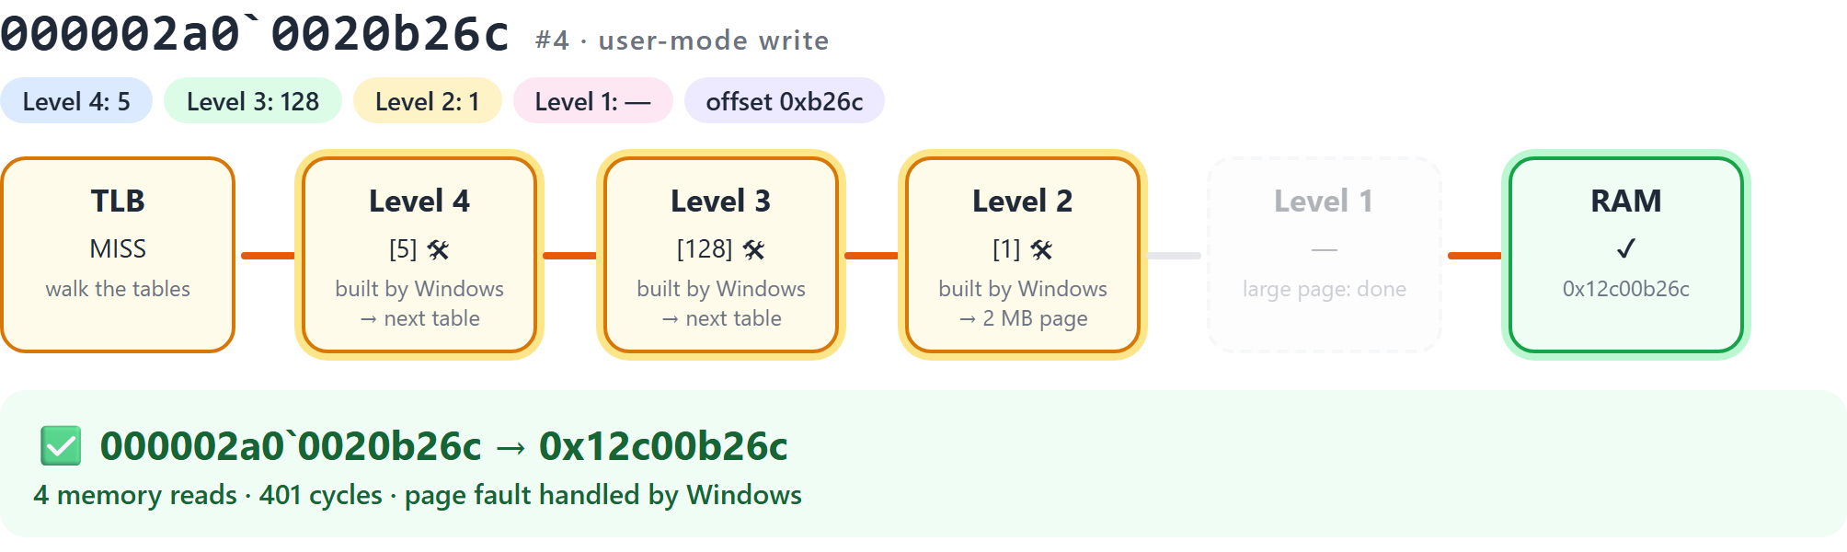
Large pages end the walk one level early
SCENARIO · LARGE PAGE
2 MB per entry
Level 2 points straight at a 2 MB page.
Level 1 skipped
one read fewer, and one 2 MB TLB entry covers 512 small pages.
Not free on Windows
needs the 'Lock pages in memory' privilege.
Notes:
The buffer is allocated with large pages, so its Level 2 entry maps 2 MB directly and the walk stops there. Turning large pages off in the Hardware menu shows the full four-level walk for the same address.

Slide 8
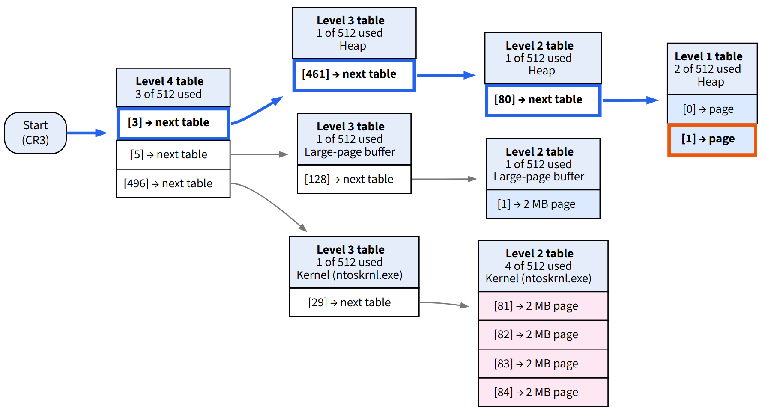
Page tables exist only where memory is used
THE LIVE TREE
8 tables
Level 4 to Level 1, built on demand
32 KB
of page-table memory for this process
512 GB
for a single flat table over the same address space
Notes:
The tree grows as you click. Orange is the latest walk, blue the levels the walk cache skipped. Only tables with a used entry exist, which is why a four-level tree beats a flat table.

Slide 9
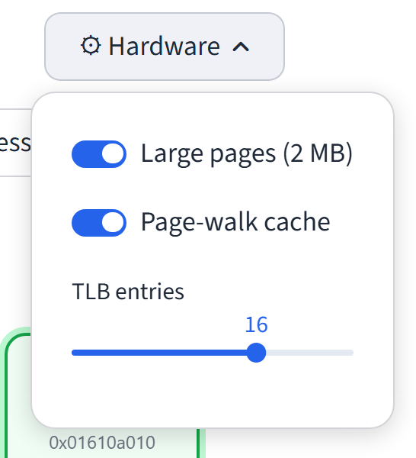
The walk cache cuts page-table reads by 4x
HARDWARE SWITCHES
192 accesses: 64 heap pages written twice, plus 64 touches of the 4 MB buffer. Model output, not a hardware measurement.
Notes:
The same switches are on the page, so this can be shown live. With the walk cache off, every TLB miss reads all four levels; with large pages off, the buffer needs 4 KB pages and an extra level.

Slide 10
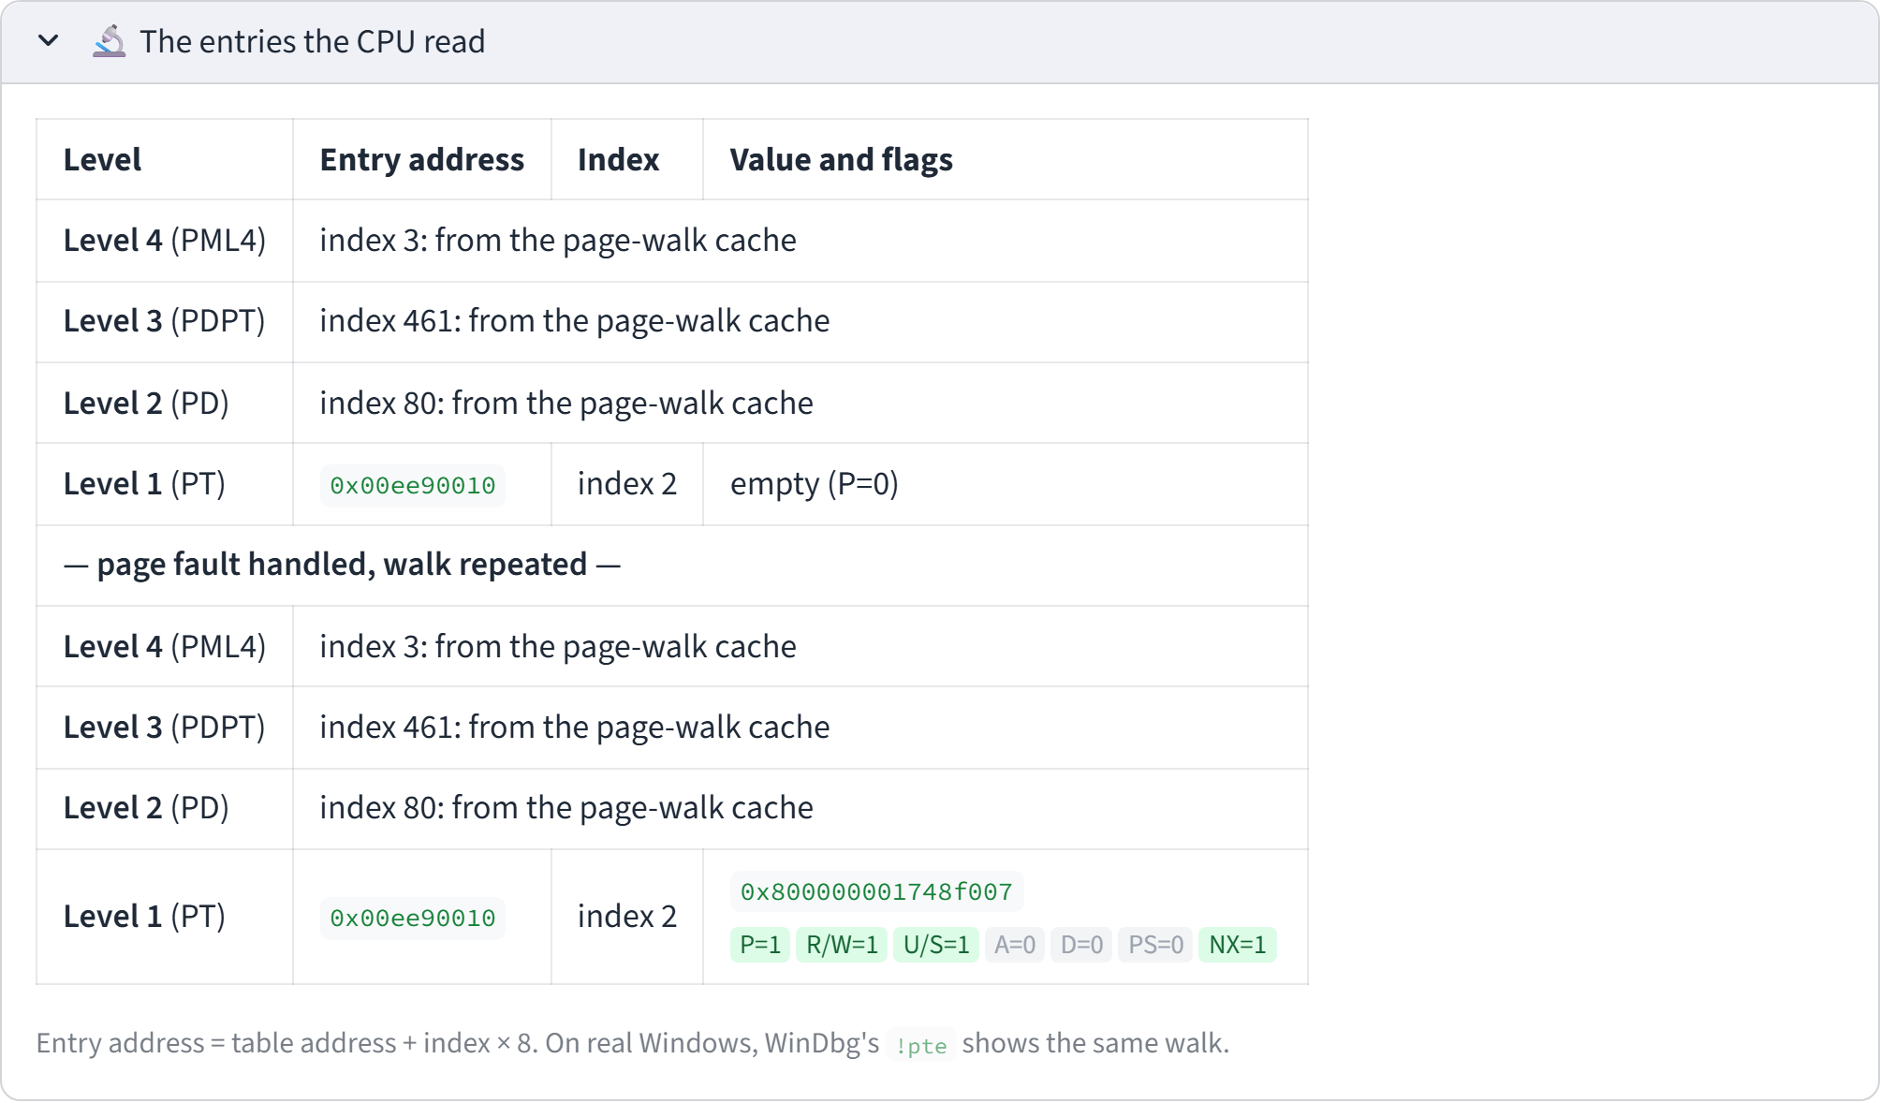
The real entry bits are one click away
FOR QUESTIONS
Bit | Meaning
P | present
R/W | writable
U/S | user mode allowed
A | accessed
D | dirty (written)
PS | large page
NX | no execute
Same format WinDbg's !pte prints on a real Windows machine.
Notes:
The demo hides the detail, but it is all there: each entry the CPU read, its address, its 64-bit value and the flag bits that decided the outcome.

Slide 11
Two new files, three updated, tests removed
WHAT CHANGED IN THE CODE
File | Change | What it does
paging/x64.py | New | Model of the four-level walk: entry bits, faults, large pages, TLB, walk cache
views/x64.py | New | The demo page: scenario buttons, animated walk, scores, detail sections
diagrams.py | Updated | Draws the live page-table tree
app.py, README.md | Updated | New page in the menu; docs
tests/ | Removed | Not needed for the hosted app
HOSTING
Streamlit Community Cloud: push to GitHub, pick app.py
No environment variables or secrets
No new packages, no extra backend
Each click is a few microseconds of Python
Notes:
Everything runs in plain Python inside Streamlit, so deployment is still just pushing the repository.

Slide 12
Click order for the review
LIVE DEMO · ABOUT ONE MINUTE
1
New heap page: page fault, Windows builds the tables
2
New heap page again: the walk cache skips three levels
3
Same page: TLB hit, nothing read
4
Large page: the walk ends at Level 2
5
Hardware: walk cache off, New heap page: all four levels read
Notes:
Run these in order on the live site. Reset first if anything is already on screen.

