Slide 1

"Track and trace : investigating the cyber attacks using honeypot”
Project Presentation
MITU22BTCS0088 Akhilesh Palve
MITU22BTCS0184 Shubham Dorik
MITU22BTCS0393 Sahil Badhe
Guided by
Prof. Smita Gumaste
Department of Computer Science & Engineering, MITSoC, Loni Kalbhor

Slide 2
Outline
Introduction.
Problem Statement.
Concepts & Methods.
Literature Review.
Implementation.
Conclusion and future work.
Reference.
Department of Computer Science & Engineering, MITSoE, Loni Kalbhor

Slide 3
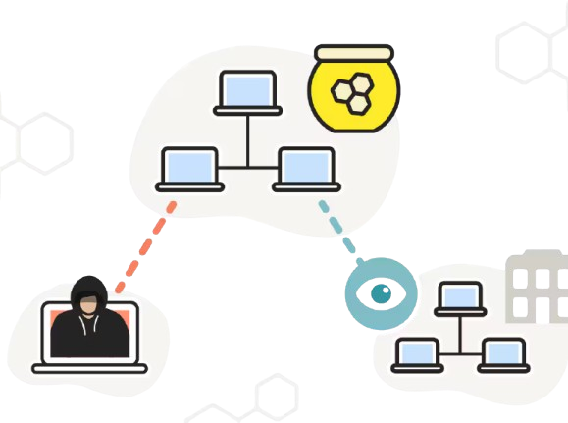
Introduction
Definition Honeypot:-
Honeypots are security mechanisms set to detect, deflect, or study cyber attacks. They appear as legitimate parts of a network but are isolated and monitored closely. Purpose to lure attackers away from critical systems and gather intelligence about threats . Act as a research tool to understand attacker behavior and improve defensive measures.
Department of Computer Science & Engineering, MITSoE, Loni Kalbhor

Slide 4
Problem Statement
Deploy a honeypot system with decoy servers to attract cyber attackers. Monitor and log their activities to gather intelligence, enhancing defenses with insights gained. Regular updates and feedback will system’s effectiveness.
Department of Computer Science & Engineering, MITSoE, Loni Kalbhor

Slide 5
Concepts and Methods
Concepts:-
A website honeypot is a decoy version of a real website or its components designed to attract cyber attackers. For websites, honeypots can simulate vulnerabilities (e.g., login pages, outdated APIs, or misconfigured servers) that attackers target.
By monitoring and analyzing interactions with the honeypot, you can trace attack patterns, identify sources, and enhance the website's overall security.
Department of Computer Science & Engineering, MITSoE, Loni Kalbhor

Slide 6
Continue…
Methods:-
1.Collecting Attack Data
Log detailed attack vectors, methods, and tools.
Monitor real-time attacker behavior and capture malware payloads.
Document attack timelines to improve response strategies.
2.Analyzing Attack Patterns
Identify attack signatures and indicators of compromise.
Study attacker techniques and their evolution over time.
Correlate honeypot data with other security systems for deeper insights.
3.Identifying Attackers and Motives
Trace attacks to IPs and geographical locations.
Attribute behaviors to known threat actors and analyze motives.
Contribute to threat intelligence and collaborate with law enforcement.
Department of Computer Science & Engineering, MITSoE, Loni Kalbhor

Slide 7
Literature Survey
Sr.No | Title | Author(s) | Year | Key Insights
1 | Evasion Techniques Used Against Honeypots | Holmes et al. | 2020 | Highlights evasion techniques used by attackers and suggests methods to make honeypots less detectable.
2 | A Survey on Honeypot Frameworks for Web Applications | Trapti Sharma et al. | 2020 | Reviews frameworks designed for web applications and emphasizes their use in detecting common web vulnerabilities like SQLi and XSS.
3 | APT Detection Through Honeypots | Choudhary et al. | 2018 | Studies Advanced Persistent Threats (APTs) and their TTPs using honeypots.
4 | Ethical and Legal Considerations in Honeypot Deployment | J. Hoepman | 2014 | Examines ethical and legal dilemmas, such as data privacy issues and entrapment risks, in honeypot deployment.
5 | Machine Learning in Honeypot-Based Intrusion Detection | Dhanabal and Shantharajah | 2015 | Explores how machine learning improves honeypot log analysis and enhances detection accuracy.
Department of Computer Science & Engineering, MITSoE, Loni Kalbhor

Slide 8
Implementation
Install Dependencies: Install paramiko and any other required libraries, such as threading, using pip.
Generate SSH Keys: Create an RSA private key for the honeypot server using ssh-keygen.
Create Custom Modules: Implement or ensure the availability of custom modules (file_read, fake_uname, diskfile, sudo_cmd) to handle fake file system operations, system information, disk usage, and sudo commands.
Set Up the Server: Configure the honeypot to listen for SSH connections on port 22 with the provided host IP.
Run the Honeypot: Execute the script to start the honeypot, which will wait for incoming connections and simulate an SSH session.
Test the Honeypot: Use an SSH client to connect to the honeypot and verify login with valid credentials to interact with the fake system.
Monitor and Log Activities: Monitor incoming connections and log commands or activities for analysis of potential attacks.
Enhance Features: Optionally, improve the honeypot by adding logging, advanced response simulations, and custom alerts for suspicious activity.
Department of Computer Science & Engineering, MITSoE, Loni Kalbhor

Slide 9
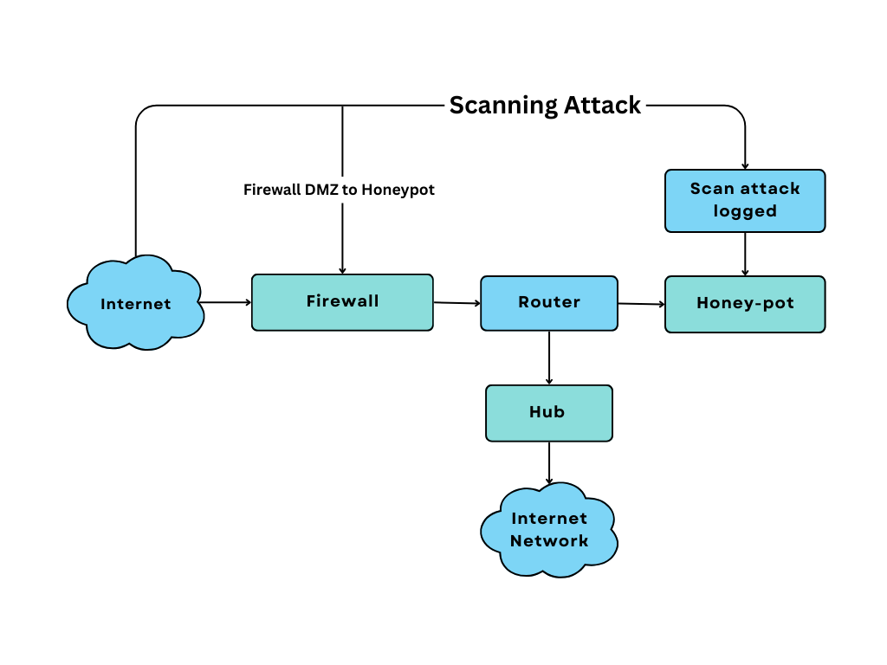
Working (Flowchart)
Department of Computer Science & Engineering, MITSoE, Loni Kalbhor

Slide 10
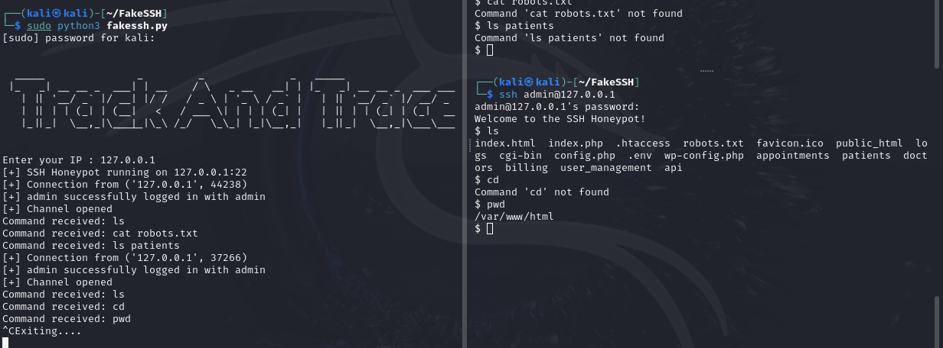
Results
Department of Computer Science & Engineering, MITSoE, Loni Kalbhor

Slide 11
Conclusion and Future Work
Honeypots are valuable tools in website cybersecurity, helping to detect and analyze cyber threats by simulating vulnerabilities. They provide crucial intelligence on attack methods and tools. However, challenges remain, such as real-time analysis, scalability, and adapting to advanced threats. Legal and ethical concerns also need addressing.
Department of Computer Science & Engineering, MITSoE, Loni Kalbhor

Slide 12
References
1. Spitzner, L. (2003). Honeypots: Concepts, Types, and Applications.
Link: https://www.sans.org/reading-room/whitepapers/incident/honeypots-concepts-types-applications-1083
2. Sharma, T., et al. (2020). A Survey on Honeypot Frameworks for Web Applications.
Link: https://ieeexplore.ieee.org/document/9117966
3. Simpson, R., et al. (2016). Threat Actor Attribution via Honeypot Analysis.
Link: https://link.springer.com/article/10.1007/s10207-016-0334-9
4. Hoepman, J. (2014). Ethical and Legal Considerations in Honeypot Deployment.
Link: https://link.springer.com/chapter/10.1007/978-3-319-09688-4_7
5. Holmes, C., et al. (2020). Evasion Techniques Used Against Honeypots.
Link: https://www.sciencedirect.com/science/article/pii/S1877056720302610
Department of Computer Science & Engineering, MITSoE, Loni Kalbhor

Slide 13
Thank You
Department of Computer Science & Engineering, MITSoE, Loni Kalbhor

