Slide 1
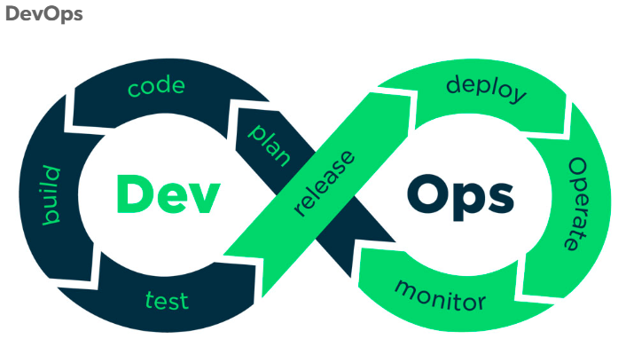

Slide 2
DevOps Modules:
DevOps Overview
Version Control Using Git & GitHub
Terraform
Continuous Integration using Jenkins
Containerization using Docker
What is Kubernets & Installations
Ansible
Continuous Monitoring using Nagios

Slide 3

DevOps Overview
Waterfall Model:
Is has distinct goals for each phase of development.
Imagine a waterfall on the cliff of a steep mountain. Once the water has flowed over the edges of the cliff, it can not turn back

Slide 4
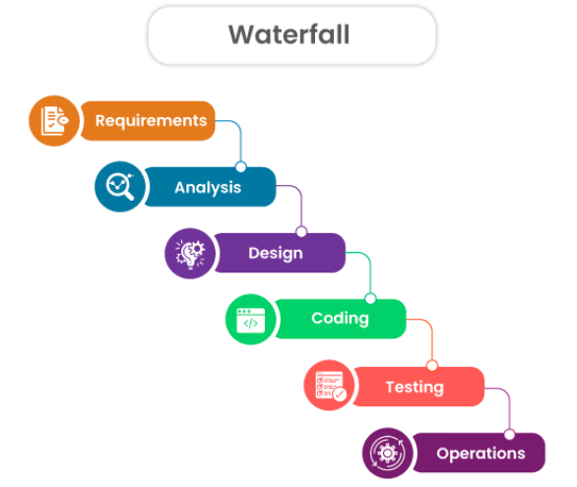
Traditional Waterfall Model:

Slide 5
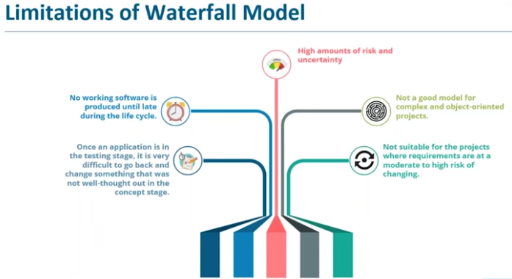
Limitations of Waterfall Model:

Slide 6
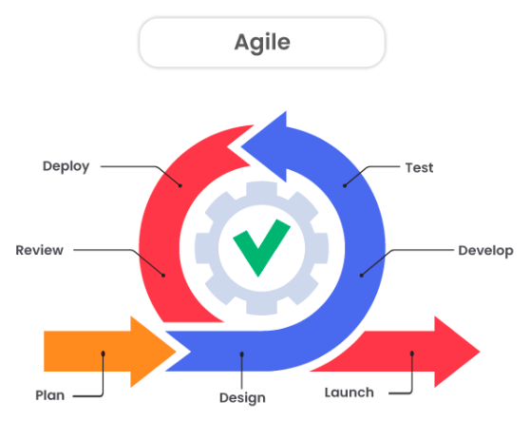
What is Agile Methodology?
DevOps is a culture, fostering collaboration amongst all participants involved in the development and maintenance of software. Agile can be described as a development methodology designed to maintain productivity and drive releases with the common reality of changing needs

Slide 7
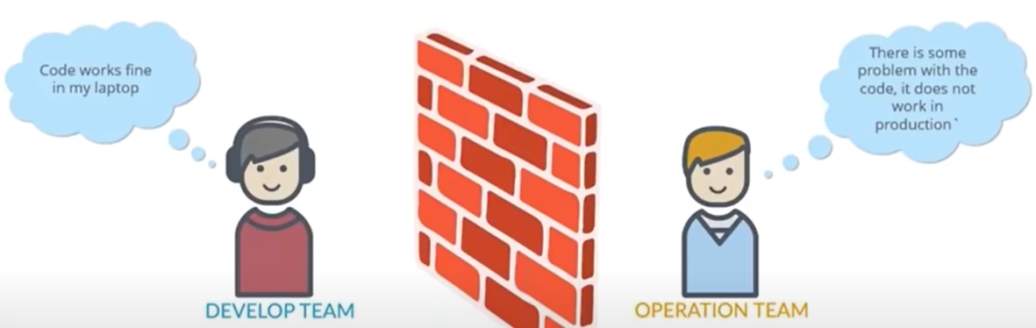
Limitations of Agile Methodology:

Slide 8
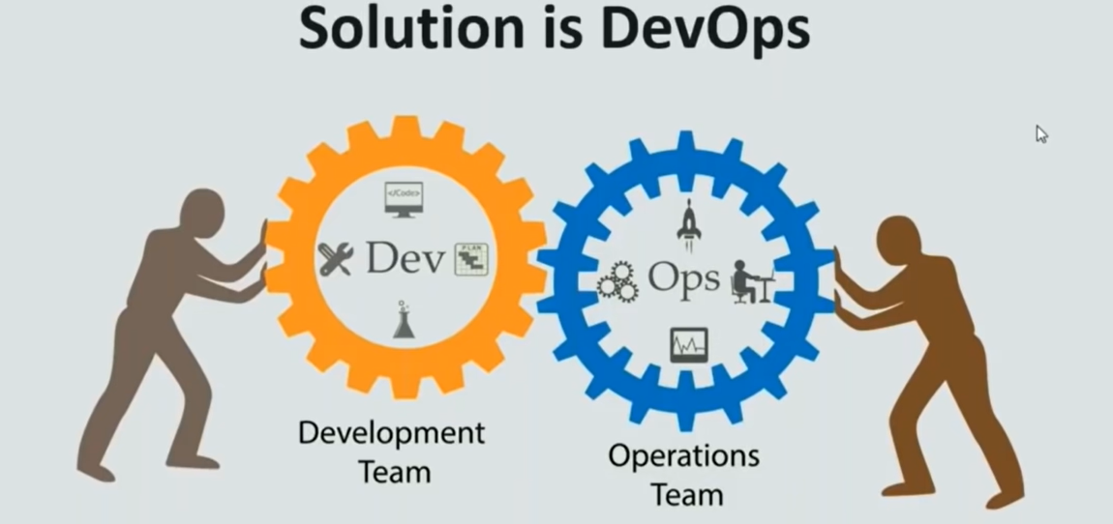

Slide 9
What is DevOps?
DevOps Model Defined:
DevOps is the combination of cultural philosophies, practices, and tools that increases an organization’s ability to deliver applications and services at high velocity: evolving and improving products at a faster pace than organizations using traditional software development and infrastructure management processes.
This speed enables organizations to better serve their customers and compete more effectively in the market.
DevOps is not a technology, it is a methodology.

Slide 10
Why DevOps Matters?
DevOps is important because it's a software development and operations approach that enables faster development of new products and easier maintenance of existing deployments.

Slide 11


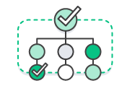


Benefits of DevOps
Speed Rapid Delivery Reliability
Improved Collaboration Scale Security

Slide 12
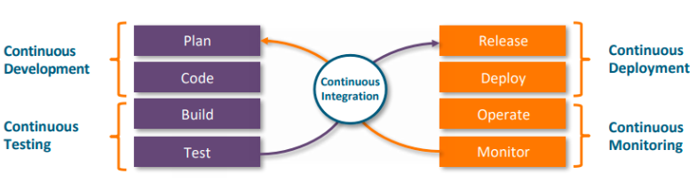
How DevOps Works?

