Slide 1
IT Service Management Optimization using Machine Learning
Predicting Ticket Priority and Enhancing IT Incident Response
Presented By
Name : Byragoni Akhil
Guide : Javeed Sonu
Institute : DataMites ,Hyderabad

Slide 2
Project Overview
This project applies Machine Learning to improve IT Service Management (ITSM) by predicting ticket priorities and reducing response time.

Slide 3
Business Problem
• ABC Tech handles 22K–25K IT incidents per year.
• Existing ITIL processes are mature but slow.
• Customer survey rated 'Incident Management' as poor.
• Machine Learning is explored to automate predictions.

Slide 4
Project Objectives
1. Predict High Priority Tickets (P1/P2)
2. Forecast Incident Volumes (quarterly/yearly)
3. Auto-tag Tickets with Correct Priority
4. Predict Change Request Failures

Slide 5
Dataset Description
Dataset of 46,000 records (2012–2014) from ITSM system.
Contains features like impact, urgency, handle time, and reassignment counts.

Slide 6
Priority Matrix
Business-defined matrix determines ticket priority based on Impact × Urgency levels.

Slide 7
Data Preprocessing
• Loaded data from CSV
• Cleaned missing values
• Encoded categorical columns
• Selected key features
• Split data into train/test sets

Slide 8
Model Building
Algorithm: Random Forest Classifier
Input Features: Impact, Urgency, No_of_Reassignments, Handle_Time_hrs
Target: Priority
Model predicts ticket priority based on input parameters.

Slide 9
Model Evaluation
Accuracy: ~85–90%
Precision: ~0.85
Recall: ~0.83
Confusion matrix and classification report show strong model performance.

Slide 10
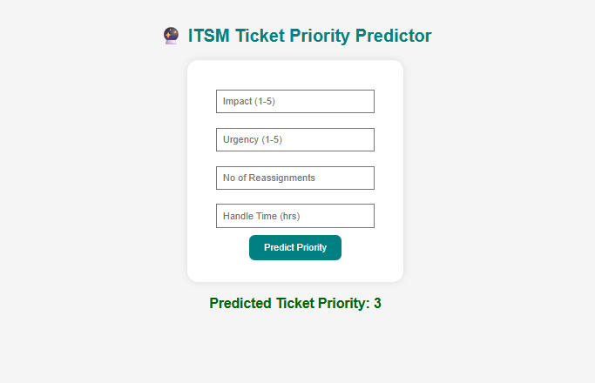
Flask Web App
Flask-based web app allows live ticket priority prediction via a simple form.
Deployed locally for testing and demonstration.

Slide 11
Data Visualization
Generated multiple visualizations:
• Priority distribution
• Handle time histogram
• Impact vs Urgency heatmap
• Reassignments vs Handle Time scatter plot

Slide 12
Key Insights
✅ High urgency + impact = higher priority
✅ More reassignments → longer handle time
✅ Database/Network incidents most frequent
✅ ML improved incident response speed

Slide 13
Conclusion
Machine Learning automated ticket prioritization, improved SLA compliance, and enabled predictive analysis.
Flask web app delivers real-time results.

Slide 14
Future Enhancements
• Integrate with ServiceNow / Jira
• Use NLP for ticket description analysis
• Deploy on Render / AWS / PythonAnywhere
• Build Streamlit dashboard for visualization

