Slide 1
Sales Performance Analysis of Walmart Stores Using Advanced MySQL Techniques
Uncovering actionable insights through data analysis

Slide 2
Project Overview
Business Problem
Analyzing sales performance, customer behavior, and product trends
Optimizing sales strategies with data-driven insights

Slide 3
SQL Techniques Used
Advanced MySQL techniques
CTEs (Common Table Expressions)
Window functions (RANK, PARTITION BY)
Aggregation, Filtering, and Sorting

Slide 4
Task 1 - Identifying the Top Branch by Sales Growth Rate
Sql query
WITH MonthlySales AS (SELECT Branch,
DATE_FORMAT(STR_TO_DATE(Date1, '%d-%m-%Y'), '%Y-%m') AS Month,
SUM(Total) AS MonthlyTotal FROM walmart_sales GROUP BY Branch, Month
),GrowthRateTable AS (SELECT Branch,
ROUND((MAX(MonthlyTotal) - MIN(MonthlyTotal)) / MIN(MonthlyTotal) * 100, 1) AS GrowthRate
FROM MonthlySales GROUP BY Branch)
SELECT Branch, GrowthRate FROM GrowthRateTable
ORDER BY GrowthRate DESC
LIMIT 1;

Slide 5
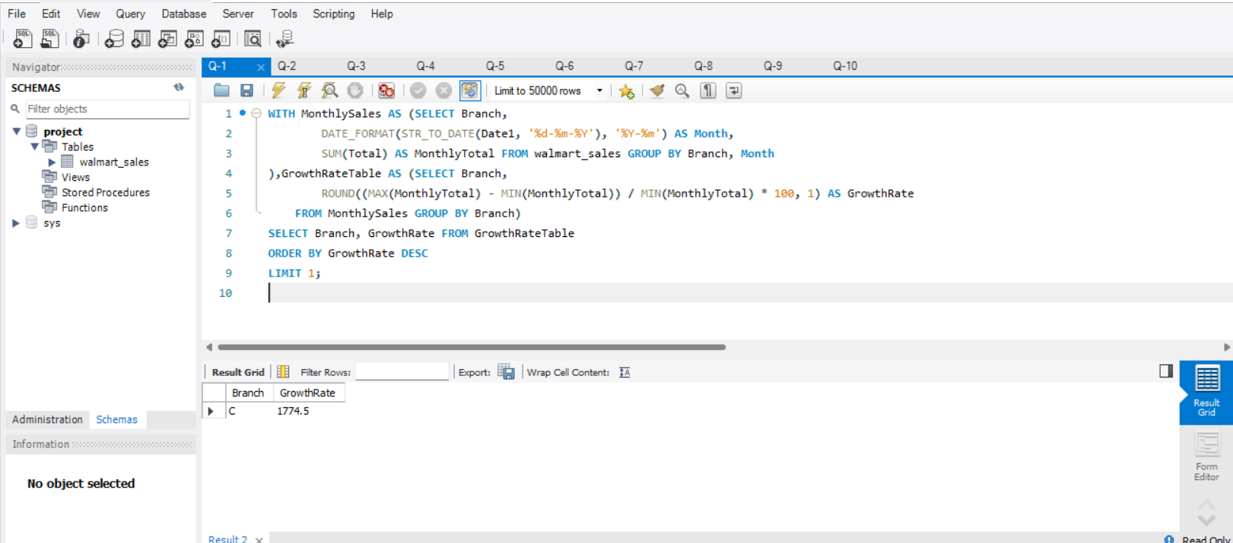

Slide 6
Task 2 -Finding the Most Profitable Product Line for Each Branch
Sql query
WITH ProductLineProfit AS ( SELECT Branch, Product_line,
round(sum(total - COGS),2) AS Profit -- Calculate profit for each product line
FROM walmart_sales GROUP BY Branch, Product_line)
SELECT Branch, Product_Line, Profit FROM ProductLineProfit
WHERE (Branch, Profit) IN (SELECT
Branch, MAX(Profit) AS MaxProfit
FROM ProductLineProfit
GROUP BY Branch)
ORDER BY Branch;

Slide 7
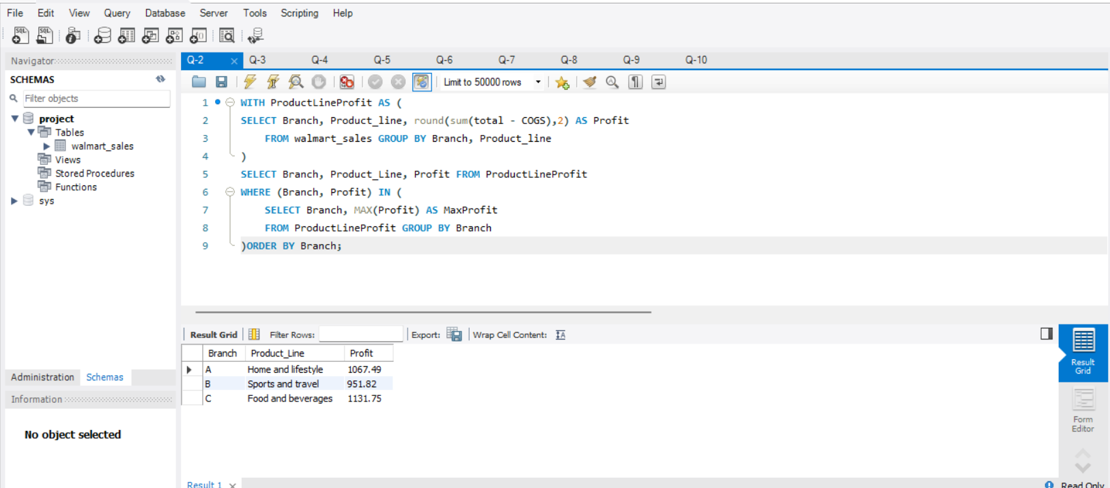

Slide 8
Task 3 - Analyzing Customer Segmentation Based on Spending
Sql query
WITH CustomerSpending AS ( SELECT Customer_ID, round(SUM(Total),2) AS TotalSpending
FROM walmart_sales GROUP BY Customer_ID
)
SELECT Customer_ID, TotalSpending,
CASE
WHEN TotalSpending < 20556 THEN 'Low Spender'
WHEN TotalSpending BETWEEN 20556 AND 23456 THEN 'Medium Spender'
ELSE 'High Spender'
END AS SpendingCategory
FROM CustomerSpending;

Slide 9
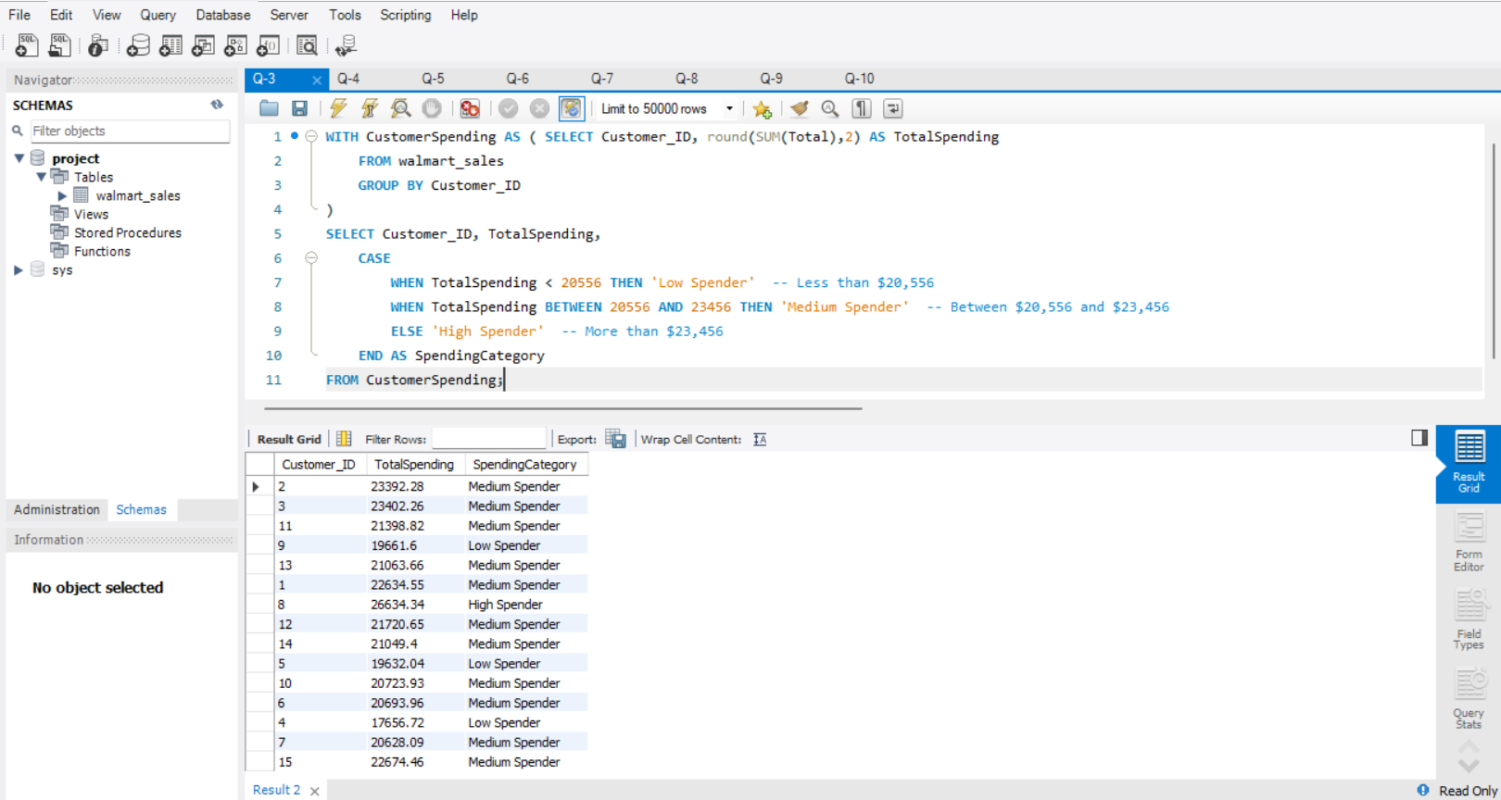

Slide 10
Task 4 - Detecting Anomalies in Sales Transactions
Sql query
WITH ProductStats AS (
SELECT Product_line, round(AVG(Total),2) AS AvgSales FROM walmart_sales GROUP BY Product_line
)SELECT w.Invoice_ID, w.Product_line, w.Total, ps.AvgSales,
CASE
WHEN w.Total > ps.AvgSales * 1.5 THEN 'High Anomaly'
WHEN w.Total < ps.AvgSales * 0.5 THEN 'Low Anomaly'
ELSE 'Normal'
END AS AnomalyStatus
FROM walmart_sales w JOIN ProductStats ps ON w.Product_line = ps.Product_line;

Slide 11
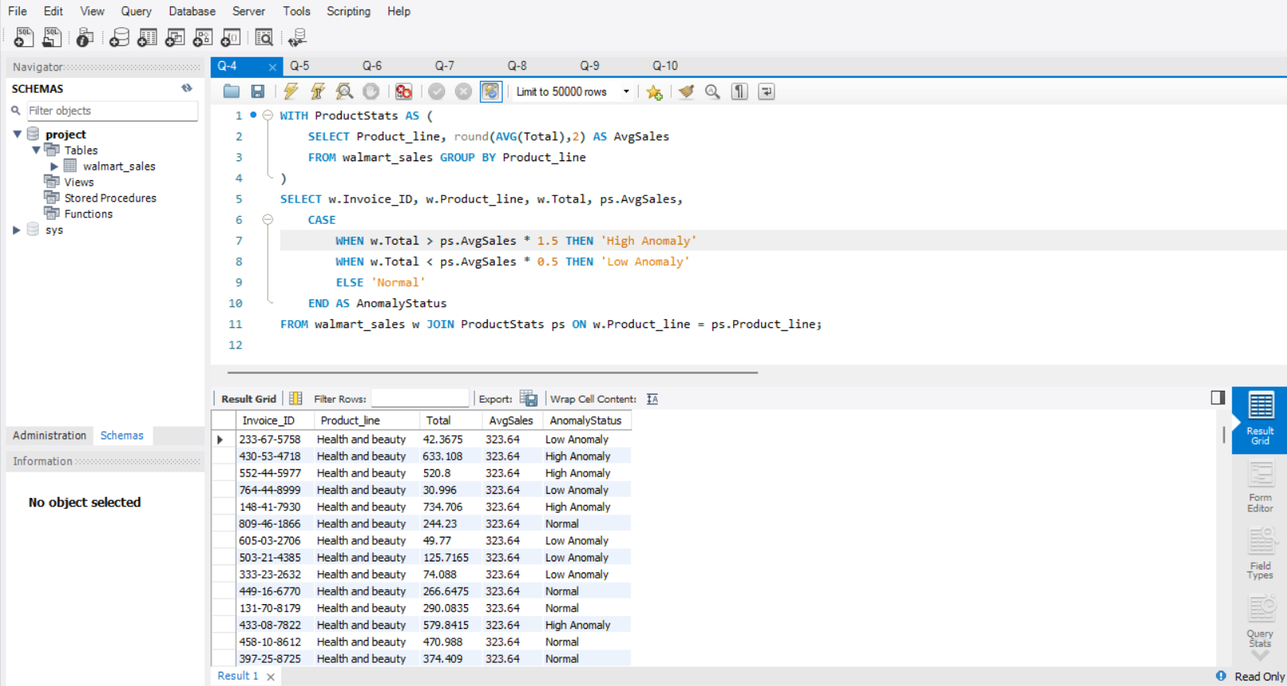

Slide 12
Task 5 - Most Popular Payment Method by City
Sql query
WITH PaymentStats AS (
SELECT City, Payment, COUNT(*) AS PaymentCount FROM walmart_sales
GROUP BY City, Payment
),
MostPopularPayment AS (
SELECT City, Payment, PaymentCount,
RANK() OVER (PARTITION BY City ORDER BY PaymentCount DESC) AS Rank1 FROM PaymentStats
)
SELECT City, Payment AS MostPopularPaymentMethod, PaymentCount AS TransactionCount
FROM MostPopularPayment WHERE Rank1 = 1;

Slide 13
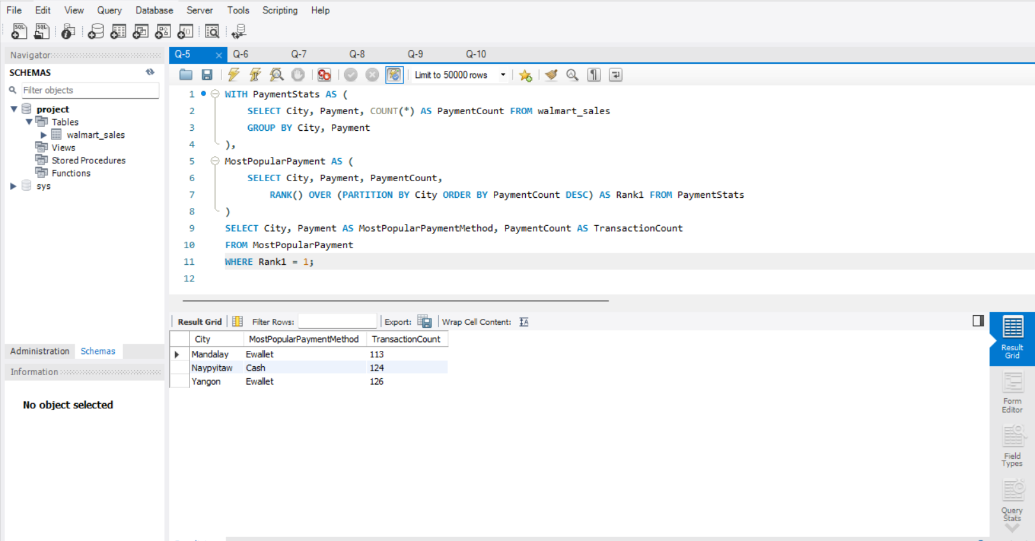

Slide 14
Task 6 - Monthly Sales Distribution by Gender
Sql query
WITH MonthlySalesByGender AS (
SELECT DATE_FORMAT(STR_TO_DATE(Date1, '%d-%m-%Y'), '%Y-%m') AS Month,
Gender,round(SUM(Total),2) AS TotalSales
FROM walmart_sales
GROUP BY Month, Gender
)
SELECT Month, Gender, TotalSales
FROM MonthlySalesByGender
ORDER BY Month, Gender;

Slide 15
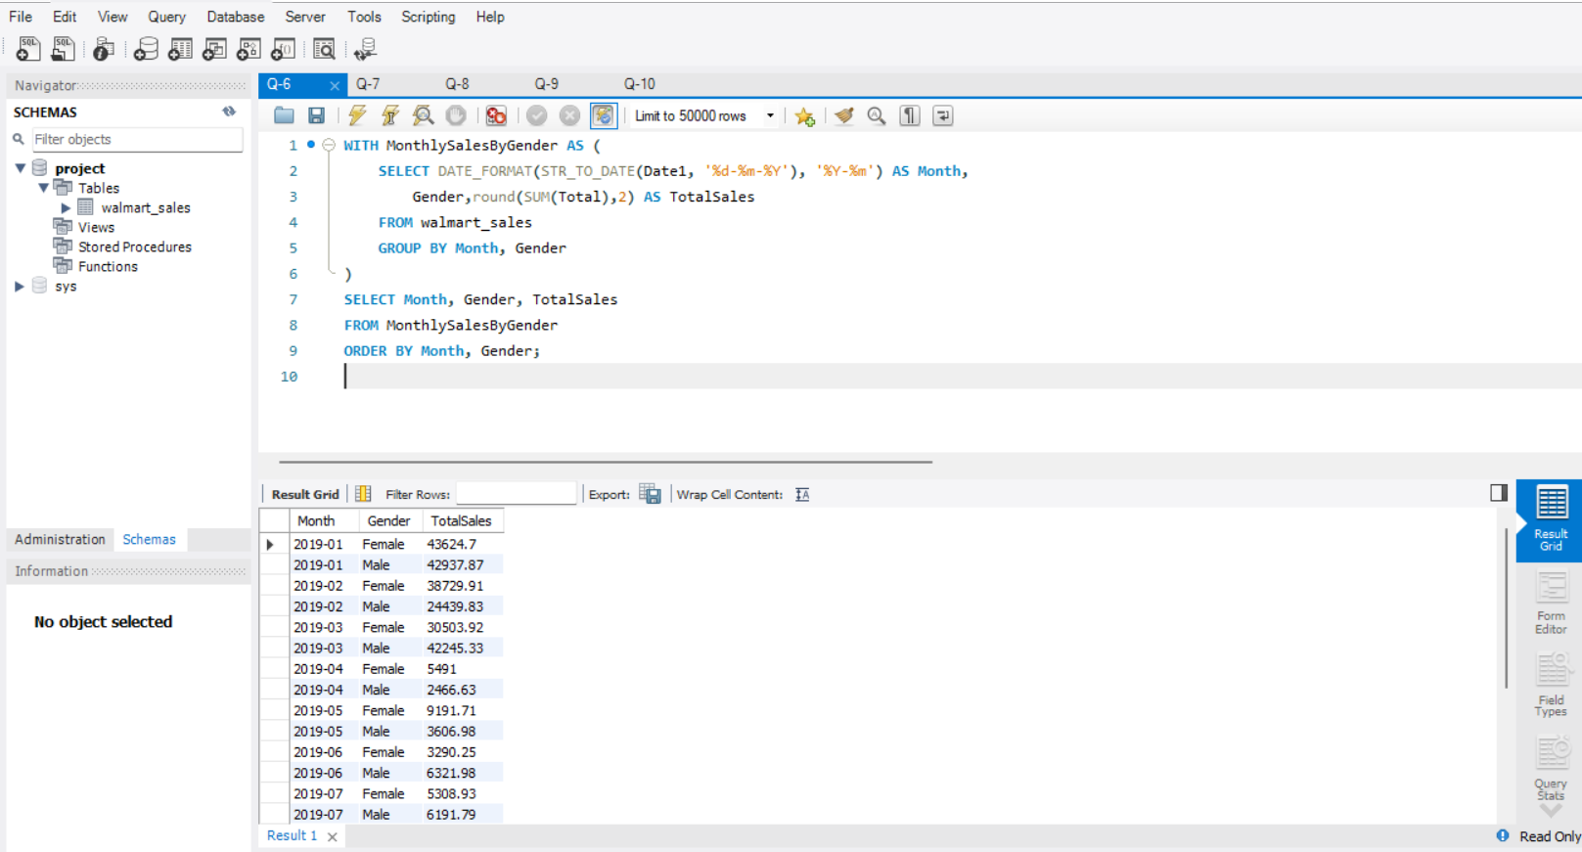

Slide 16
Task 7 - Best Product Line by Customer Type
Sql query
WITH ProductLineSales AS (
SELECT Customer_type, Product_line, round(SUM(Total),2) AS TotalSales
FROM walmart_sales GROUP BY Customer_type, Product_line
),
BestProductLine AS (
SELECT Customer_type, Product_line, TotalSales,
RANK() OVER (PARTITION BY Customer_type ORDER BY TotalSales DESC) AS Rank1
FROM ProductLineSales
)
SELECT Customer_type, Product_line AS BestProductLine, TotalSales AS SalesAmount
FROM BestProductLine WHERE Rank1 = 1;

Slide 17
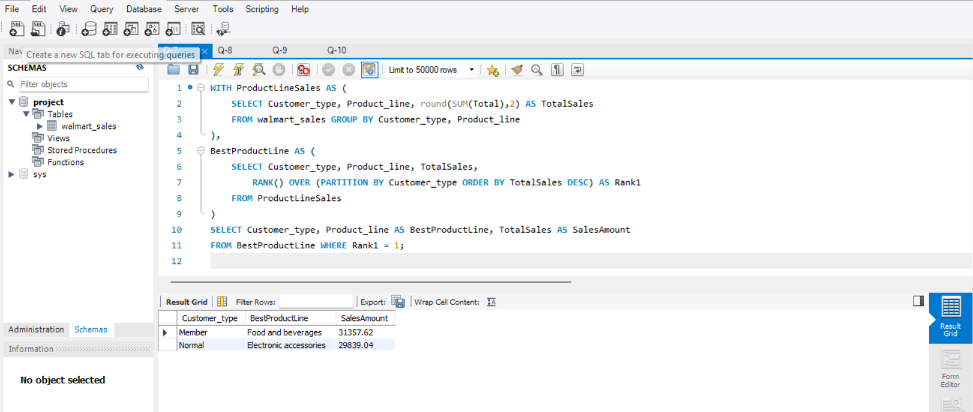

Slide 18
Task 8 - Identifying Repeat Customers
Sql query
WITH CustomerTransactions AS (
SELECT Customer_ID, STR_TO_DATE(Date1, '%d-%m-%Y') AS TransactionDate FROM walmart_sales
), RepeatCustomers AS (
SELECT c1.Customer_ID, COUNT(*) AS RepeatCount FROM CustomerTransactions c1
JOIN CustomerTransactions c2
ON c1.Customer_ID = c2.Customer_ID AND c1.TransactionDate < c2.TransactionDate
AND DATEDIFF(c2.TransactionDate, c1.TransactionDate) <= 30 -- Check if within 30 days
GROUP BY c1.Customer_ID )
SELECT Customer_ID, RepeatCount FROM RepeatCustomers WHERE RepeatCount > 0 ORDER BY RepeatCount DESC;

Slide 19
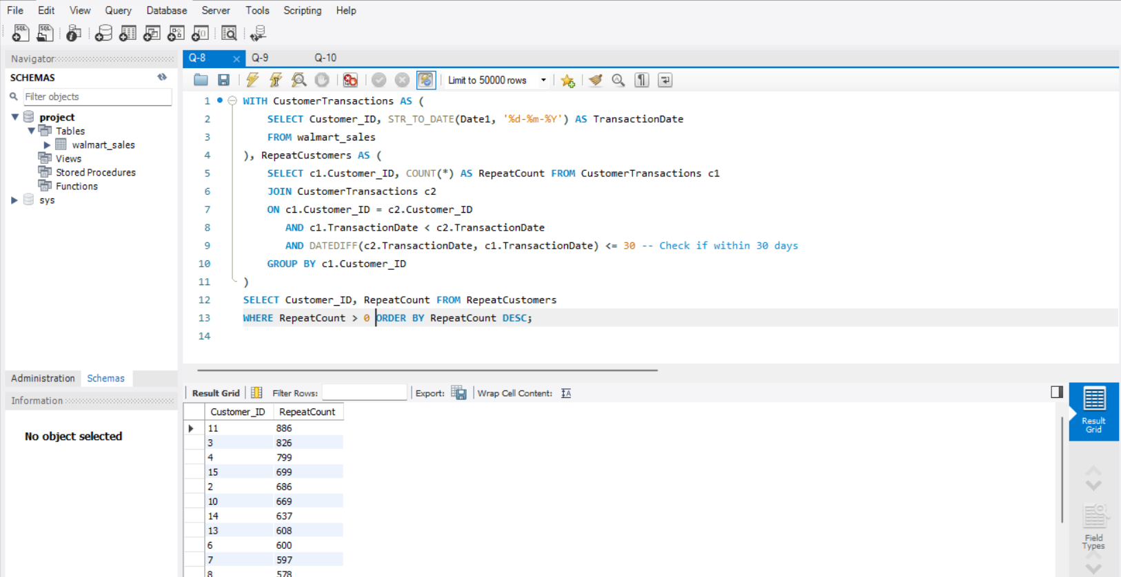

Slide 20
Task 9 - Finding Top 5 Customers by Sales Volume
Sql query
SELECT Customer_ID, round(SUM(Total),2) AS TotalSales
FROM walmart_sales
GROUP BY Customer_ID
ORDER BY TotalSales DESC
LIMIT 5;

Slide 21
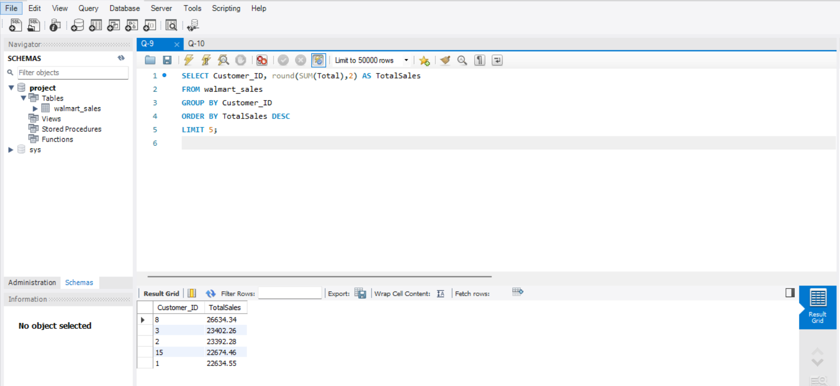

Slide 22
Task 10 - Analyzing Sales Trends by Day of the Week
Sql query
SELECT
DAYNAME(STR_TO_DATE(Date1, '%d-%m-%Y')) AS DayOfWeek,
round(SUM(Total),2) AS TotalSales
FROM walmart_sales
GROUP BY DayOfWeek
ORDER BY TotalSales DESC;

Slide 23
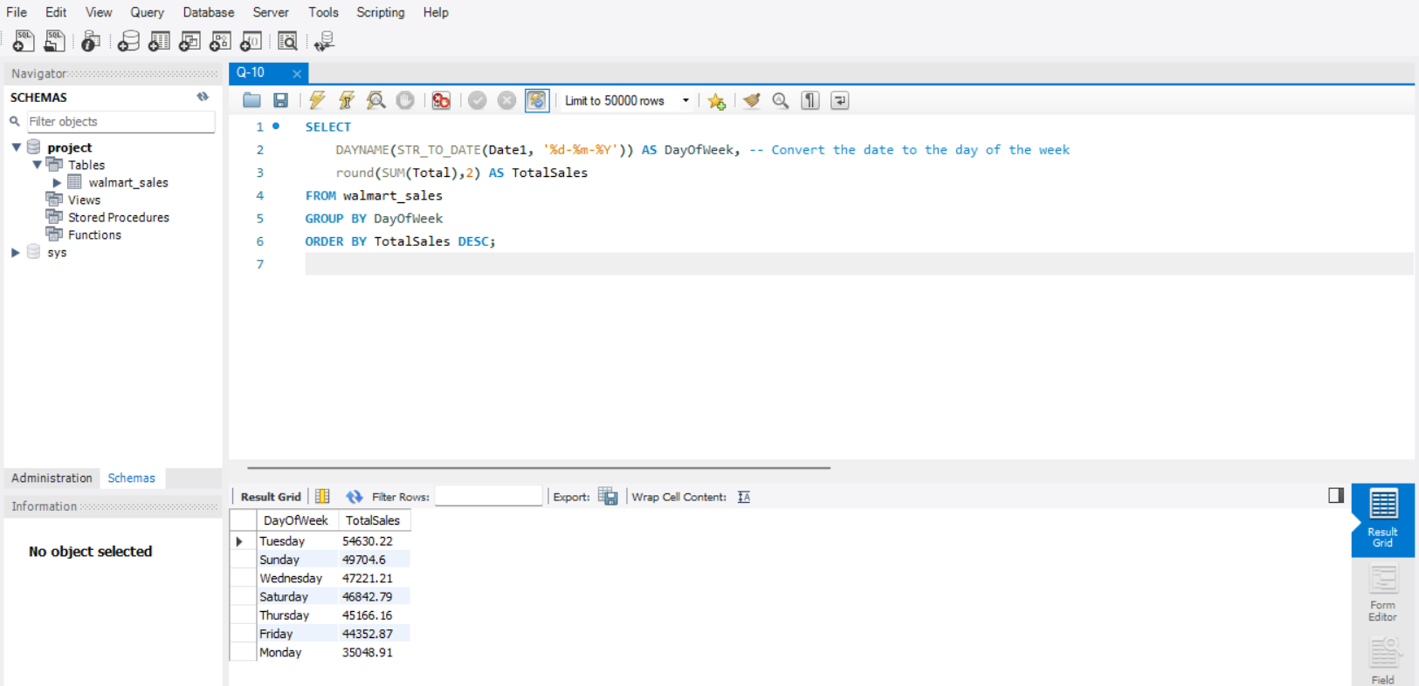

Slide 24
Thank You

