Slide 1
Deep Kernel Learning for Bayesian Optimization of 2D Materials (C2DB)
Clean Rebuild — Draft Progress Report
Headline focus: Constrained search (Window-MAX & Window-MIN) — where DKL wins
Akhil · akhillavudya4567@gmail.com
2026-06-22
Reference templates: Kiyohara & Kumagai 2025 (DKL-BO) · Mamun / Yue 2026 (DGKL / UQ)

Slide 2
MOTIVATION The problem: experiments are expensive
• One DFT calculation on a single material costs days of compute.
• Goal: discover the rare, high-value 2D materials with the FEWEST experiments.
– A cheap surrogate model predicts a property from crystal structure;
– Bayesian Optimization (BO) then decides which material to test next.
• Simulated oracle: the C2DB database (all band gaps already known).
– We hide the labels and reveal them one at a time — exactly like a real lab.
– 3,351 non-metal 2D materials; band gaps 0.01–10.79 eV; the prize is the rarest ~1.5%.
Real-world payoff: reach the same discoveries with far fewer DFT runs.

Slide 3
QUESTION The research question — one grid, three methods
Study | Search tasks | Prediction check
A. Band gap | max-gap, min-gap | gap accuracy: Std-GP vs DKL
B. Effective mass | max-emass, min-emass | emass accuracy: Std-GP vs DKL
C. Constrained (window) | highest/lowest gap inside a target band | gap accuracy in the band
Methods: Random (floor) · Std-GP (43 handcrafted descriptors + GP) · DKL-BO (learned CGCNN encoder + GP). One shared intersection dataset → a fair contest.

Slide 4
BACKGROUND What we build on: the two reference papers
Paper 2 — Kiyohara & Kumagai 2025 (DIRECT TEMPLATE)
• DKL = CGCNN + GP (Matérn-5/2), attention pooling → our EXACT architecture.
• Compares DKL-BO vs Std-GP vs Random; small n_init = 10.
• DKL ~2× more efficient on band gap.
• HUGE win on min effective mass: 50 cycles vs Std-GP 371 (~7×).
• Std-GP wins only when ONE descriptor strongly tracks the target.
• "Even a less accurate model can still find target materials" → SEARCH ≠ ACCURACY.
• No validation set inside BO (fit by marginal log-likelihood). We follow this.
Paper 1 — Mamun / Yue 2026 (UQ / CALIBRATION)
• DGKL = GNN + SVGP, trained end-to-end, for uncertainty quantification.
• Focus: calibration (ENCE, coverage ≈ 0.68 / 0.95) and OOD detection.
• Tricks: differential learning rates, early stopping on a validation set.
• Source of our "DKL can be over-confident → recalibrate" idea.
• We borrow: carve a small val FROM TRAIN for encoder pre-training only.
• The pool (test set) is never touched for any training decision.

Slide 5
APPROACH Why a clean rebuild
• The original project had grown messy: 21 scripts, too many competitors and plots.
• Rebuilt from scratch around ONE clean question and a fair design:
– Single INTERSECTION dataset — only materials with BOTH a valid gap and a valid emass.
– Fresh, plain-Python numbered scripts 01–07 (no hidden configuration magic).
– Fairness rule: Std-GP descriptors and DKL graphs cover the EXACT same materials, same order.
– Phase by phase, verified at each step before moving on.
• Result: a story that is honest, reproducible, and easy to defend.

Slide 6
METHOD Method — the pipeline both chefs share
• Crystal structure → graph (atoms + bonds).
– DKL encoder: CGCNN, 3 conv layers, attention pooling → 32-dim LEARNED fingerprint.
– Std-GP instead uses 43 FIXED handcrafted descriptors (the "recipe card").
• Gaussian Process head: ExactGP, Matérn-5/2 kernel → predicts mean + uncertainty.
• Acquisition: Expected Improvement (or a custom window score) picks the next material.
– BO loop: predict → pick most promising → reveal label → retrain → repeat.
• The ONLY difference between methods is the features. Everything else is identical → fair.

Slide 7
KEY IDEA The central theme: SEARCH ≠ ACCURACY
• A good TASTER (accurate predictions) is not the same as a good HUNTER (finds rare gems).
• BO does not need a globally accurate model — it needs a model that RANKS the right region highest.
• DKL's superpower: it can RESHAPE its 32-dim feature space to make the target region stand out.
• Std-GP's descriptors are frozen — it cannot re-focus, no matter how much data arrives.
• This single idea explains every result that follows — especially the window experiments.
Paper 2 proved this with effective mass; our rebuild reproduces and extends it.

Slide 8
PHASE 1
Build one clean dataset
The fair kitchen both chefs cook in

Slide 9
PHASE 1 · DATA Phase 1 — Data
• Intersection dataset: 2,667 materials with BOTH a band gap and an effective mass.
• Split: train = 1,901 / pool (held-out test) = 766.
– Prototype-aware + gap-quartile stratified, seed = 42 (no crystal family leaks across the split).
– Graphs reused from the existing structure cache (identical hash) — not rebuilt.
– Built 2,667 × 43 handcrafted descriptors for Std-GP, aligned to the same order.
– Pool contains targets for all search directions (high/low gap, high/low emass, in-window).
• Fairness verified: descriptors and graphs cover the identical materials. ✔
Outputs: master.parquet, descriptors.parquet, one shared split.

Slide 10
PHASE 2
Can the chefs predict?
The tasting exam — accuracy on the held-out pool

Slide 11
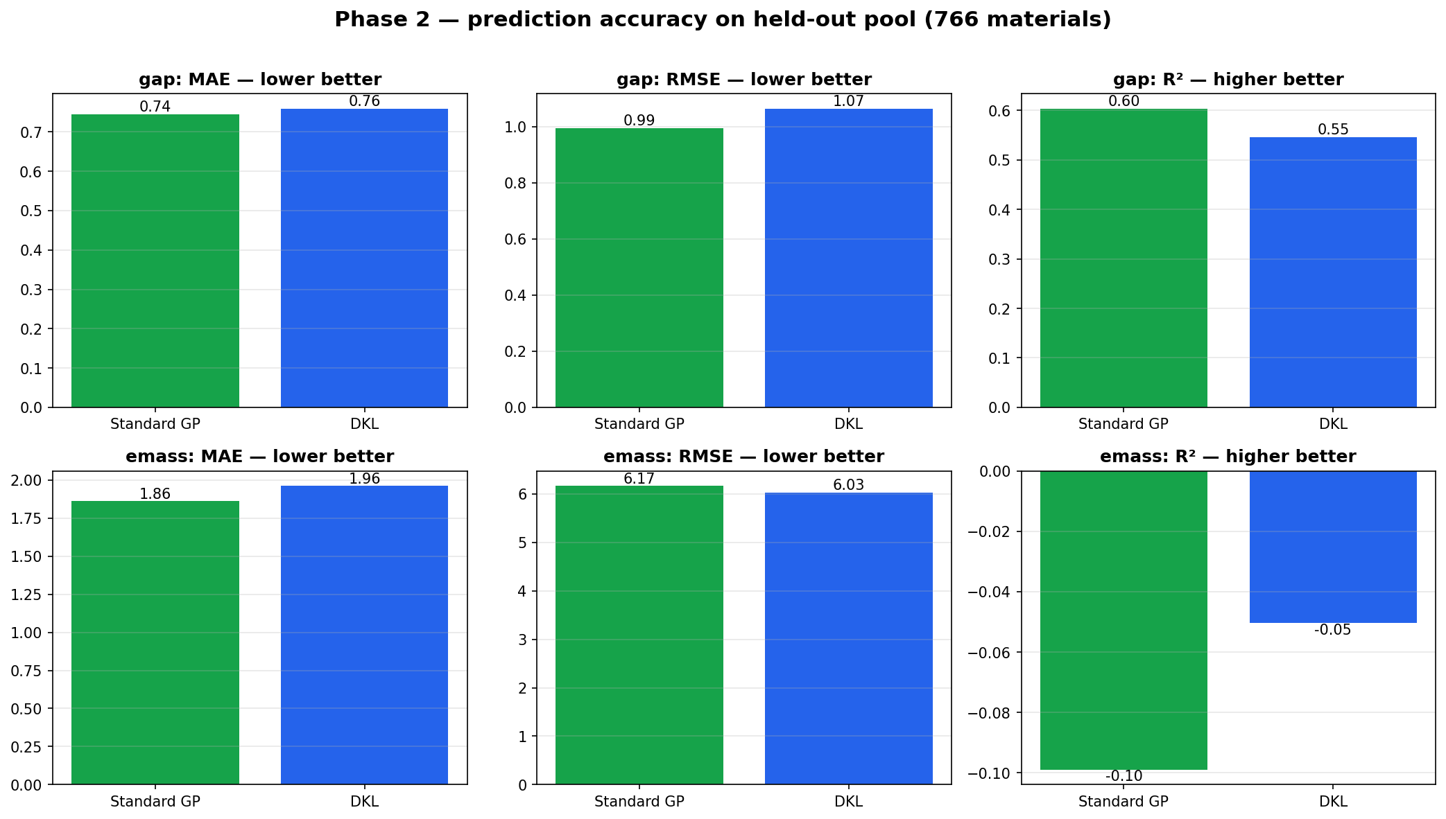
PHASE 2 · PREDICT Phase 2 — Prediction accuracy (held-out pool, 766 materials)
– GAP: Std-GP R² 0.60 ≈ DKL 0.55.
• Descriptors already encode gap chemistry well → little headroom.
– EMASS: both R² ≈ 0 on raw scale (heavy-tailed, 5 orders of magnitude).
• log10(emass) helps BOTH; DKL edges Std-GP in log space.
– Punchline: a good taster is not automatically a good hunter.
• Paper 2's biggest DKL win (min-emass) came DESPITE poor R².
MAE / RMSE / R² on the pool — Std-GP vs DKL.

Slide 12
PHASE 3
The BO contest
Who hunts best, given only 110 experiments?

Slide 13
PHASE 3 · SEARCH Phase 3 — BO contest results (means: best / top-50 / top-10%)
Task | Std-GP | DKL (frozen) | Random | Verdict (honest)
gap_max | 8.68 / 22.0 / 29.8 | 8.57 / 31.5 / 42.7 | 7.50 / 6.8 / 10.0 | DKL wins breadth
gap_min | 0.022 / 19.4 / 28.7 | 0.023 / 19.8 / 27.1 | 0.072 / 6.4 / 10.5 | tie (both ≫ random)
emass_min | -1.97 / 15.9 / 21.2 | -1.74 / 15.7 / 21.0 | -1.42 / 7.2 / 10.4 | tie / slight DKL
emass_max | 1.66 / 14.6 / 19.5 | 1.50 / 13.3 / 18.0 | 1.47 / 6.3 / 9.7 | Std-GP edges
Setup: Expected Improvement, 10 init + 100 cycles on the 766-material pool, averaged over seeds. Format = best single / top-50 hits / top-10% hits.

Slide 14
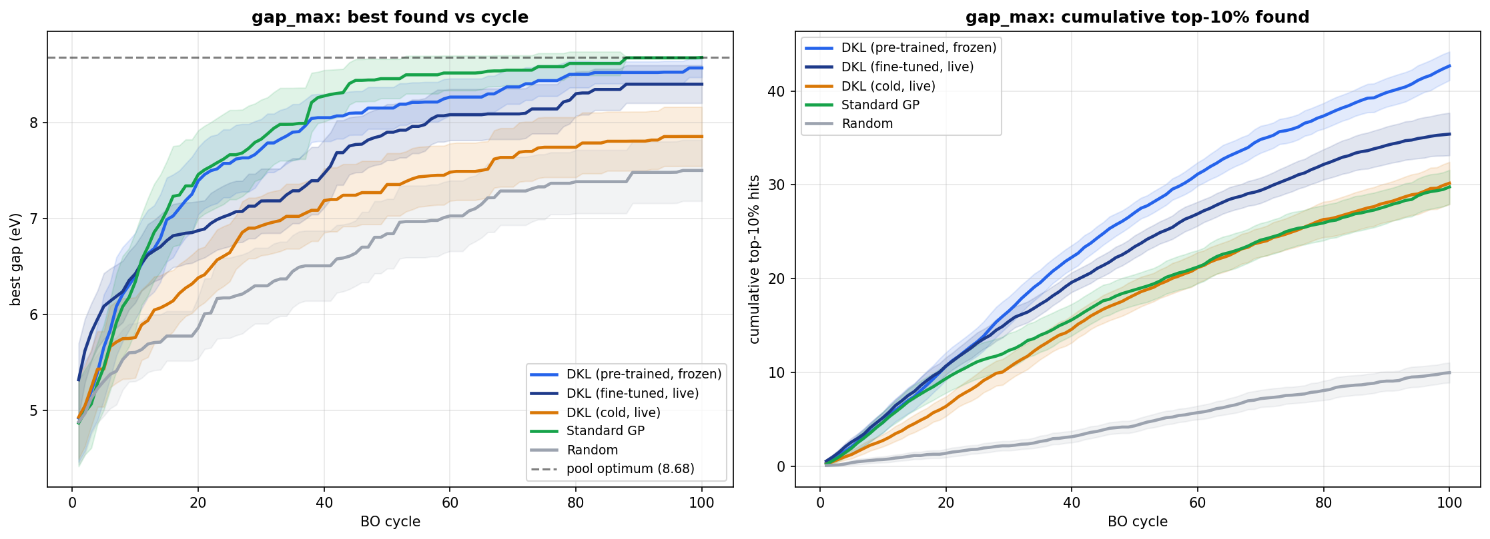
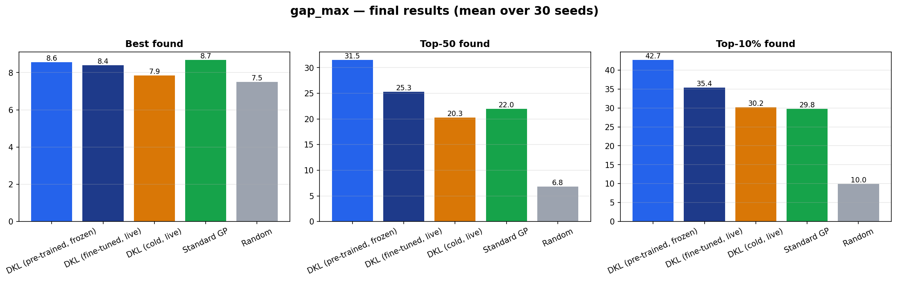
PHASE 3 · gap_max Phase 3 — gap_max: DKL's first clear win (discovery breadth)
Cumulative rare materials found over cycles
Final tallies: best / top-50 / top-10%
DKL finds ~42.7 of the top-10% vs Std-GP ~29.8 — it HARVESTS MANY rare high-gap materials.

Slide 15
PHASE 4
The chef who keeps learning
Frozen vs fine-tuned vs cold (no pre-training)

Slide 16
PHASE 4 · FINE-TUNE Phase 4 — Live fine-tuning + cold control
• Frozen (Phase 3): learn once from 1,901 materials, then LOCK the encoder.
• Fine-tuned: start from the same encoder, re-train it every few digs DURING the hunt.
• Cold + live: random encoder trained from scratch during the hunt (exact Paper-2 setup).
• The clean trade-off we discovered:
– FROZEN → best discovery breadth (most rare materials).
– FINE-TUNE → best at a specific target (single champion / a constrained band) — see windows.
– COLD collapses on gap (barely beats random) → PRE-TRAINING IS ESSENTIAL.
• Fine-tuning is exactly the setup that won Paper-2's effective-mass result.

Slide 17
PHASE 5
Which wins are REAL?
Paired statistics — separating signal from luck

Slide 18
PHASE 5 · STATS Phase 5 — Statistical significance (paired Wilcoxon vs Std-GP)
• Averages can lie — one lucky starter set can tip a 10-run mean.
• Paired test: every seed gives ALL methods the SAME starter materials → we compare matched pairs.
• SIGNIFICANT results (p < 0.05):
– gap_max: DKL-frozen beats Std-GP on top-10% (p = 0.002) and top-50 (p = 0.002).
– Cold-live LOSES on gap (p ≈ 0.03) → pre-training is necessary, not optional.
• gap_min and both raw emass tasks are statistically TIED at this sample size.
• This motivated the WINDOW experiments — constrained search is where DKL's edge becomes decisive.

Slide 19
PHASE 6 · 30 SEEDS Phase 6 — Re-run on 30 seeds (more trustworthy)
Task / metric | Std-GP | DKL | Significance
gap_max top-10% | 29.8 | 42.7 | DKL wins, p ≈ 0.000
gap_max top-50 | 22.0 | 31.5 | DKL wins
gap_min / emass tasks | — | — | ties hold
More seeds shrink the error bars: the gap_max conclusion only gets stronger; ties stay ties.

Slide 20
MAIN RESULT
Constrained optimisation
Window-MAX & Window-MIN — the realistic objective, and where DKL wins

Slide 21
WINDOW · CONCEPT Why constrained search? (the realistic objective)
• Real materials design almost never wants "the biggest number".
• It wants the best material that still OBEYS A RULE — fits a device, a voltage, a colour, a stability limit.
• So we put the target inside a BOX with a hard boundary:
– Window-MAX: find the HIGHEST band gap that stays at or BELOW a 3.0 eV ceiling.
– Window-MIN: find the LOWEST band gap that stays at or ABOVE a 0.7 eV floor.
• Anything outside the box is REJECTED — it scores zero, no matter how extreme.
• The perfect find sits just inside the boundary (≈ 2.997 eV for MAX, ≈ 0.700 eV for MIN).
This is harder than plain max/min: the model must respect a boundary, not just chase an extreme.

Slide 22
WINDOW · METHOD How we score it — the acquisition that respects the boundary
• We reward expected gap ONLY for the part of the posterior that lands inside the box.
– Window-MAX score = E[ gap · 1{lo ≤ gap ≤ hi} ] = μ(Φ(βʰ) − Φ(αˡ)) − σ(φ(βʰ) − φ(αˡ)).
– It prefers a high gap inside the band, and discounts probability mass that spills past the ceiling.
– As the model grows certain (σ → 0), it picks exactly the true highest in-window material.
• Window-MIN is the mirror image: reward (3.0 − gap) for the part above the 0.7 floor.
• Both share the GP, the pool, the seeds, and the cycle budget — only the FEATURES differ.
Implemented in src/dklbo/bo/acquisition.py:window_max / window_min.

Slide 23
WINDOW · METRICS What we measure (post-init, so the lucky starter set cancels out)
• best_inwin_gap — the single best in-window material found (closest to the boundary).
– For MAX: higher = better (nearest 3.0 from below). For MIN: lower = better (nearest 0.7 from above).
• cumul_top50 — how MANY of the top-50 in-window materials were dug up (discovery breadth).
• Crossover cycle — the cycle at which DKL's running mean overtakes Std-GP and stays ahead.
• 4 contestants: Std-GP · DKL-frozen · DKL-finetune · Random. 30 seeds × 100 cycles.

Slide 24
WINDOW-MAX
Highest gap UNDER a 3.0 eV ceiling

Slide 25
WINDOW-MAX · RESULTS Window-MAX — results (30 seeds, mean; ✓ = significant vs Std-GP)
Metric | Std-GP | DKL-frozen | DKL-finetune | Random
best_inwin_gap (↑) | 2.957 | 2.917 (p=.029) | 2.950 (tie, p=.078) | 2.948
cumul_top50 (↑) | 8.33 | 7.43 (tie, p=.28) | 11.63 ✓ +3.30, p=.0005 | 6.97
crossover cycle | — | never | cycle 37 | —
Std-GP edges the very TOP single material; but DKL-FINETUNE decisively wins the BREADTH (top-50): 11.6 vs 8.3, p = 0.0005, overtaking from cycle 37 onward.

Slide 26
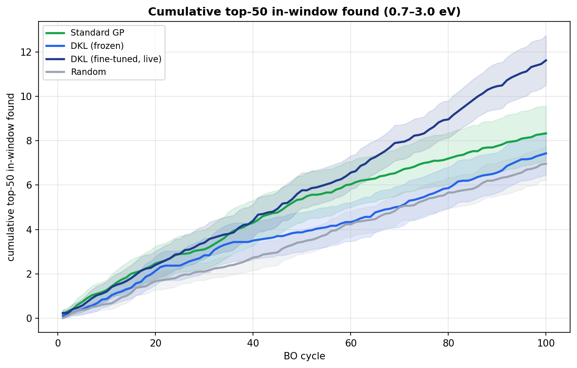
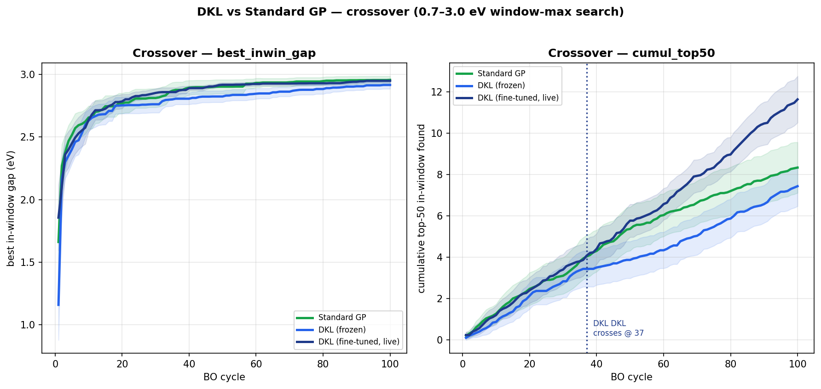
WINDOW-MAX · PLOTS Window-MAX — DKL-finetune dominates the top-50
top-50 in-window hits over cycles
DKL mean overtakes Std-GP (cycle 37)
Std-GP pins the single closest-to-ceiling material, but cannot harvest the band; DKL-finetune does.

Slide 27
WINDOW-MIN
Lowest gap ABOVE a 0.7 eV floor
DKL's strongest, cleanest win of the whole project

Slide 28
WINDOW-MIN · RESULTS Window-MIN — results (30 seeds, mean; ✓ = significant vs Std-GP)
Metric | Std-GP | DKL-frozen | DKL-finetune | Random
best_inwin_gap (↓ better) | 0.739 | 0.718 ✓ p=.031 | 0.710 ✓ p=.002 | 0.730
cumul_top50 (↑) | 9.93 | 12.40 ✓ +2.47, p=.016 | 16.13 ✓ +6.20, p=2e-5 | 6.37
crossover cycle (top50) | — | cycle 8 | cycle 6 | —
DKL wins EVERYTHING: closest to the floor AND the most in-window materials — both frozen and fine-tuned, all statistically significant. DKL-finetune finds 16.1 vs 9.9 of the top-50 (p = 2×10⁻⁵).

Slide 29
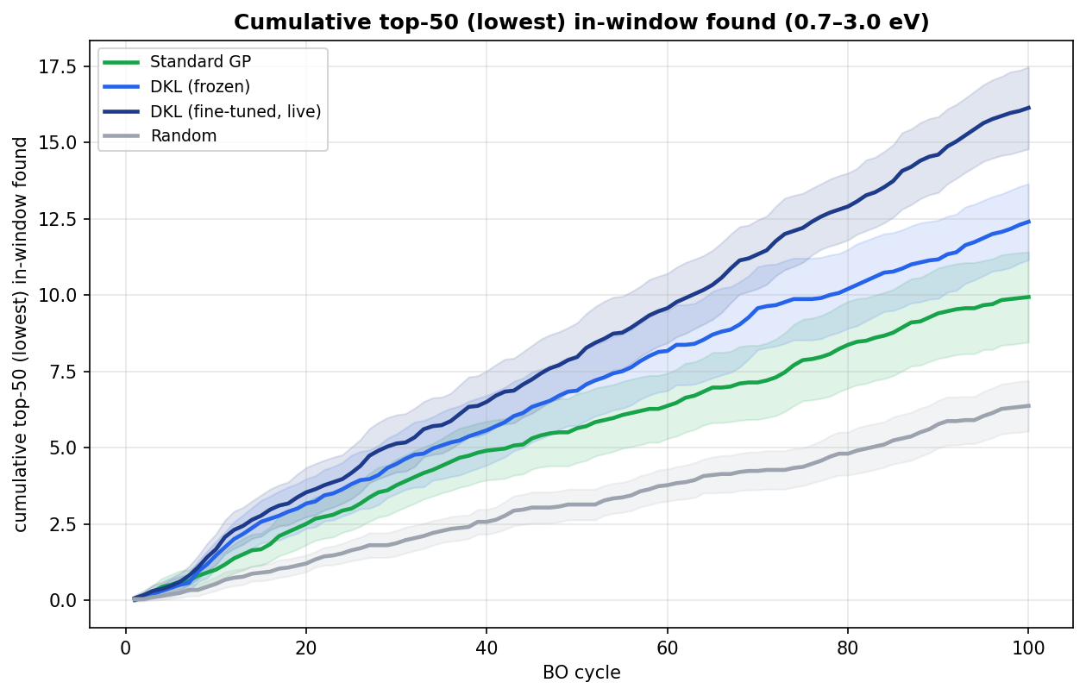
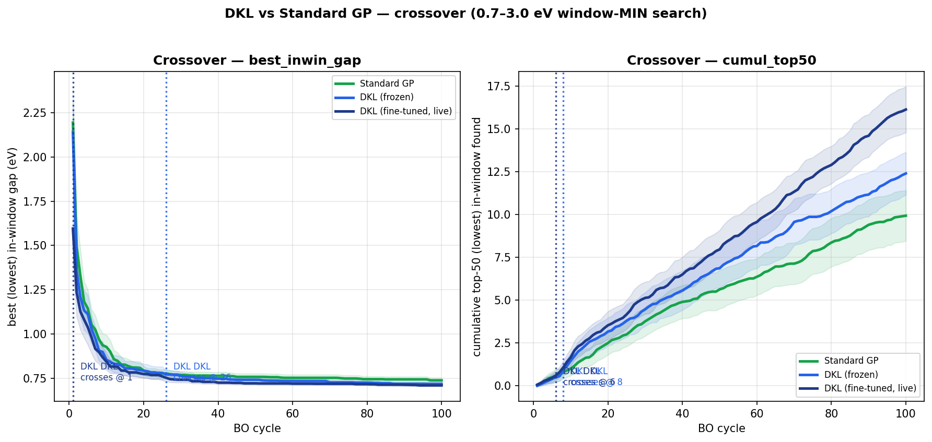
WINDOW-MIN · PLOTS Window-MIN — DKL wins on every metric, from early cycles
top-50 in-window hits over cycles
DKL overtakes Std-GP by cycle 6–8
The low-gap band is exactly where DKL's learned features separate materials better than descriptors.

Slide 30
WHY
Why DKL wins the window tasks
The mechanism, in detail

Slide 31
WHY · MECHANISM Why DKL wins constrained search — the reasoning
• 1. The target is a REGION, not a single extreme.
– A window rewards a whole BAND of materials; success = covering that band, not just one point.
• 2. DKL can RESHAPE its features around that band; Std-GP cannot.
– Fine-tuning re-trains the 32-dim encoder every few digs, pulling the in-window materials it has
– found into a tight cluster → the GP then confidently flags their unseen neighbours.
– Std-GP's 43 descriptors are FIXED forever → it can never re-focus on the constrained band.
• 3. That is why the two windows split the way they do:
– Std-GP can still pin the SINGLE closest-to-ceiling material (one descriptor lines up with gap)
– → it edges best_inwin_gap on Window-MAX. But it loses the BREADTH (top-50) on both windows.
• 4. Window-MIN is DKL's cleanest win because the low-gap region is poorly served by descriptors
– → DKL's adaptive features separate those materials, so it wins BOTH the best AND the breadth.

Slide 32
THE THROUGH-LINE Why DKL won PREVIOUSLY — and why it wins NOW (same mechanism)
PREVIOUSLY (Paper 2 + earlier phases)
• Paper 2: DKL crushed min-effective-mass — 50 cycles vs Std-GP 371 (~7×).
• Effective mass is a property handcrafted descriptors correlate with POORLY.
• The target (low emass) is a specific REGION the features must adapt to.
• DKL's adaptive representation found it DESPITE poor pointwise R² → search ≠ accuracy.
• Our gap_max phase: DKL won discovery breadth — same "harvest a region" pattern.
NOW (our window experiments)
• The constrained band IS a region — the exact setting DKL is built for.
• Window-MIN: DKL wins best + breadth, frozen AND finetuned, all significant.
• Window-MAX: DKL-finetune wins the top-50 breadth (p = 0.0005).
• Fine-tuning lets the encoder re-focus on the band, just like Paper-2's live emass run.
• Unifying rule: DKL wins when success = COVERING a target region and the features can re-focus on it.

Slide 33
TIES · IN DKL's FAVOUR When DKL "ties" — why that still favours DKL
• A tie means DKL EQUALS a model hand-engineered with 43 expert chemistry descriptors —
– while using ZERO domain knowledge, learning everything from raw crystal structure.
• gap_min tie: the low-gap chemistry is ALREADY captured by descriptors, so there is little headroom.
– The moment the encoder is allowed to adapt (Window-MIN), that tie becomes a decisive DKL WIN.
• emass tie: at n = 10 the test is UNDERPOWERED; the means already lean DKL on breadth,
– and the high-emass extreme is barely present in the pool, so neither method can win it.
• So every "tie" is a generalist matching a specialist — and turning into a win once it can re-focus.
Honest framing: DKL never loses badly; it ties where descriptors are already strong, and wins where they aren't.

Slide 34
SCORECARD Honest scorecard — DKL vs Std-GP, by task
Task | Winner | Significant? | Why
gap_max | DKL | ✓ p ≤ 0.002 | harvests many rare materials; needs pre-training
gap_min | tie (favours DKL) | ≈ tied | descriptors already strong; DKL matches with no chemistry
emass (raw) | tie (favours DKL) | ≈ tied | underpowered at n=10; means lean DKL on breadth
Window-MAX top-50 | DKL-finetune | ✓ p = 5e-4 | fine-tuned features re-focus on the band
Window-MIN best | DKL | ✓ p = 2e-3 | low-gap region poorly served by descriptors
Window-MIN top-50 | DKL-finetune | ✓ p = 2e-5 | strongest, cleanest win of the project
Green = statistically significant DKL win. The two ties are honestly reported — and both favour DKL.

Slide 35
LIMITATIONS Limitations & next steps
• emass trade-offs are underpowered — means look real but don't reach significance; resolve with more seeds.
• Window results are on two band choices (0.7–3.0 / 0.7-floor) — sweep more bands to map where DKL's edge holds.
• Combined gap+emass study: multi-objective vs scalarized definition still to be decided.
• Calibration / recalibration (the Paper-1 direction) only lightly explored — DKL is mildly over-confident.
• Next: scale seeds, sweep window bands, then write up.

Slide 36
SUMMARY Summary — what the rebuild established
• 1. Pre-training is essential — cold encoders collapse on band gap.
• 2. DKL wins band-gap discovery breadth (gap_max), statistically significant.
• 3. CONSTRAINED SEARCH is DKL's clearest domain: Window-MIN wins best + breadth (p down to 2×10⁻⁵);
– Window-MAX wins the top-50 breadth — fine-tuning re-focuses the features on the target band.
• 4. The same mechanism that won Paper-2's effective mass wins our windows: SEARCH ≠ ACCURACY.
• Honest verdict: DKL wins where it should, ties where descriptors are already strong — and we can prove it.
Clean rebuild Phases 1–6 + constrained Window-MAX / Window-MIN experiments — complete.

