Slide 1

TAXI FARE PREDICTION
Vennela Vadde
Venkat Akhil Mothe
Hansika Karnati

Slide 2
Introduction:
A fare is the money you pay when you use public transportation like trains, buses, or taxis.
The fare you pay is figured out using a fare system that calculates how much each passenger should pay at a specific time.
The final fare you pay depends on things like how far you traveled, the day of the week, the time of day, how long your trip was, and other factors.

Slide 3
Project Objective:
Objective: The main goal of this project is to develop a predictive model using linear regression for forecasting taxi fares in upcoming rides. By utilizing historical taxi ride data, our primary emphasis is on training and validating the predictive model to improve accuracy and reliability.
Data Utilization: We will harness historical taxi ride data to train and validate our predictive model.

Slide 4
Data Sources and Collection:
Our dataset comprises detailed taxi trip records, utilizing historical data from 2023 with a size of 2.5 GB. Key columns include:
Pick-Up and Drop-Off Locations
Trip Distance
Passenger Count
Payment Type
You can find the dataset here: https://www.nyc.gov/site/tlc/about/tlc-trip-record-data.page

Slide 5
Tools and Technologies:
Azure Data Lake Storage: Scalable, secure storage with seamless Azure integration and efficient data organization.
Databricks: Unified Analytics Platform for collaborative computing, integrating with Apache Spark for distributed tasks.
PySpark: Python API for Apache Spark, providing high-level abstractions for efficient, scalable data processing.
SparkML: Integrated machine learning in Spark, offering distributed, scalable predictions with seamless PySpark integration.

Slide 6
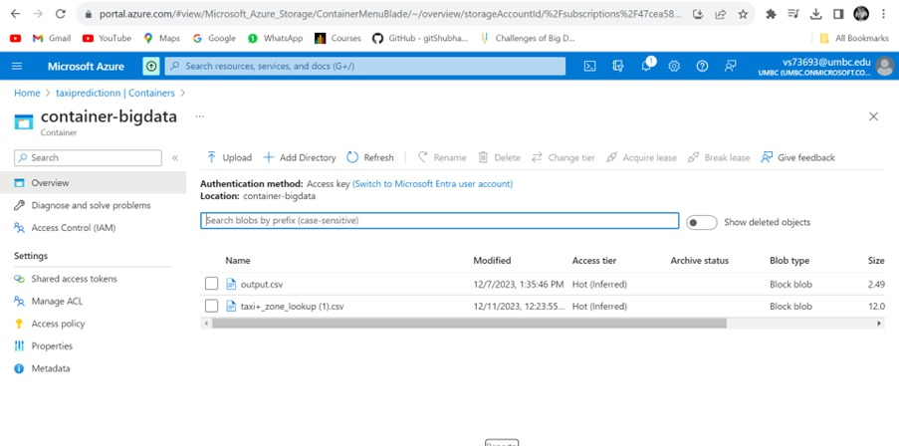
Data Storage in Azure Data Lake:

Slide 7




Data source(nyc.gov/site/tlc)
Data Ingestion
Data Query Layer
Analytics Engine
Data Processing Layer
Batch Processing
Data Storage Layer
Azure Data Lake Storage

Slide 8
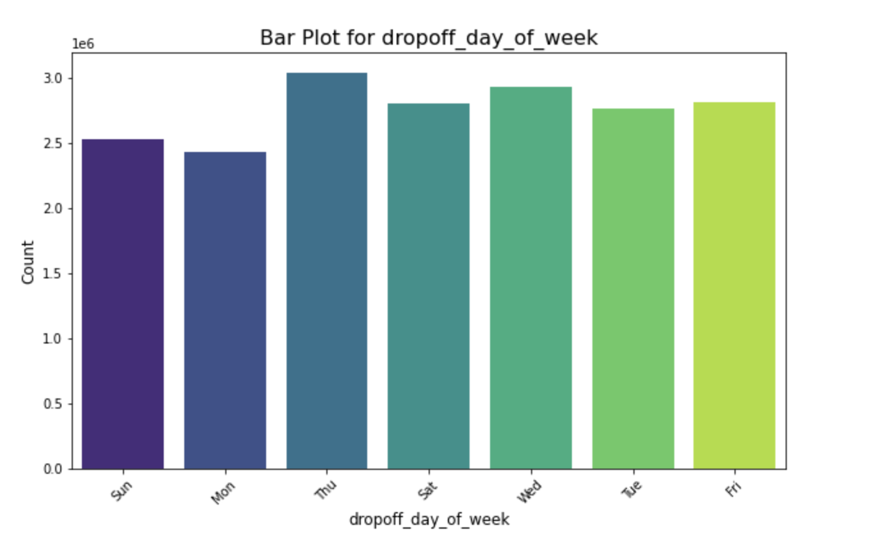
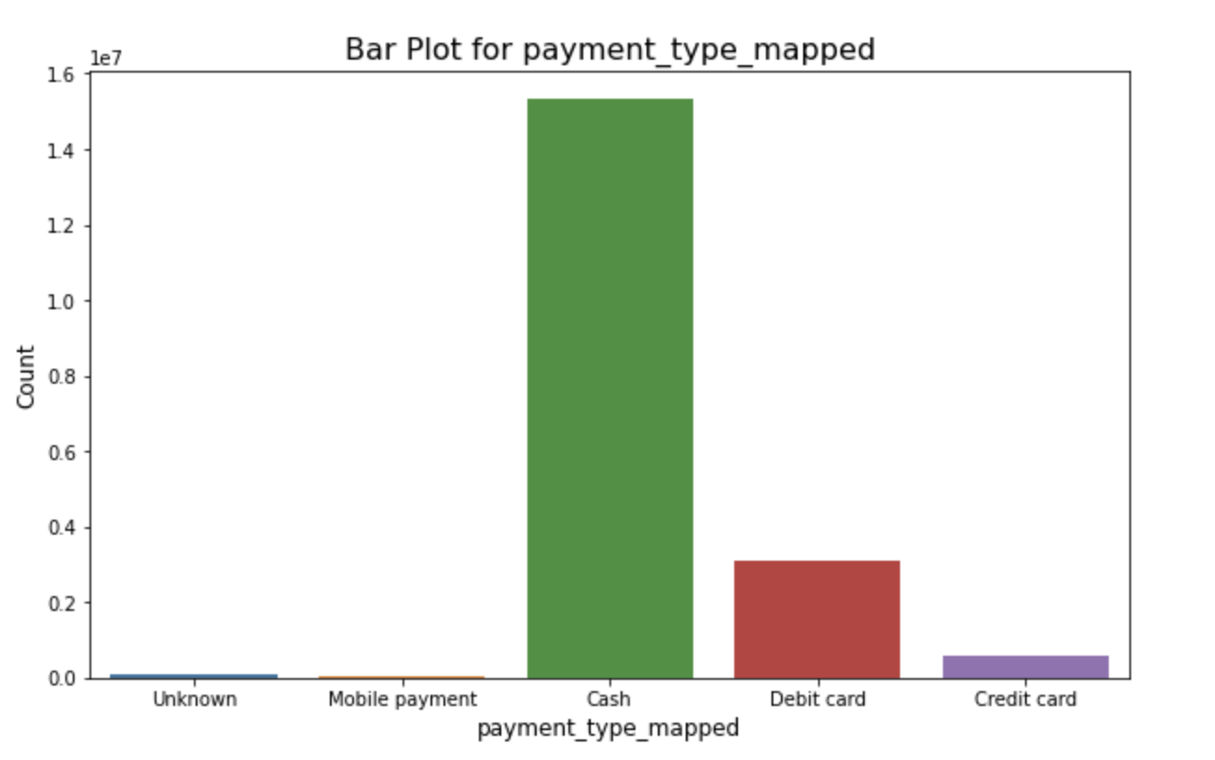
Reports:

Slide 9
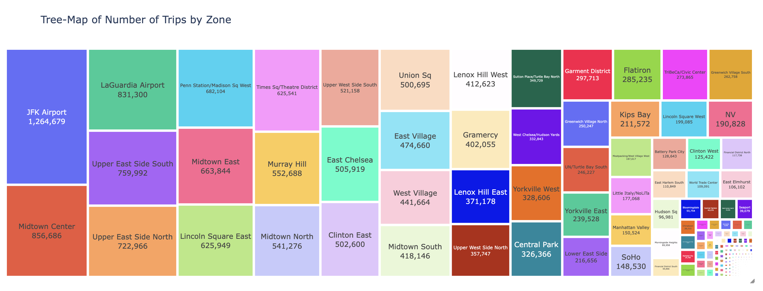
Reports:

Slide 10
Insights:
Report | Insights | Suggestions for C-level Executives
High Concentration of Shorter Distance Trips | Concentration of shorter distance trips is significant, influencing overall revenue. | Explore dynamic pricing models for short-distance trips to optimize revenue- consider loyalty programs or promotions for frequent short distance riders.
High Pickups at Specific Locations | Certain locations experience consistently high pickups, indicating popularity or demand clusters. | Investigate reasons behind the popularity of specific locations. Consider partnerships or events to further boost demand in these areas.
Elevated Pickups on Thursdays at 12 PM | Pickup demand notably increases on Thursdays at 12 PM, suggesting a peak period. | Implement targeted promotions or discounts during this time to capitalize on increased demand. Ensure ample driver availability during peak periods.

Slide 11
Insights Contd:
Report | Insights | Suggestions for C-level Executives
Gradual Fare Increase with Passengers | Fare amounts gradually increase with the number of passengers, specifically from 6-7 passengers | Analyze the impact of fare increases on rider behavior and demand. Introduce promotions for larger groups or explore subscription-based models for frequent group travelers.
High Number of Cash Payments | A substantial portion of payments is made in cash, indicating a reliance on traditional payment methods. | Evaluate the feasibility of promoting cashless transactions to streamline operations. Incentivize cashless payments for both passengers and drivers.

Slide 12
References:
Anwaar, S. (2021, August 18). Taxi-demand-fare-prediction-dataset. Kaggle. https://www.kaggle.com/datasets/sohaibanwaar1203/taxidemandfarepredictiondataset/data
TLC Trip Record Data. TLC Trip Record Data - TLC. (n.d.). https://www.nyc.gov/site/tlc/about/tlc-trip-record-data.page
Taxi trips in 2022. Open Data DC. (n.d.). https://opendata.dc.gov/documents/2b61c28adfbd431587ec728829cceb6e/explore

