Slide 1
FoodLinked Partners
Apply here
Sign In
Partners for Success
LOGO
LOGO
LOGO
LOGO
LOGO
LOGO
Community Management
Share updates with a community of current students, alumni, association members and/or employees who are related to you.
Data Analytics
Get deeper insights into what your students are studying, explore the career paths of your graduates, get advised on members and employees engagement.
Revenue Sharing
Get a direct revenue share from what your related users spend and what advertisers pay.
Hiring & Employment
FREE Solutions
Allow your community members to benefit from accessing Job posts in private that no one else can access or view.
Branding & Culture Awareness Creation
Allow your community members to review and rate you and see your ranking within annual published ranks to attract more students, members, and/or employees.
Choose the type of partnership you belong to
LOGO
Schools
LOGO
Corporates
Hotels
LOGO
Associations
LOGO
Influencers
Apply
Apply
Apply
Apply

Slide 2
FoodLinked Partners
Sign In
Apply to become a FoodLinked Partner
What kind of partner you are? -- Select One --
Selection List:
School
Hotel / Corporate
Association
Influencer
Next
Once option is selected and a user press Next
Then related application will open

Slide 3
School Partner Application
ADDRESS
School Name
Street Address
City
Region / State
Postal code/Zip
Country
DATA
School Website
School Video (hyperlink)
School Overview
Number of students (More than)
Logo Upload
Profile Upload
CONTACT PERSON
Salutation
First Name
Last Name
Role
Email
Phone
Fax
Best time to contact
Notes or comments
Submit
Applications should go to the FoodLinked Admin to review and Accept / Reject
If Accepted then an approval email will go with a username and password sharing process
If Rejected then an apology email will be sent back

Slide 4
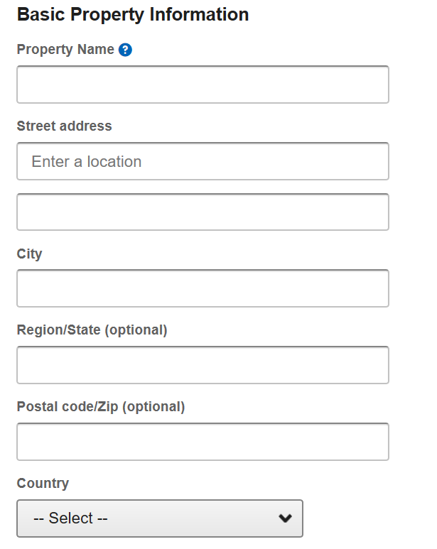
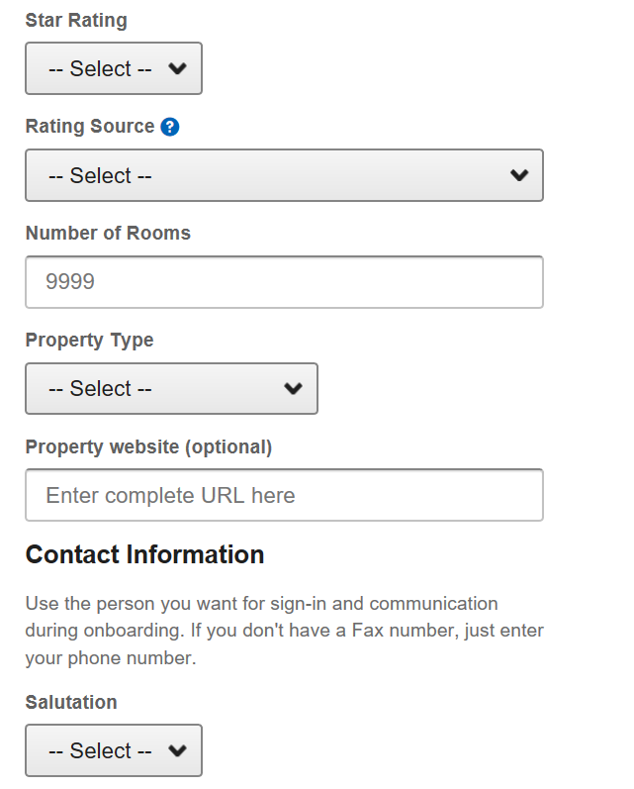
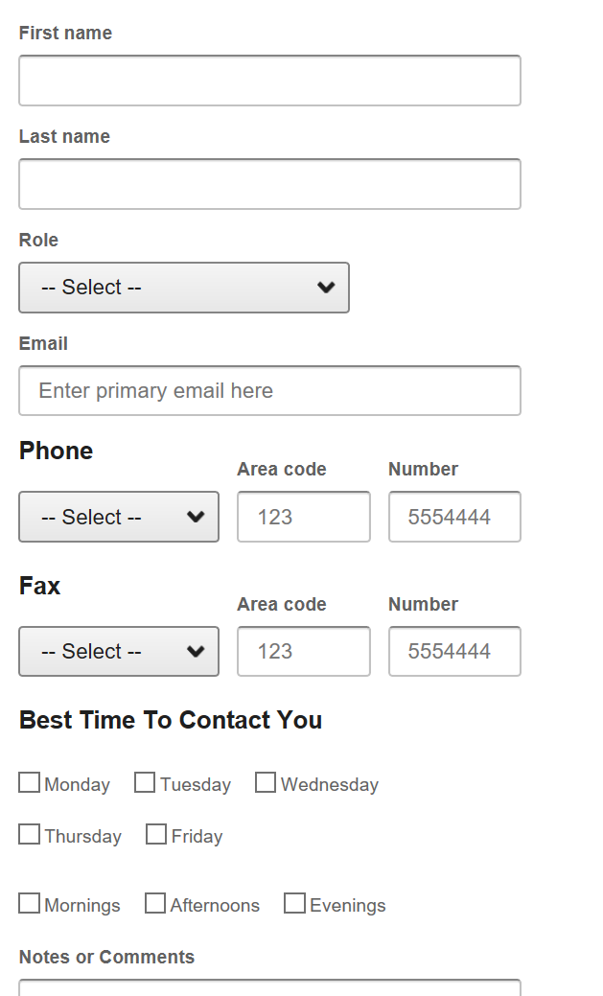
HOTEL Partner Application
Submit
Applications should go to the FoodLinked Admin to review and Accept / Reject
If Accepted then an approval email will go with a username and password sharing process
If Rejected then an apology email will be sent back

Slide 5
Association Partner Application
ADDRESS
Association Name
Street Address
City
Region / State
Postal code/Zip
Country
DATA
Association Website
Association Video (hyperlink)
Association Overview
Number of members (More than)
Logo Upload
Profile Upload
CONTACT PERSON
Salutation
First Name
Last Name
Role
Email
Phone
Fax
Best time to contact
Notes or comments
Submit
Applications should go to the FoodLinked Admin to review and Accept / Reject
If Accepted then an approval email will go with a username and password sharing process
If Rejected then an apology email will be sent back

Slide 6
Influencer Partner Application
Step 1 / 6
Personal Info
Date of Birth
Gender
Marital Status
Nationality
Current Address
Website / Link
About Yourself
Upload Resume (only to recruiters Yes / NO)
Upload Photo
Experience
Education
Skills
Certification
Influential Impact
0 %
Profile Strength
Next

Slide 7
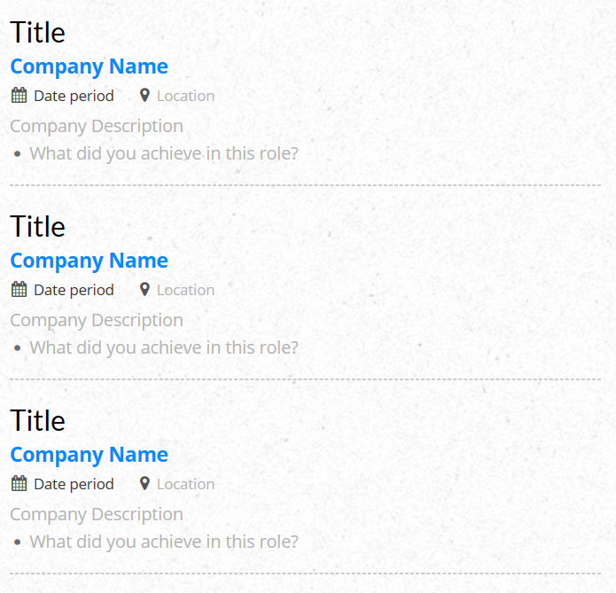
Influencer Application
Step 2 / 6
Personal Info
Experience
Education
Skills
Certification
Influential Impact
Add
Delete
Next

Slide 8
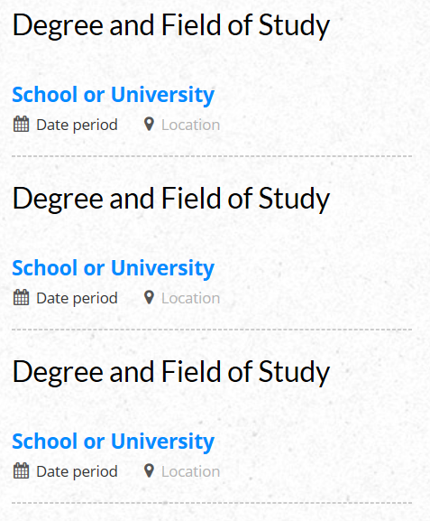
Influencer Application
Step 3 / 6
Personal Info
Experience
Education
Skills
Certification
Influential Impact
Add
Delete
Next

Slide 9
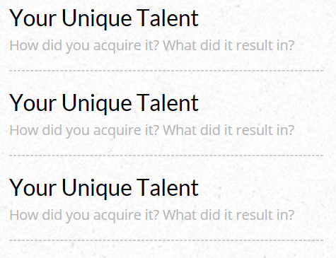
Influencer Application
Step 4 / 6
Personal Info
Experience
Education
Skills
Certification
Influential Impact
Add
Delete
Next

Slide 10
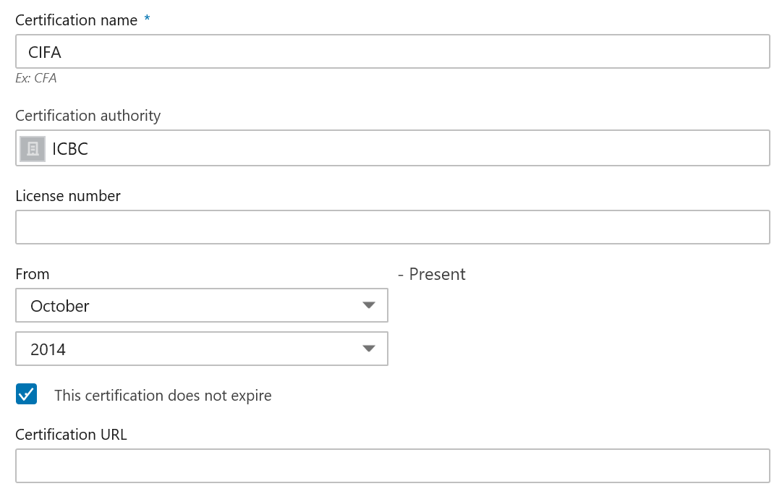
Influencer Application
Step 5 / 6
Personal Info
Experience
Education
Skills
Certification
Influential Impact
Add
Delete
Next

Slide 11
Influencer Application
Step 6 / 6
Why You fit as an influencer
Why you want to be a FoodLinked influencer
Current number of followers of Facebook
Current number of followers of Instagram
Current number of followers of Linkedin
Current number of followers of YouTube
Current number of followers of Twitter
Personal Info
Experience
Education
Skills
Certification
Influential Impact
APPLY
Applications should go to the FoodLinked Admin to review and Accept / Reject
If Accepted then an approval email will go with a username and password sharing process
If Rejected then an apology email will be sent back

Slide 12
FoodLinked Partners
Apply here
Sign in to the FoodLinked Partner Admin Panel
Sign in as? -- Select One --
Selection List:
School
Hotel / Corporate
Association
Influencer log in … should be from standard portal but with super Features of his posts being shared with ALL foodlinked users
Username -- Select One --
Password -- Select One --
Forgot your Password?
Sign In

Slide 13
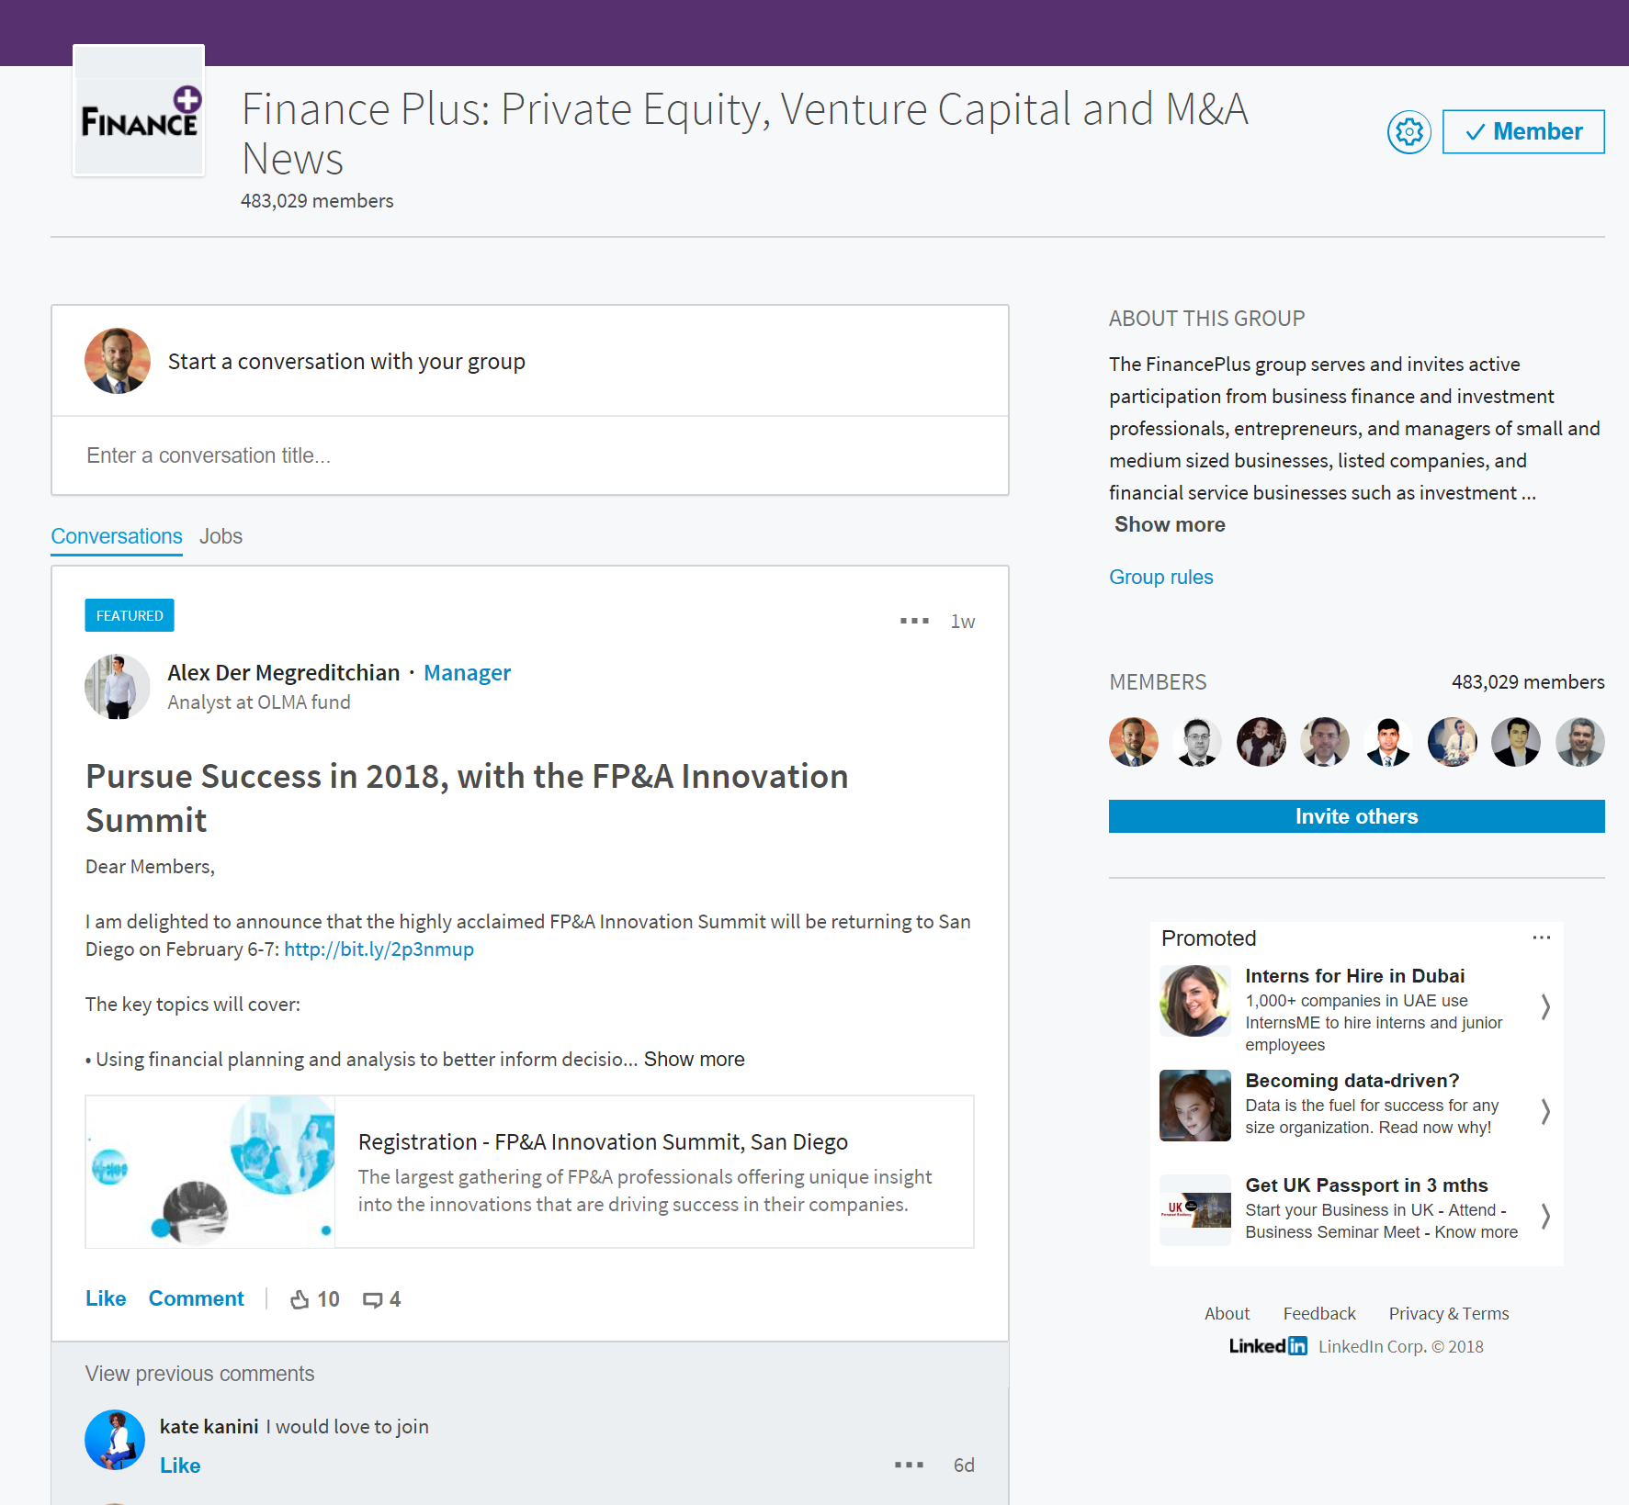
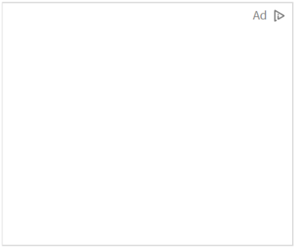
FoodLinked School Partner
Sections / Tabs
Logo
Name
Settings
Admin Menu
About School
Post to conversations
Group conversation dialogue
Internships Tab
ODC (One Day Catering) Tab
Jobs Tab
School Reviews
Members List Link
Invite Others
Members Availability Schedule
Received Offers
Admin
Manage School Profile
Revenue Account
Data Analytics
Change Password
Logout
Internships
ODCs
Jobs
School Reviews
Members Availability Schedule
Received Offers

Slide 14
FoodLinked School Partner
Sections / Tabs
Logo
Name
Settings
Admin Menu
About School
Post to conversations
Group conversation dialogue
Internships Tab
ODC (One Day Catering) Tab
Jobs Tab
School Reviews
Members List Link
Invite Others
Members Availability Schedule
Received Offers
Admin
Manage School Profile
Revenue Account
Data Analytics
Change Password
Logout
Internships
ODCs
Jobs
School Reviews
Members Availability Schedule
Received Offers

Slide 15
FoodLinked School Partner
Sections / Tabs
Logo
Name
Settings
Admin Menu
About School
Post to conversations
Group conversation dialogue
Internships Tab
ODC (One Day Catering) Tab
Jobs Tab
School Reviews
Members List Link
Invite Others
Members Availability Schedule
Received Offers
Admin
Manage School Profile
Revenue Account
Data Analytics
Change Password
Logout
Internships
ODCs
Jobs
School Reviews
Admin Related
all other options
and tabs are same
for all community
members
Members Availability Schedule
Received Offers

Slide 16
FoodLinked School Partner
Sections / Tabs
Logo
Name
Settings
Admin Menu
About School
Post to conversations
Group conversation dialogue
Internships Tab
ODC (One Day Catering) Tab
Jobs Tab
School Reviews
Members List Link
Invite Others
Members Availability Schedule
Received Offers
Admin
Manage School Profile
Revenue Account
Data Analytics
Change Password
Logout
Internships
ODCs
Jobs
School Reviews
The School Admin will be allowed to manage “Members Availability Schedule” and “Manage Received offers”
Once clicked the Members Availability Schedule will open in New Tab (see next slide)
Members Availability Schedule
Received Offers

Slide 17
FoodLinked School Partner
Members Availability Schedules
Received Offers
+ Create NEW List
Sr. # | Availability Schedules | Type | Country | City | Period From | Period To
1 | XXXXXX | Internship | xxxxxx | xxxx | Xx/xx/xx | Xx/xx/xx | Share END
2 |  | ODC
3
Once a Create New List is selected, then a Pop up will come to:
Step 1: Select Type of Schedule Internship or ODC
Step 2: fill in names / schedule details (see next slide)

Slide 18
FoodLinked School Partner
Members Availability Schedules
Received Offers
+ Create NEW List
Sr. # | Availability Schedules | Country | City | Period From | Period To
1 | XXXXXX | xxxxxx | xxxx | Xx/xx/xx | Xx/xx/xx | Share END
2
3
NEW LIST
Step1:
Select type of Schedule
Step 2:
Sr. # | Intern Name | Country | City | Period From | Period To
1 |  | xxxxxx | xxxx | Xx/xx/xx | Xx/xx/xx
2
3
Once Submit is selected, the user should be asked if he would like to share campaign now or later
+ Add More Members
Cancel
Submit
This will be a drop down list with all members and Group of members in the School Community

Slide 19
FoodLinked School Partner
Members Availability Schedules
Received Offers
+ Create NEW List
Sr. # | Availability Schedules | Type | Country | City | Period From | Period To
1 | XXXXXX | Internship | xxxxxx | xxxx | Xx/xx/xx | Xx/xx/xx | Share END
2 |  | ODC
3
Once a Share is selected, then a Pop up will come to select Hotel Partners with whom the campaign offer can be shared … this we need to work on and see how to see the list of properties, filter, sort … in order to make it easy to share … See Slide 29

Slide 20
FoodLinked School Partner
Members Availability Schedules
Received Offers
+ Create NEW List
Sr. # | Availability Schedules | Type | Country | City | Period From | Period To
1 | XXXXXX | Internship | xxxxxx | xxxx | Xx/xx/xx | Xx/xx/xx | Share END
2 |  | ODC
3
Once the list name is selected then this will show a New Tab with the existing campaign info and allow to Share or End the campaign

Slide 21
FoodLinked School Partner
Members Availability Schedules
Received Offers
Sr. # | Member Name | Offer From | Offer Date received | Country | City | Period From | Period To | Actions
1 | XXXXXX |  |  | xxxxxx | xxxx | Xx/xx/xx | Xx/xx/xx | Approve / Reject / Negotiate
2
3
Once an action is taken then a notification will go to both Hotel and to Intern and the status on hotel side will be updated
For Negotiate, the user will be allowed to post comment / message
IF we create the sub-admin concept then we can work on adding a “Send for further approval” action

Slide 22
FoodLinked School Partner
Sections / Tabs
Logo
Name
Settings
Admin Menu
About School
Post to conversations
Group conversation dialogue
Internships Tab
ODC (One Day Catering) Tab
Jobs Tab
School Reviews
Members List Link
Invite Others
Members Availability Schedule
Received Offers
Admin
Manage School Profile
Revenue Account
Data Analytics
Change Password
Logout
Internships
ODCs
Jobs
School Reviews
Members Availability Schedule
Received Offers
This will show list of
Current members
With option to:
Block Member
Send Message
We can also allow to
Group members
Also under this section the Admin will be allowed to see the requests to Join and Approve / Reject

Slide 23
FoodLinked School Partner
Sections / Tabs
Logo
Name
Settings
Admin Menu
About School
Post to conversations
Group conversation dialogue
Internships Tab
ODC (One Day Catering) Tab
Jobs Tab
School Reviews
Members List Link
Invite Others
Members Availability Schedule
Received Offers
Admin
Manage School Profile
Revenue Account
Data Analytics
Change Password
Logout
Internships
ODCs
Jobs
School Reviews
Members Availability Schedule
Received Offers
This should allow to
Invite new users to
FoodLinked
+
Allow to invite users
From FoodLinked to
Join Community

Slide 24
FoodLinked School Partner
Sections / Tabs
Logo
Name
Settings
Admin Menu
About School
Post to conversations
Group conversation dialogue
Internships Tab
ODC (One Day Catering) Tab
Jobs Tab
School Reviews
Members List Link
Invite Others
Members Availability Schedule
Received Offers
Admin
Manage School Profile
Revenue Account
Data Analytics
Change Password
Logout
Internships
ODCs
Jobs
School Reviews
Members Availability Schedule
Received Offers
Once clicked … a review school pop up opens (see next slide)

Slide 25
FoodLinked School Partner
Sections / Tabs
Logo
Name
Settings
Admin Menu
About School
Post to conversations
Group conversation dialogue
Internships Tab
ODC (One Day Catering) Tab
Jobs Tab
School Reviews
Members List Link
Invite Others
Members Availability Schedule
Received Offers
Admin
Manage School Profile
Revenue Account
Data Analytics
Change Password
Logout
Internships
ODCs
Jobs
School Reviews
Members Availability Schedule
Received Offers
Once clicked … a review school pop up opens (see next slide)

Slide 26
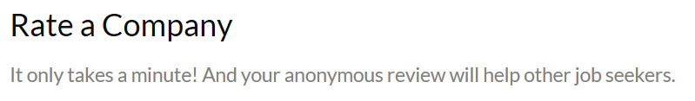
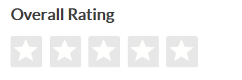
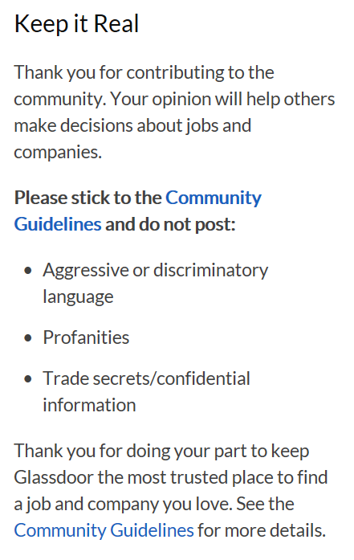
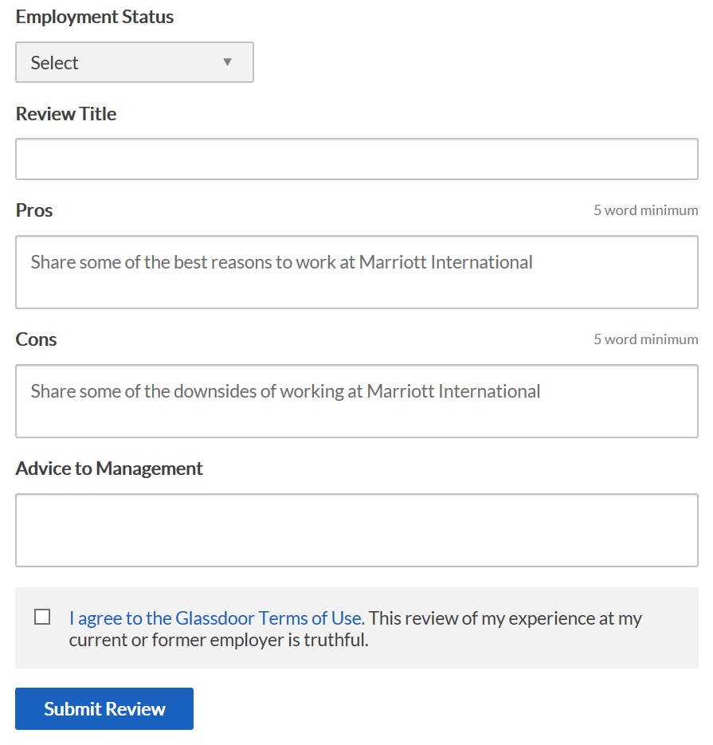

Slide 27
FoodLinked School Partner
Sections / Tabs
Logo
Name
Settings
Admin Menu
About School
Post to conversations
Group conversation dialogue
Internships Tab
ODC (One Day Catering) Tab
Jobs Tab
School Reviews
Members List Link
Invite Others
Members Availability Schedule
Received Offers
Admin
Manage School Profile
Revenue Account
Data Analytics
Change Password
Logout
Internships
ODCs
Jobs
School Reviews
Members Availability Schedule
These are feed in Tabs that get there feed from IRS (Employers) … refer to upcoming slide 28 to see … same feed come to Admin and to other Members
Received Offers

Slide 28
v
Search
1
2
3
4
5
Me
7
8
9
My Network
Communities
Messages
Notifications
Jobs
v
BUY v
SELL v
RECRUIT v
MORE v
Employer Dashboard
Appoint from Campus
Internship
Part-time / ODC
Full-time
Post a Job
Manage Job Postings
Active Job Openings
Candidate’s Applications
Search and select schools to share the Vacancy with
Sort /Filter by Area, Ranking, ..
Allow select all
Campus Recruit
- Post to Schools
- School Availability Schedules
- Issued Offers
Job will be posted on the community wall of the selected schools
Invite Talents
The job will be posted in the TAB inside community based on the selected type of appointment
The Job will be added to “Active Job Openings” and whoever apply to the Job will come under Candidates Applications … so this is treated as any other Job Post

Slide 29
v
Search
1
2
3
4
5
Me
7
8
9
My Network
Communities
Messages
Notifications
Jobs
v
BUY v
SELL v
RECRUIT v
MORE v
Employer Dashboard
Post a Job
Sr. # | School Name | Country | City | Period From | Period To
1 | XXXXXX | xxxxxx | xxxx | Xx/xx/xx | Xx/xx/xx
2
3
Manage Job Postings
Active Job Openings
Candidate’s Applications
Campus Recruit
- Post to Schools
- School Availability Schedules
- Issued Offers
Invite Talents

Slide 30
v
Search
1
2
3
4
5
Me
7
8
9
My Network
Communities
Messages
Notifications
Jobs
v
BUY v
SELL v
RECRUIT v
MORE v
Employer Dashboard
Post a Job
Manage Job Postings
Sr. # | School Name | Country | City | Period From | Period To
1 | XXXXXX | xxxxxx | xxxx | Xx/xx/xx | Xx/xx/xx
2
3
Active Job Openings
Candidate’s Applications
Campus Recruit
- Post to Schools
- School Availability Schedules
- Issued Offers
Invite Talents
Once the school name is clicked then a table with the interns names will open in new tab (refer to following slide)

Slide 31
v
Search
1
2
3
4
5
Me
7
8
9
My Network
Communities
Messages
Notifications
Jobs
v
BUY v
SELL v
RECRUIT v
MORE v
XXX SCHOOL
Sr. # | Intern Name | Country | City | Period From | Period To | Status | Actions
1 | XXXXXX | xxxxxx | xxxx | Xx/xx/xx | Xx/xx/xx |  | Submit Offer
2
3

Slide 32
v
Search
1
2
3
4
5
Me
7
8
9
My Network
Communities
Messages
Notifications
Jobs
v
BUY v
SELL v
RECRUIT v
MORE v
XXX SCHOOL
Sr. # | Intern Name | Country | City | Period From | Period To | Status | Actions
1 | XXXXXX | xxxxxx | xxxx | Xx/xx/xx | Xx/xx/xx |  | Submit Offer
2
3
Once the intern name is clicked then the intern profile will open in new tab

Slide 33
v
Search
1
2
3
4
5
Me
7
8
9
My Network
Communities
Messages
Notifications
Jobs
v
BUY v
SELL v
RECRUIT v
MORE v
XXX SCHOOL
Sr. # | Intern Name | Country | City | Period From | Period To | Status | Actions
1 | XXXXXX | xxxxxx | xxxx | Xx/xx/xx | Xx/xx/xx |  | Submit Offer
2
3
Once the submit offer is clicked then a POP OUT will come

Slide 34
v
Search
1
2
3
4
5
Me
7
8
9
My Network
Communities
Messages
Notifications
Jobs
v
BUY v
SELL v
RECRUIT v
MORE v
XXX SCHOOL
Sr. # | Intern Name | Country | City | Period From | Period To | Status | Actions
1 | XXXXXX | xxxxxx | xxxx | Xx/xx/xx | Xx/xx/xx |  | Submit Offer
2
3
Internship Offer
To: XXXXX
Cancel
Submit

Slide 35
v
Search
1
2
3
4
5
Me
7
8
9
My Network
Communities
Messages
Notifications
Jobs
v
BUY v
SELL v
RECRUIT v
MORE v
Employer Dashboard
Post a Job
Sort v
Filter v
Manage Job Postings
Sr. # | Intern Name | Country | City | Period From | Period To | Status | Action
1 | XXXXXX | xxxxxx | xxxx | Xx/xx/xx | Xx/xx/xx | Accepted | Withdraw – Re-offer
2 |  |  |  |  |  | Rejected
3 |  |  |  |  |  | Negotiate
 |  |  |  |  |  | Pending
 |  |  |  |  |  | Re-offered
Active Job Openings
Candidate’s Applications
Campus Recruit
- Post to Schools
- School Availability Schedules
- Issued Offers
Invite Talents
Withdraw: will give a pop up message “are you sure to cancel ?”
Re-offer: will give a pop up message similar to offer creation, user will edit details and submit

Slide 36
FoodLinked HOTEL / CORPORATE Partner
Sections / Tabs
Logo
Name
Settings
Admin Menu
About Hotel
Post to conversations
Group conversation dialogue
Jobs Tab
Hotel Reviews
Members List Link
Invite Others
Internal Recruitment Management
Assess Members
Admin
Manage Hotel Profile
Revenue Account
Data Analytics
Change Password
Logout
Jobs
Hotel Reviews
Internal Recruitment Management
Assess Members

Slide 37
FoodLinked HOTEL / CORPORATE Partner
Sections / Tabs
Logo
Name
Settings
Admin Menu
About Hotel
Post to conversations
Group conversation dialogue
Jobs Tab
Hotel Reviews
Members List Link
Invite Others
Internal Recruitment Management
Assess Members
Admin
Manage Hotel Profile
Revenue Account
Data Analytics
Change Password
Logout
Jobs
Hotel Reviews
Internal Recruitment Management
Assess Members

Slide 38
FoodLinked HOTEL / CORPORATE Partner
Sections / Tabs
Logo
Name
Settings
Admin Menu
About Hotel
Post to conversations
Group conversation dialogue
Jobs Tab
Hotel Reviews
Members List Link
Invite Others
Internal Recruitment Management
Assess Members
Admin
Manage Hotel Profile
Revenue Account
Data Analytics
Change Password
Logout
Jobs
Hotel Reviews
Admin Related
all other options
and tabs are same
for all community
members
Internal Recruitment Management
Assess Members

Slide 39
FoodLinked HOTEL / CORPORATE Partner
Sections / Tabs
Logo
Name
Settings
Admin Menu
About Hotel
Post to conversations
Group conversation dialogue
Jobs Tab
Hotel Reviews
Members List Link
Invite Others
Internal Recruitment Management
Assess Members
Admin
Manage Hotel Profile
Revenue Account
Data Analytics
Change Password
Logout
Jobs
Hotel Reviews
The Hotel Admin will be allowed to do Internal Recruitment Management and offer Jobs privately inside Group / Community were only community members will be able to see and apply
Under Internal Recruitment Management we need to allow for the following:
Post Internal Job
Manage Internal Job Posts
See Active Internal Job Openings
Manage Candidates Application:
Assign Test
Assign Video Interview
Internal Recruitment Management
Assess Members
Same as regular job posts (IRS) but for private / group use only

Slide 40
FoodLinked HOTEL / CORPORATE Partner
Sections / Tabs
Logo
Name
Settings
Admin Menu
About Hotel
Post to conversations
Group conversation dialogue
Jobs Tab
Hotel Reviews
Members List Link
Invite Others
Internal Recruitment Management
Assess Members
Admin
Manage Hotel Profile
Revenue Account
Data Analytics
Change Password
Logout
Jobs
Hotel Reviews
Internal Recruitment Management
This will allow Hotel admin to assign an assessment test to any Group / Community Member
Assess Members

Slide 41
FoodLinked HOTEL / CORPORATE Partner
Sections / Tabs
Logo
Name
Settings
Admin Menu
About Hotel
Post to conversations
Group conversation dialogue
Jobs Tab
Hotel Reviews
Members List Link
Invite Others
Internal Recruitment Management
Assess Members
Admin
Manage Hotel Profile
Revenue Account
Data Analytics
Change Password
Logout
Jobs
Hotel Reviews
Internal Recruitment Management
Assess Members
Once clicked … a review Hotel pop up opens (see next slide)

Slide 43
FoodLinked ASSOCIATION Partner
Sections / Tabs
Logo
Name
Settings
Admin Menu
About Association
Post to conversations
Group conversation dialogue
Association Reviews
Members List Link
Invite Others
Admin
Manage Hotel Profile
Revenue Account
Data Analytics
Change Password
Logout
Association Reviews

Slide 44
FoodLinked ASSOCIATION Partner
Sections / Tabs
Logo
Name
Settings
Admin Menu
About Association
Post to conversations
Group conversation dialogue
Association Reviews
Members List Link
Invite Others
Admin
Manage Hotel Profile
Revenue Account
Data Analytics
Change Password
Logout
Association Reviews

Slide 45
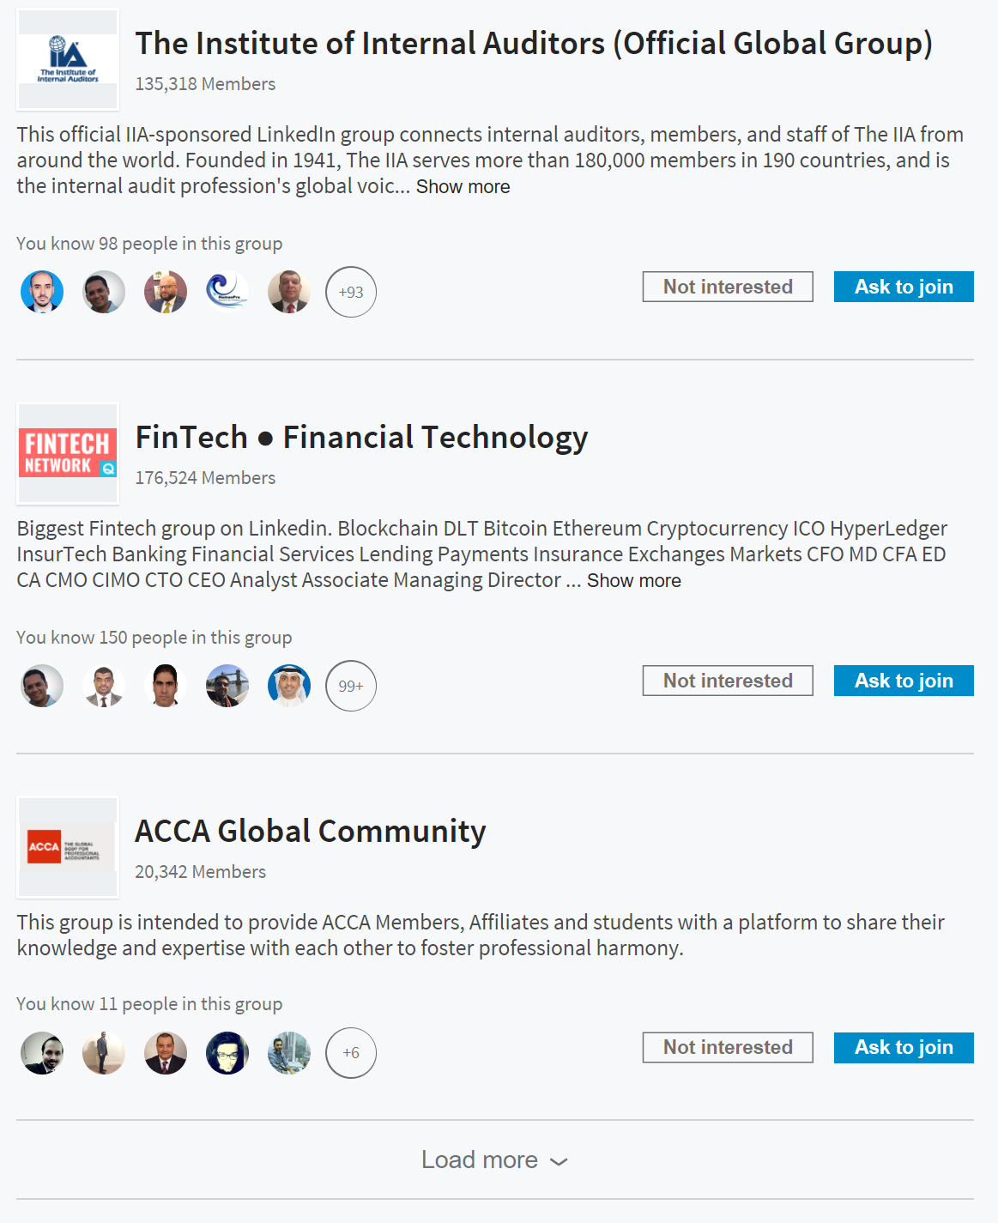
v
Search
1
2
3
4
5
Me
7
8
9
My Network
Communities
Messages
Notifications
Jobs
v
BUY v
SELL v
RECRUIT v
MORE v
Join Communities
Filter v
Sort by v
My Communities
One of the filter / sort options is by type:
Schools
Hotels
Associations
Quick Links
Post Buying Request
Request for Quotation
Post a Product
Post a Job
Apply for Job
Join Communities

Slide 46
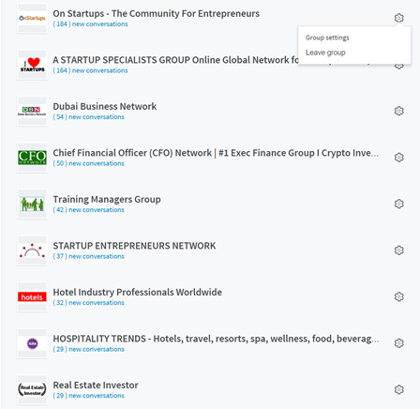
v
Search
1
2
3
4
5
Me
7
8
9
My Network
Communities
Messages
Notifications
Jobs
v
BUY v
SELL v
RECRUIT v
MORE v
Join Communities
Filter v
Sort by v
My Communities
Quick Links
Post Buying Request
Request for Quotation
Post a Product
Post a Job
Apply for Job
Join Communities

Slide 47
v
Search
1
2
3
4
5
Me
7
8
9
My Network
Communities
Messages
Notifications
Jobs
v
BUY v
SELL v
RECRUIT v
MORE v
School Community:
- Member view
Same functions like the ones on slides 13 & 14 … but without the Admin functions
Internships
ODCs
Jobs
School Reviews

Slide 48
v
Search
1
2
3
4
5
Me
7
8
9
My Network
Communities
Messages
Notifications
Jobs
v
BUY v
SELL v
RECRUIT v
MORE v
Hotel Community:
- Member view
Same functions like the ones on slides 36 & 37 … but without the Admin functions
Jobs
Hotel Reviews

Slide 49
v
Search
1
2
3
4
5
Me
7
8
9
My Network
Communities
Messages
Notifications
Jobs
v
BUY v
SELL v
RECRUIT v
MORE v
Association Community:
- Member view
Same functions like the ones on slides 43 & 44 … but without the Admin functions
Association Reviews

