Slide 1
Predicting Parkinson’s disease using ML algorithms
Group - 5
Akhil Reddy Annreddy, Srivatsa Kurada, Pooja Madireddy, Ramya Yeddla

Slide 2
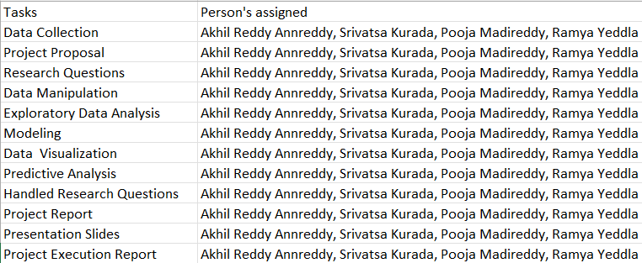
Team Work

Slide 3
Background
Parkinson's disease is a movement illness that affects the nerve system. Symptoms appear gradually and may begin with a barely detectable tremor in only one hand. Tremors are common in this disease. The Patient’s face may display little or no expression in the early stages of Parkinson's disease. When a patient walks, his/her arms may not swing. It's possible that their voice will become hushed or slurred. The symptoms of Parkinson's disease grow as the disease advances.
Parkinson's disease affects upwards of 10 million people globally. It affects one-and-a-half times more men than women.
The dataset was created by Athanasios Tsanas and Max Little of the University of Oxford.

Slide 4
Data set Information
This dataset is composed of a range of biomedical voice measurements from 42 people with early-stage Parkinson's disease recruited to a six-month trial of a telemonitoring device for remote symptom progression monitoring. The recordings were automatically captured in the patient's homes.
Columns in the table contain subject number, subject age, subject gender, time interval from baseline recruitment date, motor UPDRS, total UPDRS, and 16 biomedical voice measures. Each row corresponds to one of 5,875 voice recording from these individuals. There are a total of 22 columns in this data set with 16 voice measures and rest of the variables are general information about patients.
The main aim of the data is to predict the motor and total UPDRS scores ('motor_UPDRS' and 'total_UPDRS').
The data is in ASCII CSV format. The rows of the CSV file contain an instance corresponding to one voice recording. There are around 200 recordings per patient, the subject number of the patient is identified in the first column.

Slide 5
Data Cleansing and Manipulation
There are no missing values in the data set.
There were negative values in variable test_time so removed those negative values for data cleansing.
There are 3996 records for male patients and 1867 records of female patients implying that the disease is more prominent in male patients than female patients.
NHR is inversely proportional to voice quality. Since, NHR are having high number of outliers as seen from the scattered plot and bivariate plot and because NHR and HNR are inversely proportional, we are removing NHR to reduce the dimensionality.
The variables motor_UPDRS and total_UPDRS are highly correlated (>0.8). Both these variables are related hence excluded motor_UPDRS.

Slide 6
Exploratory Data Analysis

Slide 7
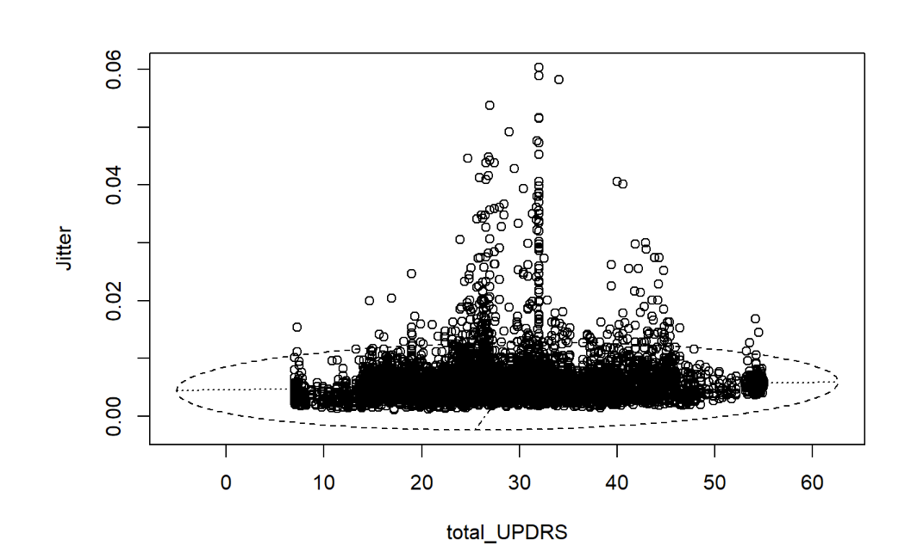
Outliers
The key variable of relevance is the total UPDRS (Unified Parkinson’s Disease Ratings Score), which measures the clinical impression of Parkinson’s disease (PD) severity.
To locate outliers, we plot total UPDRS scores against other variables in our data set. We found out that outliers are present in almost all the voice measures.
We have removed some outliers using Convex Hull method. We still had many outliers in our dataset and removing them would reduce the distribution of data. Hence we decided to use Ensemble Models for prediction analysis as they are robust to outliers.

Slide 8
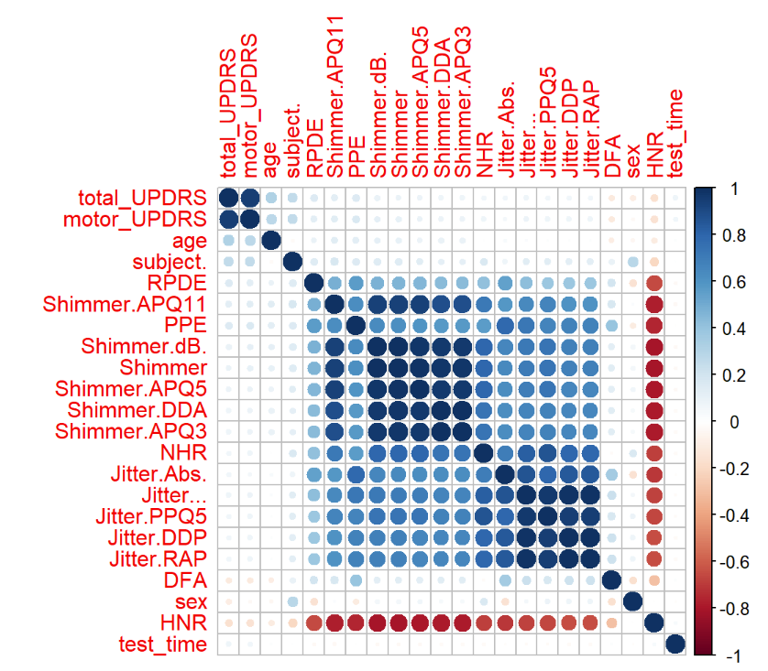
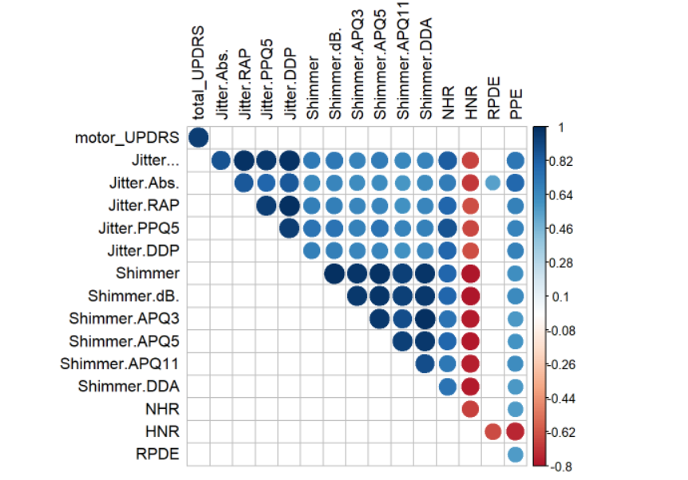
CORRELATION

Slide 9
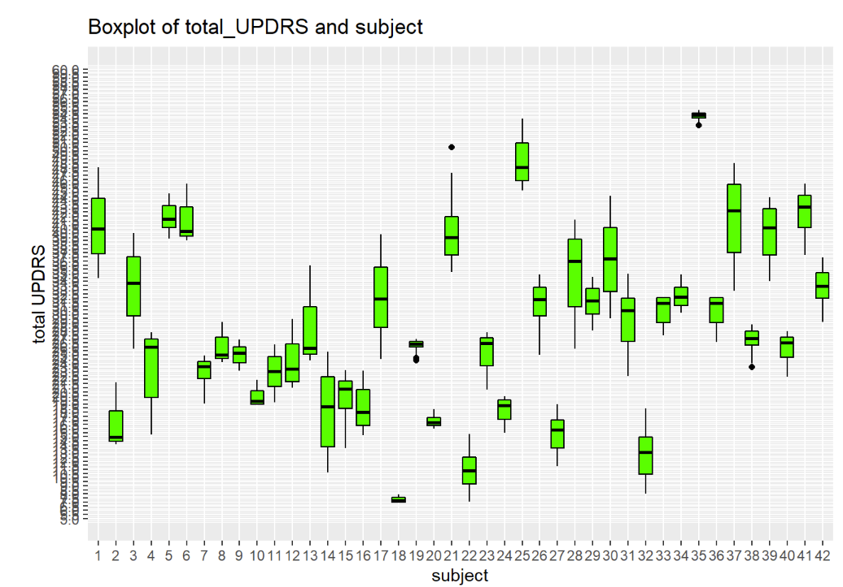
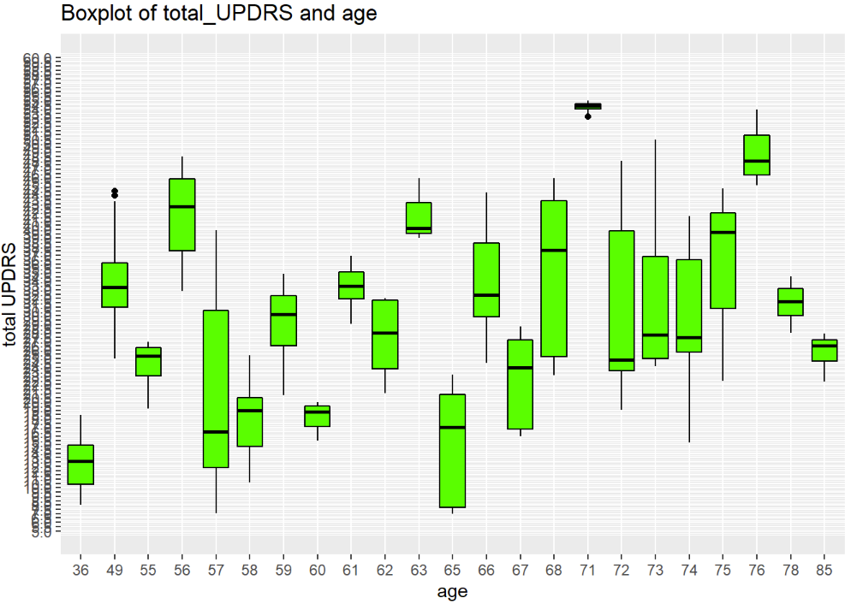
BOX PLOT

Slide 10
Normalization
Before applying PCA, we are normalizing data so as to have best variance explained by PCA.
We have decided to use preProcess() to normalize data to a range of [0,1].

Slide 11
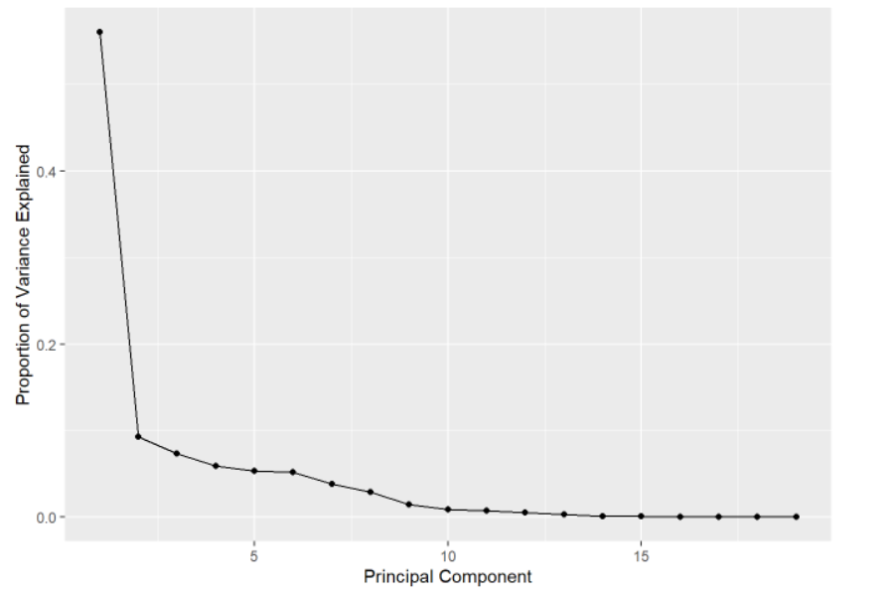
Principal Component Analysis
A total of 8 principal components are necessary in predicting the performance of the model for this data set.

Slide 12
Data Analysis and Results

Slide 13

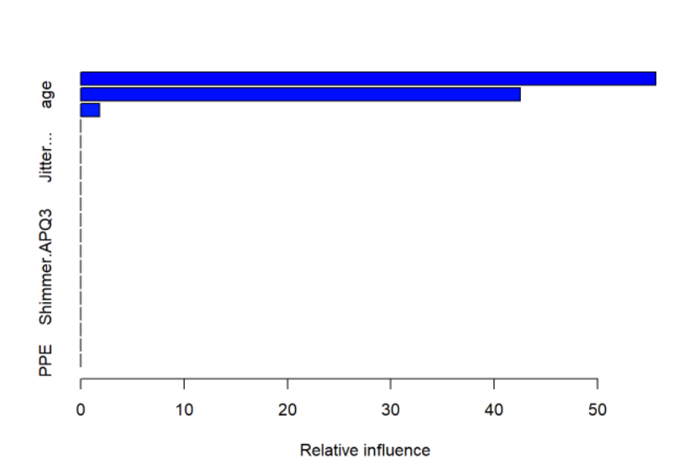
GRADIENT BOOSTING MACHINE:
The R-squared value for this model is: 0.4785.
Performs poor compared to Random Forest.
Three features were found to have non-zero influence.
Feature Importance:

Slide 14

RANDOM FOREST:
We used random forest because tree based methods are robust on outliers and their performance is high compared to other models in handling outliers.
With random forest we built the model on total_UPDRS considering mtry as 6.
Modeling with random forest on trained data resulted in R-squared value of 0.97.

Slide 15
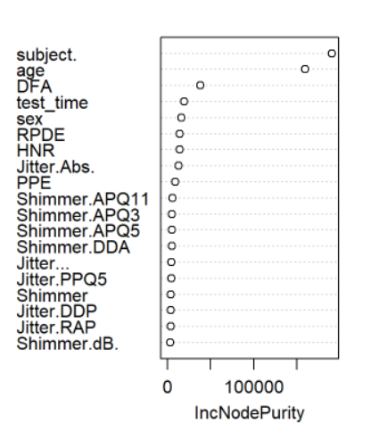
Feature Importance:
Subject, age and DFA (Detrended Fluctuation Analysis) are the most important features.
If we include only voice measures then DFA , RPDE, HNR, Jitter.Abs and PPE are the important features.
If we consider Shimmer variable, then Shimmer.APQ11 has the highest importance.

Slide 16
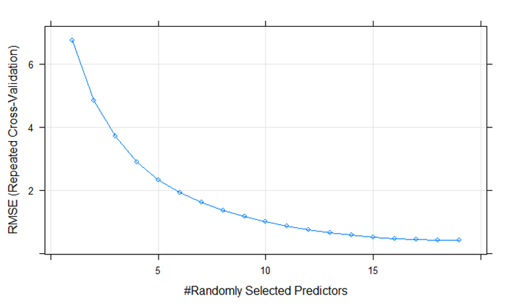
Predictors behavior after Hyperparameter Tuning.
Optimal value of mtry is 19.

Slide 17
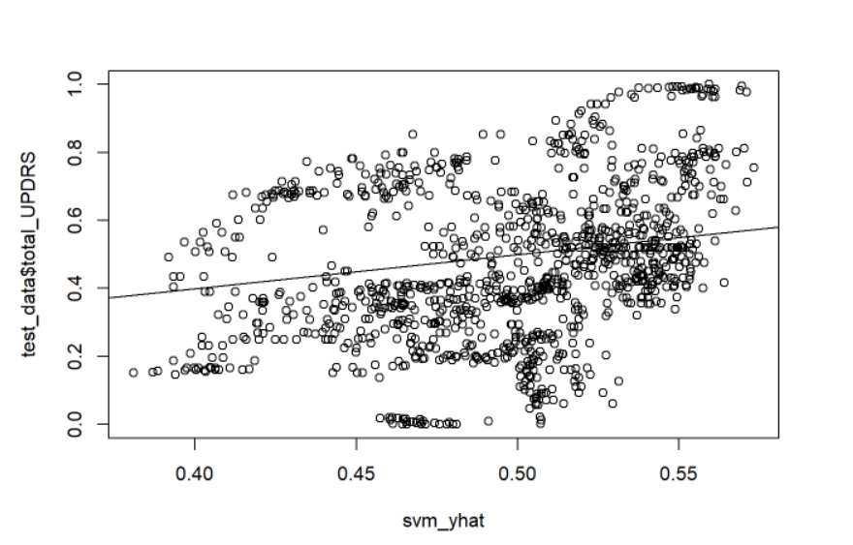
SUPPORT VECTOR MACHINE:
We chose SVM model as it can handle both classification and regression.
Different kernels were used to check the best parameters.
Radial kernel performs the best for this dataset with the R-squared value of this model is 0.81 on training data..

Slide 18
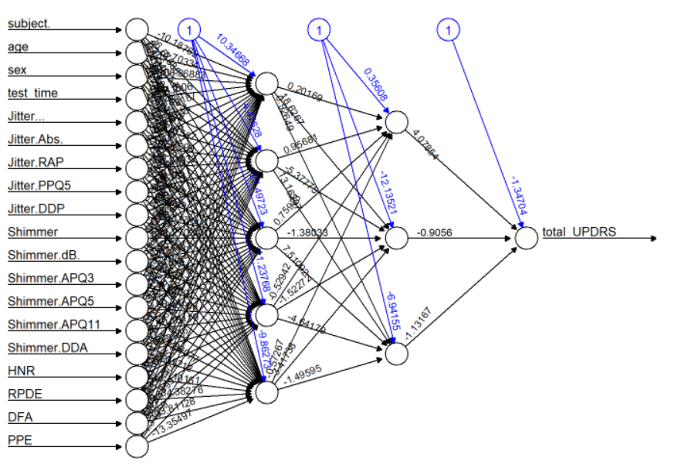
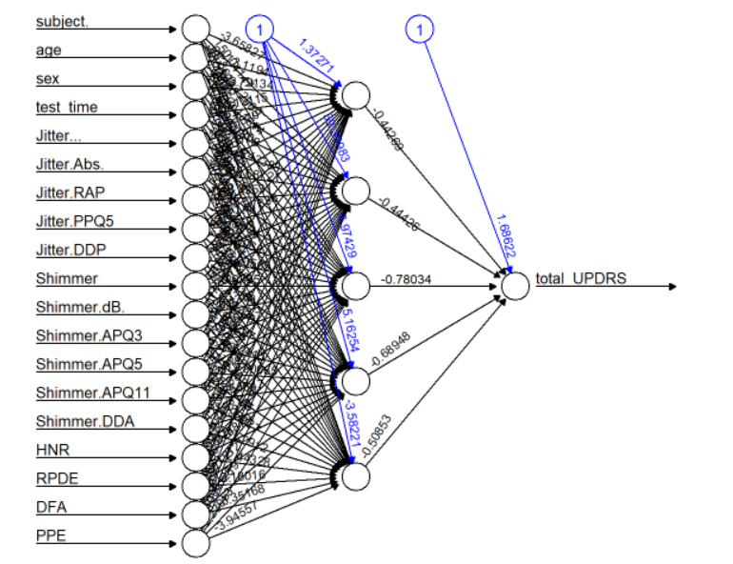
ARTIFICIAL NEURAL NETWORKS:
We chose neural network because it requires less formal statistical training, it can detect all possible interactions between predictor variables and it has the ability to train multiple training algorithms.
Two hidden layers performs the best rather than one hidden layer.
The R- squared value for 2 hidden layer is 0.000397 which implies this model performs poorly for this dataset. R-squared value for 1-hidden layer is 0.000129

Slide 19
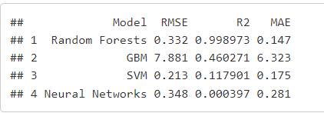
Model Comparison
Upon comparing, we estimated that rf performs best for the test data considering r-squared as a factor.

Slide 20
Potential Problems
Working on this project, we came across problem with outliers. Even though we could remove some of the outliers, we could not remove all the outliers as it would have hampered the distribution of the data set. Due to these additional outliers, we found problems in performance of models GBM and ANN.
Variables subject, age and sexuality causing the data to be biased.

Slide 21
Conclusion
Subject, Age and DFA are the most important variables in predicting the UPDRS score.
From the final performance measures of different Machine Learning Models Random Forest performs the best compared to Support Vector Machine Neural Network, Gradient Boosting Machine.
The variables DFA, RPDE, HNR, Jitter (Absolute value), PPE and Shimmer (APQ.11) are the noise measures which are most important in predicting UPDRS.

Slide 22
Any Questions?

