Slide 1
Consumer Preferences and Pricing Trends in Amazon Cell Phones Market: A Data-Driven Analysis

Slide 2
Introduction
“Amazon is a highly competitive marketplace, especially for cell phones. Our project aims to understand what drives consumer purchasing decisions, focusing on factors like price, ratings, and brand reputation. By analyzing these elements, we aim to help sellers optimize their listings.”

Slide 3
Objectives
“Our project has four main objectives:”
Identify the key factors influencing consumer purchasing decisions for cell phones on Amazon.
Analyze pricing trends and assess how different strategies impact sales and feedback.
Provide practical recommendations for sellers to optimize product listings and improve sales.
Compare how different brands perform in terms of customer satisfaction, pricing, and ratings.

Slide 4
Dataset Overview
“We analyzed a dataset sourced from Kaggle, containing over 3,300 entries of Amazon cell phones. It includes attributes like product name, brand, price, ratings, and more.”
Key Attributes: Product Name, Brand, Price, Rating, Number of Reviews, etc.
Total Entries: 3,351
Link:
https://www.kaggle.com/datasets/michaelmatta0/amazon-cell-phones-cleaned-scraped-data

Slide 5
Methodology
“Our approach is structured around several key data analysis techniques.”
Data Cleaning & Preparation: Ensuring data is accurate and usable.
Exploratory Data Analysis (EDA): Identifying initial trends and patterns.
Regression Analysis: Quantifying the impact of product features on sales outcomes.
Sentiment Analysis (Based on Ratings): Categorizing consumer sentiment into positive, neutral, and negative based on ratings.
Clustering Analysis: Grouping similar products to identify key market segments.

Slide 6
Data Cleaning & Preparation
“We focused on handling missing values, standardizing data, and preparing it for further analysis. For instance, we filled missing values for price, RAM, and other critical fields.”
Key Steps: Filling missing prices, standardizing categorical variables, handling outliers.

Slide 7
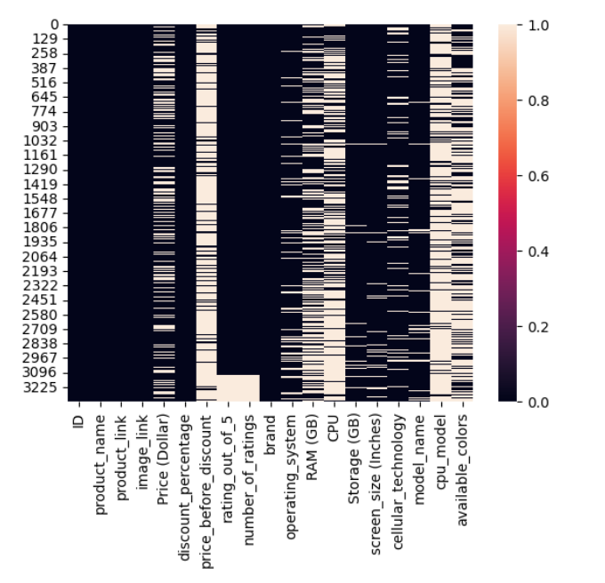
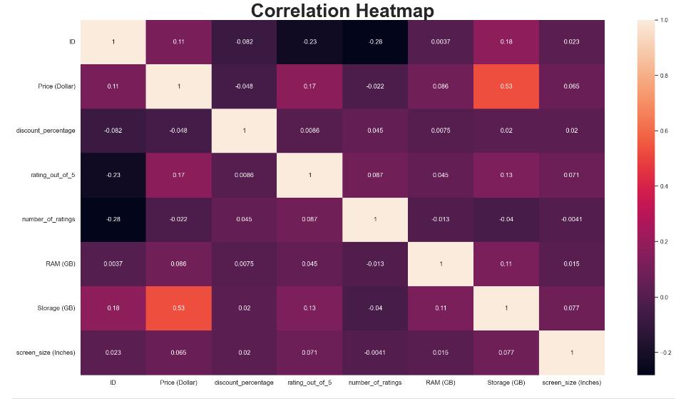

Slide 8
Exploratory Data Analysis (EDA)
“Through our EDA, we explored how key variables interact. For example, we analyzed the relationship between price, ratings, and brand performance.”
Visuals:
Scatter plot: Price vs. Ratings
Bar chart: Average Price by Brand
Key Insight: Products with higher prices don’t always receive better ratings.

Slide 9
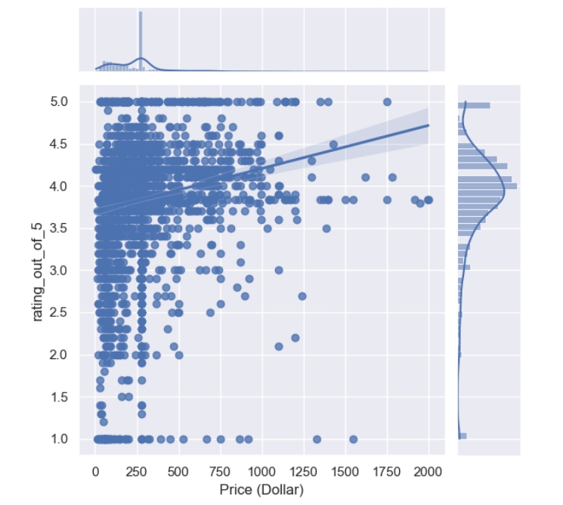
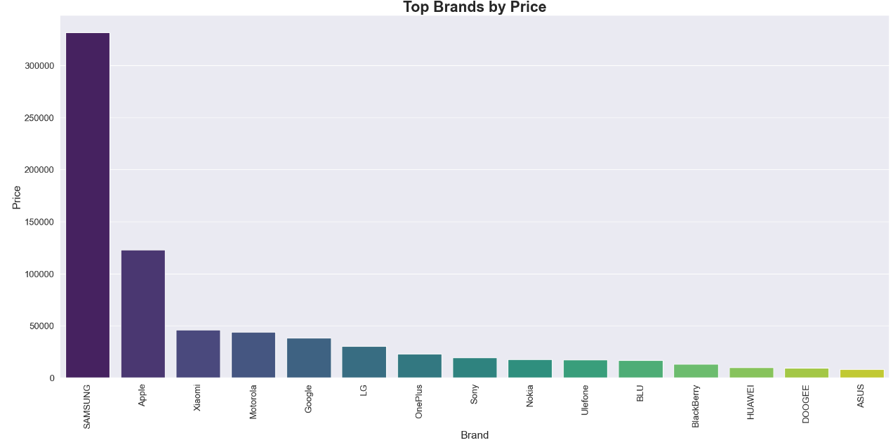

Slide 10
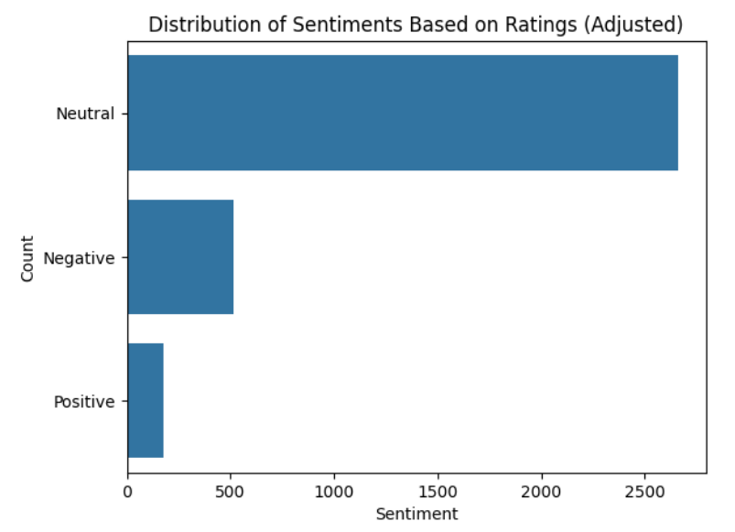
Sentiment Analysis Based on Ratings
“We noticed a high count of Neutral ratings, so we adjusted the criteria: Positive (only 5), Neutral (3-4), Negative (1-2). This gave us a clearer picture of how customers perceive the products.”

Slide 11
Regression Analysis
“We used regression analysis to understand how different features influence the price of cell phones on Amazon. Here are the results:”
Model Used: Linear Regression
Evaluation Metrics:
Mean Squared Error (MSE): 35,111.90
This indicates the average squared difference between the predicted and actual prices.
R-squared: 0.305
About 30.5% of the variation in price can be explained by the features used in the model. This shows some predictive power, but there are other factors affecting price that aren’t captured here.

Slide 12
Key Features and Their Impact on Price:
Feature | Importance | Interpretation
rating_out_of_5 | 36.84 | Higher ratings tend to slightly increase the price, suggesting that well-rated products might be positioned as premium.
number_of_ratings | -0.0005 | Insignificant effect, meaning the sheer number of ratings doesn’t impact the price.
RAM (GB) | 0.29 | More RAM generally leads to a higher price, which aligns with expectations.
Storage (GB) | 0.72 | Additional storage has a noticeable impact on price.
discount_percentage | -1.19 | Higher discounts correlate with lower prices, as expected.

Slide 13
Insights from Regression Analysis
“Here’s what we can take away from the regression model:”
Ratings Have a Modest Positive Influence: While better ratings can justify slightly higher prices, the effect is not very strong.
RAM and Storage Drive Price: As expected, products with more RAM and storage tend to be priced higher.
Discounts Effectively Lower Prices: The more discounts offered, the lower the final price, which indicates aggressive pricing strategies.

Slide 14
Conclusion
Key Takeaways:
Consumer Preferences: Ratings, RAM, and storage drive pricing, but higher prices don’t always mean better ratings.
Sentiment Insights: Many products fall into Neutral or Negative sentiment, showing room for improvement in customer satisfaction.
Actionable Strategies: Sellers can use insights to adjust pricing, highlight key features, and improve product listings.
Future Work:
Enhance analysis with text-based sentiment if customer reviews are available.
“Data-driven insights empower sellers to optimize strategies and succeed in Amazon’s competitive market.”

Slide 15
Thank You

