Slide 1






IT Tickets Analysis &
Agent Performance Dashboard
Excel-based Data Analytics Dashboard
Presented By
Akhil B. Wabhitkar

Slide 2

Problem Statement
You are tasked with analyzing the IT support ticket management system to understand the performance of IT agents, the efficiency of ticket resolution, and the satisfaction levels of employees. The objective is to identify high and low performers among IT agents, assess the overall effectiveness of the team, and pinpoint areas for improvement in the ticket resolution process. The ultimate goal is to make informed staffing decisions, including hiring, firing, and training, to enhance overall service quality and team performance.

Slide 3
Dataset Structure
Data Overview
Datasets Used
Tickets Sheet: 97,498 records with attributes like ID Ticket, Fecha, Employee ID, Agent ID, Request Category, Issue Type, Severity, Priority, Resolution Time (Days), Satisfaction Rate.
Tickets
97,498
Agents
50
Data Cleaning & Preprocessing:
IT Agents Sheet: 50 agents with demographic info (Agent ID, Full Name, Year of Birth, Month of Birth, Day of Birth)
Fixed spelling inconsistencies: "Mayor" → "Major", “Unassigned” ”Unassigned”,”Unclassified” →”Unclassified” etc.
Confirmed no missing values in any column
Why This Data is Critical:
Data Attributes
Provides complete visibility into the ticket lifecycle, from assignment through resolution.
Helps evaluate individual agent performance and productivity.
Supports key performance indicators (KPIs) for both day-to-day operations and long-term decision-making.
TIME SPAN
5 Years (2016-2020)
20 Quarters Complete data lifecycle
DATA QUALITY
No missing values
Standardized categories
Consistent naming

Slide 4
Ticket Category Distribution
Key Insight
• System: 39,002 tickets (40.0%).
• Login Access: 29,193 tickets (29.9%).
• Together they account for 68,195 tickets (70.0%) — the largest workload concentration.
• These categories are the strongest candidates for automation and process redesign.

Slide 5
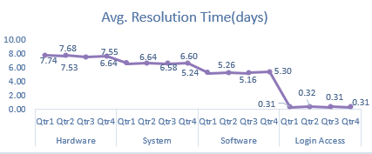
Average Resolution Time(Days) By Ticket Category
Key Insight
Hardware tickets take the longest to resolve, with average resolution time remaining around 7.5 days across the quarters.
Software resolution time improved steadily, decreasing from 6.60 days to 5.16 days, indicating faster issue resolution.
Login Access tickets are resolved fastest, with resolution time consistently close to 0.31 days across all quarters.

Slide 6
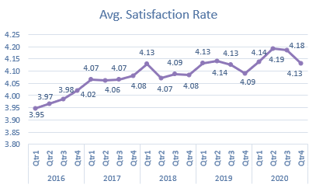
Average Satisfaction Rate Over Time
Key Insight
Satisfaction improved steadily: increased from 3.95 in Q1 2016 to 4.13 in Q4 2020.
Highest satisfaction recorded: 4.19 in Q2 2020, indicating strong customer satisfaction.
Satisfaction remained stable: stayed mostly between 4.07 and 4.14 from 2017 onward, despite quarterly fluctuations.

Slide 7
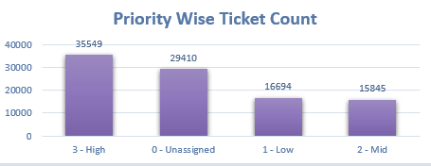
Priority Wise Ticket Volume
Key Insight
High priority leads: 35,549 tickets (36.5%) have high priority.
Unassigned tickets remain significant: 29,410 tickets (30.2%) have no priority assigned.
High + Unassigned account for 66.6% of all tickets, showing a strong concentration in these two groups.

Slide 8
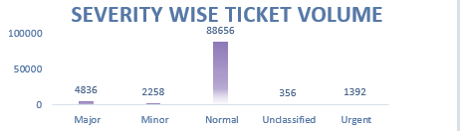
Severity Wise Ticket Volume
Key Insight
• Normal severity dominates: 88,656 tickets (90.93%).
• Major + Urgent account for 6,228 tickets (6.39%).
• Urgent is only 1,392 tickets (1.43%).
• 356 tickets (0.37%) are Unclassified, indicating a small triage-quality gap.

Slide 9
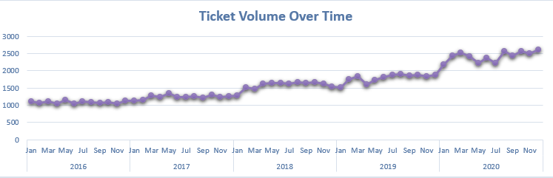
Ticket Volume Over Time
Key Insight:
• Ticket volume rose from 13,051 in 2016 to 29,088 in 2020.
• This is a 122.9% increase across five years.
• 2020 alone grew 35.36% year over year.
• The trend indicates a need for scalable capacity and stronger ticket triage.
Year-wise Ticket Volume
13,051
2016
14,915
2017
+14.28% YoY
18,954
2018
+27.08% YoY
21,490
2019
+13.38% YoY
29,088
2020
+35.36% YoY

Slide 10
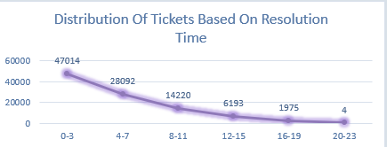
Distribution Of Tickets Based On Resolution Time
Key Insight
• 47,014 tickets (48.2%) were resolved within 0–3 days.
• 75,106 tickets (77.0%) were resolved within 0–7 days.
• Only 1,979 tickets (2.0%) took more than 16 days.
• The distribution is concentrated in shorter resolution windows, with a small long-tail.

Slide 11
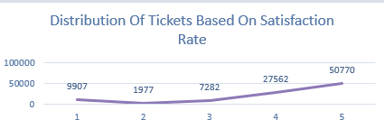
Distribution Of Tickets Based On Satisfaction Rate
Key Insight
• 50,770 tickets (52.1%) received the top score
• Scores of 4 or 5 total 78,332 tickets (80.3%).
• Score 1 appears about 5× as often as score 2.
• Overall feedback is strongly concentrated toward high satisfaction.

Slide 12
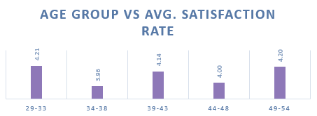
Age Group Vs Average Satisfaction Rate
Key Insight
• 29–33 has the highest average satisfaction: 4.21.
• 34–38 has the lowest: 3.96.
• 39–43 improves to 4.14; 49–54 reaches 4.20.
• The 0.25-point gap between the highest and lowest groups identifies 34–38 as the clearest improvement area.

Slide 13
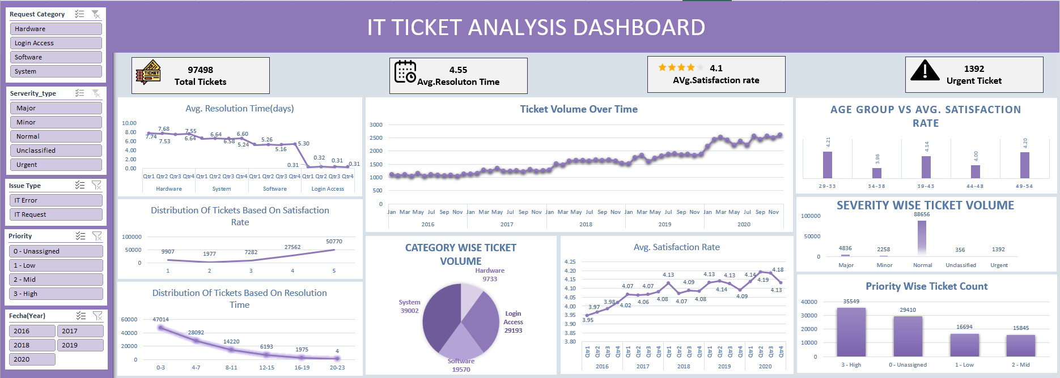
DASHBOARD

Slide 14
RECOMMENDATIONS
Prioritized actions with measurable targets and deadlines
1. Reduce resolution time
2. Automate high-volume work
3. Improve ticket triage
Hardware: 7.63 → 5.0 days
System: 6.62 → 5.0 days
Target: within 3 months.
Automate Login Access + System workflows. Target: Reduce volume by 20% in 6 months
Unclassified: 356 tickets (0.37%).
Target: reduce to fewer than 200
within 3 months.
4. Train bottom performers
5. Lift the weakest satisfaction group
6. Plan capacity for growth
Focus: Agents 3, 6, 22 and 28.
Run a 12-week coaching plan.
Target: 10% lower average resolution time.
Volume rose 122.9% from 2016–2020.
Review capacity and staffing quarterly
against ticket growth and SLA performance.
Age 34–38: 3.96/5.
Target: reach at least 4.10/5
within 6 months.

Slide 15
CONCLUSION
key Findings And Performance Highlights
1. High Ticket Volume
2. Significant Volume Growth
3. Resolution Time Needs Attention
The support team handled 97,498 tickets, indicating a substantial and sustained service workload.
Ticket volume increased by 122.9% from 2016–2020, showing rising demand for IT support.
The overall average resolution time is 4.55 days, with Hardware and System tickets taking longer to resolve..
4. High-Volume Workflows Drive Demand
5. Triage & Classification Gap
6. Satisfaction & Agent Performance Vary
Login Access and System workflows account for a major share of ticket volume, making them key workload drivers.
There are 356 unclassified tickets (0.37%), indicating room for better ticket categorization and routing.
Overall satisfaction is 4.1/5, with the 34–38 age group lowest at 3.96/5. Some agents also show weaker resolution performance

Slide 16
TOOLS USED
Acknowledgements & References
DATA SOURCES
Tickets Dataset:-
97,498 records with complete ticket metadata.
Source: Internal IT Management System
Microsoft Excel:
Primary platform for analysis & dashboard creation
PivotTables:
Powerful tool for aggregation & cross-tabulation
50 agents with demographic & performance data
Charts & Graphs:
Visualize trends and performance metrics
👤
Formulas Used:
AVERAGE, XLOOKUP, IF, TEXT, Mid, Round
Created By:-
Akhil B. Wabhitkar

