Slide 1
Gen AI for Software Developers
Windsurf Editor
By Thaneshwar M

Slide 2
AI : Artificial Intelligence
Enable the Machin's to
  Analise the data(Train the model->Million/Billions/Trillions of data),
  Learn, (learn from existing data)
  Think, (Based on user requirement this will think )
  Make Decision ---> like Humans
Ex: Chat GPT / Co-pilot / Gemini

Slide 3
Examples :
1 ) Self Drive Car :
2 ) Smart Email Reply : Smart Reply
3 ) Voice Assistance : Customer Care
4 ) Google Suggestions :
5 ) Mobile Face Unlock :
6 ) Netflix Recommendation : What kind of Movies you like ,
7 ) Google Maps Traffic Predications :
8 ) online Fraud Dictation :
9 )Chatbots & customer Support :
10)Resume Screening :
11) Whether Forecasting
12) Online Shopping Search Result
13) Insat & You tube Alg
14)Online Food delivery time predication
15)online job Recommendation

Slide 4
WHY was Wind Surf introduced? (Problem it solves)
Traditional GenAI tools (e.g., basic code completion or chat-based assistants) have limitations:
Traditional AI Coding | WindSurf Approach
Knows only current file | Understands entire codebase
Passive suggestions | Active agent that performs tasks
One-shot prompts | Continuous reasoning loop
Manual copy-paste | Direct code execution & edits

Slide 5
Why WindSurf matters in GenAI:
Reduces developer cognitive load
Accelerates end-to-end feature development
Enables agent-based automation
Improves code correctness & consistency

Slide 6
WHERE is WindSurf used? (Use cases)
A. Application Development
Spring Boot APIs
Microservices
Angular / React frontends
MEAN / MERN stacks
B. Enterprise Engineering
Legacy code understanding
Large codebase refactoring
Bug root-cause analysis

Slide 7
C. Learning & Training
Explaining code line by line
Converting monolithic → layered architecture
Writing unit tests (JUnit, Mockito, Jest)
D. DevOps & Automation
Generating Dockerfiles
CI/CD scripts
YAML (K8s, GitHub Actions)

Slide 8
WindSurf vs ChatGPT vs Copilot
Feature | ChatGPT | GitHub Copilot | WindSurf
Chat-based help | Yes | Limited | Yes
Full project awareness | No | Partial | Yes
Agentic execution | No | No | Yes
IDE-native | No | Plugin | Native IDE
Best for teaching architecture | Medium | Low | High

Slide 9
Example Prompt (Spring Boot – your domain)
Convert this controller into layered architecture
with Service, Repository, Exception Handling
and add Swagger configuration.
WindSurf will:
Create Controller, Service, Repo
Add @ExceptionHandler
Configure Swagger/OpenAPI
Explain why each layer exists

Slide 10
Why WindSurf is important for future Java/ FSD
Industry moving from coding → reasoning + orchestration
GenAI-first development is becoming standard
IDEs are evolving into AI agents
Developers must learn how to guide AI, not fight it

Slide 11
Final One-Line Summary
Windsurf represents the next generation of GenAI-powered development—where AI is not a helper, but an intelligent coding partner.

Slide 12
When to Choose Which? (Practical Guidance)
Scenario | Best Fit
You want classic IDE + AI suggestions, max ecosystem | VS Code + AI
You want AI agents that assist end-to-end | Windsurf
You want fast interactive coding with strong autocomplete | Cursor
You need deep codebase understanding | Windsurf or Cursor

Slide 13
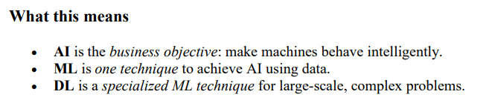

Slide 14
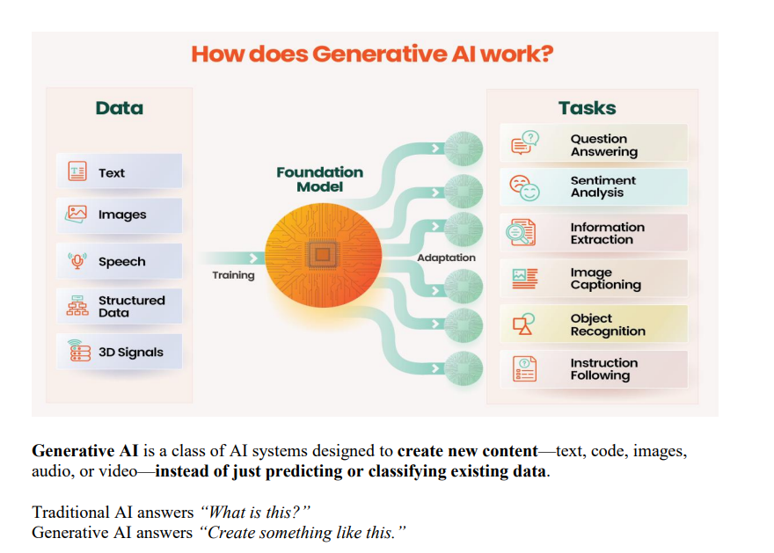

Slide 15
Download the S/w
https://windsurf.com/download/confirmation?code=wu
Chatgpt to understand WindSurf in GenAI

