Slide 1
Contribution of Students, Intellectuals, and Females in Bangladesh's Liberation War.

Slide 2



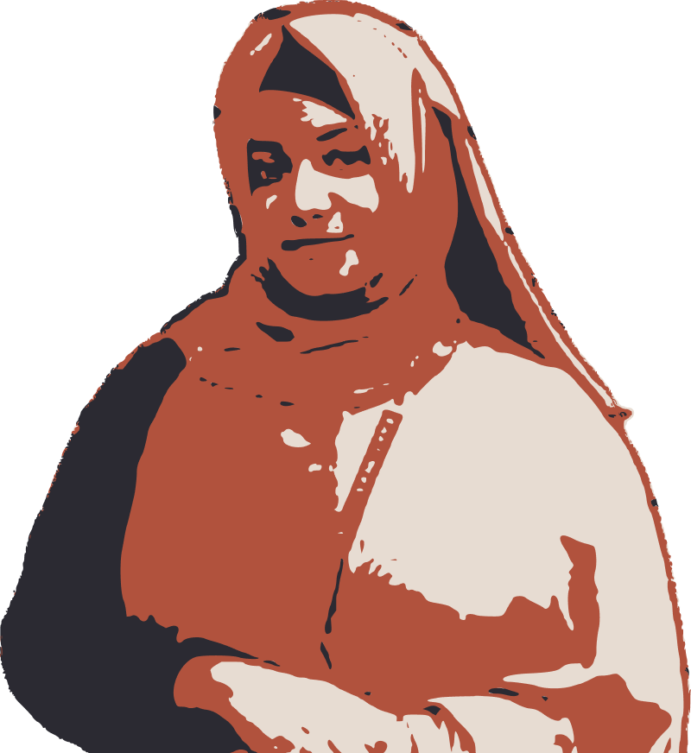

Meet the Team:
Aklhak Hossain 2022-3-60-057
Dept. of CSE
Ahsanur Parul 2022-3-60-190
Dept. of CSE
Asiful Alam Sami 2022-3-60-230
Dept. of CSE
Asifa Akter Liya 2022-3-60-186
Dept. of CSE
Benazir Meem 2022-3-60-169
Dept. of CSE

Slide 3
Significance of contributing to the liberation war by the ​Students, Intellectuals, and Females

Slide 4
Historical Background Leading to the Bangladesh Liberation War:
Marginalization
-01-
East Pakistan was being marginalized from the beginning
Economical Development:
-02-
The central administration, perpetuated policies that favored the economic interests of the western region
Political Disadvantage
-03-
political disparities that sowed the seeds of a fervent desire for autonomy in East Pakistan.

Slide 5
Students' Contribution:
February 21, 1952
students rallied for the recognition of Bengali as one of the state languages, a precursor to the larger demand for autonomy.
Public Sentiment Generation
Students’ energy and determination galvanized public sentiment, turning the demand for autonomy into a formidable movement.
Mukti Bahini
The liberation army that fought alongside, often young and idealistic, became frontline soldiers, demonstrating unparalleled bravery and resolve.

Slide 6
Intellectuals' Contribution:
Creating Awareness
As the situation escalated, intellectuals took on the responsibility of creating awareness about the socio-political realities in East Pakistan.
Framing The Discourse
Intellectuals also played a crucial role in framing the discourse on the national identity of Bangladesh. Through their writings, speeches, and cultural expressions, and identity,
December 14, 1971
Despite the risks, intellectuals remained undeterred, using their pens and voices to inspire resistance, and creating the Bengali identity.

Slide 7
Women's Contribution:
Multifaceted Role Despite Societal Norms
Beyond the domestic sphere, women actively participated in the broader struggle by joining protests, organized rallies, and, in some cases, directly engaged in armed resistance.
On The Home Front
Women went beyond conventional norms, directly engaging in armed resistance, demanding the recognition of their right to a sovereign nation.
Sacrifices
Acknowledging the sacrifices of countless women is imperative to truly understand the narrative of Bangladesh's liberation.

Slide 8
Conclusion:

Slide 9
Thank You For
Being with Us.
If you have any questions, I would be happy to answer them.

