Slide 1
Finova
A personal Finance Management App that helps you grow.

Slide 2
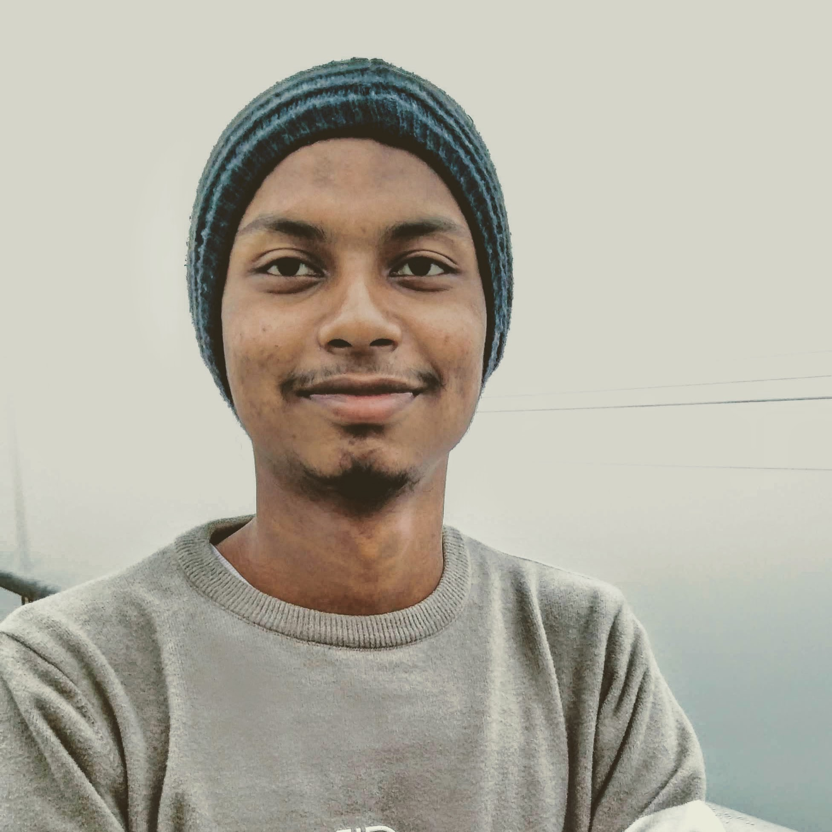
The Team
Akhlak Hossain Jim
2022-3-60-057
Department of CSE

Slide 3
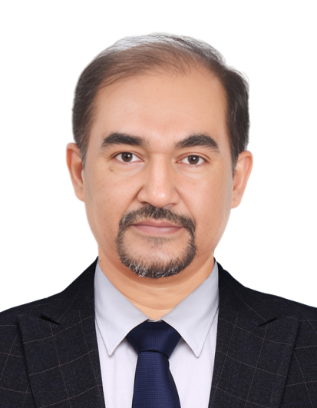
Instructor
Dr. Shamim H Ripon
Professor
Department of CSE

Slide 4

Table of Contents
Project Features/Functionalities
Lab Works Overview
Assignment Overview
Case Study Overview
Project Demonstration
Conclusion
Project Screenshots (Appendix)

Slide 5
Project Features/Functionalities

Slide 6
Core Features
Supports Multi-currency
Income Management
Shopping List Integration
Analytics Dashboard
Cultural Finance Modules

Slide 7
LAB WORKS
Enhance your Personal Finance.

Slide 8
CPM Diagram
Activity | Sudo Name | Predecessor | Duration
SDE | A | - | 1
Core UI/Frontend | B | A | 7
Core Navigation Structure | C | B | 1
Core Backend Setup | D | A | 2
Frontend Backend Integration | E | C, D | 3
Alpha Build & Upload | F | E | 2
Fix Bugs & Beta Deploy | G | F | 16
Final Fixes & Stable Version | H | G | 5

Slide 9
CPM Diagram
Activity | Sudo Name | Predecessor | Duration
SDE | A | - | 1
Core UI/Frontend | B | A | 7
Core Navigation Structure | C | B | 1
Core Backend Setup | D | A | 2
Frontend Backend Integration | E | C, D | 3
Alpha Build & Upload | F | E | 2
Fix Bugs & Beta Deploy | G | F | 16
Final Fixes & Stable Version | H | G | 5

Slide 10
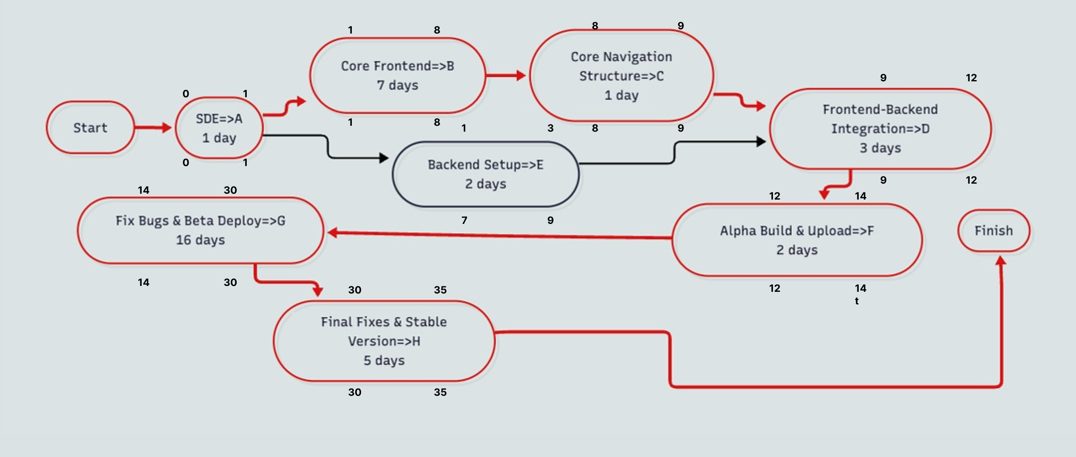
CPM Diagram with Critical Path

Slide 11
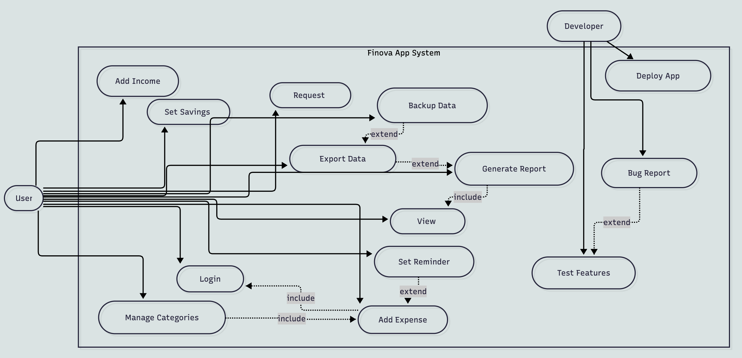
Use Case Diagram

Slide 12
Use Case Diagram

Slide 13
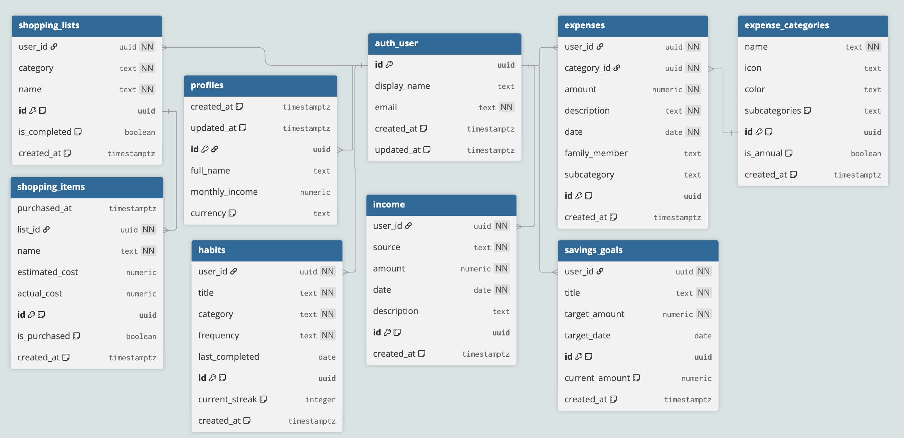
Class Diagram

Slide 14
Class Diagram

Slide 15
ASSIGNMENT
Enhance your Personal Finance.

Slide 16
Project Requirement and Planning (Stakeholders & Actors)
Primary Users: Individual professionals, families, financial managers
Development Team
Technical Partners
Beta Testers

Slide 17
Project Requirement and Planning (Resource Management)
Human Resources: Solo Developer
Technical Resources: VS Code, React-Native, Supabase, Github
Financial Resources: Self-funded
Timeline

Slide 18
Project Requirement and Planning (Risk Management)
Technical Risks: Performance on older devices, Supabase Scaling
Business Risks: Market Adoption & Competition
Development Risks: Solo development bandwidth and Future Scopes
Mitigation: MVP Approach

Slide 19
Project Requirement and Planning (Quality Management)
Code Quality: Typescript, & ESLint Standards
UX: Beta testing cycle, & feedbacks
Performance: React-Native/Expo Monitoring updates
Security: Encrypted data with, Authentication & Authorisations

Slide 20
CPM Diagram
App/Project | Features | Strengths | Limitations
Pocket Money Manager | Budget alerts, offline use | Simple, offline | No analytics, limited export
MyMoney Pro | Expense tracking, multi-category | Local support | Basic UX, poor analytics
Mint | Auto sync, budget, analytics | Rich features | Not local, card-based only
PocketGuard | AI spend optimization | Personalized tips | No cultural adaptation
Goodbudget | Manual envelopes, sync | User control | No bank integration, manual

Slide 21
Project Demonstration
Enhance your Personal Finance.

Slide 22
Conclusion
Detailed project planning and requirement gathering ensure the development of a reliable, culturally-sensitive finance management app.
Emphasis on risk management, quality assurance, and user-centered design supports timely delivery and high user satisfaction.
Finova aims to empower users in diverse cultural contexts to build healthier financial habits and achieve financial wellness.

Slide 23


Thank you
I would love to answer any Questions.

Slide 24

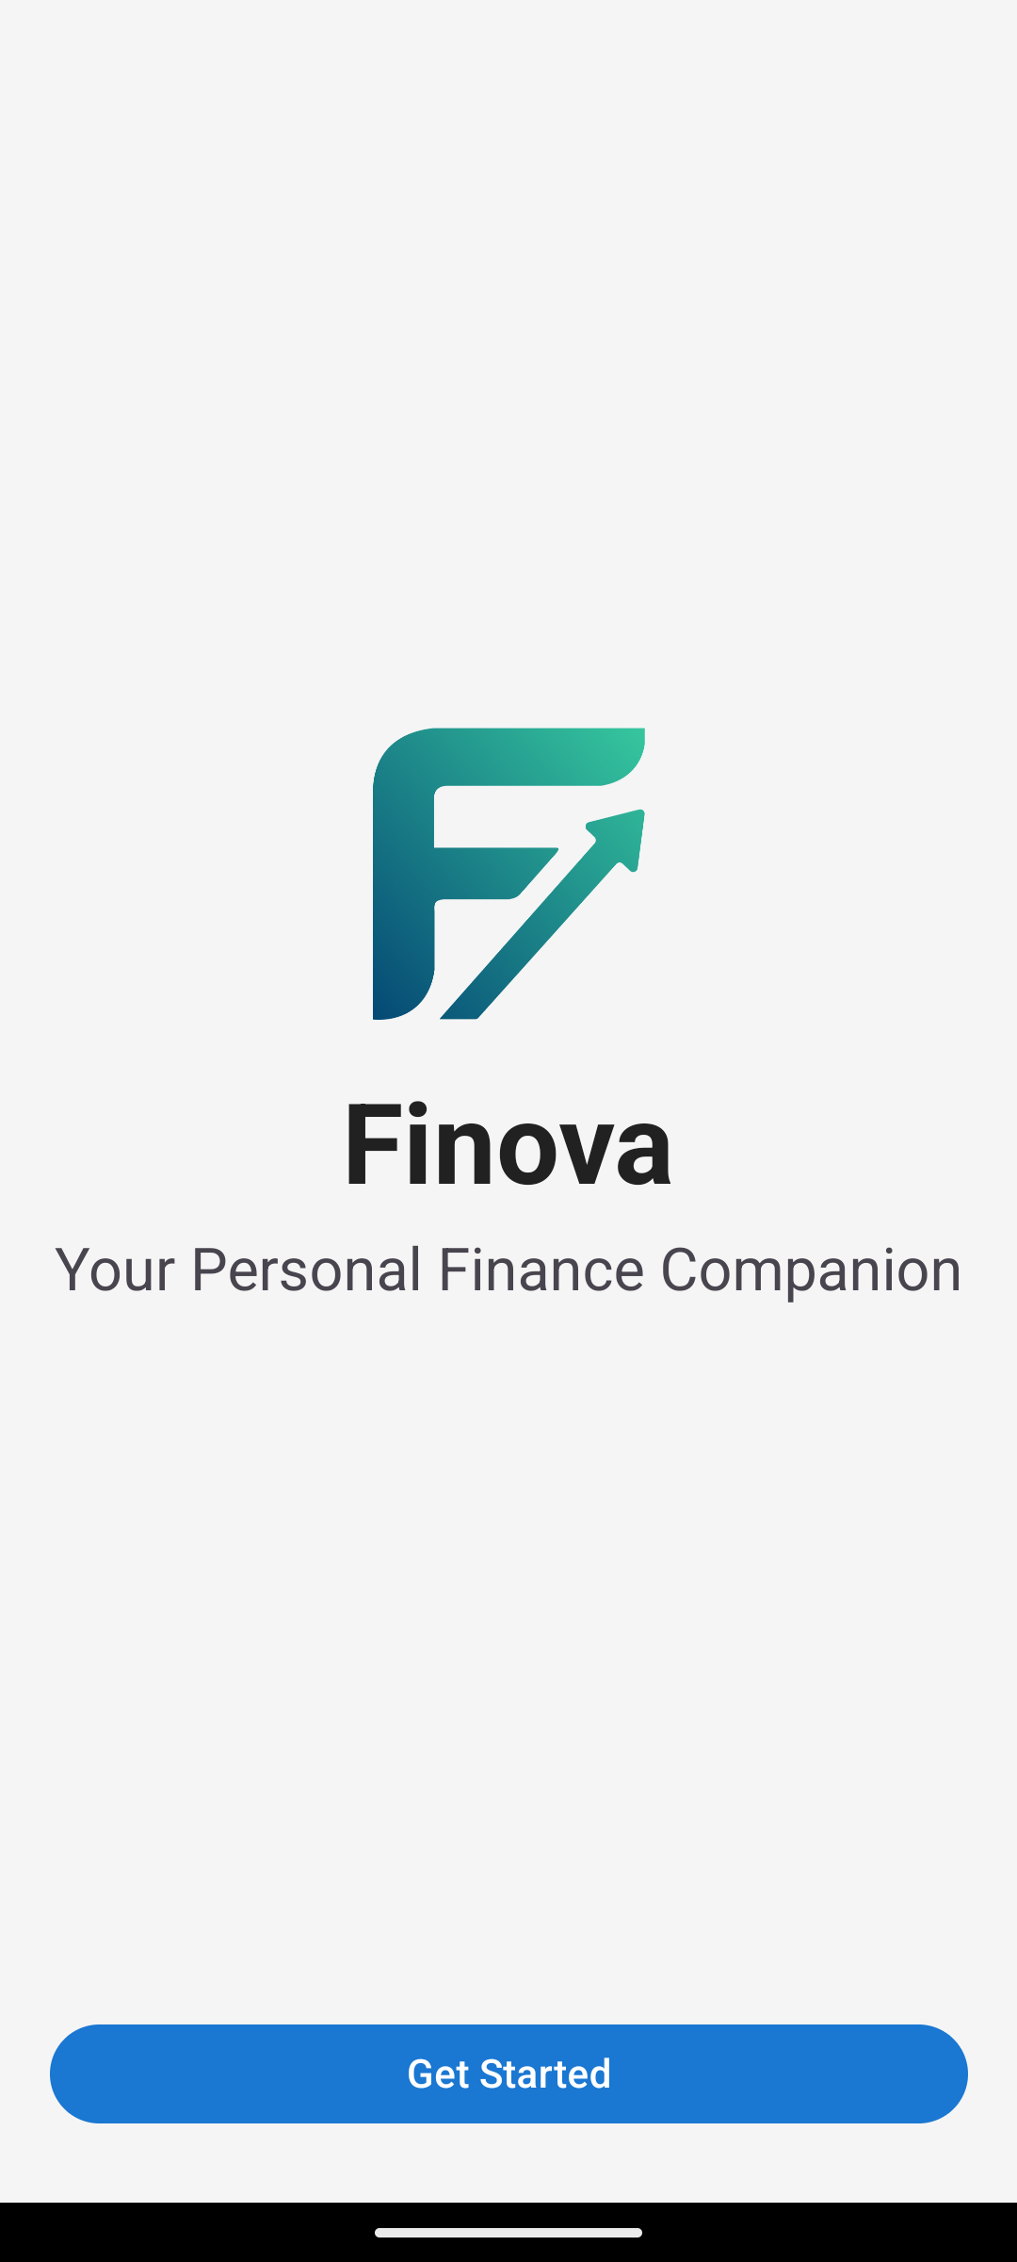
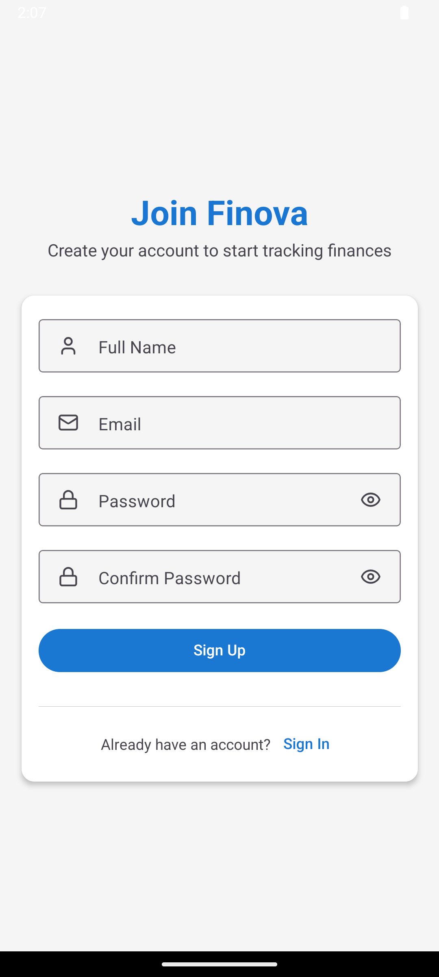
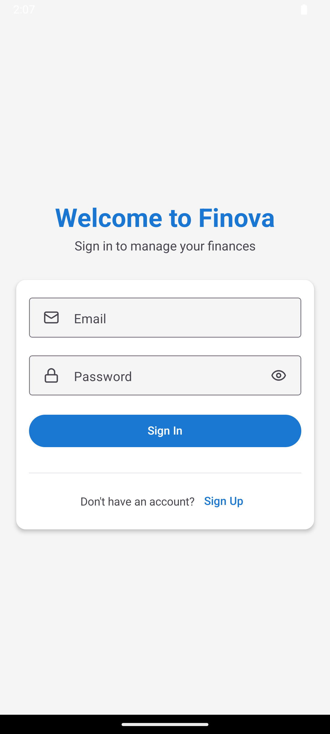

Slide 25
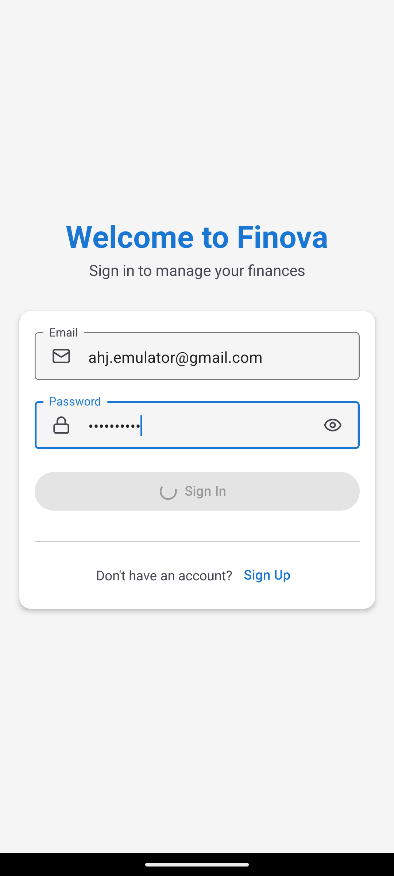
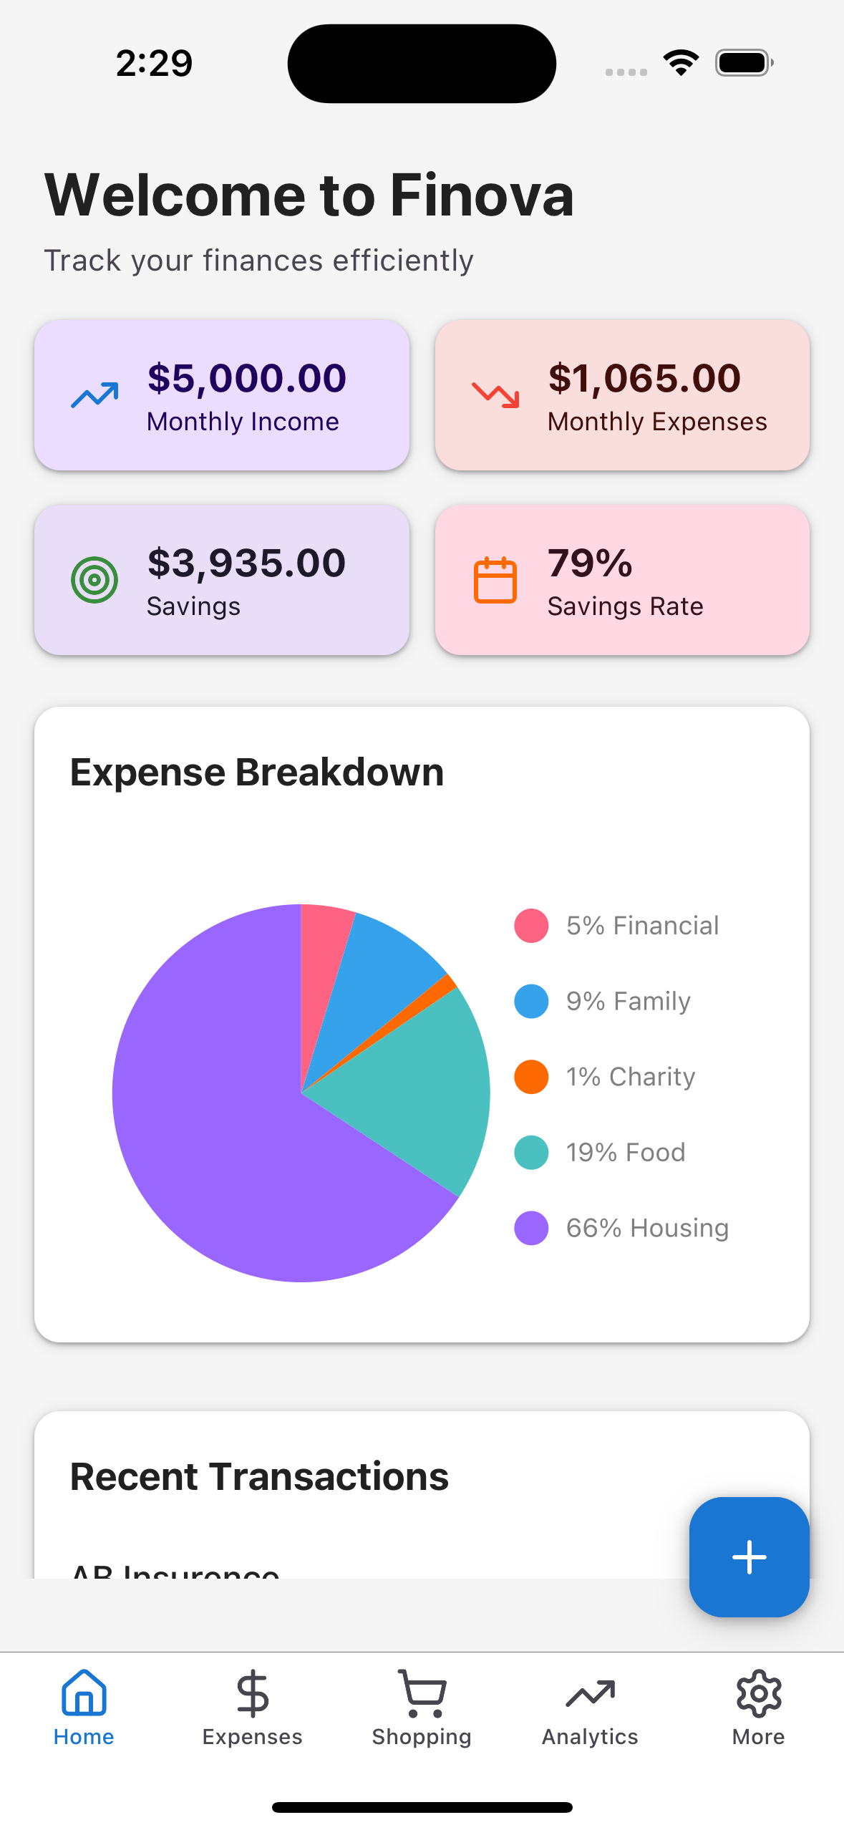
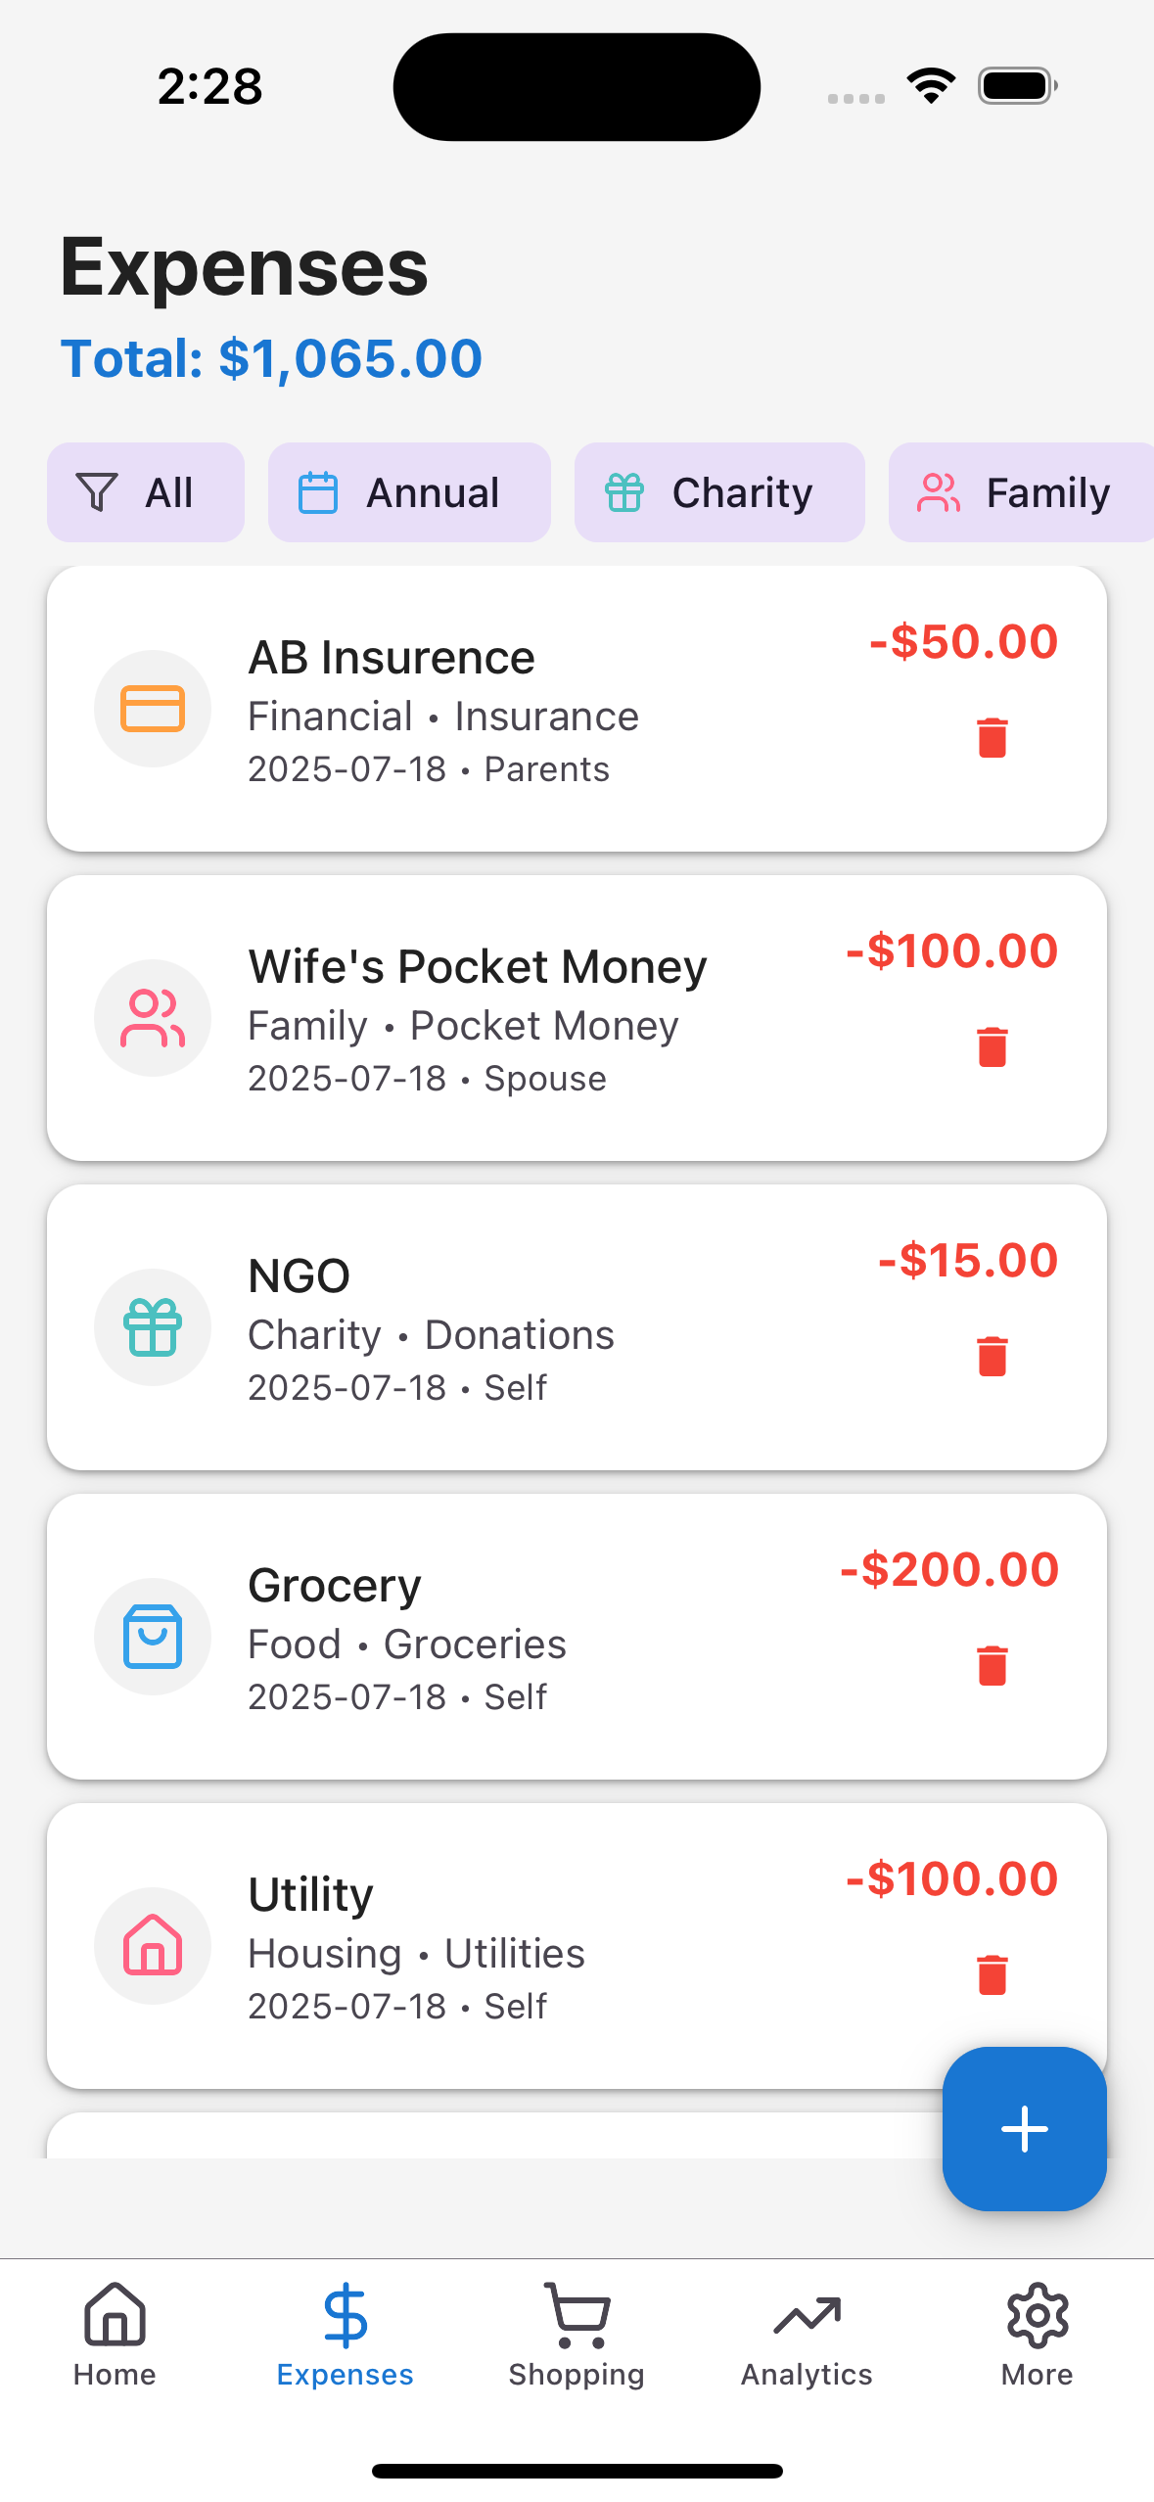
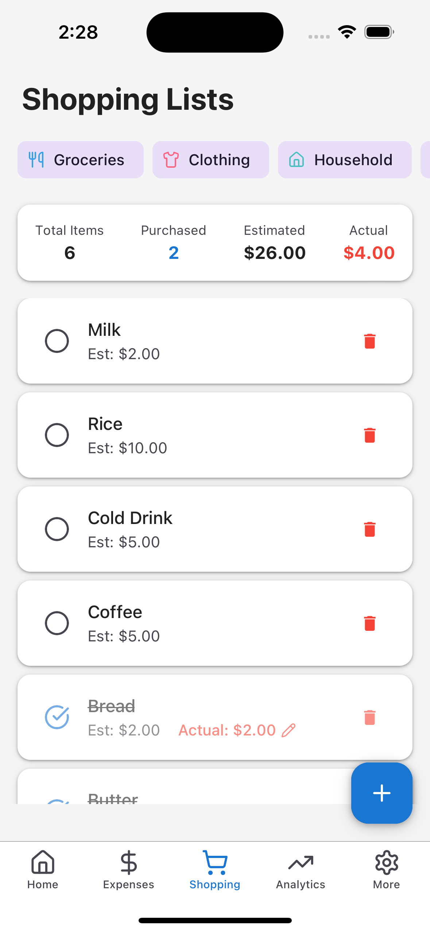

Slide 26
