Slide 1
Structured Programming CSE 103
Professor Dr. Mohammad Abu Yousuf

Slide 2
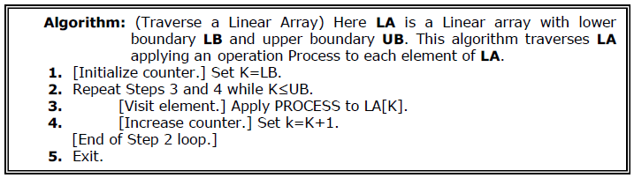
Traversing in Linear Array
It means processing or visiting each element in the array exactly once;
Let ‘A’ is an array stored in the computer’s memory. If we want to display the contents of ‘A’, it has to be traversed i.e. by accessing and processing each element of ‘A’ exactly once.

Slide 3
Sorting in Linear Array
Sorting an array is the ordering the array elements in ascending (increasing - from min to max) or descending (decreasing – from max to min) order.
Example:
{2 1 5 7 4 3} →{1, 2, 3, 4, 5,7} ascending order
{2 1 5 7 4 3} →{7,5, 4, 3, 2, 1} descending order

Slide 4
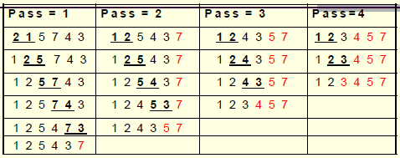
Bubble Sort
Example:
This sorting algorithm is comparison based algorithm in which each pair of adjacent elements is compared and elements are swapped if they are not in order.

Slide 5
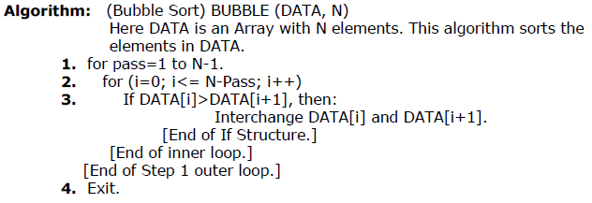
Bubble Sort

Slide 6
#include <stdio.h>
int main()
{
int data[100],i,n,step,temp;
printf("Enter the number of elements to be sorted: ");
scanf("%d",&n);
for(i=0;i<n;++i)
{ printf("%d. Enter element: ",i+1);
scanf("%d",&data[i]);
}
for(step=1;step<n;++step)
for(i=0;i<n-step;++i)
{
if(data[i]>data[i+1])
{
temp=data[i];
data[i]=data[i+1];
data[i+1]=temp;
}
}
printf("In ascending order: ");
for(i=0;i<n;++i)
printf("%d ",data[i]);
return 0;
}
Bubblesort

Slide 7
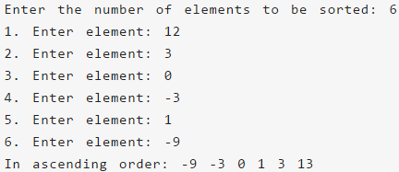
Bubble Sort
Output of previous program:

Slide 8
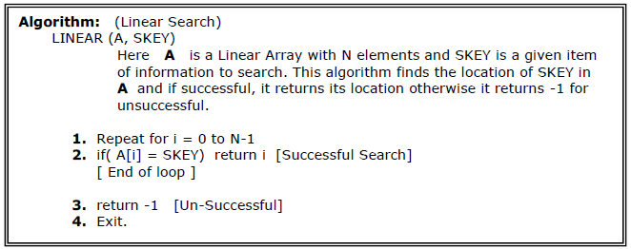
Searching in Linear Array
Linear Search:
The linear search compares each element of the array with the search key until the search key is found. To determine that a value is not in the array, the program must compare the search key to every element in the array.

Slide 9
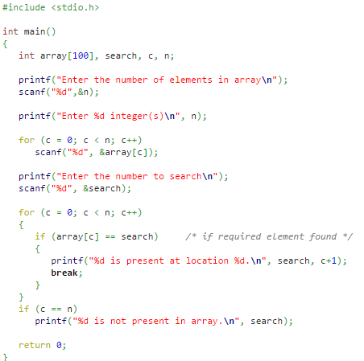
Linear search

Slide 10
Binary Search
It is useful for the large sorted arrays. The binary search algorithm can only be used with sorted array and eliminates one half of the elements in the array being searched after each comparison.

Slide 11
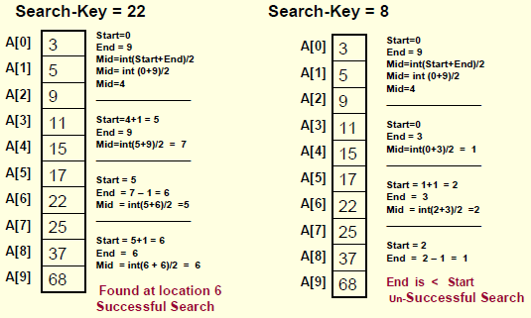
Binary Search
Example:

Slide 12
// Binary Search in C
#include <stdio.h>
int binarySearch(int array[], int x, int low, int high) {
while (low <= high) {
int mid = low + (high - low) / 2;
if (array[mid] == x)
return mid;
if (array[mid] < x)
low = mid + 1;
else
high = mid - 1;
}
return -1;
}
int main(void) {
int array[] = {3, 4, 5, 6, 7, 8, 9};
int n = sizeof(array) / sizeof(array[0]);
int x = 4;
int result = binarySearch(array, x, 0, n - 1);
if (result == -1)
printf("Not found");
else
printf("Element is found at index %d", result);
return 0;
}

Slide 13
Thank you

