Slide 1
Structured Programming Language PGDIT 101
Professor Dr. Mohammad Abu Yousuf

Slide 2
Pointers

Slide 3
What is Pointer?
A pointer is a variable that represents the location (rather than the value) of a data item, such as a variable or an array element.
Within the computer’s memory, every stored data item occupies one or more contiguous memory cells (i.e., adjacent words or bytes). The number of memory cells required to store a data item depends on the type of data item. For example, a single character will typically be stored in one byte (8 bits) of memory;

Slide 4
Pointer Fundamental
Suppose v is a variable that represents some particular data item. The compiler will automatically assign memory cells for this data item. The data item can then be accessed if we know the location (i.e., the address)of the first memory cell. The address of v ’s memory location can be determined by the expression &v, where & is a unary operator, called the address operator, that evaluates the address of its operand.
Now let us assign the address of v to another variable, pv. Thus,
pv = &v
This new variable is called a pointer to v, since it “points” to the location where v is stored in memory. Remember, however, that pv represents v’s address, not its value. Thus, pv is referred to as a pointer variable.

Slide 5
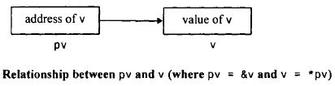
Pointer Fundamental (cont…)
The data item represented by v (i.e., the data item stored in v’s memory cells) can be accessed by the expression *pv, where * is a unary operator, called the indirection operator, that operates only on a pointer variable. Therefore, *pv and v both represent the same data item (i.e., the contents of the same memory cells). Furthermore, if we write pv = &v and u = *pv, then u and v will both represent the same value; Le., the value of v will indirectly be assigned to u. (It is assumed that u and v are of the same data type.)

Slide 6
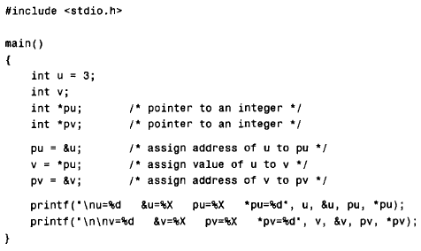
Pointer Fundamental (cont…)
C program that illustrates the relationship between two integer variables, their corresponding addresses and their associated pointers.

Slide 7

Pointer Fundamental (cont…)
In the first line, we see that u represents the value 3, as specified in the declaration statement. The address of u is determined automatically by the compiler as F8E (hexadecimal). The pointer pu is assigned this value; hence, pu also represents the (hexadecimal) address F8E. Finally, the value to which pu points (i.e., the value stored in the memory cell whose address is F8E) is 3, as expected.
Similarly, the second line shows that v also represents the value 3. This is expected, since we have assigned the value *pu to v. The address of v, and hence the value of pv, is F8C. Notice that u and v have different addresses. And finally, we see that the value to which pv points is 3, as expected.

Slide 8
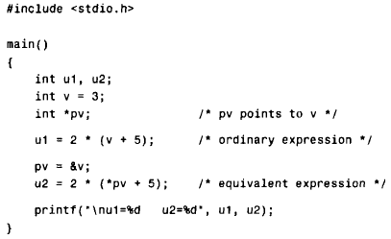
Consider the simple C program
This program involves the use of two integer expressions. The first, 2 * (v + 5),is an ordinary arithmetic expression whereas the second, 2 * (*pv + 5) , involves the use of a pointer. The expressions are equivalent, since v and *pv each represent the same integer value.

Slide 9
Pointer Fundamental (cont…)
The following output is generated when the program is executed.
u1=16 u2=16

Slide 10
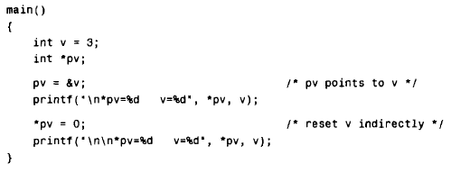
Pointer Fundamental (cont…)
When the program is executed, the following output is generated.
*pv=3 v=3
*pv=0 v=0

Slide 11
POINTER DECLARATIONS
Thus, a pointer declaration may be written in general terms as
data- type *ptvar;
where ptvar is the name of the pointer variable, and data-type refers to the data type of the pointer’s object. Remember that an asterisk must precede ptvar.
Example:
float u, v;
float *pv;
The first line declares u and v to be floating-point variables. The second line declares pv to be a pointer variable whose object is a floating-point quantity; i.e., pv points to a floating-point quantity. Note that pv represents an address, not a floating-point quantity.

Slide 12
POINTER DECLARATIONS
Within a variable declaration, a pointer variable can be initialized by assigning it the address of another variable. Remember that the variable whose address is assigned to the pointer variable must have been declared earlier in the program.
Example:
float u, v;
float *pv = &v;
The variables u and v are declared to be floating-point variables and pv is declared as a pointer variable that points to a floating-point quantity. In addition, the address of v is initially assigned to pv.

Slide 13

POINTER DECLARATIONS
Remember that these declarations are equivalent to writing
Note that an asterisk is not included in the assignment statement.

Slide 14
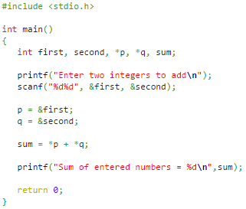

Add two numbers using pointer

Slide 15
PASSING POINTERS TO A FUNCTION
Pointers are often passed to a function as arguments. This allows data items within the calling portion of the program to be accessed by the function, altered within the function, and then returned to the calling portion of the program in altered form.
We refer to this use of pointers as passing arguments by reference (or by address or by location),in contrast to passing arguments by value.

Slide 16
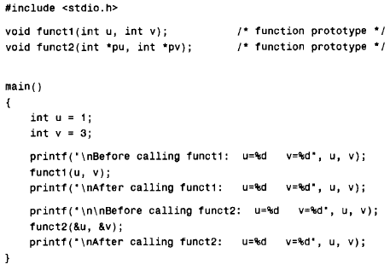
PASSING POINTERS TO A FUNCTION

Slide 17
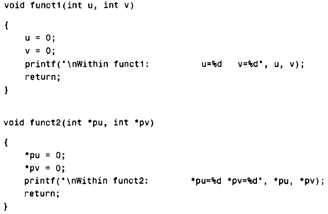
PASSING POINTERS TO A FUNCTION

Slide 18


PASSING POINTERS TO A FUNCTION
Output of previous program:

Slide 19
Explanation of previous output:
This program contains two functions, called funct1 and funct2. The first function, funct1 , receives two integer variables as arguments. These variables are originally assigned the values 1 and 3, respectively. The values are then changed, to 0, 0 within funct1. The new values are not recognized in main, however, because the arguments were passed by value, and any changes to the arguments are local to the function in which the changes occur.
Now consider the second function, funct2. This function receives two pointers to integer variables as its arguments. The arguments are identified as pointers by the indirection operators (i.e., the asterisks) that appear in the argument declaration. In addition, the argument declaration indicates that the pointers contain the addresses of integer quantities.
Within funct2, the contents of the pointer addresses are reassigned the values 0, 0. Since the addresses are recognized in both funct2 and main, the reassigned values will be recognized within main after the call to funct2. Therefore, the integer variables U and v will have their values changed from 1, 3 to 0,0.

Slide 20
Difference between call by value and call by reference
When an argument is passed by value, the data item is copied to the function. Thus, any alteration made to the data item within the function is not carried over into the calling routine.
When an argument is passed by reference, however (i.e., when a pointer is passed to a function), the address of a data item is passed to the function. The contents of that address can be accessed freely, either within the function or within the calling routine. Moreover, any change that is made to the data item (i.e., to the contents of the address) will be recognized in both the function and the calling routine.
Thus, the use of a pointer as a function argument permits the corresponding data item to be altered globally from within the function.

Slide 21
Array name is actually a pointer to the array
We have already mentioned the fact that an array name is actually a pointer to the array; i.e., the array name represents the address of the first element in the array . Therefore, an array name is treated as a pointer when it is passed to a function. However, it is not necessary to precede the array name with an ampersand within the function call.
An array name that appears as a formal argument within a function definition can be declared either as a pointer or as an array of unspecified size. The choice is a matter of personal preference, though it will often be determined by the manner in which the individual array elements are accessed within the function.

Slide 22
POINTERS AND ONE-DIMENSIONAL ARRAYS
Recall that an array name is really a pointer to the first element in the array. Therefore, if x is a one dimensional array, then the address of the first array element can be expressed as either &x[ 0] or simply as x.
Moreover, the address of the second array element can be written as either &x[1] or as (x + 1), and so on.
In general, the address of array element (i+1) can be expressed as either &x[i]or as (x + i).
Thus we have two different ways to write the address of any array element: We can write the actual array element, preceded by an ampersand; or we can write an expression in which the subscript is added to the array name.

Slide 23
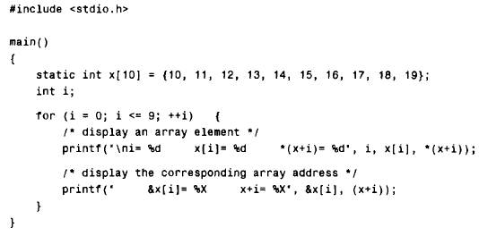
Since &x[i] and (x + i)both represent the address of the ith element of x, it would seem reasonable that x[i]and *(x + i) both represent the contents of that address, i.e., the value of the ith element of x. This is indeed the case. The two terms are interchangeable.

Slide 24
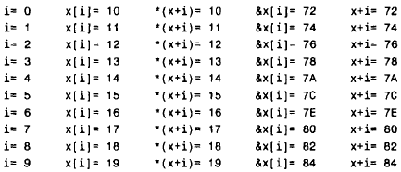
Output of previous program:

Slide 25
Pointer to Pointer
int **p; // pointer to a pointer which is pointing to an integer.
#include<stdio.h>
void main ()
{
int a = 10;
int *p;
int **pp;
p = &a; // pointer p is pointing to the address of a
pp = &p; // pointer pp is a double pointer pointing to the address of pointer p
printf("address of a: %x\n",p); // Address of a will be printed
printf("address of p: %x\n",pp); // Address of p will be printed
printf("value stored at p: %d\n",*p); // value stoted at the address contained by p i.e. 10 will be printed
printf("value stored at pp: %d\n",**pp); // value stored at the address contained by the pointer stoyred at pp
}
address of a: d26a87340
address of p: d26a8738
value stored at p: 10
value stored at pp: 10

Slide 26
Thank you

