Slide 1
Structured Programming CSE 103
Professor Dr. Mohammad Abu Yousuf

Slide 2
Pointer-2

Slide 3
Example
int m=3, n=100, *p;
p=m;
printf("m is %d\n",*p);
m++;
printf("now m is %d\n",*p);
p=&n;
printf("n is %d\n",*p);
*p=500; /* *p is at the left of "=" */
printf("now n is %d\n", n);

Slide 4

Output of previous program:

Slide 5
More on pointers as function parameters
void min_max(int a, int b,
int *min, int *max){
if(a>b){
*max=a;
*min=b;
}
else{
*max=b;
*min=a;
}
}
int main()
{
int x,y;
int small,big;
printf("Two integers: ");
scanf("%d %d", &x, &y);
min_max(x,y,&small,&big);
printf("%d <= %d", small, big);
return 0;
}

Slide 6
What’s wrong of the following program ....
#include <stdio.h>
int main()
{
int *p;
scanf("%d",p);
return 0;
}

Slide 7
This one is correct:
#include <stdio.h>
int main()
{
int *p;
int a;
p = &a;
scanf("%d",p);
return 0;
}

Slide 8
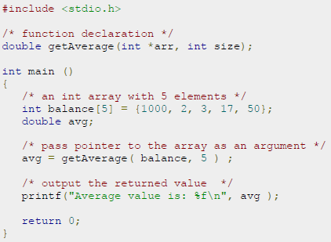
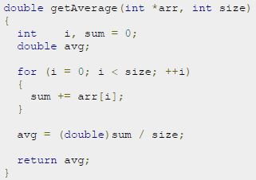

Slide 9
#include <stdio.h> int main() { // Declare an array int v[3] = {10, 100, 200}; // Declare pointer variable int *ptr; // Assign the address of v[0] to ptr ptr = v; for (int i = 0; i < 3; i++) { printf("Value of *ptr = %d\n", *ptr); printf("Value of ptr = %p\n\n", ptr); // Increment pointer ptr by 1 ptr++; } }
Output:
Value of *ptr = 10
Value of ptr = 0x7ffcae30c710
Value of *ptr = 100
Value of ptr = 0x7ffcae30c714
Value of *ptr = 200
Value of ptr = 0x7ffcae30c718

Slide 10
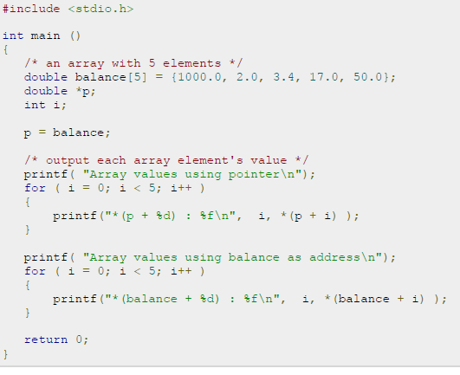

Slide 11
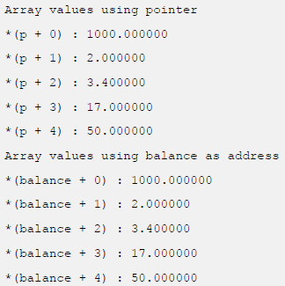

Slide 12
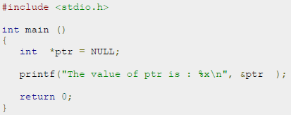
NULL Pointers in C
It is always a good practice to assign a NULL value to a pointer variable in case you do not have exact address to be assigned. This is done at the time of variable declaration. A pointer that is assigned NULL is called a null pointer.
The NULL pointer is a constant with a value of zero defined in several standard libraries.

Slide 13
Pointer Arithmetic (1)
When a pointer variable points to an array element, there is a notion of adding or subtracting an integer to/from the pointer.
int a[ 10 ], *p;
p = &a[2];
*p = 10;
*(p+1) = 10;
printf("%d", *(p+3));
int a[ 10 ], *p;
a[2] = 10;
a[3] = 10;
printf("%d", a[5]);
p
p+1
p+2
p+3
p+4
p+5
p+6
p+7
a
a[0]
a[1]
a[2]
a[3]
a[4]
a[5]
a[6]
a[7]
a[8]
a[9]

Slide 14
Pointer Arithmetic (2)
More examples:
int a[10], *p, *q;
p = &a[2];
q = p + 3; /* q points to a[5] now */
p = q – 1; /* p points to a[4] now */
p++; /* p points to a[5] now */
p--; /* p points to a[4] now */
*p = 123; /* a[4] = 123 */
*q = *p; /* a[5] = a[4] */
q = p; /* q points to a[4] now */
scanf("%d", q) /* scanf("%d", &a[4]) */

Slide 15
Pointer Arithmetic (3)
If two pointers point to elements of a same array, then there are notions of subtraction and comparisons between the two pointers.
int a[10], *p, *q , i;
p = &a[2];
q = &a[5];
i = q - p; /* i is 3*/
i = p - q; /* i is -3 */
a[2] = a[5] = 0;
i = *p - *q; /* i = a[2] – a[5] */
p < q; /* true */
p == q; /* false */
p != q; /* true */

Slide 16
Find output
What will be the output of the following C code?
#include <stdio.h>
void main()
{
int a[3] = {1, 2, 3};
int *p = a;
printf("%p\t%p", p, a);
}
Output:
Same address is printed

Slide 17
DYNAMIC MEMORY ALLOCATION
Since an array name is actually a pointer to the first element within the array, it should be possible to define the array as a pointer variable rather than as a conventional array.
However, a conventional array definition results in a fixed block of memory being reserved at the beginning of program execution, whereas this does not occur if the array is represented in terms of a pointer variable.
Therefore, the use of a pointer variable to represent an array requires some type of initial memory assignment before the array elements are processed. This is known as dynamic memory allocation. Generally, the malloc library function is used for this purpose.

Slide 18
DYNAMIC MEMORY ALLOCATION
Suppose x is a one-dimensional, 10-element array of integers. It is possible to define x as a pointer variable rather than an array
int *x;
rather than
int x [10] ;
However, x is not automatically assigned a memory block when it is defined as a pointer variable, though a block of memory large enough to store 10 integer quantities will be reserved in advance when x is defined as an array.
To assign sufficient memory for x, we can make use of the library function malloc, as follows.
x = (int *) malloc(10 * sizeof(int));
This function reserves a block of memory whose size (in bytes) is equivalent to 10 integer quantities. As written, the function returns a pointer to an integer. This pointer indicates the beginning of the memory block.

Slide 19
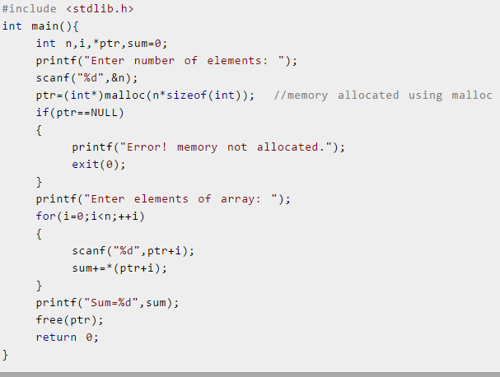
find sum of n elements entered by user using malloc function

Slide 20
Malloc and free function:
#include <stdio.h>
#include <stdlib.h>
int main(){
int *p;
p = (int *) malloc( sizeof(int) );
scanf("%d", p);
printf("%d", *p);
free(p); /* This returns the memory to the system.*/
/* Important !!! */
}

Slide 21
POINTERS AND MULTIDIMENSIONAL ARRAYS
A two-dimensional array declaration can be written as
data- type ( *ptvar) [ expression 2] ;
rather than
data- type array[ expression I] [ expression 2];
Example:
int (*x)[20];
rather than
int x[10][20];

Slide 22
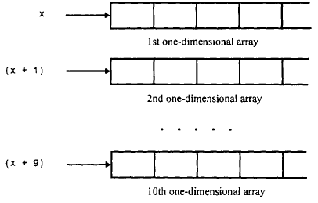
POINTERS AND MULTIDIMENSIONAL ARRAYS

Slide 23
Suppose x is a two-dimensional integer array having 10 rows and 20 columns, as declared in the previous example. The item in row 2, column 5 can be accessed by writing either
x[2][5] or * ( * ( x + 2) + 5)
The second form requires some explanation. First, note that (x + 2) is a pointer to row 2. Therefore the object of this pointer, * ( x + 2),refers to the entire row. Since row 2 is a one-dimensional array, * ( x + 2) is actually a pointer to the first element in row 2.
We now add 5 to this pointer. Hence, (*(x + 2) + 5) is a pointer to element 5 (i.e., the sixth element) in row 2. The object of this pointer, * ( * (x + 2) + 5),therefore refers to the item in column 5 of row 2, which is x [ 2] [ 5].

Slide 24
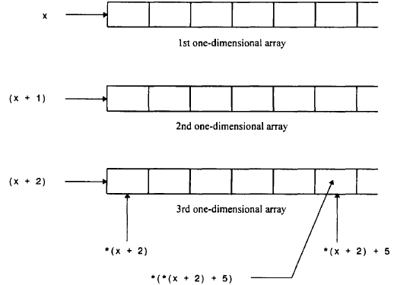

Slide 25
Thank you

