Slide 1
Structured Programming CSE 103
Professor Dr. Mohammad Abu Yousuf

Slide 2
String

Slide 3
In C programming, array of character are called strings. A string is terminated by null character /0. For example:
"c string tutorial“
Here, "c string tutorial" is a string. When, compiler encounters strings, it appends null character at the end of string.

Slide 4

Declaration of strings
Strings are declared in C in similar manner as arrays. Only difference is that, strings are of char type.
char s[5];

Slide 5
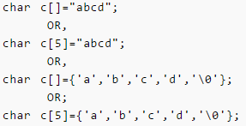

Initialization of strings
In C, string can be initialized in different number of ways.

Slide 6
String can also be initialized using pointers
char *c="abcd";

Slide 7
Reading Strings from user.
char c[20];
scanf("%s",c);
String variable c can only take a word. It is because when white space is encountered, the scanf() function terminates.

Slide 8
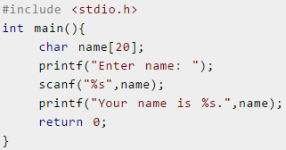

How to read string from terminal
Here, program will ignore Ritchie because, scanf() function takes only string before the white space.

Slide 9
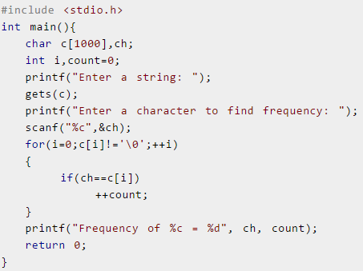
Find the Frequency of Characters

Slide 10
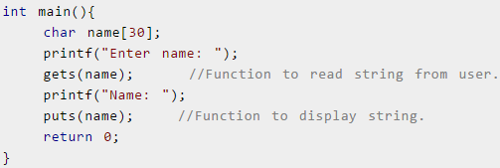

There are predefined functions gets() and puts in C language to read and display string respectively.

Slide 11
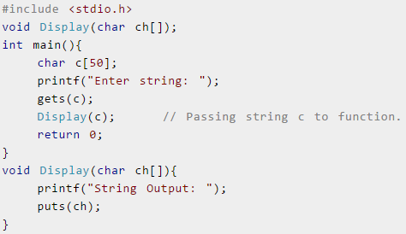
Passing Strings to Functions
String can be passed to function in similar manner as arrays as, string is also an array.

Slide 12
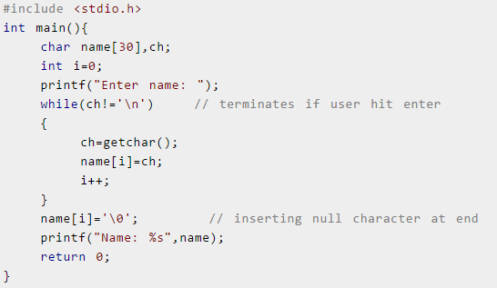
Reading a line of text
Read line of text manually.

Slide 13
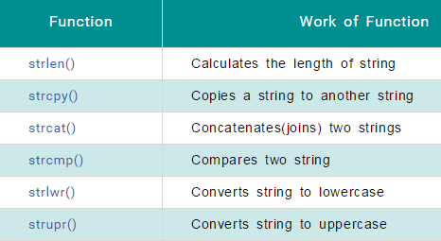
String Function
There are numerous functions defined in "string.h" header file. Few commonly used string handling functions are discussed below:

Slide 14
String Function
C program to find string length
#include <stdio.h>
#include <string.h>
int main()
{
char a[100];
int length;
printf("Enter a string to calculate it's length\n");
gets(a);
length = strlen(a);
printf("Length of entered string is = %d\n",length);
return 0;
}

Slide 15
String Function
C program to compare two strings using strcmp
#include <stdio.h>
#include <string.h>
int main()
{ char a[100], b[100];
printf("Enter the first string\n");
gets(a);
printf("Enter the second string\n");
gets(b);
if (strcmp(a,b) == 0)
printf("Entered strings are equal.\n");
else
printf("Entered strings are not equal.\n");
return 0;
}

Slide 16
String Function
C program to copy a string
#include <stdio.h>
#include <string.h>
int main()
{ char source[1000], destination[1000];
printf("Input a string\n");
gets(source);
strcpy(destination, source);
printf("Source string: \"%s\"\n", source);
printf("Destination string: \"%s\"\n", destination);
return 0;
}

Slide 17
String Function
C program to concatenate strings
#include <stdio.h>
#include <string.h>
int main(){
char a[1000], b[1000];
printf("Enter the first string\n");
gets(a);
printf("Enter the second string\n");
gets(b);
strcat(a,b);
printf("String obtained on concatenation is %s\n",a);
return 0;
}

Slide 18
String Function
C program to Reverse string
#include <stdio.h>
#include <string.h>
int main(){
char arr[100];
printf("Enter a string to reverse\n");
gets(arr);
strrev(arr);
printf("Reverse of entered string is \n%s\n",arr);
return 0;
}

Slide 19
C program to find the frequency of the word ‘the’ in a given sentence.
#include <stdio.h>
void main()
{
int count = 0, i, times = 0, t, h, e, space;
char string[100];
puts("Enter a string:");
gets(string);
/* Traverse the string to count the number of characters */
while (string[count] != '\0')
{
count++;
}
/* Finding the frequency of the word 'the' */
for (i = 0; i <= count - 3; i++)
{
t =(string[i] == 't' || string[i] == 'T’);
h =(string[i + 1] == 'h' || string[i + 1] == 'H’);
e =(string[i + 2] == 'e'|| string[i + 2] == 'E’);
space =(string[i + 3] == ' ' || string[i + 3] == '\0’);
if ((t && h && e && space) == 1)
times++;
}
printf("Frequency of the word 'the' is %d\n", times);
}

Slide 20
Output:
Enter a string:
The brown fox jump over the lazy dog.
Frequency of the word 'the' is 2

Slide 21
Thank you

