Slide 1
Structured Programming CSE 103
Professor Dr. Mohammad Abu Yousuf

Slide 2
Structure

Slide 3
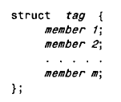
DEFINING A STRUCTURE
In this declaration, struct is a required keyword; tag is a name that identifies structures of this type (i.e., structures having this composition); and member 1 , member 2, . . . , member m are individual member declarations.

Slide 4
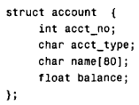
DEFINING A STRUCTURE
Example
We can now declare the structure variables oldcustomer and newcustomer as follows.
struct account oldcustomer, newcustomer;
Thus, oldcustomer and newcustomer are variables of type account.

Slide 5
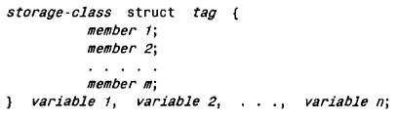
DEFINING A STRUCTURE
It is possible to combine the declaration of the structure composition with that of the structure variables, as shown below.
The tag is optional in this situation.

Slide 6
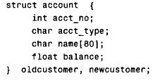
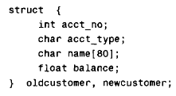
DEFINING A STRUCTURE
The above declaration can also be written as

Slide 7
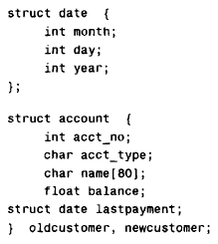
DEFINING A STRUCTURE
A structure variable may be defined as a member of another structure. In such situations, the declaration of the embedded structure must appear before the declaration of the outer structure.

Slide 8
DEFINING A STRUCTURE
The second structure (account) now contains another structure (date) as one of its members. Note that the declaration of date precedes the declaration of account.

Slide 9
DEFINING A STRUCTURE
The members of a structure variable can be assigned initial values in much the same manner as the elements of an array. The initial values must appear in the order in which they will be assigned to their corresponding structure members, enclosed in braces and separated by commas. The general form is
struct tag variable = {value 1, value 2, . . ., value n);
where value1 refers to the value of the first member, value 2 refers to the value of the second member, and so on.

Slide 10

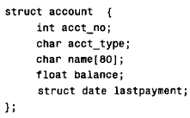
DEFINING A STRUCTURE
struct account_customer = (12345, ' R I , "John W. Smith", 586.30, 5, 24, 90);

Slide 11
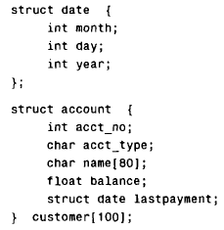
DEFINING A STRUCTURE
It is also possible to define an array of structures

Slide 12
PROCESSING A STRUCTURE
A structure member can be accessed by writing
variable. member
where variable refers to-the name of a structure-type variable, and member refers to the name of a member within the structure.

Slide 13
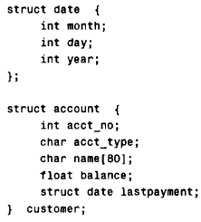
PROCESSING A STRUCTURE
customer.acct_no

Slide 14
#include <stdio.h>
#include <string.h>
// create struct with person1 variable
struct Person {
char name[50];
int citNo;
float salary;
} person1;
int main() {
// assign value to name of person1
strcpy(person1.name, "George Orwell");
// assign values to other person1 variables
person1.citNo = 1984;
person1. salary = 2500;
// print struct variables
printf("Name: %s\n", person1.name);
printf("Citizenship No.: %d\n", person1.citNo);
printf("Salary: %.2f", person1.salary);
return 0;
}
Output
Name: George Orwell
Citizenship No.: 1984
Salary: 2500.00

Slide 15
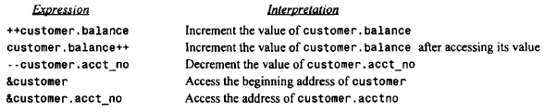
PROCESSING A STRUCTURE
Several expressions involving the structure variable customer and its members are given below.

Slide 16
PROCESSING A STRUCTURE
if a structure member is itself a structure, then a member of the embedded structure can be accessed by writing
variable. member. submember
where member refers to the name of the member within the outer structure, and sub member refers to the name of the member within the embedded structure.
To access the month of the last payment, we would therefore write
customer.lastpayment.month
Moreover, this value can be incremented by writing
++customer.lastpayment.month

Slide 17
PROCESSING A STRUCTURE
Similarly, if a structure member is an array, then an individual array element can be accessed by writing
variable. member[ expression]
where expression is a nonnegative value that indicates the array element.
Example: The third member of customer is the character array customer. name. The third character within this array can be accessed by writing
customer.name[2]

Slide 18
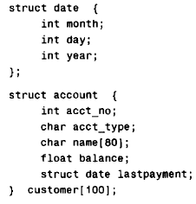
The use of the period operator can be extended to arrays of structures, by writing
array[ expression] .member
14th customer's balance can be accessed by writing customer[ 13]. balance. The corresponding address can be obtained as &customer[ 13]. balance.

Slide 19
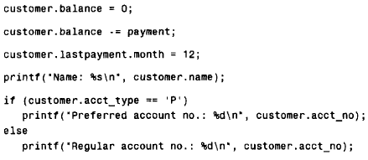

Slide 20
USER-DEFINED DATA TYPES (typedef)
The typedef feature allows users to define new data-types that are equivalent to existing data types. Once a user-defined data type has been established, then new variables, arrays, structures, etc. can be declared in terms of this new data type.
In general terms, a new data type is defined as
typedef type new-type;
where type refers to an existing data type (either a standard data type, or previous user-defined data type), and new- type refers to the new user-defined data type. It should be understood, however, that the new data type will be new in name only. In reality, this new data type will not be fundamentally different from one of the standard data types.

Slide 21
USER-DEFINED DATA TYPES (typedef)
Example:
typedef int age;
In this declaration age is a user-defined data type, which is equivalent to type int. Hence, the variable declaration
age male, female;
is equivalent to writing
int male, female;
In other words, male and female are regarded as variables of type age, though they are actually integer-type variables.

Slide 22
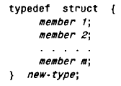
Define Structure using Tag
In general terms, a user-defined structure type can be written as
where new- type is the user-defined structure type. Structure variables can then be defined in terms of the new data type.

Slide 23
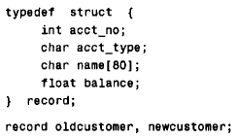
Example:
The first declaration defines record as a user-defined data type. The second declaration defines oldcustomer and newcustomer as structure variables of type record.
The typedef feature is particularly convenient when defining structures, since it eliminates the need to repeatedly write struct tag whenever a structure is referenced.

Slide 24
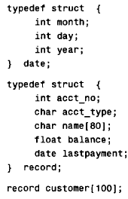
Example:

Slide 25
#include <stdio.h>
#include <string.h>
// struct with typedef person
typedef struct Person {
char name[50];
int citNo;
float salary;
} person;
int main() {
// create Person variable
person p1;
// assign value to name of p1
strcpy(p1.name, "George Orwell");
// assign values to other p1 variables
p1.citNo = 1984;
p1. salary = 2500;
// print struct variables
printf("Name: %s\n", p1.name);
printf("Citizenship No.: %d\n", p1.citNo);
printf("Salary: %.2f", p1.salary);
return 0;
}
Output
Name: George Orwell
Citizenship No.: 1984
Salary: 2500.00

Slide 26
STRUCTURES AND POINTERS
The beginning address of a structure can be accessed in the same manner as any other address, through the use of the address (&) operator. Thus, if variable represents a structure-type variable, then &variable represents the starting address of that variable. Moreover, we can declare a pointer variable for a structure by writing
type *ptvar;
where type is a data type that identifies the composition of the structure, and ptvar represents the name of the pointer variable. We can then assign the beginning address of a structure variable to this pointer by writing
ptvar = &variable;

Slide 27
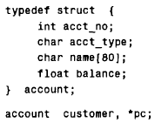
STRUCTURES AND POINTERS
Example:
In this example customer is a structure variable of type account, and pc is a pointer variable whose object is a structure variable of type account. Thus, the beginning address of customer can be assigned to pc by writing
pc = &customer;

Slide 28
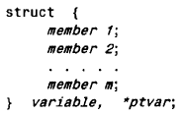
STRUCTURES AND POINTERS
The variable and pointer declarations can be combined with the structure declaration by writing
where variable again represents a structure-type variable, and ptvar represents the name of a pointer variable.

Slide 29
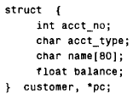
STRUCTURES AND POINTERS
Example:
The beginning address of customer can be assigned to pc by writing
pc = &customer;
as in the previous example.

Slide 30
STRUCTURES AND POINTERS
An individual structure member can be accessed in terms of its corresponding pointer variable by writing
ptvar- >member
where ptvar refers to a structure-type pointer variable and the operator -> is comparable to the period (.).
Thus, the expression
ptvar->member
is equivalent to writing
variable. member
where variable is a structure-type variable

Slide 31
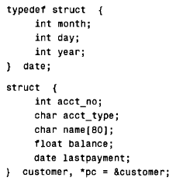
Example:
If we wanted to access the customer’s account number, we could write any of the following:
customer.acct-no pc->acct-no (*pc).acct-no
The parentheses are required in the last expression because the period operator has a higher precedence than the indirection operator (*). Without the parentheses the compiler would generate an error, because pc (a pointer) is not directly compatible with the dot operator.

Slide 32
The month of the last payment can be accessed by writing any of the following:
customer.lastpayment.month pc->lastpayment.month (*pc).lastpayment.month
Finally, the customer's name can be accessed by writing any of the following:
customer. name pc ->name (*pc).name
Therefore, the third character of the customer's name can be accessed by writing any of the following.
customer.name[2] pc->name[2] (*pc).name[2]
*(customer. name + 2) pc->(name + 2) *((*pc).name + 2)

Slide 33
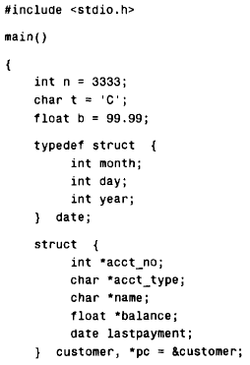

Slide 34
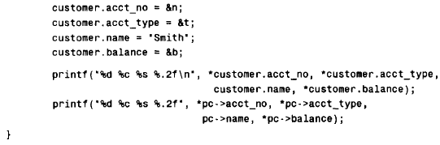

Slide 35
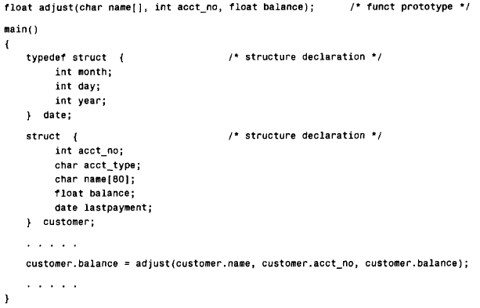
PASSING STRUCTURES TO FUNCTIONS

Slide 36
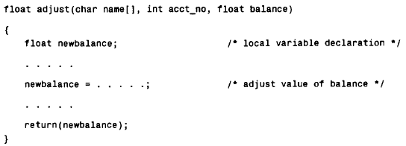
PASSING STRUCTURES TO FUNCTIONS

Slide 37
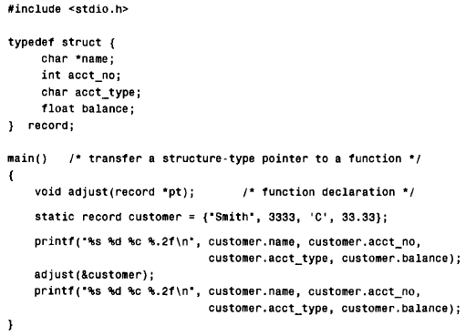
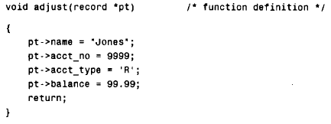
Example:

Slide 38
Thank you

