Slide 1
Structured Programming Language PGDIT 101
Professor Dr. Mohammad Abu Yousuf

Slide 2
Array of Structure Example
#include<stdio.h>
#include <string.h>
struct student{
int rollno;
char name[10];
};
int main(){
int i;
struct student st[5];
printf("Enter Records of 5 students");
for(i=0;i<5;i++){
printf("\nEnter Rollno:");
scanf("%d",&st[i].rollno);
printf("\nEnter Name:");
scanf("%s",&st[i].name);
}
printf("\nStudent Information List:");
for(i=0;i<5;i++){
printf("\nRollno:%d, Name:%s",st[i].rollno,st[i].name);
}
return 0;
}

Slide 3
UNIONS
Unions, like structures, contain members whose individual data types may differ from one another. However, the members within a union all share the same storage area within the computer’s memory, whereas each member within a structure is assigned its own unique storage area.
Thus, unions are used to conserve memory. They are useful for applications involving multiple members, where values need not be assigned to all of the members at any one time.

Slide 4
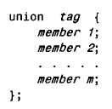



Slide 5
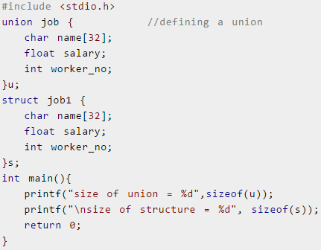
Difference between union and structure

Slide 6

Output
There is difference in memory allocation between union and structure as suggested in above example. The amount of memory required to store a structure variables is the sum of memory size of all members.
But, the memory required to store a union variable is the memory required for largest element of an union.

Slide 7
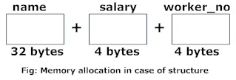
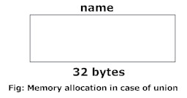

Slide 8
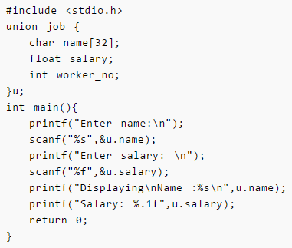

Slide 9
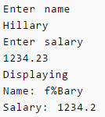
Output:
Note: You may get different garbage value of name.
Why this output?
Initially, Hillary will be stored in u.name and other members of union will contain garbage value. But when user enters value of salary, 1234.23 will be stored in u.salary and other members will contain garbage value. Thus in output, salary is printed accurately but, name displays some random string.

Slide 10
As you know, all members of structure can be accessed at any time. But, only one member of union can be accessed at a time in case of union and other members will contain garbage value.

Slide 11
Data Files

Slide 12
Introduction
Many applications require that information be written to or read from an auxiliary memory device.
Such information is stored on the memory device in the form of a data file.
Thus, data files allow us to store information permanently, and to access and alter that information whenever necessary.

Slide 13
OPENING AND CLOSING A DATA FILE
When working with a stream-oriented data file, the first step is to establish a buffer area, where information is temporarily stored while being transferred between the computer’s memory and the data file.
This buffer area allows information to be read from or written to the data file more rapidly than would otherwise be possible.
The buffer area is established by writing
FILE *ptvar;
where FILE (uppercase letters required) is a special structure type that establishes the buffer area, and ptvar is a pointer variable that indicates the beginning of the buffer area.

Slide 14
OPENING AND CLOSING A DATA FILE
A data file must be opened before it can be created or processed.
Syntax:
ptvar = fopen( file-name, file-type);
where file-name and file- type are strings that represent the name of the data file and the manner in which the data file will be utilized.
The fopen function returns a pointer to the beginning of the buffer area associated with the file.

Slide 15
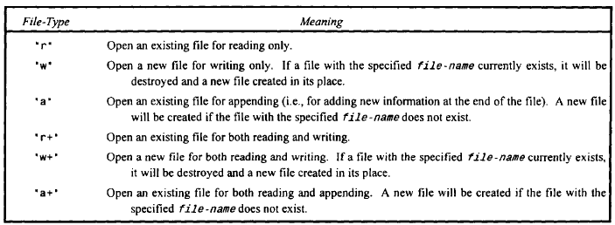
OPENING AND CLOSING A DATA FILE

Slide 16
OPENING AND CLOSING A DATA FILE
Finally, a data file must be closed at the end of the program. This can be accomplished with the library function fclose.
The syntax is simply
fclose (ptvar);
It is good programming practice to close a data file explicitly using the fclose function

Slide 17
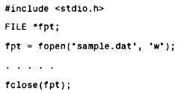
OPENING AND CLOSING A DATA FILE

Slide 18
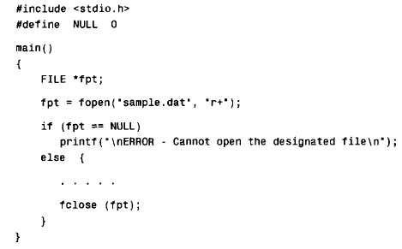
OPENING AND CLOSING A DATA FILE

Slide 19
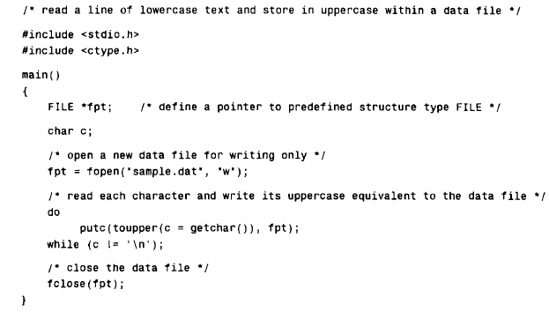
CREATING A DATA FILE

Slide 20
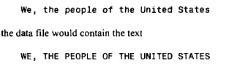
OPENING AND CLOSING A DATA FILE
Output:

Slide 21

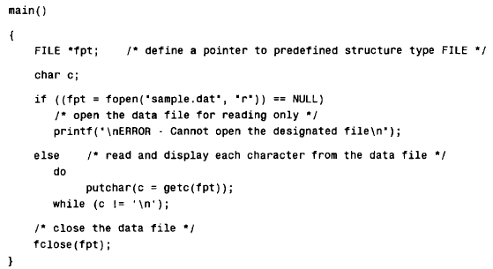

Slide 22
Thank You

