Slide 1
Structured Programming Language PGDIT 101
Professor Dr. Mohammad Abu Yousuf

Slide 2
fscanf, fprintf
The functions gets and puts read or write strings to or from the standard output devices, whereas fgets and fputs exchange strings with data files.
the fscanf function permits formatted data to be read from a data file associated with a particular stream, and fprintf permits formatted data to be written to the data file.
The actual format specifications are the same as those used with the scanf and printf functions
The functions fprintf() and fscanf() are the file version of printf() and fscanf(). The only difference while using fprintf() and fscanf() is that, the first argument is a pointer to the structure FILE.

Slide 3
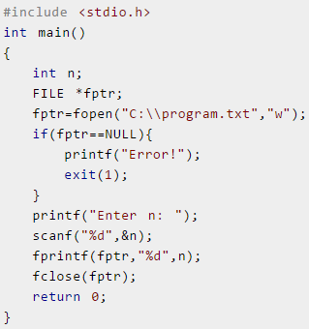
Write a file
This program takes the number from user and stores in file. After you compile and run this program, you can see a text file program.txt created in C drive of your computer. When you open that file, you can see the integer you entered.

Slide 4
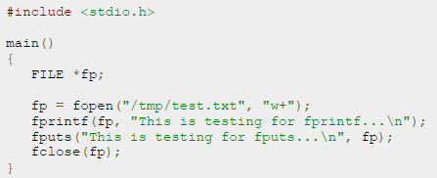

Slide 5
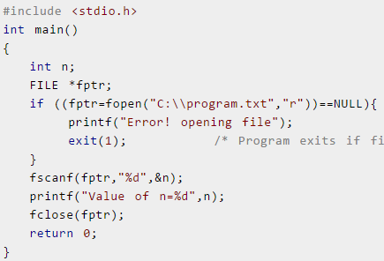
Reading from a file
fscanf() can be used to read data from file.
If you have run program above to write in file successfully, you can get the integer back entered in that program using this program.
Other functions like fgetchar(), fputc() etc. can be used in similar way.

Slide 6
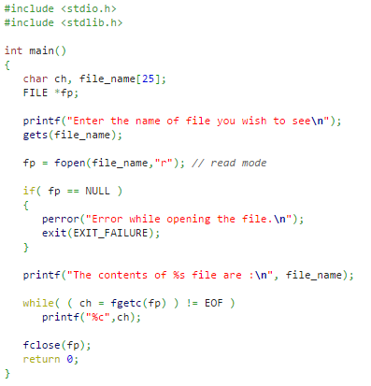
Read a file

Slide 7

Output of previous program-

Slide 8
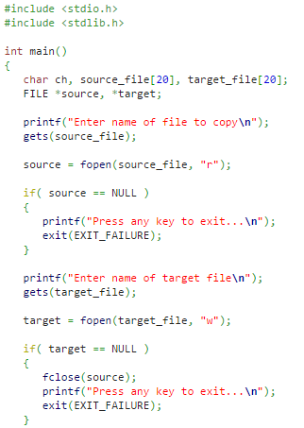
Copy a file

Slide 9
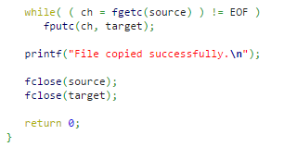

Output
Copy a file

Slide 10
Binary Files
Depending upon the way file is opened for processing, a file is classified into text file and binary file.
If a large amount of numerical data it to be stored, text mode will be insufficient. In such case binary file is used.
Working of binary files is similar to text files with few differences in opening modes, reading from file and writing to file.

Slide 11
Opening modes of binary files:
Opening modes of binary file are rb, rb+, wb, wb+,ab and ab+. The only difference between opening modes of text and binary files is that, b is appended to indicate that, it is binary file.
Reading and writing of a binary file:
Functions fread() and fwrite() are used for reading from and writing to a file on the disk respectively in case of binary files. Function fwrite() takes four arguments, address of data to be written in disk, size of data to be written in disk, number of such type of data and pointer to the file where you want to write.
Function fread() also take 4 arguments similar to fwrite() function as above

Slide 12
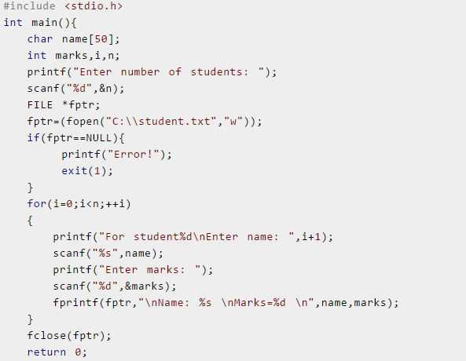
Write a C program to read name and marks of n number of students from user and store them in a file

Slide 13
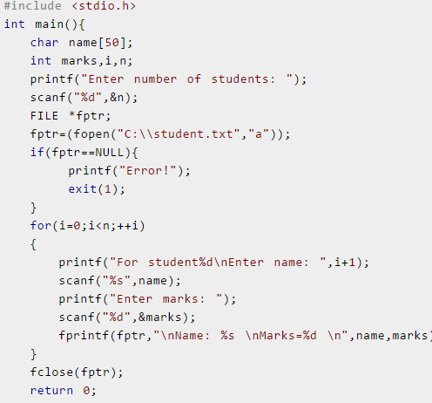
Write a C program to read name and marks of n number of students from user and store them in a file. If the file previously exits, add the information of n students.

Slide 14
Thank you

