Slide 1
Structured Programming Language PGDIT 101
Professor Dr. Mohammad Abu Yousuf

Slide 2
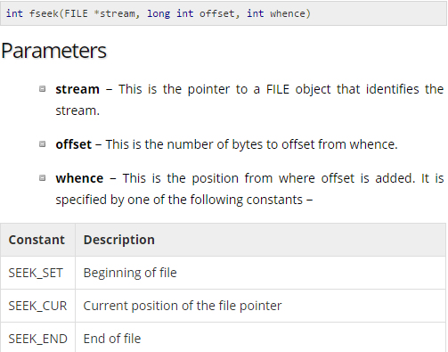
Example of fread, fwrite, fseek

Slide 3
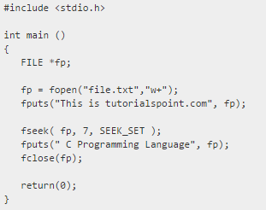
Output:
This is C Programming Language

Slide 4
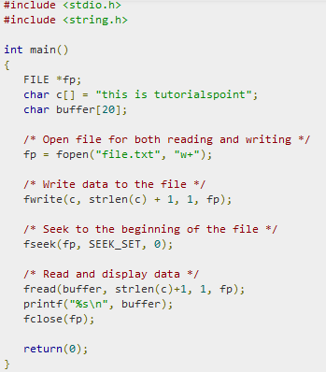
Output:
this is tutorialspoint

Slide 5
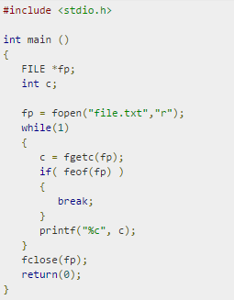
Find output

Slide 6
Output:

Slide 7
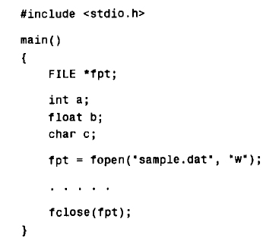
Enter values for a, b and c from the keyboard, in response to prompts generated by the program. Then write the values to the data file. Format the floating-point value so that not more than two decimals are written to the data file.

Slide 8

Output

Slide 9
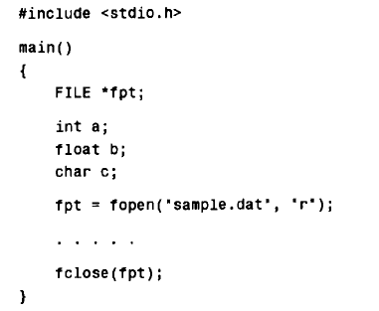
Read the values of a,b and c from the data file and display them on the screen.

Slide 10

Output

Slide 11
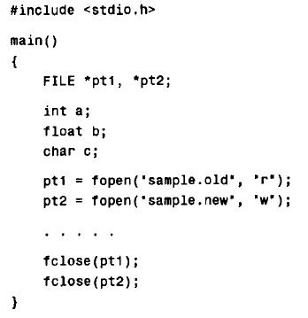
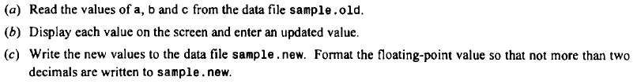

Slide 12
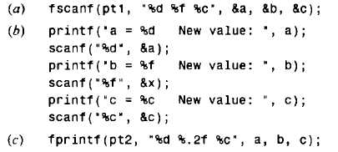
Output:

Slide 13
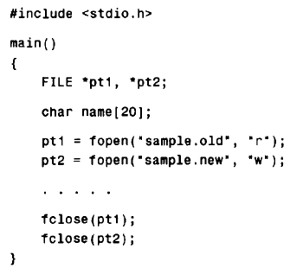
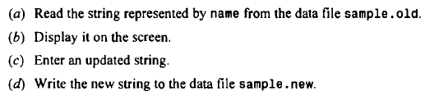

Slide 14
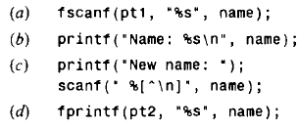
Output:

Slide 15
Thank You

