Slide 1
Structured Programming CSE 103
Professor Dr. Mohammad Abu Yousuf

Slide 2
Multi-dimensional Array
Syntax:
storage-class data- type array[ expression1] [expression2] . . . [ expression n] ;
where storage-class refers to the storage class of the array, data- type is its data type, array is the array name, and expression 1, expression 2, . . ., expression n are positive-valued integer expressions that indicate the number of array elements associated with each subscript.
Remember that the storage-class is optional; the default values are automatic for arrays that are defined inside of a function, and external for arrays defined outside of a function.

Slide 3
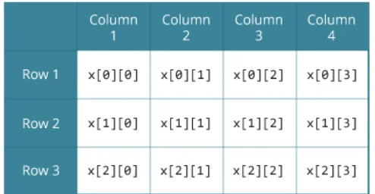
Multi-dimensional Array
float x[3][4];

Slide 4
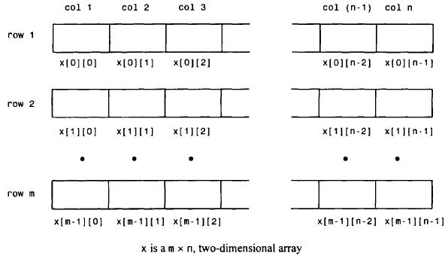
Multi-dimensional Array
An m x n, two-dimensional array can be thought of as a table of values having m rows and n columns

Slide 5
Example:
float table[50][50];
char page[24][80];
double records[100][66][255];
double records[L][M][N];
int values[3][4] = {1, 2, 3, 4, 5, 6, 7, 8, 9, 10, 11, 12};
Note that values can be thought of as a table having 3 rows and 4 columns (4 elements per row).
values[0][0] = 1 values[0][1] = 2 values[0][2] = 3 values[0][3] = 4
values[1][0] = 5 values[1][1] = 6 values[1][2] = 7 values[1][3] = 8
values[2][0] = 9 values[2][1] = 10 values[2][2] = 11 values[2][3] = 12

Slide 6



Variation of the two-dimensional array definition
This definition results in the same initial assignments as in the last example.
Now consider :
This definition assigns values only to the first three elements in each row.

Slide 7

Multi-dimensional Array
Then three of the array elements will again be assigned zeros, though the order of the assignments will be different.

Slide 8
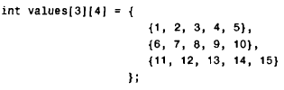
Multi-dimensional Array
Finally, consider the array definition
This will result in a compilation error, since the number of values in each inner pair of braces (five values in each pair) exceeds the defined array size (four elements in each row).

Slide 9
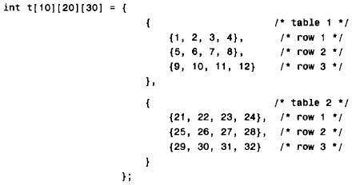
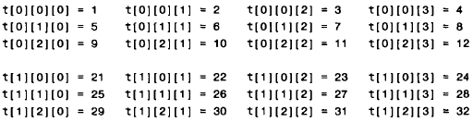
Consider the following three-dimensional array definition
All of the remaining array elements will be assigned zeros

Slide 10
Multi-dimensional Array
#include<stdio.h>
int main(){
int i=0,j=0;
int arr[4][3]={{1,2,3},{2,3,4},{3,4,5},{4,5,6}};
//traversing 2D array
for(i=0;i<4;i++){
for(j=0;j<3;j++){
printf("arr[%d] [%d] = %d \n",i,j,arr[i][j]);
}//end of j
}//end of i
return 0;
}
Output:
arr[0][0] = 1
arr[0][1] = 2
arr[0][2] = 3
arr[1][0] = 2
arr[1][1] = 3
arr[1][2] = 4
arr[2][0] = 3
arr[2][1] = 4
arr[2][2] = 5
arr[3][0] = 4
arr[3][1] = 5
arr[3][2] = 6

Slide 11
#include <stdio.h>
void main ()
{
int arr[3][3],i,j;
for (i=0;i<3;i++)
{
for (j=0;j<3;j++)
{
printf("Enter a[%d][%d]: ",i,j);
scanf("%d",&arr[i][j]);
}
}
printf("\n printing the elements ....\n");
for(i=0;i<3;i++)
{
printf("\n");
for (j=0;j<3;j++)
{
printf("%d\t",arr[i][j]);
}
}
}
2D array example: Storing elements in a matrix and printing it.

Slide 12
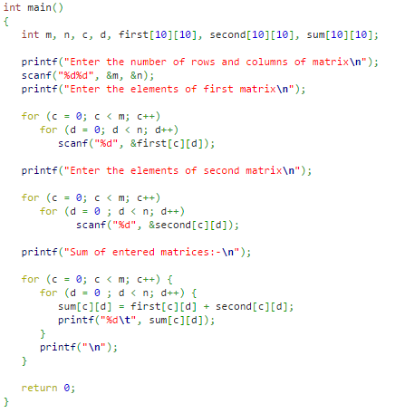
C program to add two matrix:

Slide 13
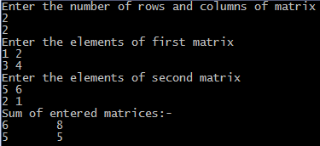
Output of previous program:

Slide 14
Thank you

