Slide 1
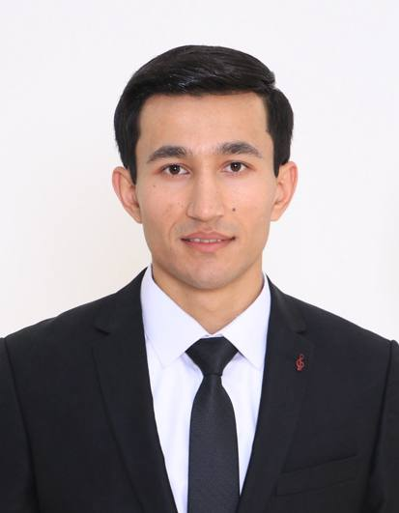
PORTFOLIO
Akhmad
Kholmurodov
Full-Stack Developer
React · Next.js · TypeScript · Node.js · PostgreSQL · Docker
Visa type: E-7
seehyuk2000@gmail.com · +82 10-3802-1005 · github.com/AkhmadKholmurodov
Notes:
Cover slide. Replace the photo placeholder with a professional portrait or a photo of you working.

Slide 2
01 · INTRODUCTION
About Me
I build and run web products end to end.
My path into development started in a university Cloud Computing Lab, where I rebuilt an autonomous-vehicle control prototype from Flutter to React + TypeScript — my first lesson in choosing the right architecture instead of the convenient one.
Today at SAMBU I own the company's e-commerce platform from the first component to server uptime, and I keep shipping my own products on the side. Alongside development I practise application security — OWASP Top 10, penetration testing and bug bounty — because I would rather find the hole in my own code first.
I work in Korean, English and Uzbek, and I like problems that sit between a clean interface and a system that has to stay up.
BASED IN
Daegu, South Korea
EXPERIENCE
3+ years, production web platforms
FOCUS
Next.js · Nest · TypeScript · Node.js · WebOps
ALSO
Application security & bug bounty
LANGUAGES
Korean, English, Uzbek
EDUCATION
Daegu University: Software Engineering
02

Slide 3
02 · CAPABILITIES
Tech Stack
Frontend
Backend
Databases
React 19, Next.js 14/15
TypeScript, Tailwind CSS
ShadcnUI, MUI, Zustand
Node.js, Prisma
REST APIs, GraphQL
Clerk (Auth), Stripe
PostgreSQL (Neon,Supabase)
MySQL, MariaDB
Schema & query design
DevOps
Security
Ways of working
Docker, Kubernetes (k8s/k3s)
GitHub Actions, GitLab CI
Vercel, Linux (Ubuntu)
OWASP Top 10
Penetration testing
Network & WLAN security
Git flow & code review
Agile sprints
Figma hand-off
03

Slide 4
03 · TRACK RECORD
Experience
SAMBU Co., Ltd.
Sep 2025 – Present
Full-Stack & WebOps Engineer
Designed, built and operate lowshop.net — the company's official e-commerce platform — owning everything from frontend implementation to server operations.
Launched and manage the storefront across Coupang, Naver SmartStore and Toss, including profile setup and sales system administration.
Maintain uptime and stability monitoring; optimised payment and data-synchronisation workflows.
Cloud Computing Lab
May 2022 – Sep 2024
Frontend / Full-Stack Developer
Built a web/app prototype for remote control and telemetry of autonomous vehicles.
Proposed and led the migration from a Flutter codebase to ReactJS + TypeScript, fixing the mobile rendering and compatibility issues that blocked delivery.
Delivered the migration ahead of deadline with the Node.js backend developer; owned responsive UI and REST data sync.
04

Slide 5
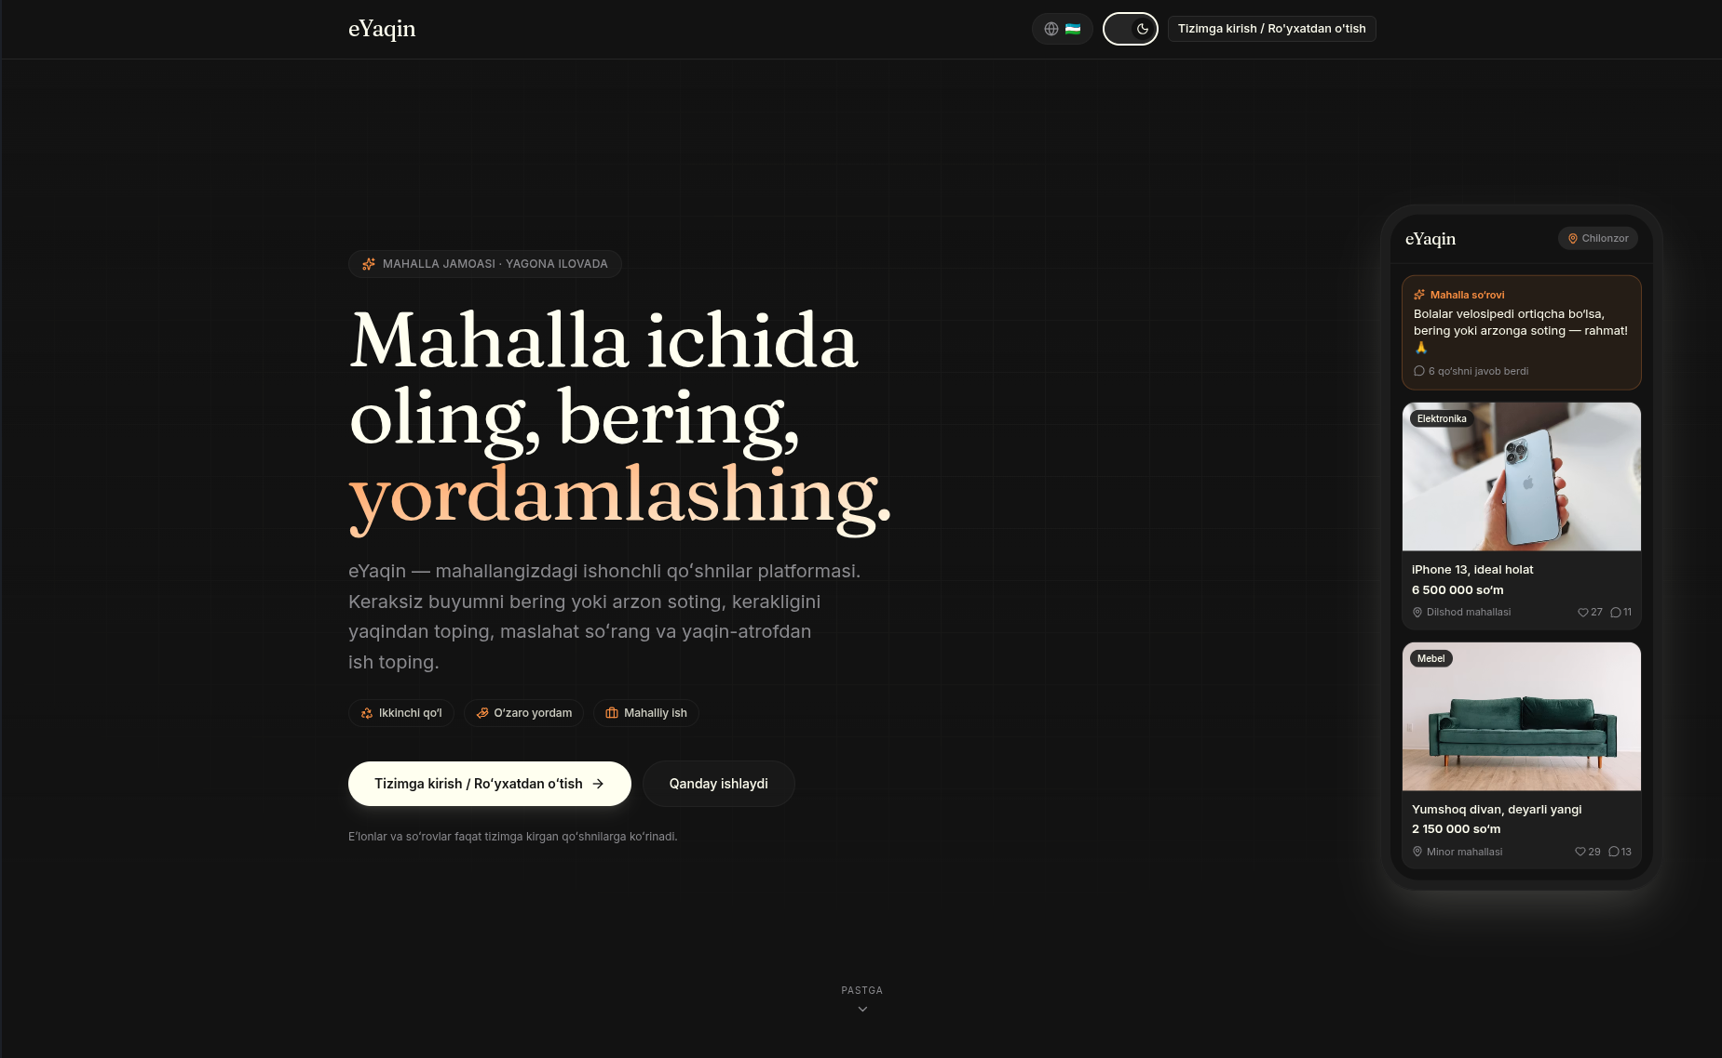
04 · PROJECT 01
eYaqin — Local C2C Marketplace
https://eyaqin.vercel.app
eYaqin is a neighbourhood-first second-hand marketplace. Instead of a nationwide feed, it ranks and filters listings by how close they actually are to you — by district and by radius — so a trade stays a short walk away.
It is a solo, full-stack build: schema design, API surface, real-time chat, moderation tooling and deployment.
Solo
5-state
Real-time
full-stack build
listing lifecycle
buyer–seller chat
Next.js · React 19 · TypeScript · Prisma · PostgreSQL (Neon) · Zustand · Tailwind · Vercel
05

Slide 6
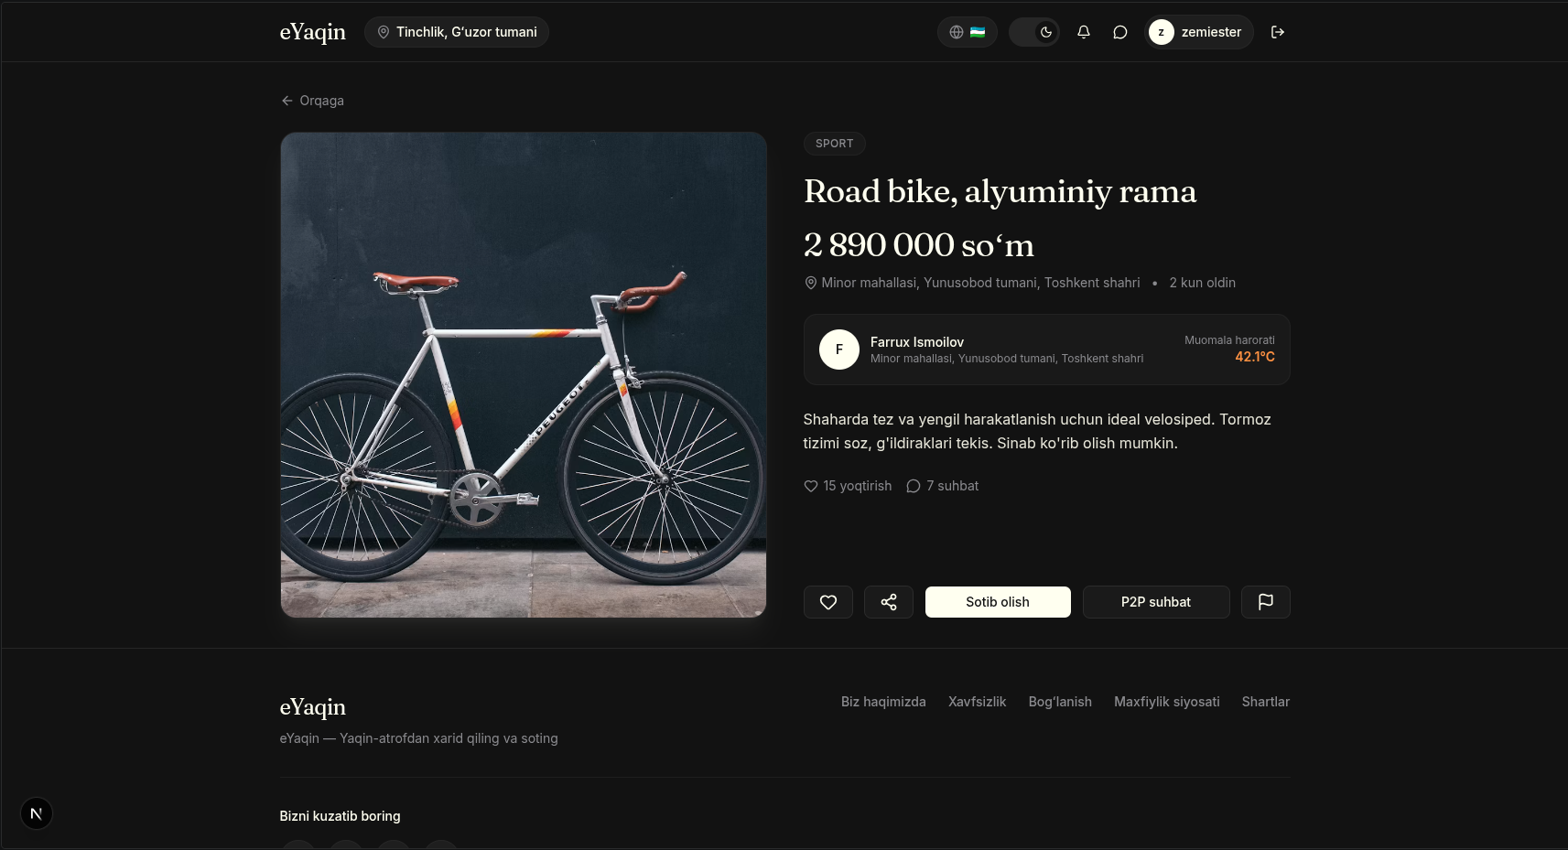
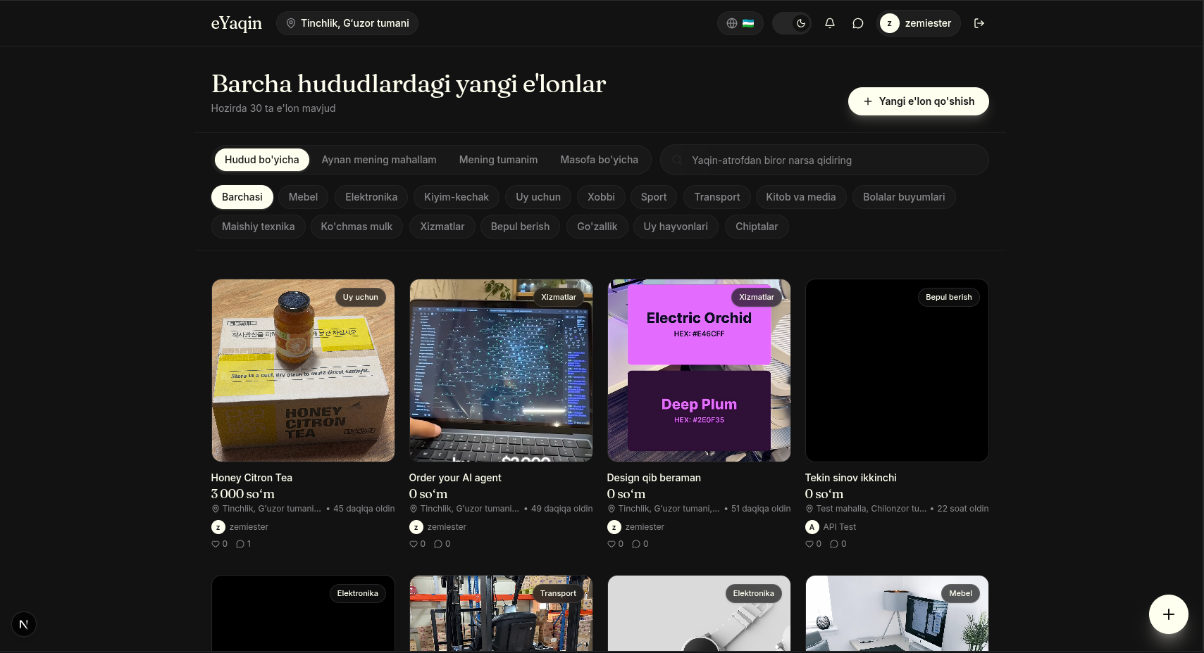
04 · PROJECT 01
eYaqin — Main Features
1
Location-aware discovery
District and radius based search and filtering.
2
Listing lifecycle
Explicit states from active through to sold.
3
Real-time chat
Buyer–seller messaging with read status.
4
Trust & safety
Reporting and moderation workflow.
5
Engagement
Likes, saved items, nearby discovery feed.
6
Auth & accounts
Session handling and profile management.
06

Slide 7
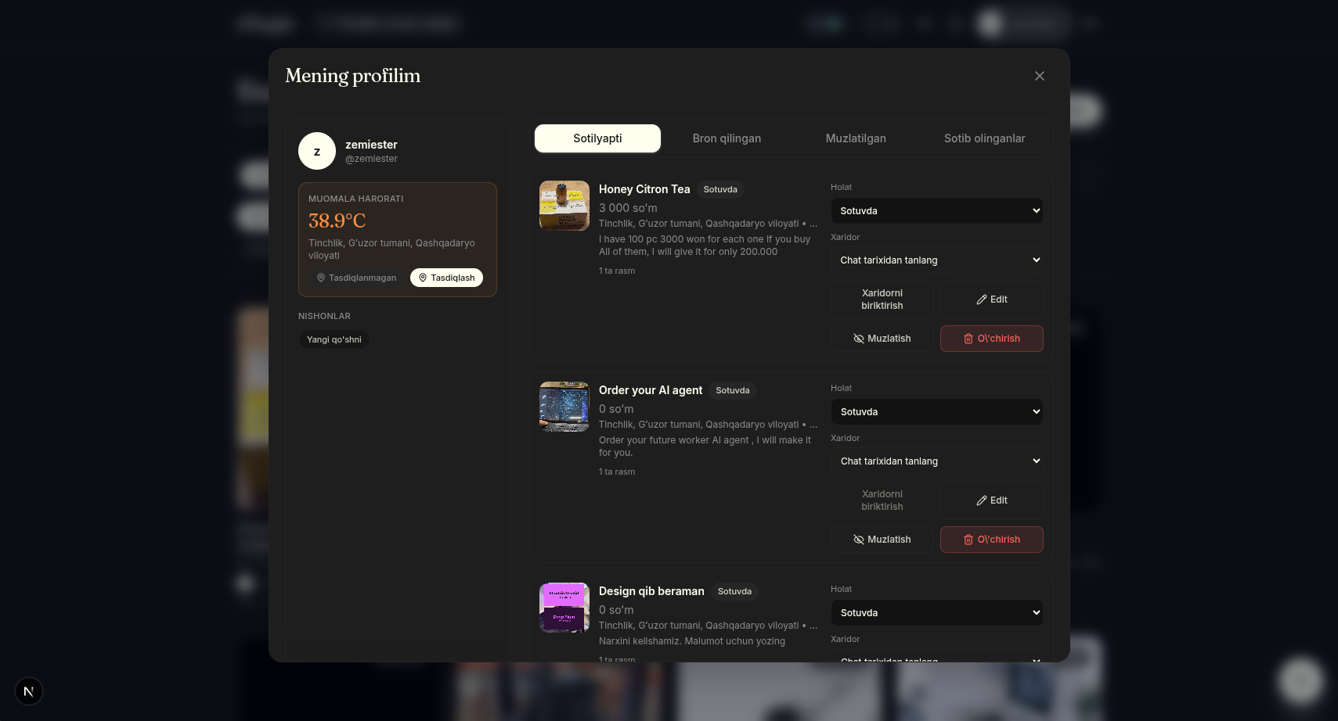
04 · PROJECT 01
Listing Lifecycle Design
Every listing moves through explicit states, so both sides always know where a trade stands — and moderation has a single place to intervene.
active
reserved
escrow_verification
sold
hidden
Listed and visible in local search
Buyer agreed, item held
Payment held and checked
Trade complete
Withdrawn or moderated
Why states, not booleans
A boolean "is_sold" cannot express a held item, a disputed payment or a removed listing.
Transitions are validated server-side, so the UI can never invent an impossible state.
07

Slide 8
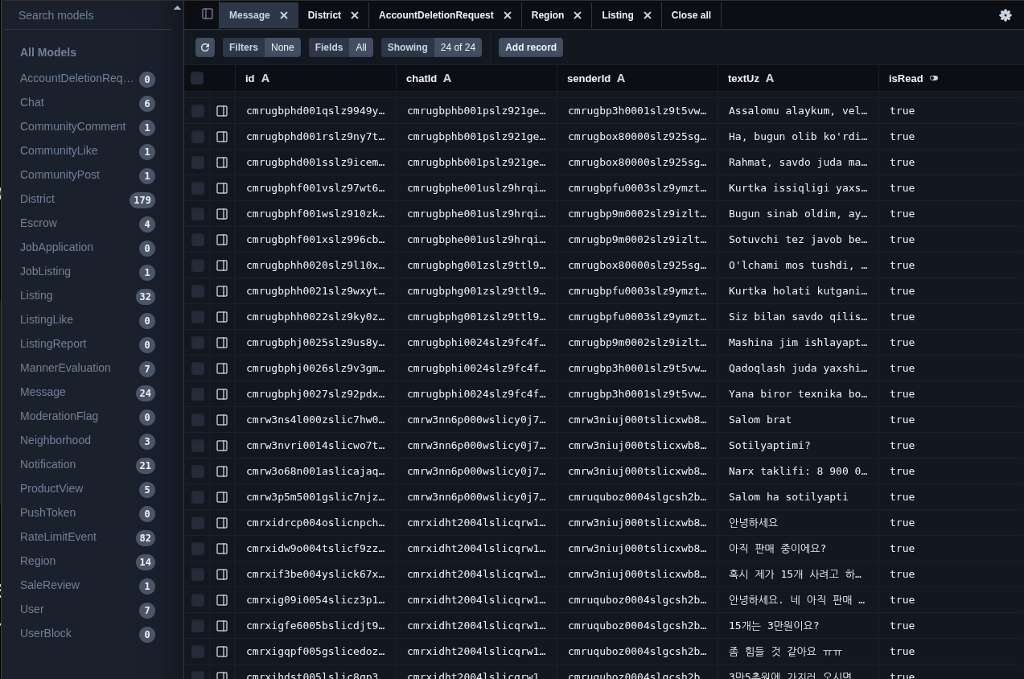
04 · PROJECT 01
Architecture & Delivery
Frontend
Next.js App Router with React 19 and TypeScript. Zustand for client state, Tailwind for styling, server components for listing pages.
Backend & data
Route handlers over Prisma against PostgreSQL (Neon). API grouped by concern: auth, listings, engagement, nearby discovery.
Delivery
What I would do next
Deployed on Vercel with preview builds per branch; environment-separated database branches for safe schema migration.
Move image storage to object storage with signed URLs.
Add search indexing so radius queries stay fast at scale.
08

Slide 9
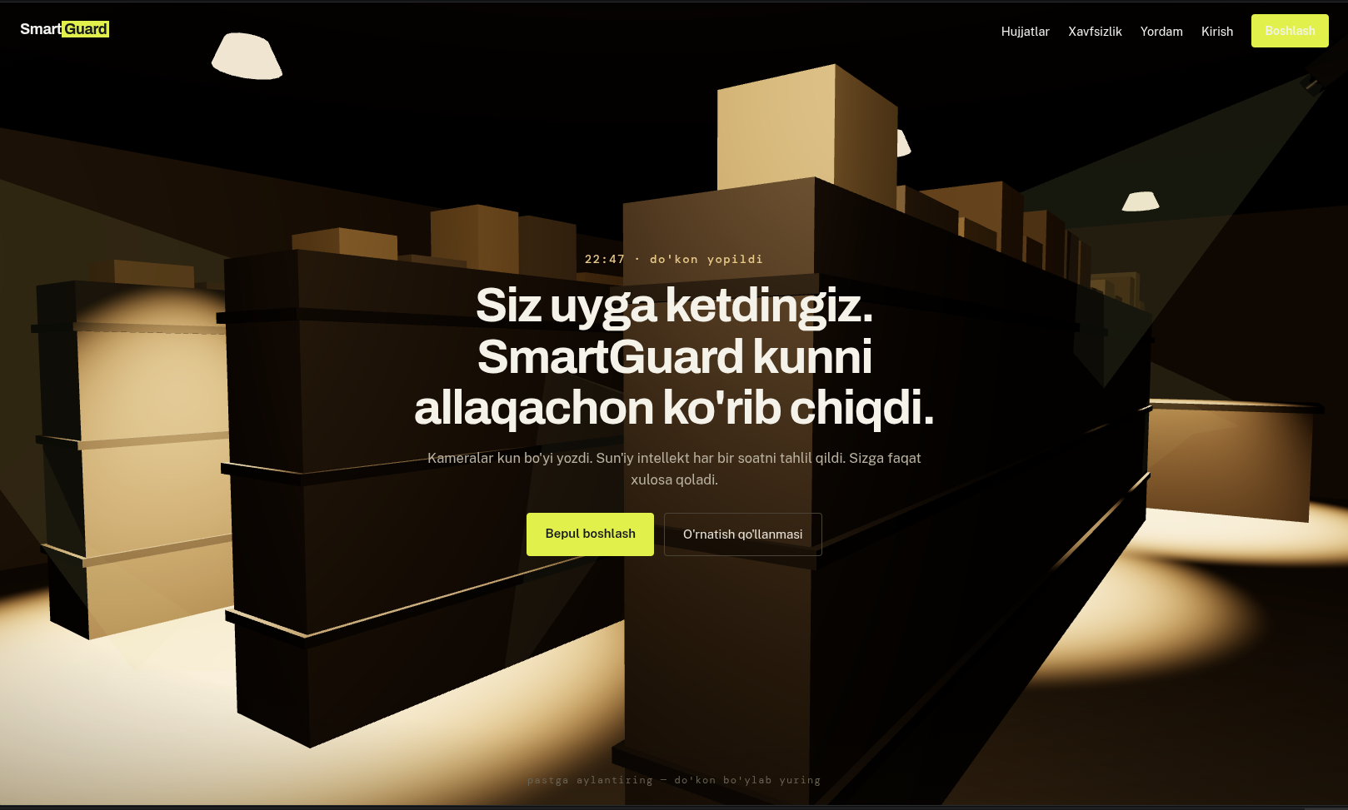
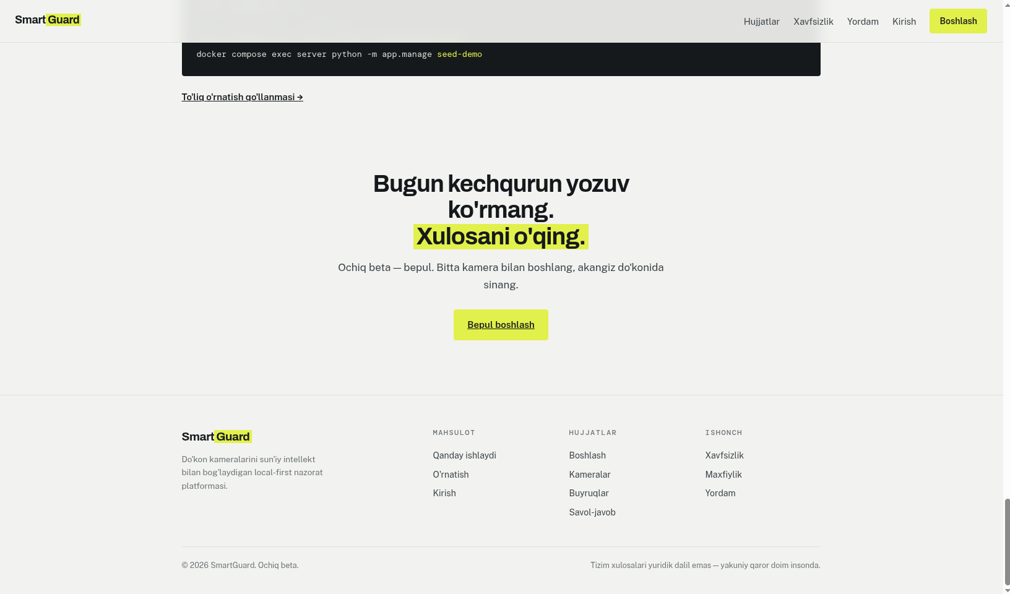
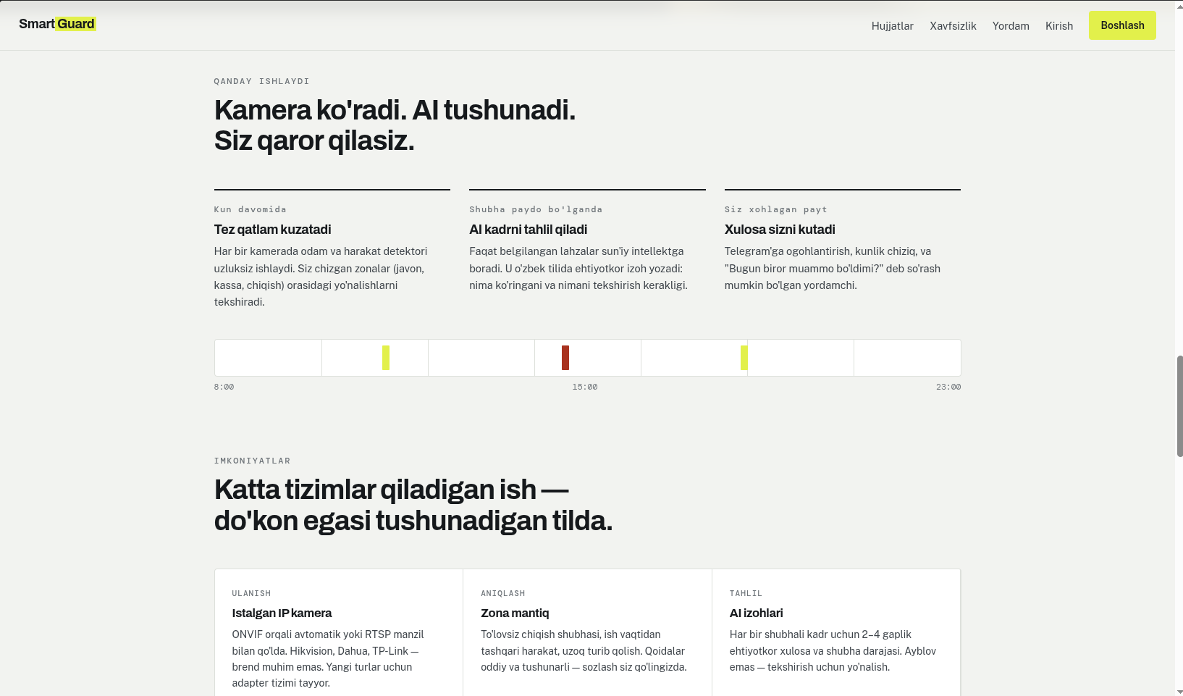
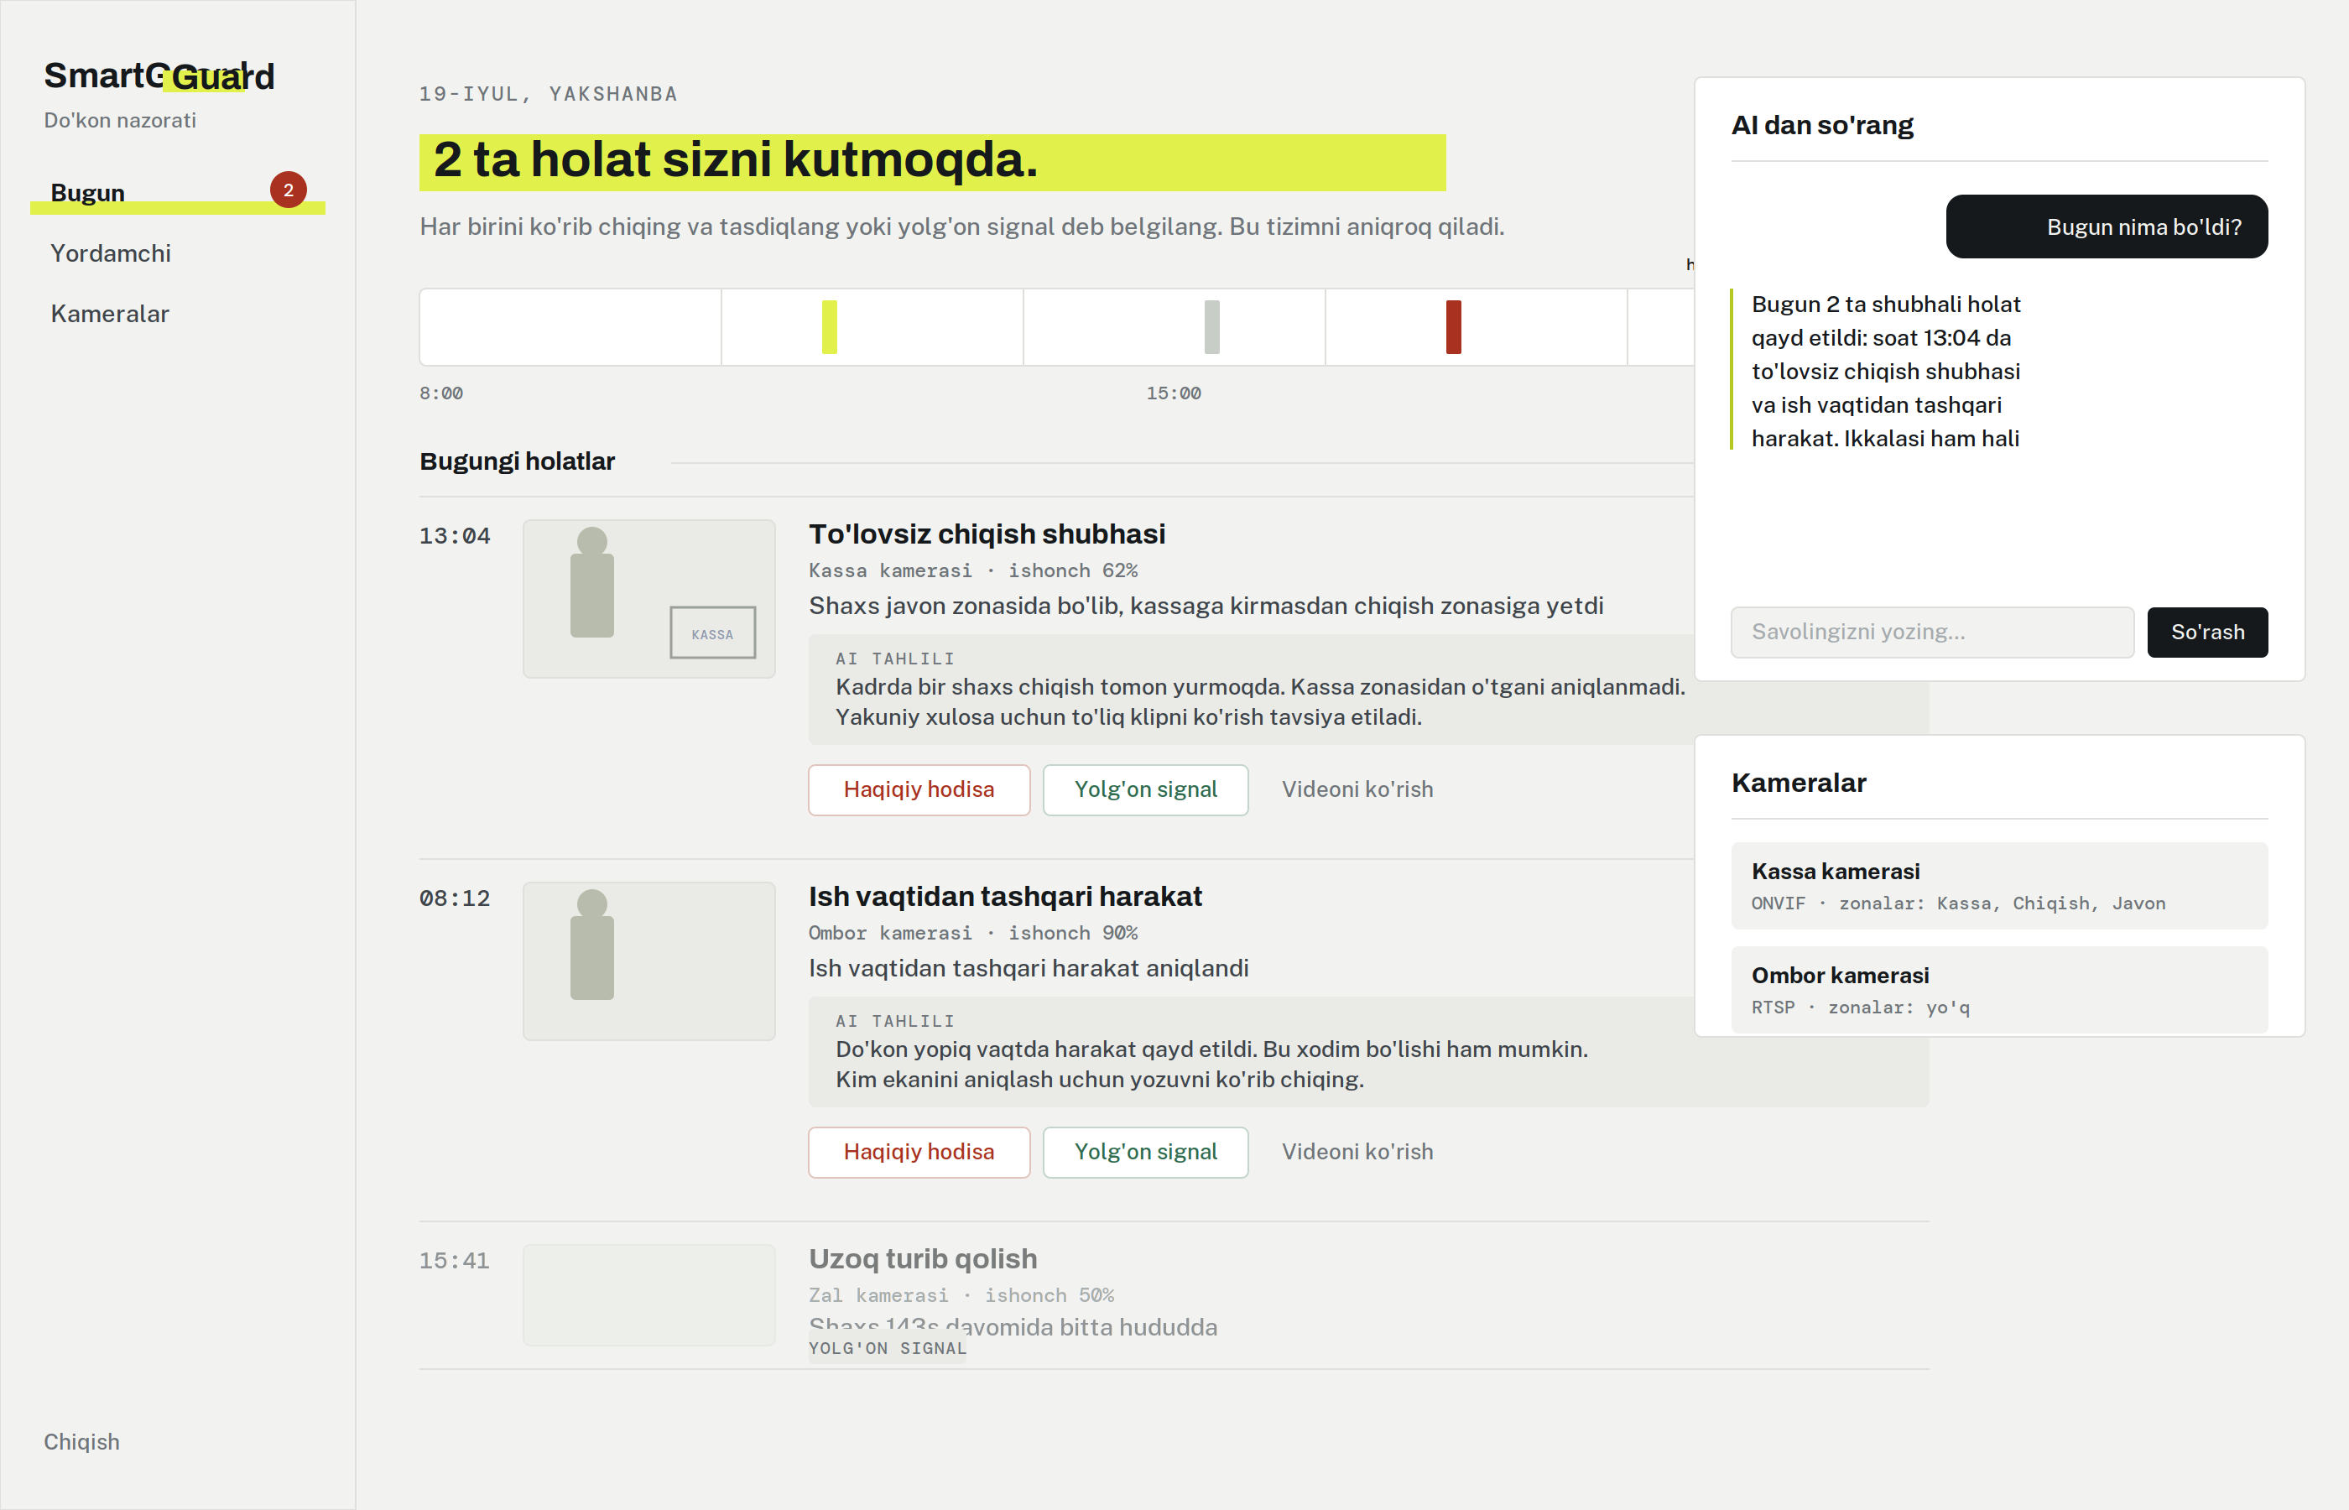
05 · PROJECT 02
SmartGuard (SuniyKoz)
SmartGuard is an AI surveillance platform that monitors retail CCTV in real-time to alert owners of suspicious activity via Telegram.
Overview
Small retail stores lose inventory to theft and waste hours reviewing CCTV footage. SmartGuard links IP cameras to Claude Vision to auto-detect suspicious activity and send instant Telegram alerts. I built a hybrid edge/cloud pipeline using local motion detectors to route only key frames to VLM, cutting API costs by over 100x.
Stack & my role
Tech Stack: React 18, Python/FastAPI, PostgreSQL, OpenCV, Claude Vision, Docker.
My Role: Engineerd the entire platform end-to-end, including multi-threaded camera pipelines, AI routing logic, and web UI.
Status: Live (Active in retail production).
09

Slide 10
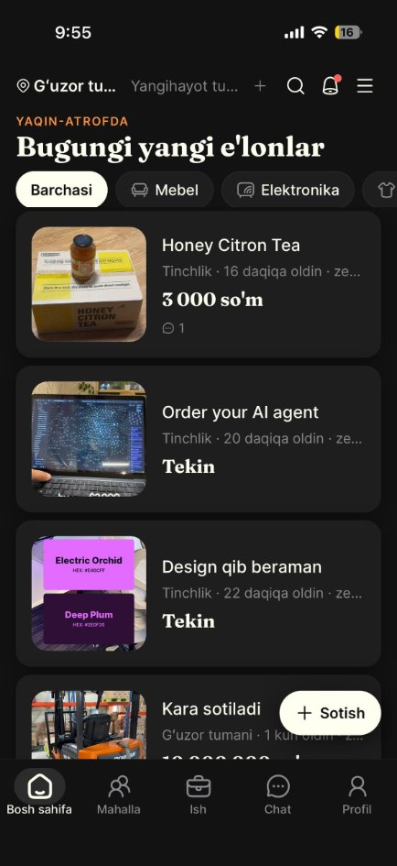
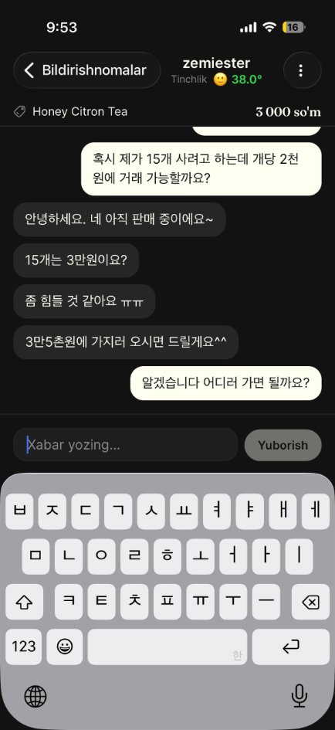
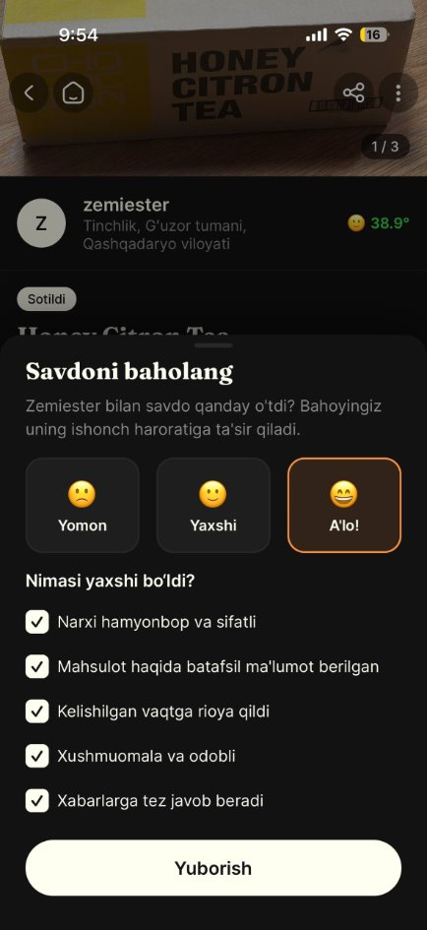
06 · PROJECT 03
eYaqin Mobile — React Native
The native client for eYaqin. A second-hand trade happens on the phone and between strangers — so upload speed and trust both had to live there.
1
Camera & gallery upload
List an item straight from the camera or the photo library.
2
Listing sharing
Send any listing to people outside the app.
3
Real-time chat
Buyer–seller messaging while the trade is being agreed.
4
Neighbourhood community
Residents post local requests and find work nearby.
5
Manner temperature
A reputation score that makes a trading history visible.
6
Review-gated completion
A sale is only confirmed once a review has been written.
7
In-app feedback channel
Structured feature requests — direct product research.
10

Slide 11
07 · BEYOND THE STACK
Security Practice
I develop with an attacker's checklist in mind — the same OWASP categories I practise against on training platforms are the ones I review my own code for.
HackerOne
HTB & TryHackMe
Certified
Submitted a valid vulnerability report on a live production application. Technically validated and triaged by the vendor's security team — closed as duplicate, validity officially confirmed.
Regular practice in web application vulnerability analysis, infrastructure penetration testing and OWASP Top 10 exercises.
Secure Wireless LAN 7.6 Administrator — Fortinet Training Institute & ISC2 (2026), CISSP domain: Communication and Network Security.
Also certified: Front End Development Libraries — freeCodeCamp (2025) Languages: Korean (advanced) · English (advanced) · Uzbek (native)
12

Slide 12

Thank you
I would be glad to talk about how I can contribute to your team.
EMAIL
seehyuk2000@gmail.com
PHONE
+82 10-3802-1005
GITHUB
github.com/AkhmadKholmurodov
LINKEDIN
linkedin.com/in/akhmadkholmurodov
LIVE PROJECT
eyaqin-app.vercel.app
Notes:
Closing slide.

