Slide 1
Gini Index and Entropy: Understanding Measures of Impurity in Machine Learning
By AKHATAR ALI

Slide 2
INTRODUCTION
Decision trees are widely used in machine learning for classification and regression tasks.
Goal of decision trees is to create pure or homogeneous subsets.
Decision tree algorithms use measures of impurity, such as Gini index and entropy, to make effective splits.

Slide 3
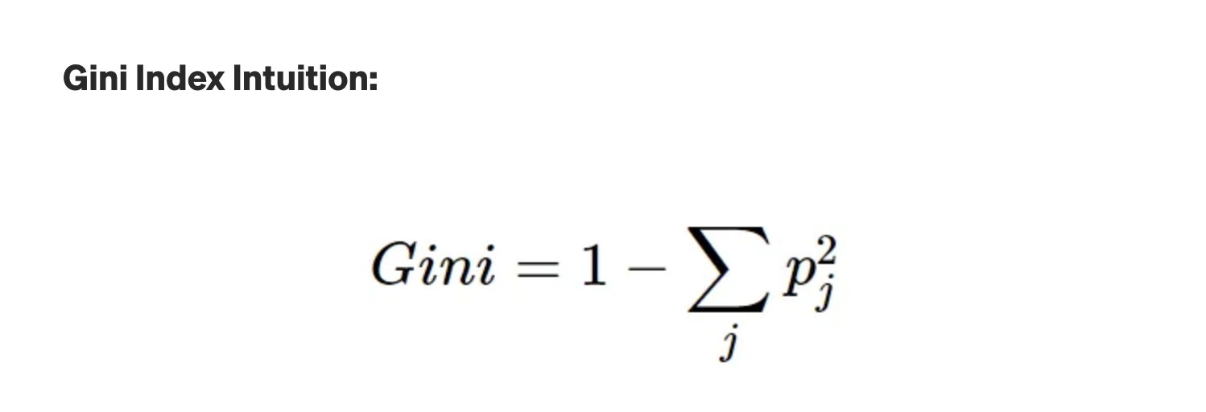
Gini Index
Gini index is a measure of impurity in decision tree algorithms.
Gini index ranges from 0 (pure) to 1 (impure) and is commonly used as a splitting criterion in decision trees.
Lower Gini index values indicate purer nodes.

Slide 4
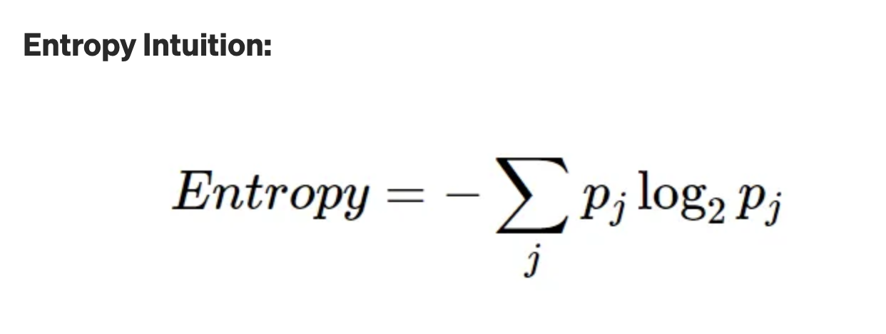
ENTROPY
Entropy is another measure of impurity in decision tree algorithms.
It quantifies the amount of uncertainty or randomness in a node's class distribution.
Higher entropy values indicate more impure nodes with less homogeneous class distributions.
Entropy is calculated as the sum of the probabilities of each class multiplied by their logarithm with base 2, and then negated.

Slide 5
GiNI INDEX VS ENTROPY
Both Gini index and entropy are used to measure impurity in decision tree algorithms.
Both measures range from 0 to 1.
Gini index is more efficient.

Slide 6



USE CASES IN APPLIED RESEARCH:
FRAUD DETECTION
SENTIMENT ANALYSIS
MEDICAL DIAGNOSIS

Slide 7
CONCLUSION
Gini index and entropy are important measures of impurity in machine learning.
They are used in decision tree algorithms to make optimal splits and create pure subsets for effective predictions.
Understanding Gini index and entropy can help in building accurate and reliable decision tree models.

Slide 8
REFERENCES
Pattern Recognition and Machine Learning" by Christopher Bishop - This comprehensive textbook covers various topics in pattern recognition and machine learning, including decision trees and ensemble methods, and provides in-depth explanations of impurity measures such as Gini index and entropy.
"Machine Learning: A Probabilistic Perspective" by Kevin P. Murphy - This textbook provides a probabilistic perspective on machine learning and covers decision trees, ensemble methods, and impurity measures such as Gini index and entropy in the context of probabilistic models.

Slide 9
THANK yOu

