Slide 1
School Management System (Al-Azhar Public School Madyan Swat)

Slide 2
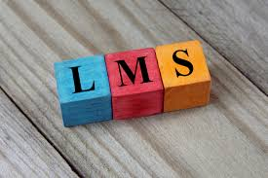
Introduction
A learning management system (LMS) is a software application for the administration, documentation, tracking, reporting, and delivery of educational courses, training programs, or learning and development programs.^{[1]}

Slide 3
Objective
Managing Fee records
Managing Staff salaries
Managing Utility Bills
Managing Full records
Managing Exams
Managing School schedules
Managing Alert systems
• Advertisements
Certificates allocation

Slide 4
Problem Statement
To help promote students achievement and success, schools must have access to complete accurate, and timely information about students. One of the benefits of automated SMS is that the student record system will simplify retrieval of required information and is a great instrument for school improvement by taking measures from the information acquired

Slide 5


Slide 6
Solution
To handle such problem we built a web based software that will work online as well offline it is an automated system that will be able to save all the information of school. And it will provide ease to staff and administration department, account department and class room teachers to find any record easily by just clicking and entering Id.

Slide 7

Tools
HTML, CSS, BOOTSTRAP is used for external interface.
ASP.NET as a programming language.
SQL server database used for storing data.
Email module is used to send Email Notification..

Slide 8
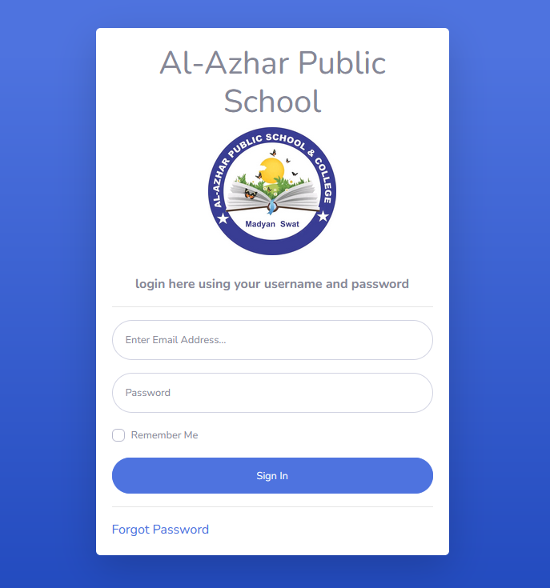
Log in

Slide 9
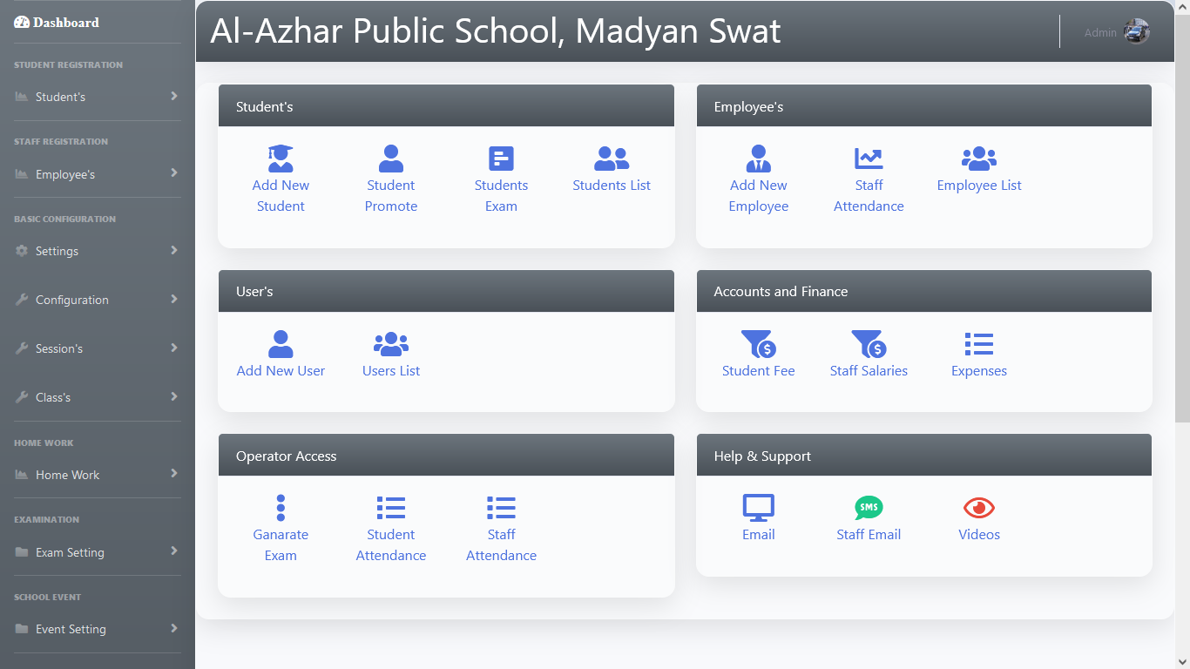
Principal DashBoard

Slide 10
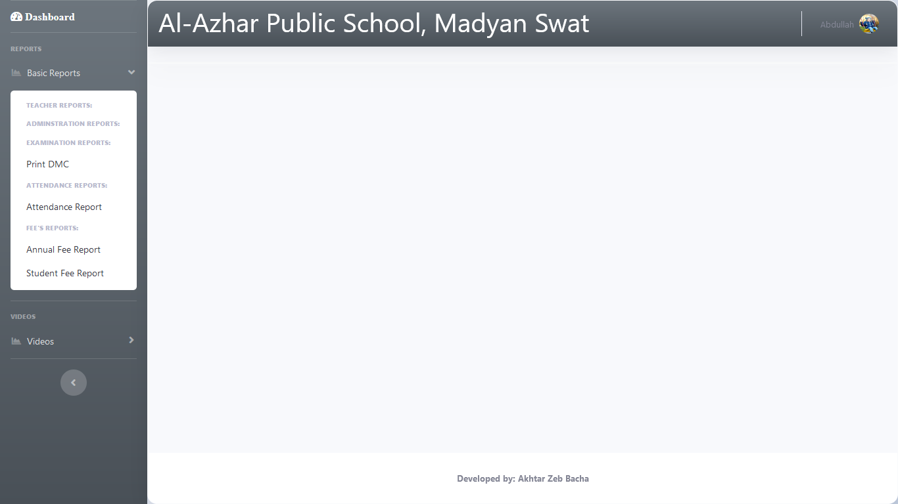
Student Dashboard

Slide 11
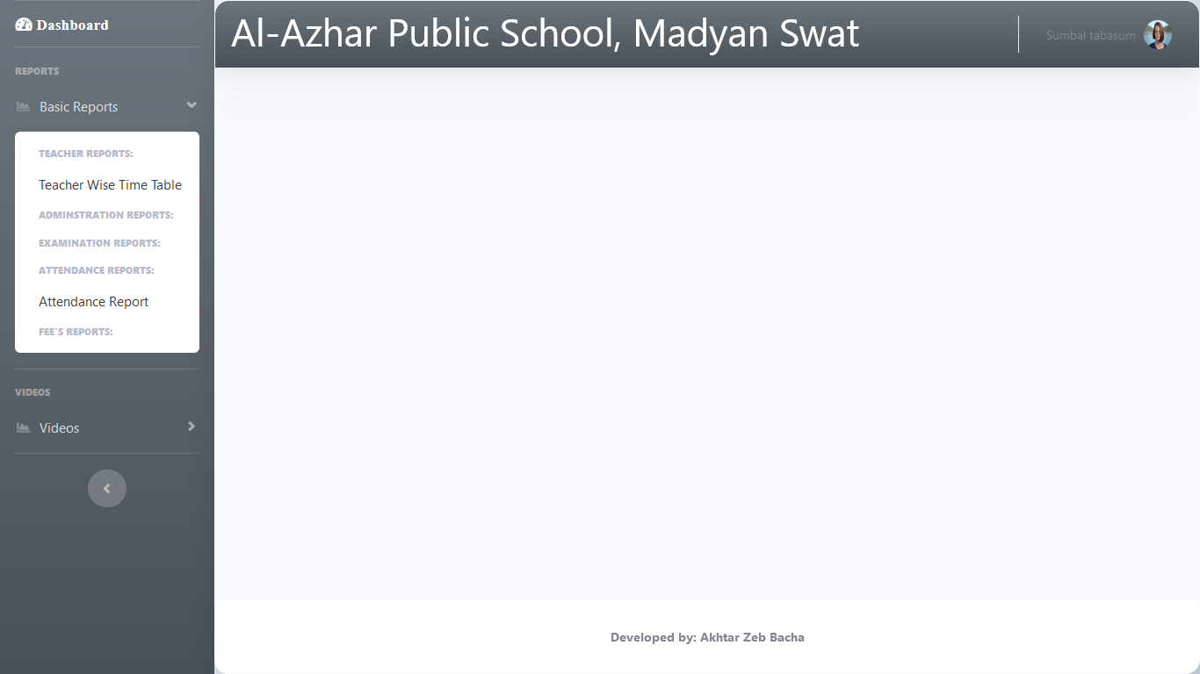
Teacher Dashboard

Slide 12
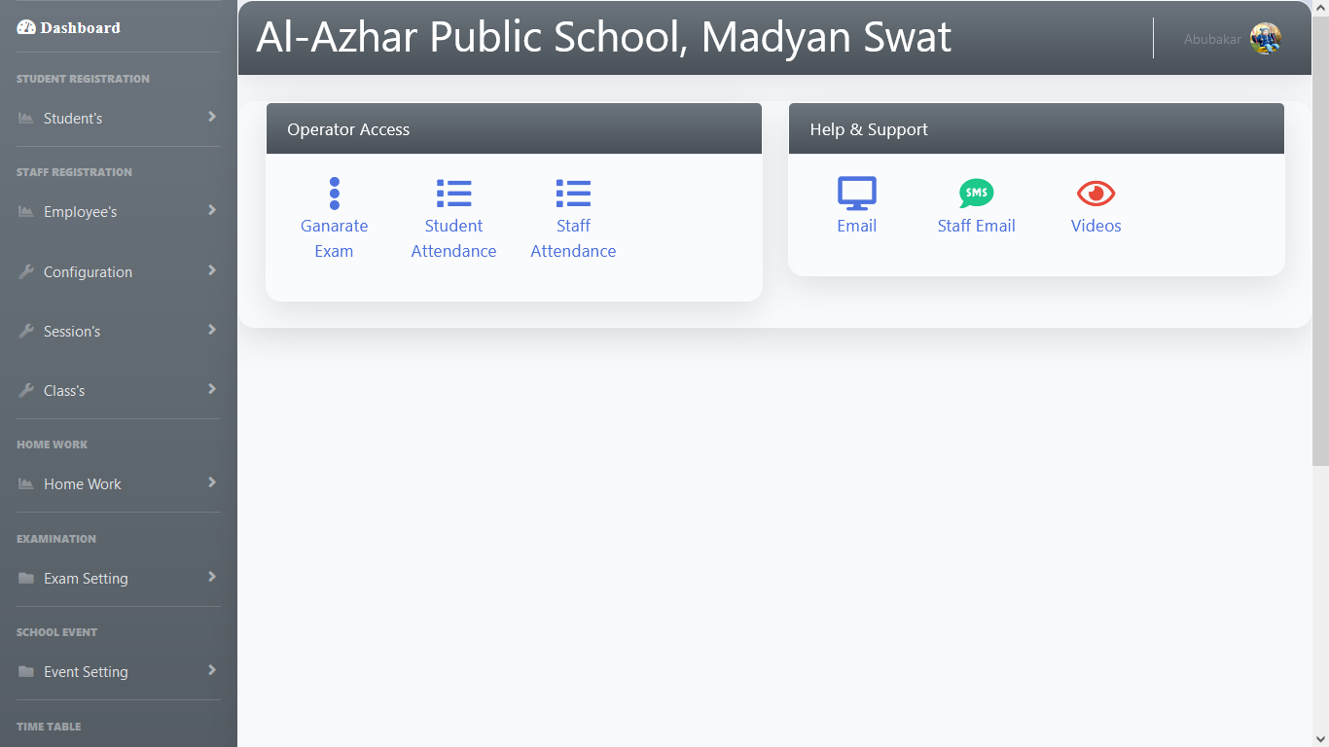
Operator Dashboard

Slide 13
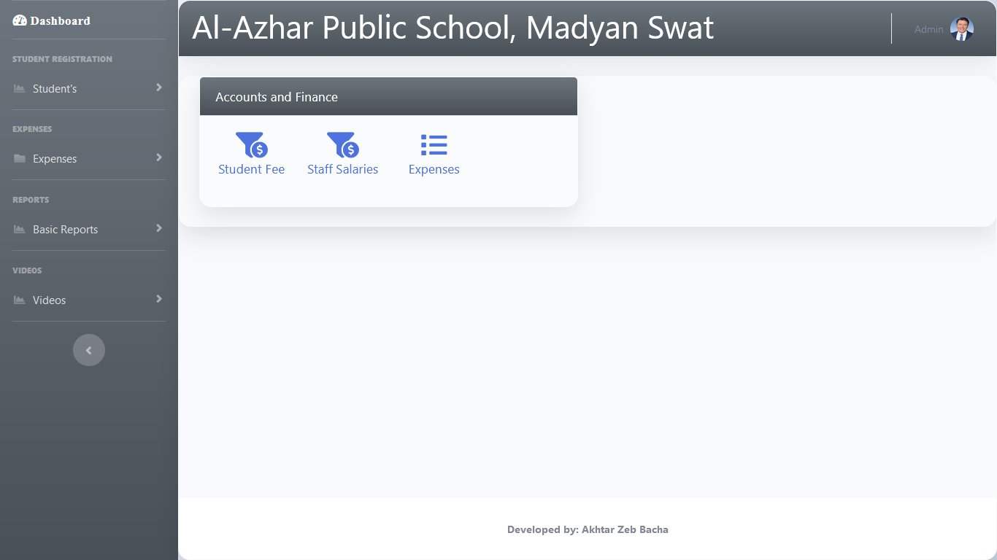
Accountant Dashboard

Slide 14
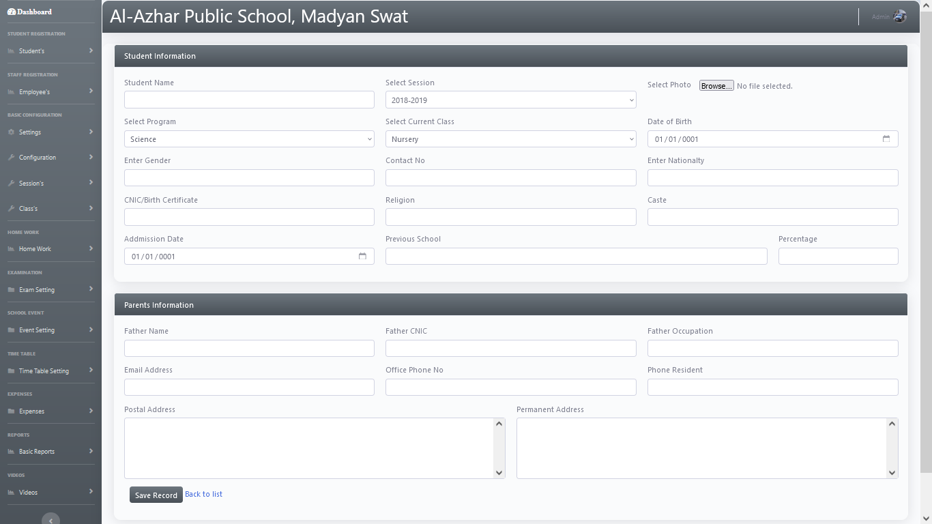
Add Student

Slide 15
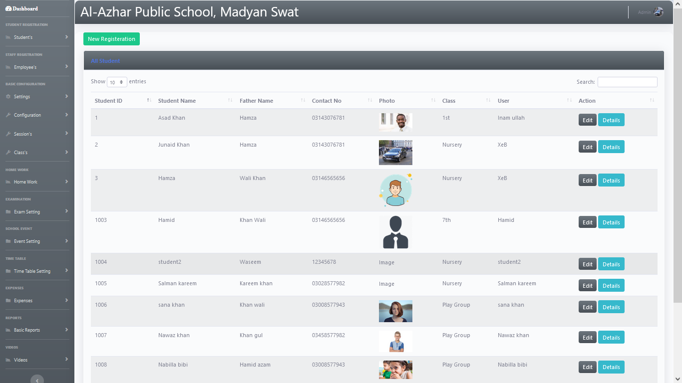
Students Information

Slide 16
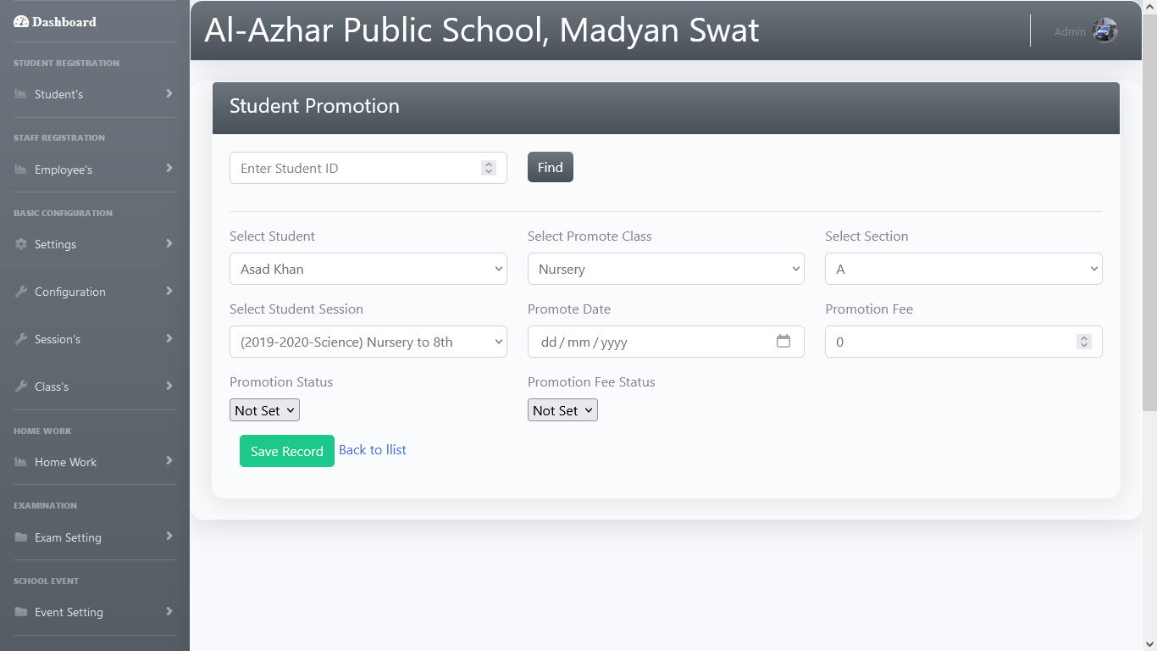
Student Promotion

Slide 17
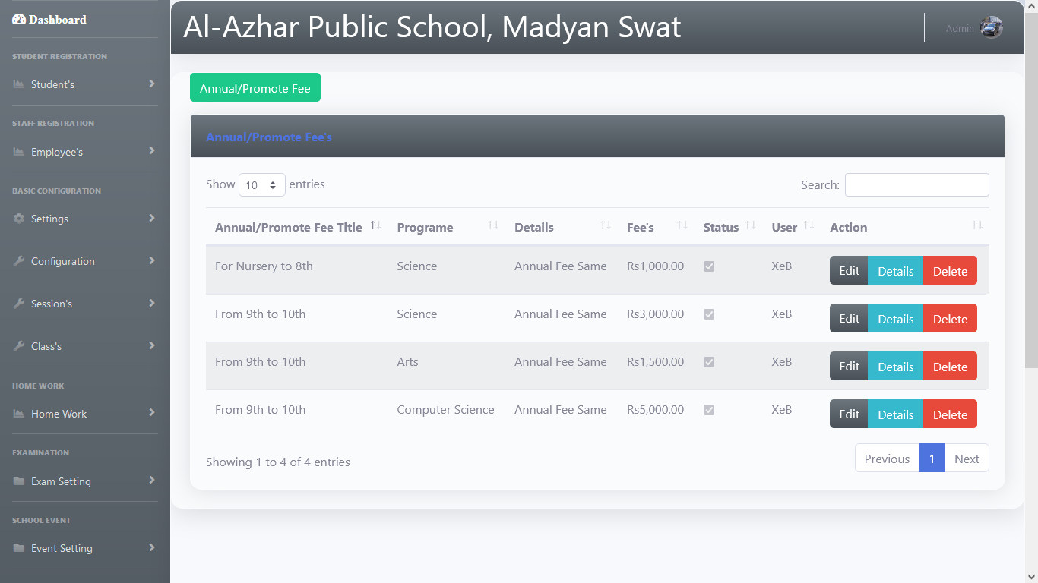
Student Fee Record

Slide 18
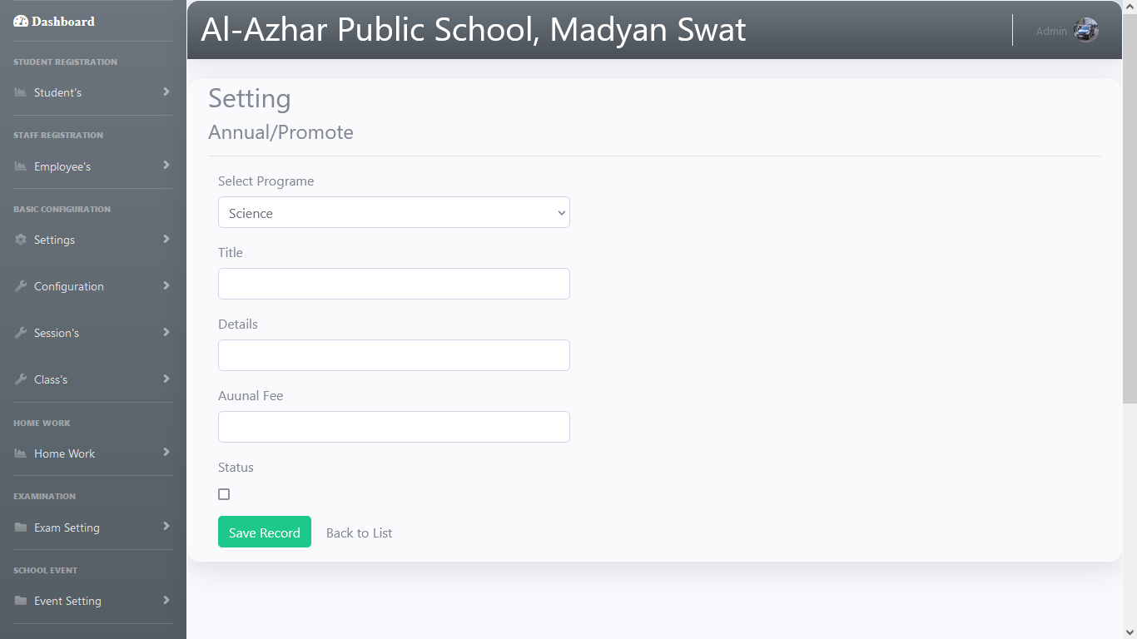
Annual Promotion

Slide 19
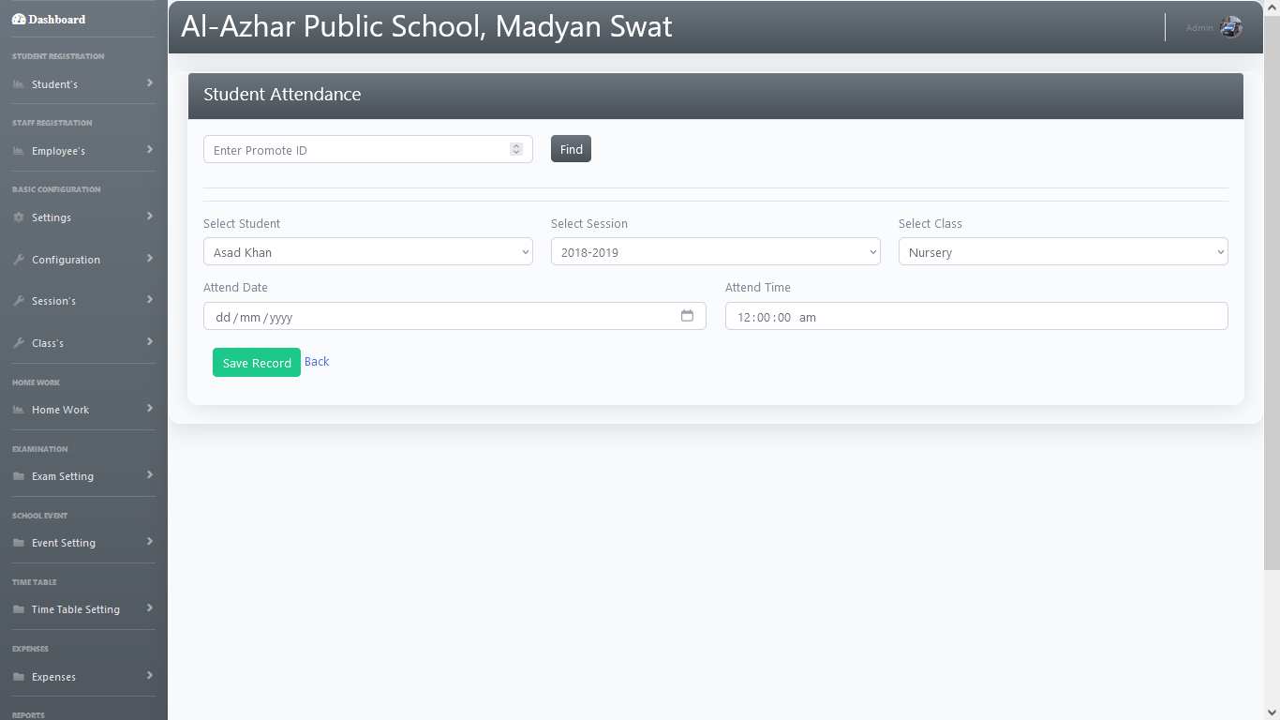
Student Attendance

Slide 20
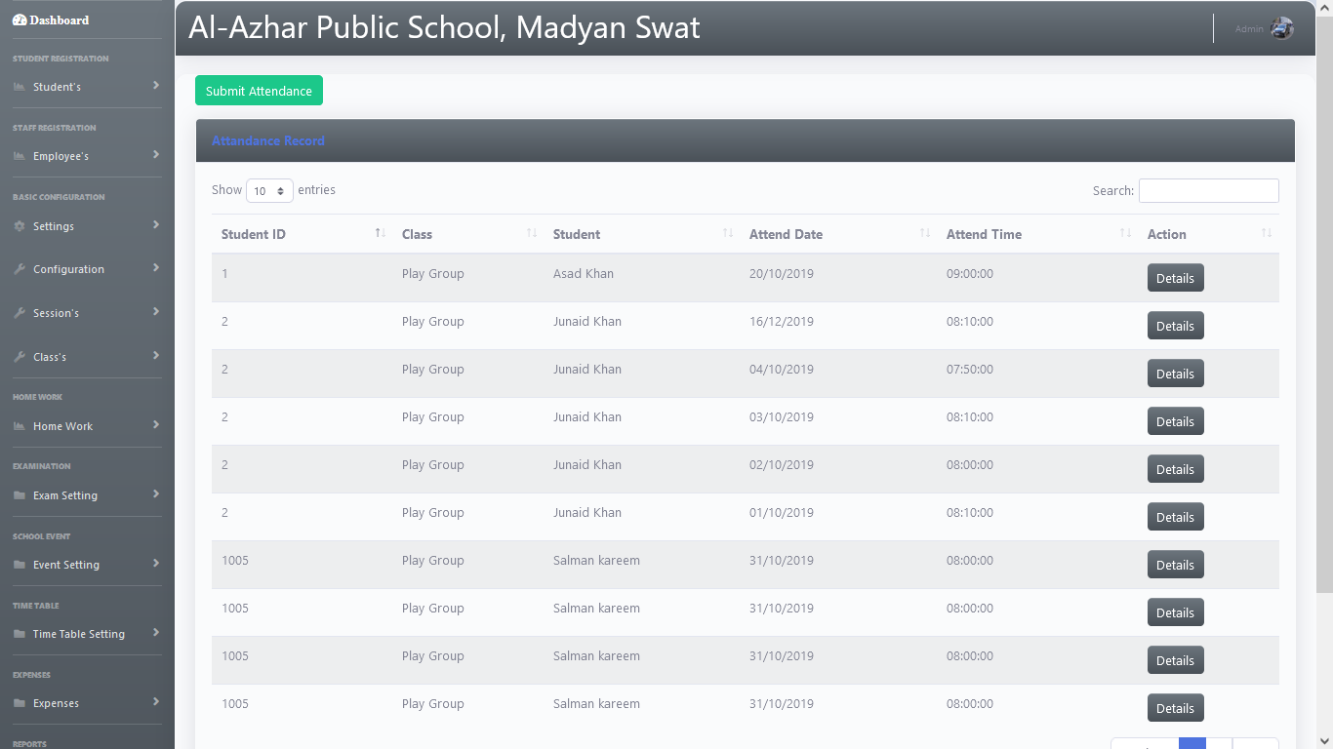
All Student Attendance

Slide 21
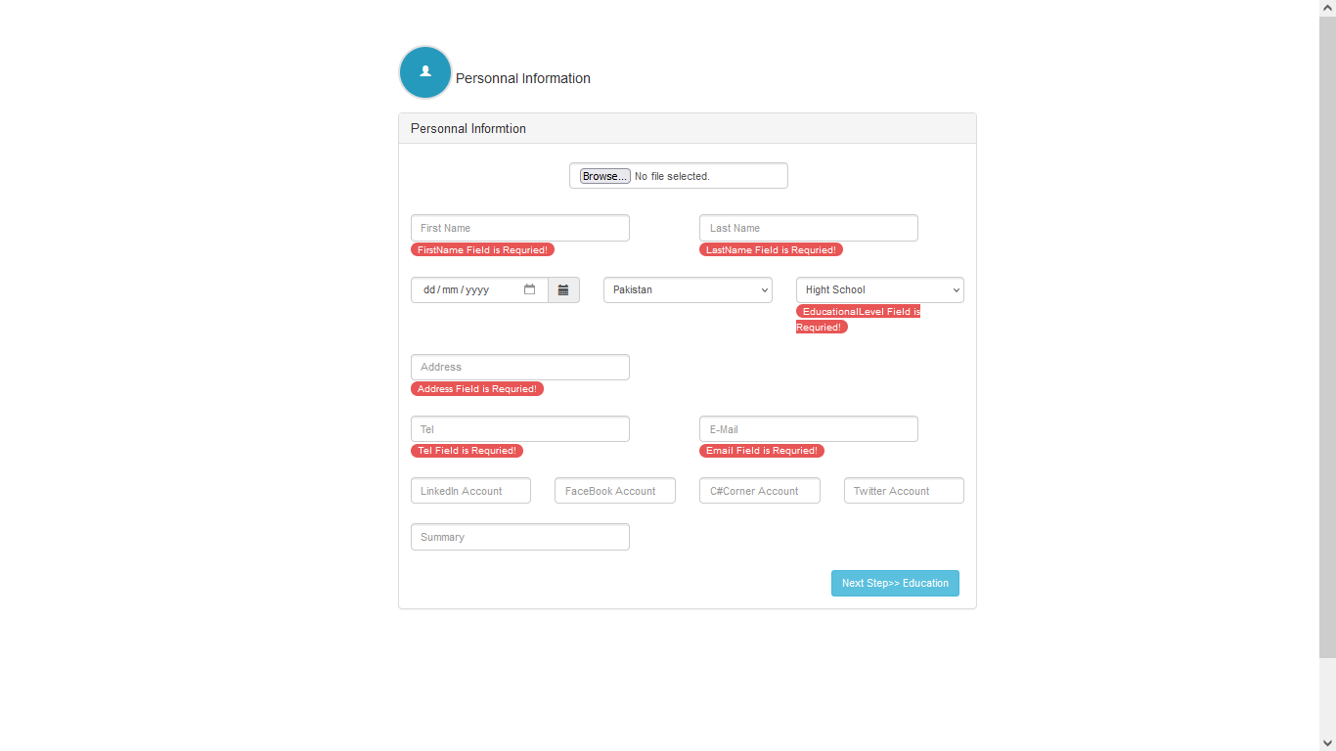
Adding Resume of Employes

Slide 22

Web Application
Creating users.
Compilation of collected data.
Report generation.

Slide 23
Diagrams

Slide 24
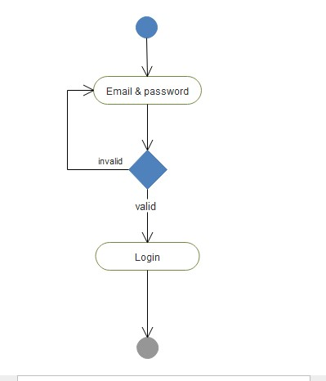
Activity diagram for Log in

Slide 25
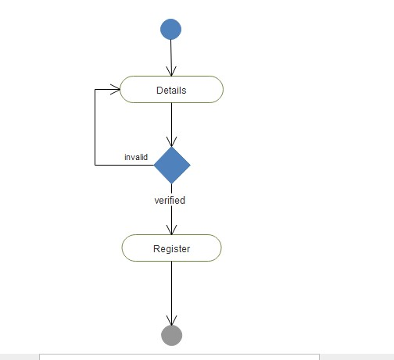
Activity diagram for User Regis..

Slide 26
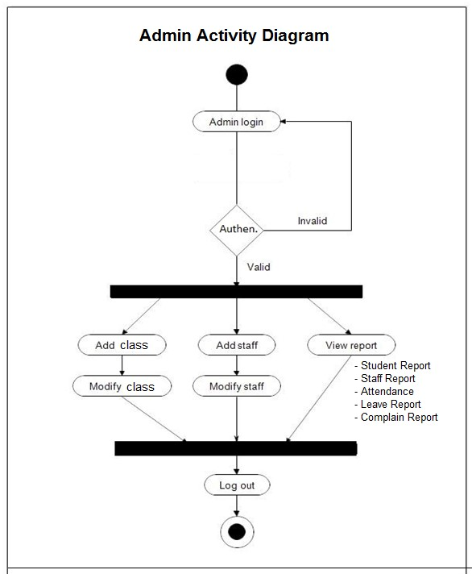
Activity diagram for Admin

Slide 27
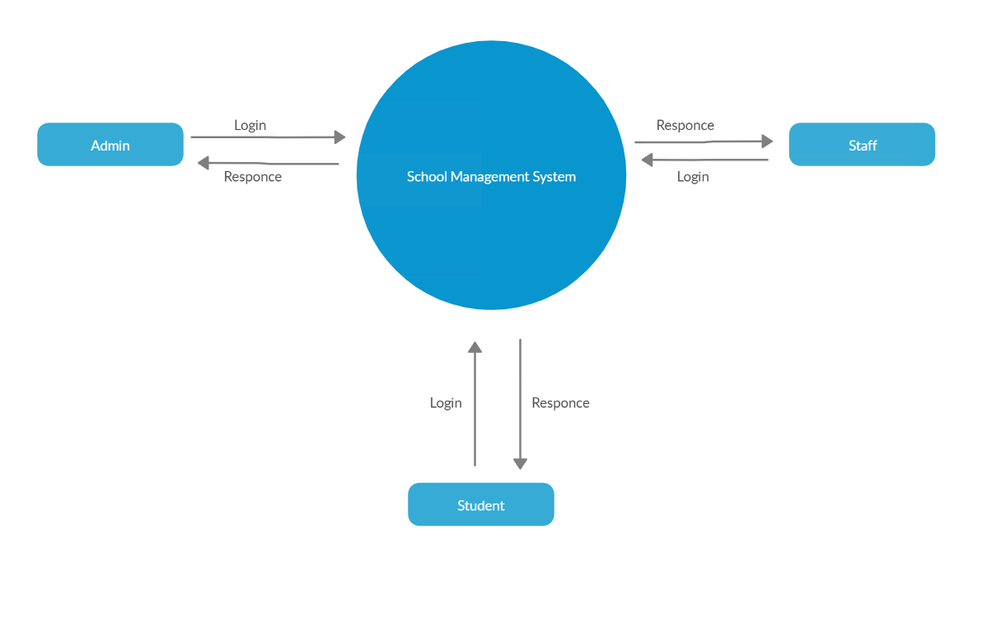
DFD Level 0
Zero Level Data flow Diagam

Slide 28
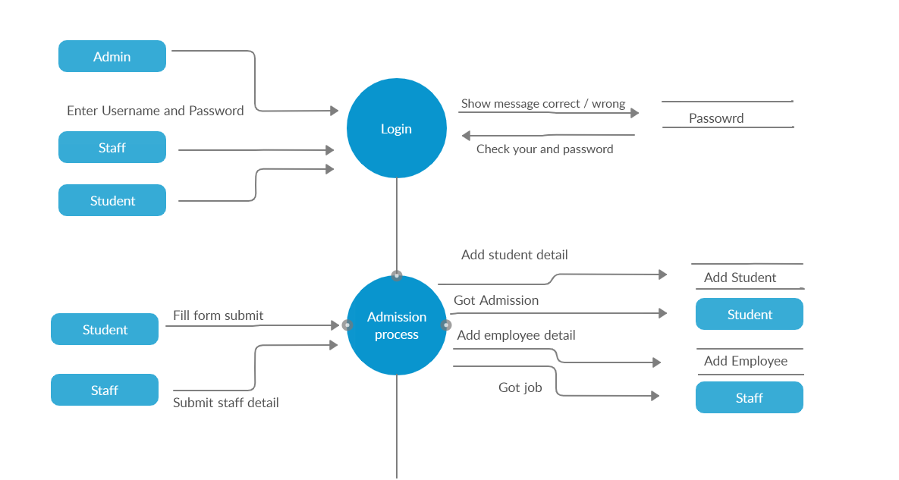
DFD Level First

Slide 29
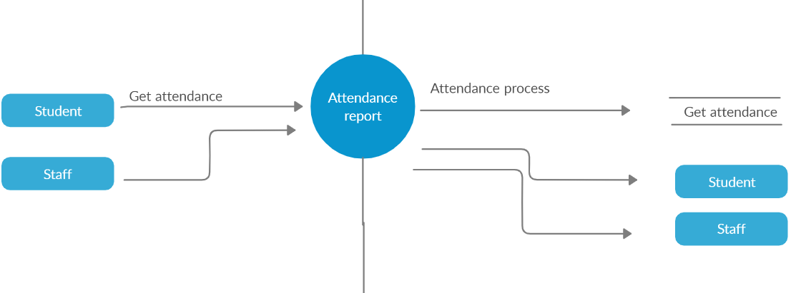

Slide 30
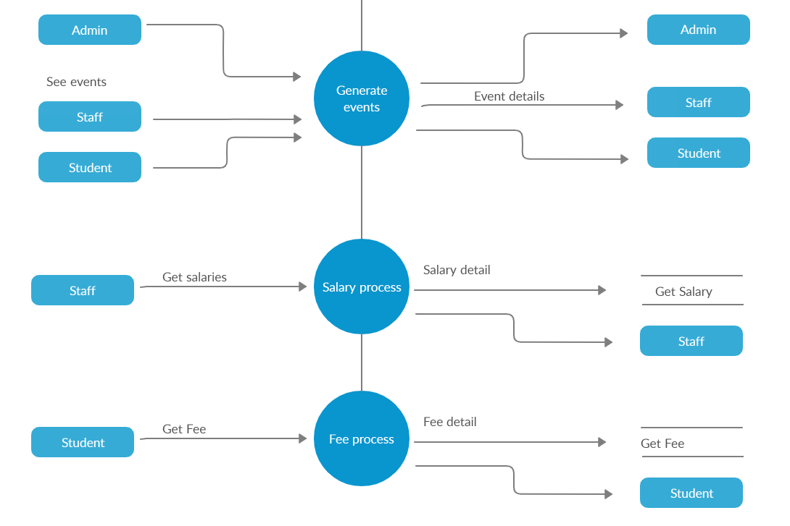

Slide 31
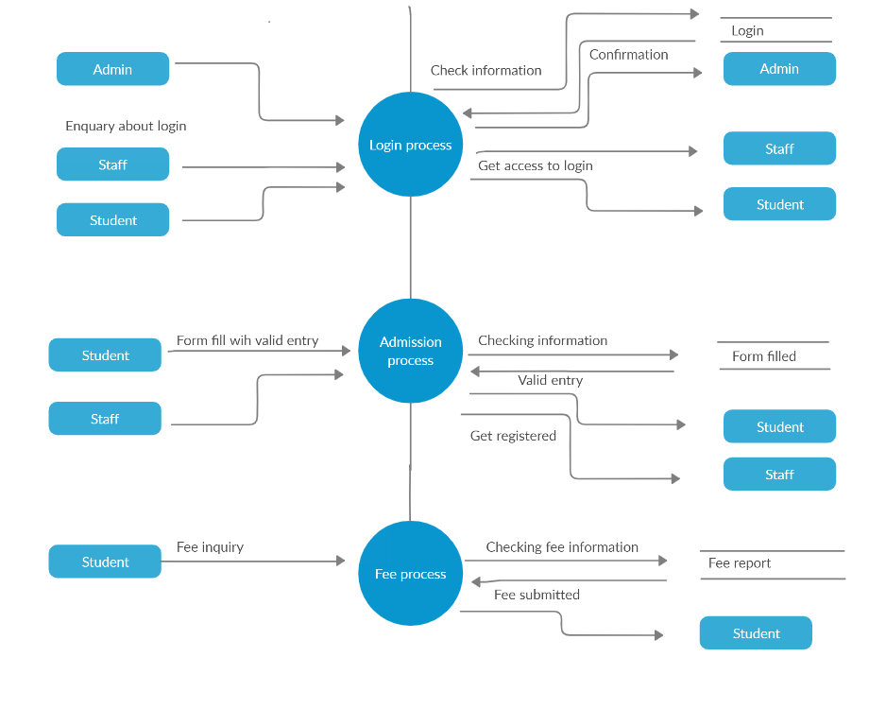
DFD Level 2

Slide 32
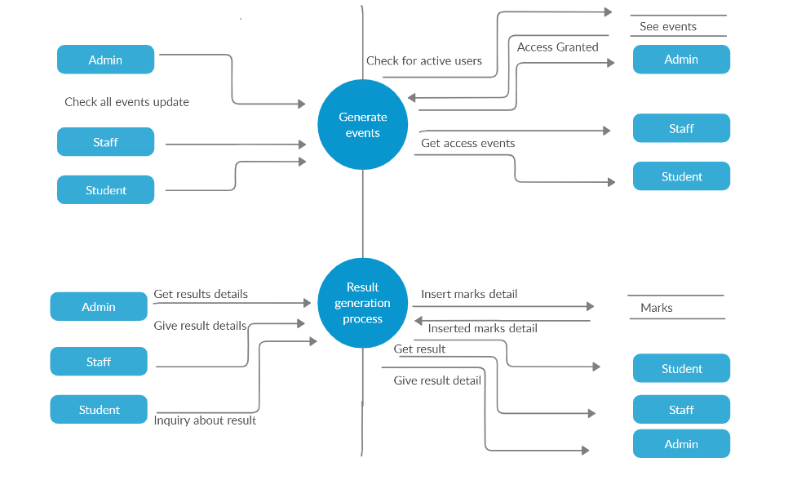

Slide 33
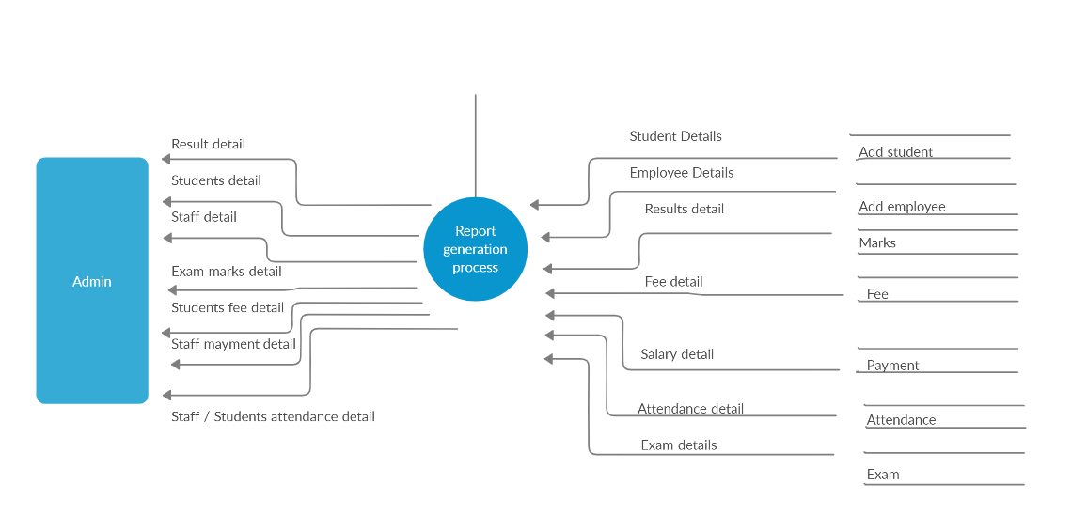

Slide 34
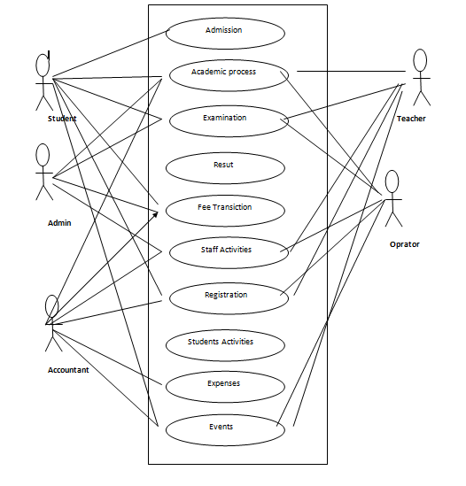
Use Case Diagram

Slide 35
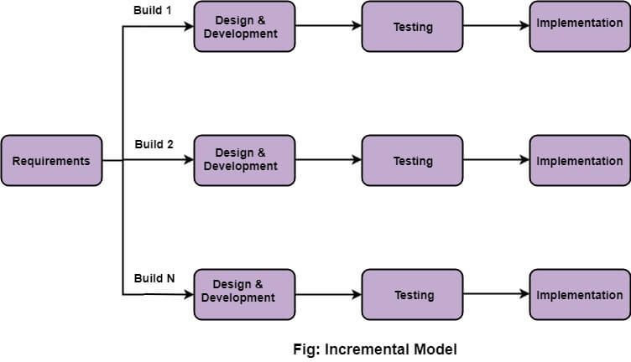
Methodology
Incremental model

Slide 36
Conclusion
An automated school management system that facilitates the various activities taking place at schools is developed . The system developed in the project consists of windows and web applications. The windows application takes most of the activities such as offline student registering, transcript and report card generation and producing the timetable. The web application facilitates attendance recording by the homeroom teachers and to view reports, to view status of students by students, teachers and parents. Data structures are used to implement the timetable designed. Finally the result generated is stored in a database. In addition to generating a feasible master timetable it produces a time table for each Employee. Furthermore it has been shown that the web application of the system helps attendance recording by the homeroom teacher and parents can view the status of their children using the Internet or Intranet of the school.

Slide 37
References
1
https://en.wikipedia.org/wiki/Learning_management_system#Purpose
2
https://www.google.com/search?q=lms+methodology&rlz=1C1SQJL_enPK873&source=lnms&tbm=isch&sa=X&ved=0ahUKEwjdiau2ksflAhUmz4UKHRL7B3QQ_AUIEigB&biw=1366&bih=657#imgrc=_

Slide 38
Keep Learning & Keep Smiling

