Slide 1
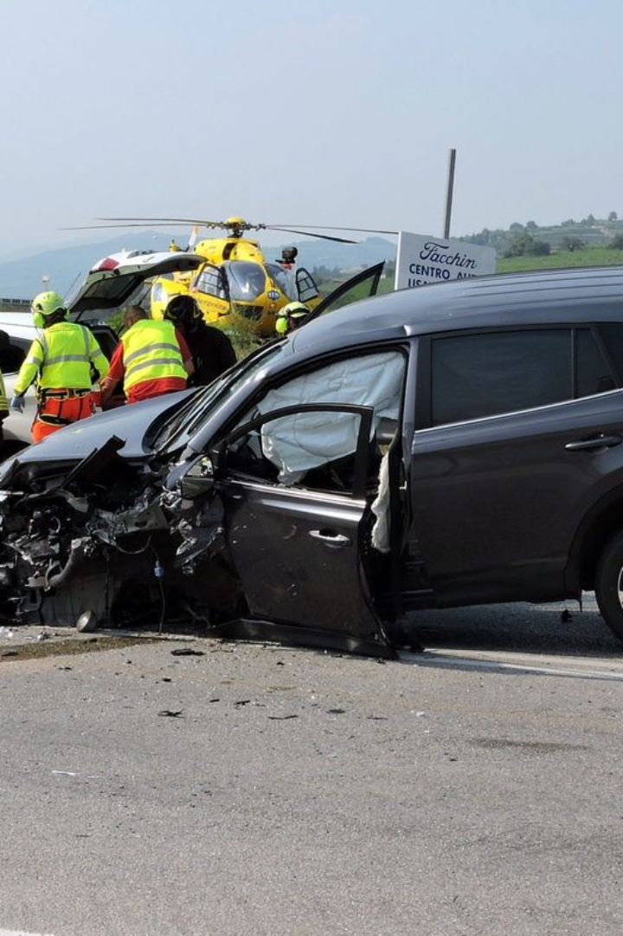
Road Accident Report
Objective
The client wants to create a Road Accident Dashboard for the years 2021 and 2022 so that they can have insight into the requirements.

Slide 2
Key Performance Indicators
1
Primary KPI
2
Secondary KPI
Total casualties took place after the accident.
Total casualties with respect to vehicle type.
Total casualties & percentage of total with respect to accident severity and maximum casualties by type of vehicle.
Monthly trend showing comparison of casualties for current year and previous year.
Maximum casualties by road type.
Distribution of total casualties by Road Surface.
Relationship between Casualties by Area, Location, & Day/Night.

Slide 3
Stakeholders
1
Ministry of Transport
2
Road Transport Department
3
Police Force
Responsible for transportation policies and programs.
Responsible for law enforcement and public safety.
Responsible for vehicle registration and licensing.
4
Emergency Services Department
5
Road Safety Corps
6
Transport Operators
Responsible for promoting road safety and awareness.
Responsible for managing transportation services.
Responsible for providing emergency medical services.
7
Traffic Management Agencies
8
Public
9
Media
General public as users of the transportation system.
Responsible for disseminating information to the public.
Responsible for managing traffic flow and safety.

Slide 4
Metadata
File Extension: .xlsx
Number of Rows: 3.07 million
Number of Fields: 21
File format for the road accident data.
Total fields and columns in the road accident dataset.
Total rows of data in the road accident dataset.

Slide 5







Steps Followed
Requirement gathering from client
Identify the Stakeholders of the Project
Data cleaning as per the requirement
Data Processing by adding some customized columns to data
Understanding the client's needs and expectations.
Recognizing the key individuals and organizations involved.
Ensuring the data is accurate and consistent.
Enhancing the dataset with additional relevant information.
Data Analysis by Pivot Tables and Excel Functions
Data Visualization to create charts and custom sheets to show the insights
Report and dashboard creation from start to finish
Utilizing Excel functions to derive insights from the data.
Presenting the data in a visually appealing and informative manner.
Developing a comprehensive report or dashboard based on the insights.

Slide 6
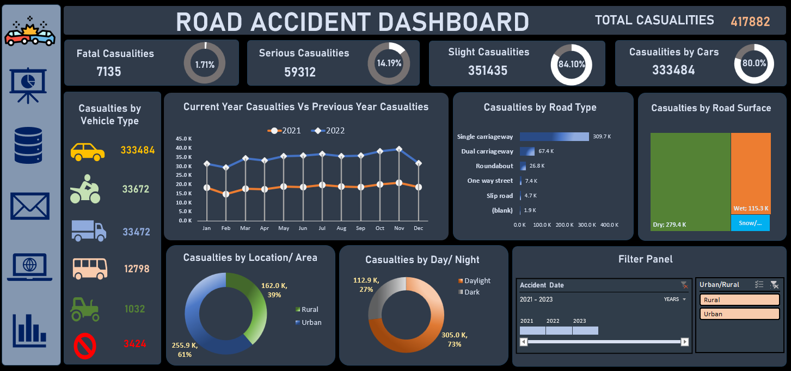

Slide 7
Key Insights
1
Total Casualties
2
Vehicle Types Involved
There have been a total of 417,882 casualties.
Cars account for the highest number of casualties (333,484).
Among these, 7,135 were fatal, 59,312 were serious, and 351,435 were slight casualties.
Other vehicle types include vans, motorcycles, bicycles, and buses and coaches.
3
Monthly Trends
4
Location and Time
Casualties remained relatively consistent from May to December between 2021 and 2022.
Most accidents occur in urban areas (255.9k) compared to rural areas (112k).
Most accidents happen during the dark hours (73%).

Slide 8
Conclusion
Total Casualties
Fatalities and Severity
Vehicle Types Involved
The alarming figure of 417,882 total casualties underscores the critical need for comprehensive strategies to enhance road safety and reduce the human toll of accidents.
With 7,135 fatal incidents and 59,312 serious casualties, there is a clear indication that not only the frequency but also the severity of road accidents demand urgent attention and targeted interventions.
Cars emerge as a significant contributor to road accidents, accounting for a substantial 333,484 casualties. Understanding the dynamics of different vehicle types is crucial for developing tailored safety measures.
Monthly Trends
Location Analysis
Other Vehicle Types
The stability in casualty rates from May to December across the years 2021 and 2022 suggests a consistent risk throughout the year, prompting the need for sustained awareness campaigns, law enforcement, and safety measures irrespective of the season.
The involvement of various vehicle types, including vans, motorcycles, bicycles, and buses and coaches, emphasizes the need for a holistic approach to road safety that considers the unique challenges posed by each mode of transportation.
The concentration of accidents in urban areas, totaling 255,900, compared to rural areas (112,000), underscores the importance of targeted safety measures in city planning and infrastructure development.
Temporal Patterns
The concerning fact that 73% of accidents occur during the dark hours calls for enhanced visibility measures, improved lighting infrastructure, and heightened awareness campaigns to address the specific challenges posed by nighttime driving.
In conclusion, the insights from the Road Accident Dashboard demand a collaborative and multifaceted approach to road safety. Whether through improved urban planning, targeted interventions for specific vehicle types, or enhanced safety measures during nighttime hours, addressing the highlighted issues is paramount. The dashboard serves as a crucial tool for informed decision-making and underscores our shared responsibility to create safer roads. Stay safe and contribute to making our roads secure for everyone.

