Slide 1
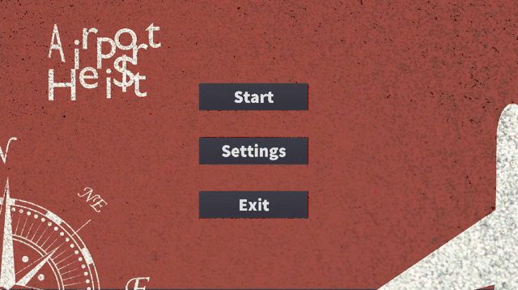
Criminals minds:
Eiaki Morooka
Francesco Natanni
Khai Cao
Kiana Aghajani
Notes:
Frank
Airport Heist is a single player game, where the main character aims to make it to the final destination airport, before they are captured or their stamina or money runs out.
BTW the artwork you see in these slides were created by AI. We used a image generating website called dreamstudio. This first slide will be the home screen of the game and was made by Aki.

Slide 2
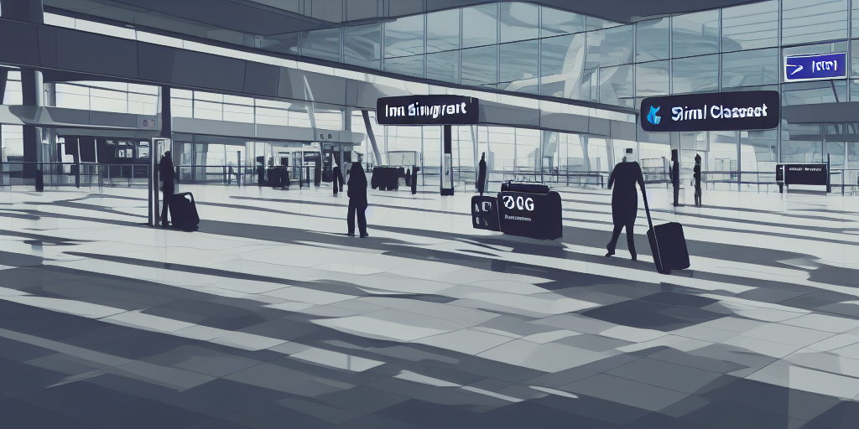
Backstory
You are a master thief, captured by the Finnish authorities on the minor charge of jaywalking. They have no idea of your genius though and neglect to watch over you properly. You make a daring, yet surprisingly easy escape from Jokela Prison and are now on the run! You need to get out of Finland A.S.A.P though as the finnish authorities will stop at nothing to bring you to justice.
Due to your expert skills you are able to steal 10,000€ from the Alepa at Helsinki Airport. The police, however, have been alerted of your activities and are hot on your tail. Time to make your next move before interpol gets you!
Notes:
Frank

Slide 3
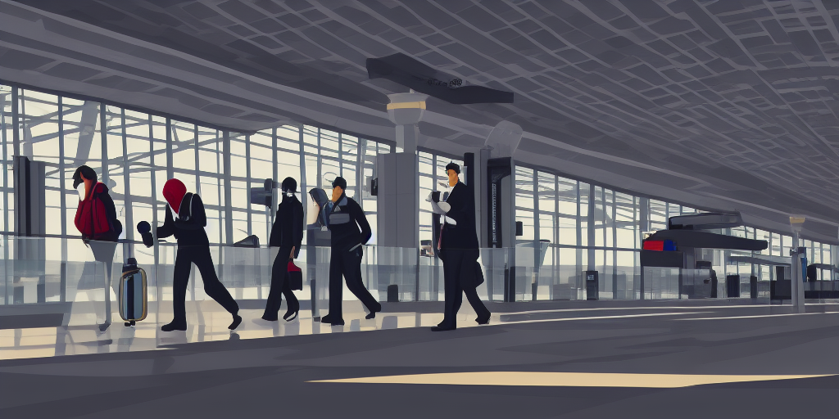
Objective
Your mission is to get to your extraction team who are waiting at the destination airport so they can smuggle you out of the EU.
Notes:
Khai -
Until then avoid interpol by travelling to other airports.

Slide 4
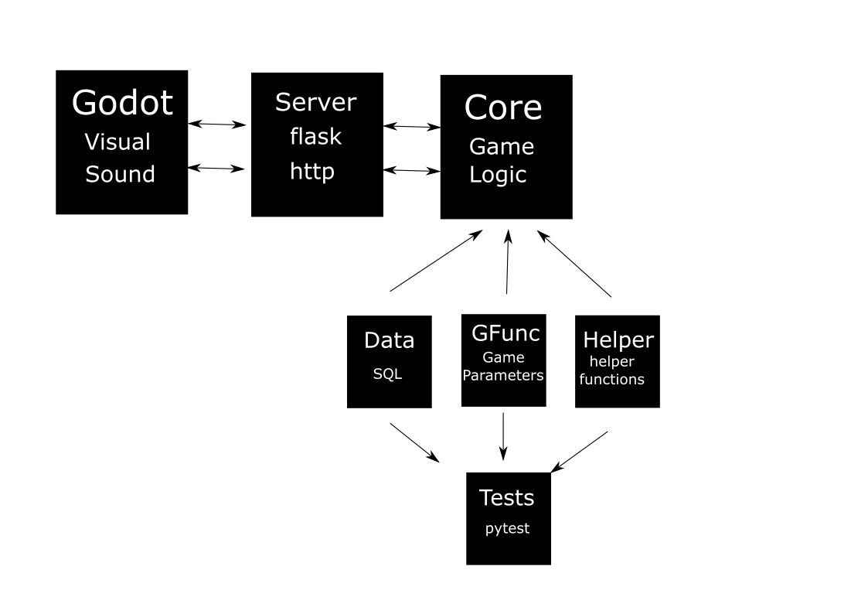
Now the Demo
Notes:
Aki

