Slide 1
POLARIS
Calibrated triangulation of non-coding variant evidence
into mechanism and target gene
type 2 diabetes + coronary artery disease · transparent · reproducible from public APIs

Slide 2
90% of disease variants are non-coding — the bottleneck is integration
Powerful oracles disagree, are uncalibrated, and conflate molecular effect with disease cause. POLARIS turns the two guardrails into mathematics.
Guardrail 1 — functional ≠ pathogenic
Posterior factorizes into molecular-function × disease-linkage. Rarity is INVERTED for common-variant traits (replicated in 2 diseases).
Guardrail 2 — distrust any single oracle
Each channel is a noisy annotator; a latent-truth EM learns its reliability. Channels are largely independent (Marchenko–Pastur).

Slide 3
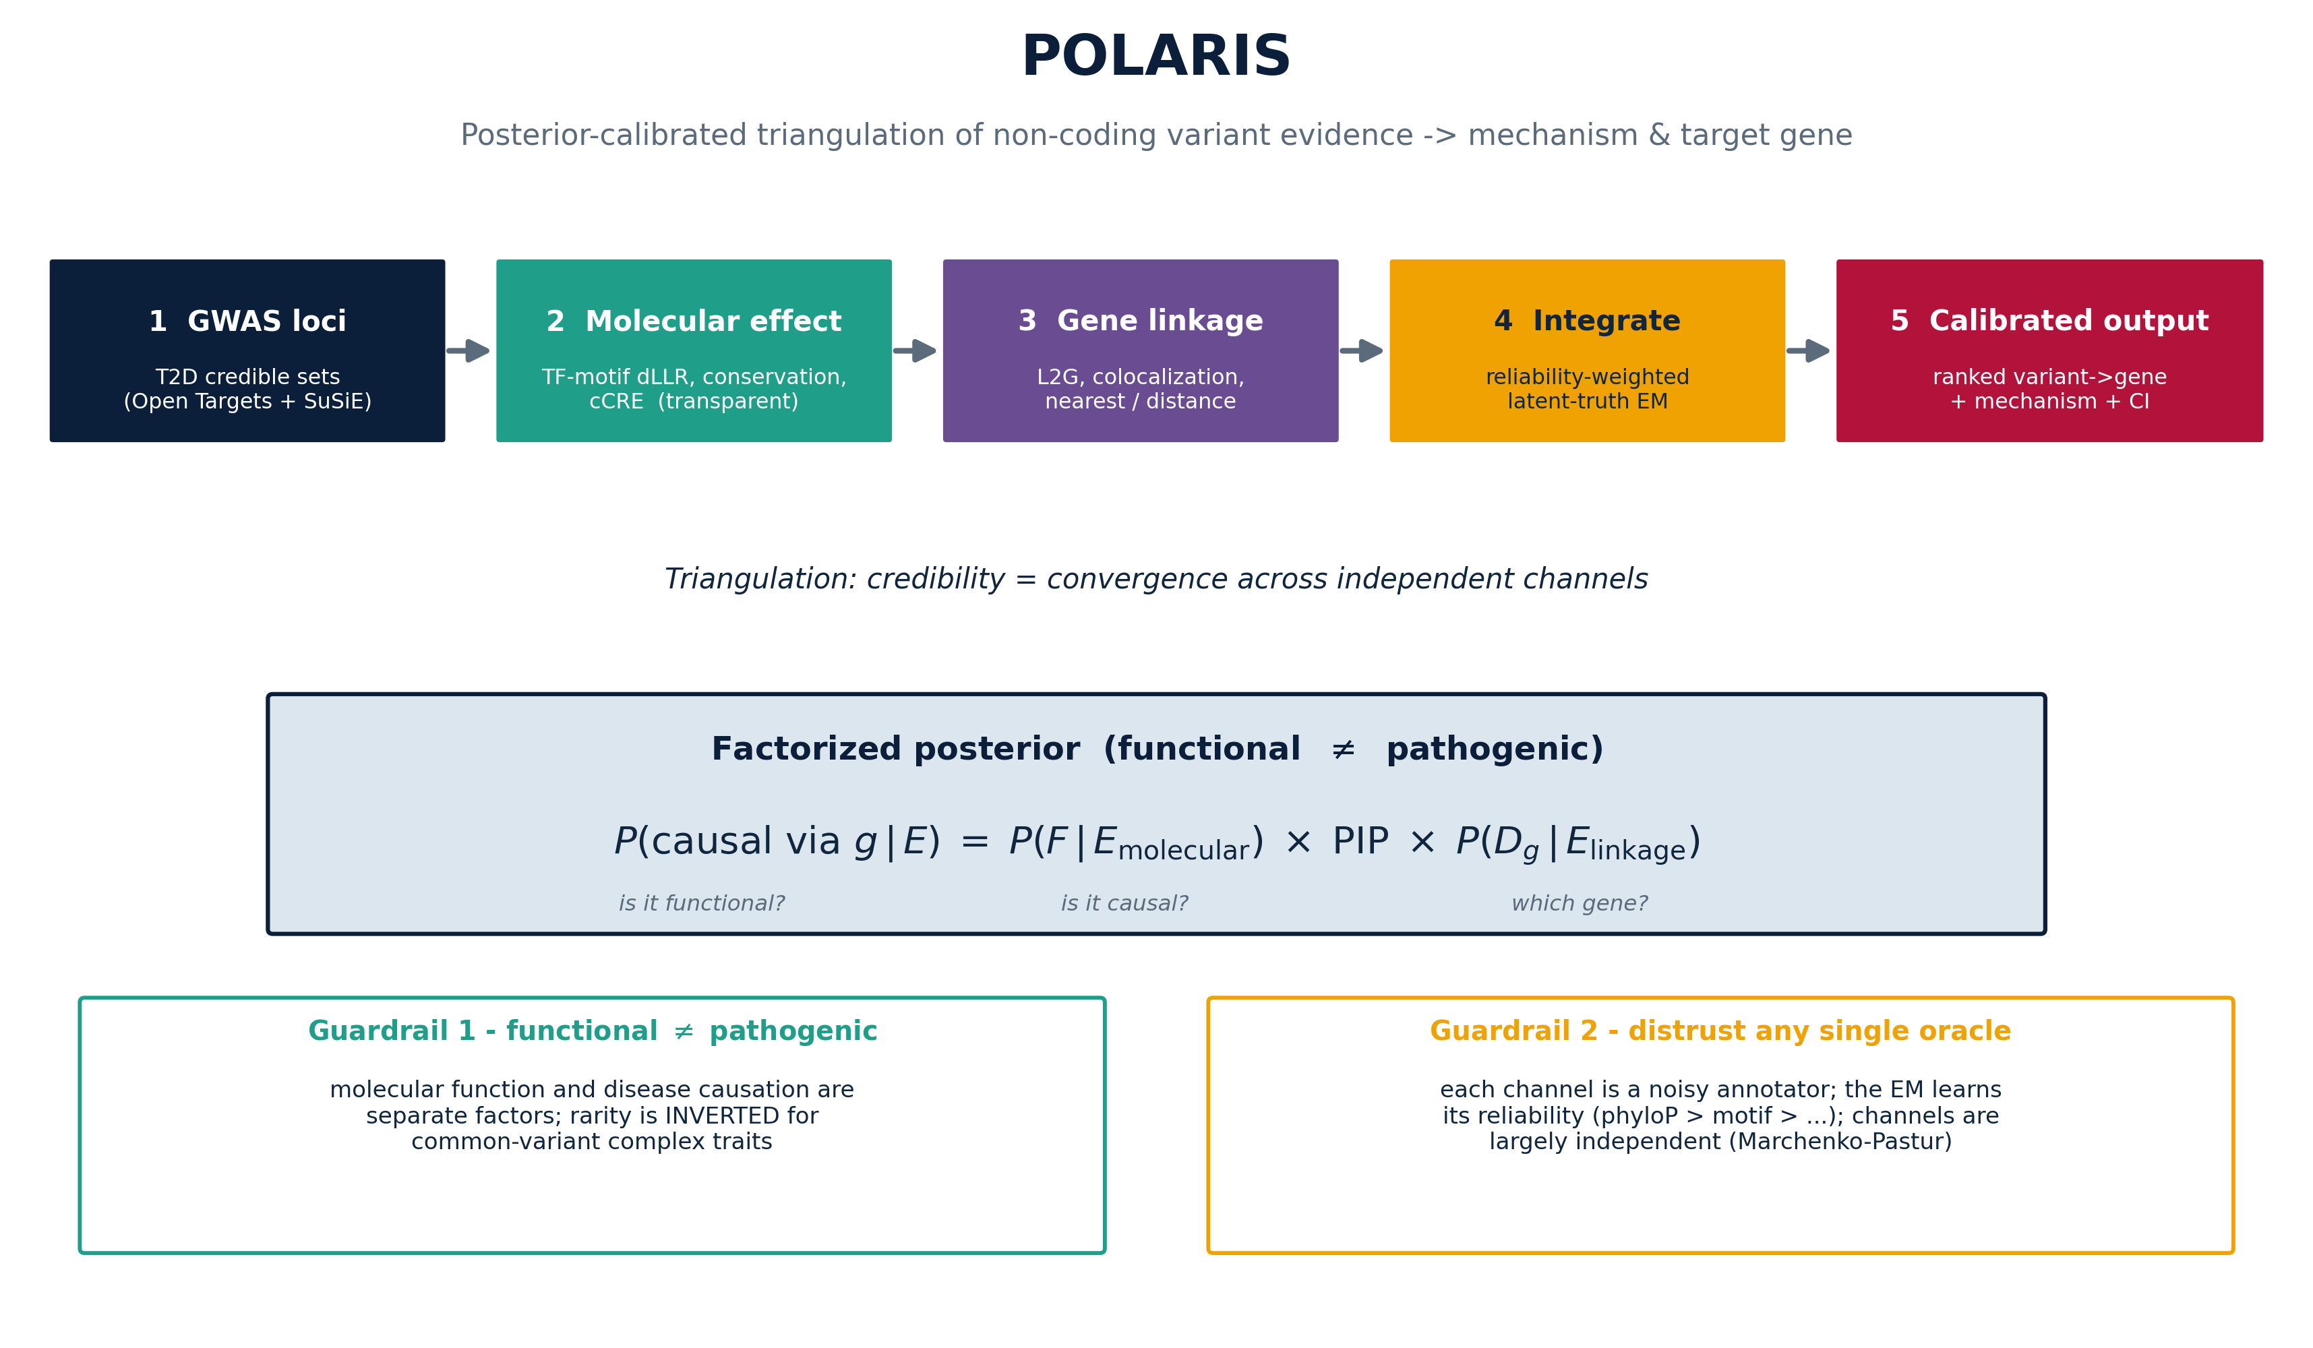
The pipeline — six steps, entirely from public data
Ranked variant → gene hypotheses with an auditable mechanism and a calibrated probability

Slide 4
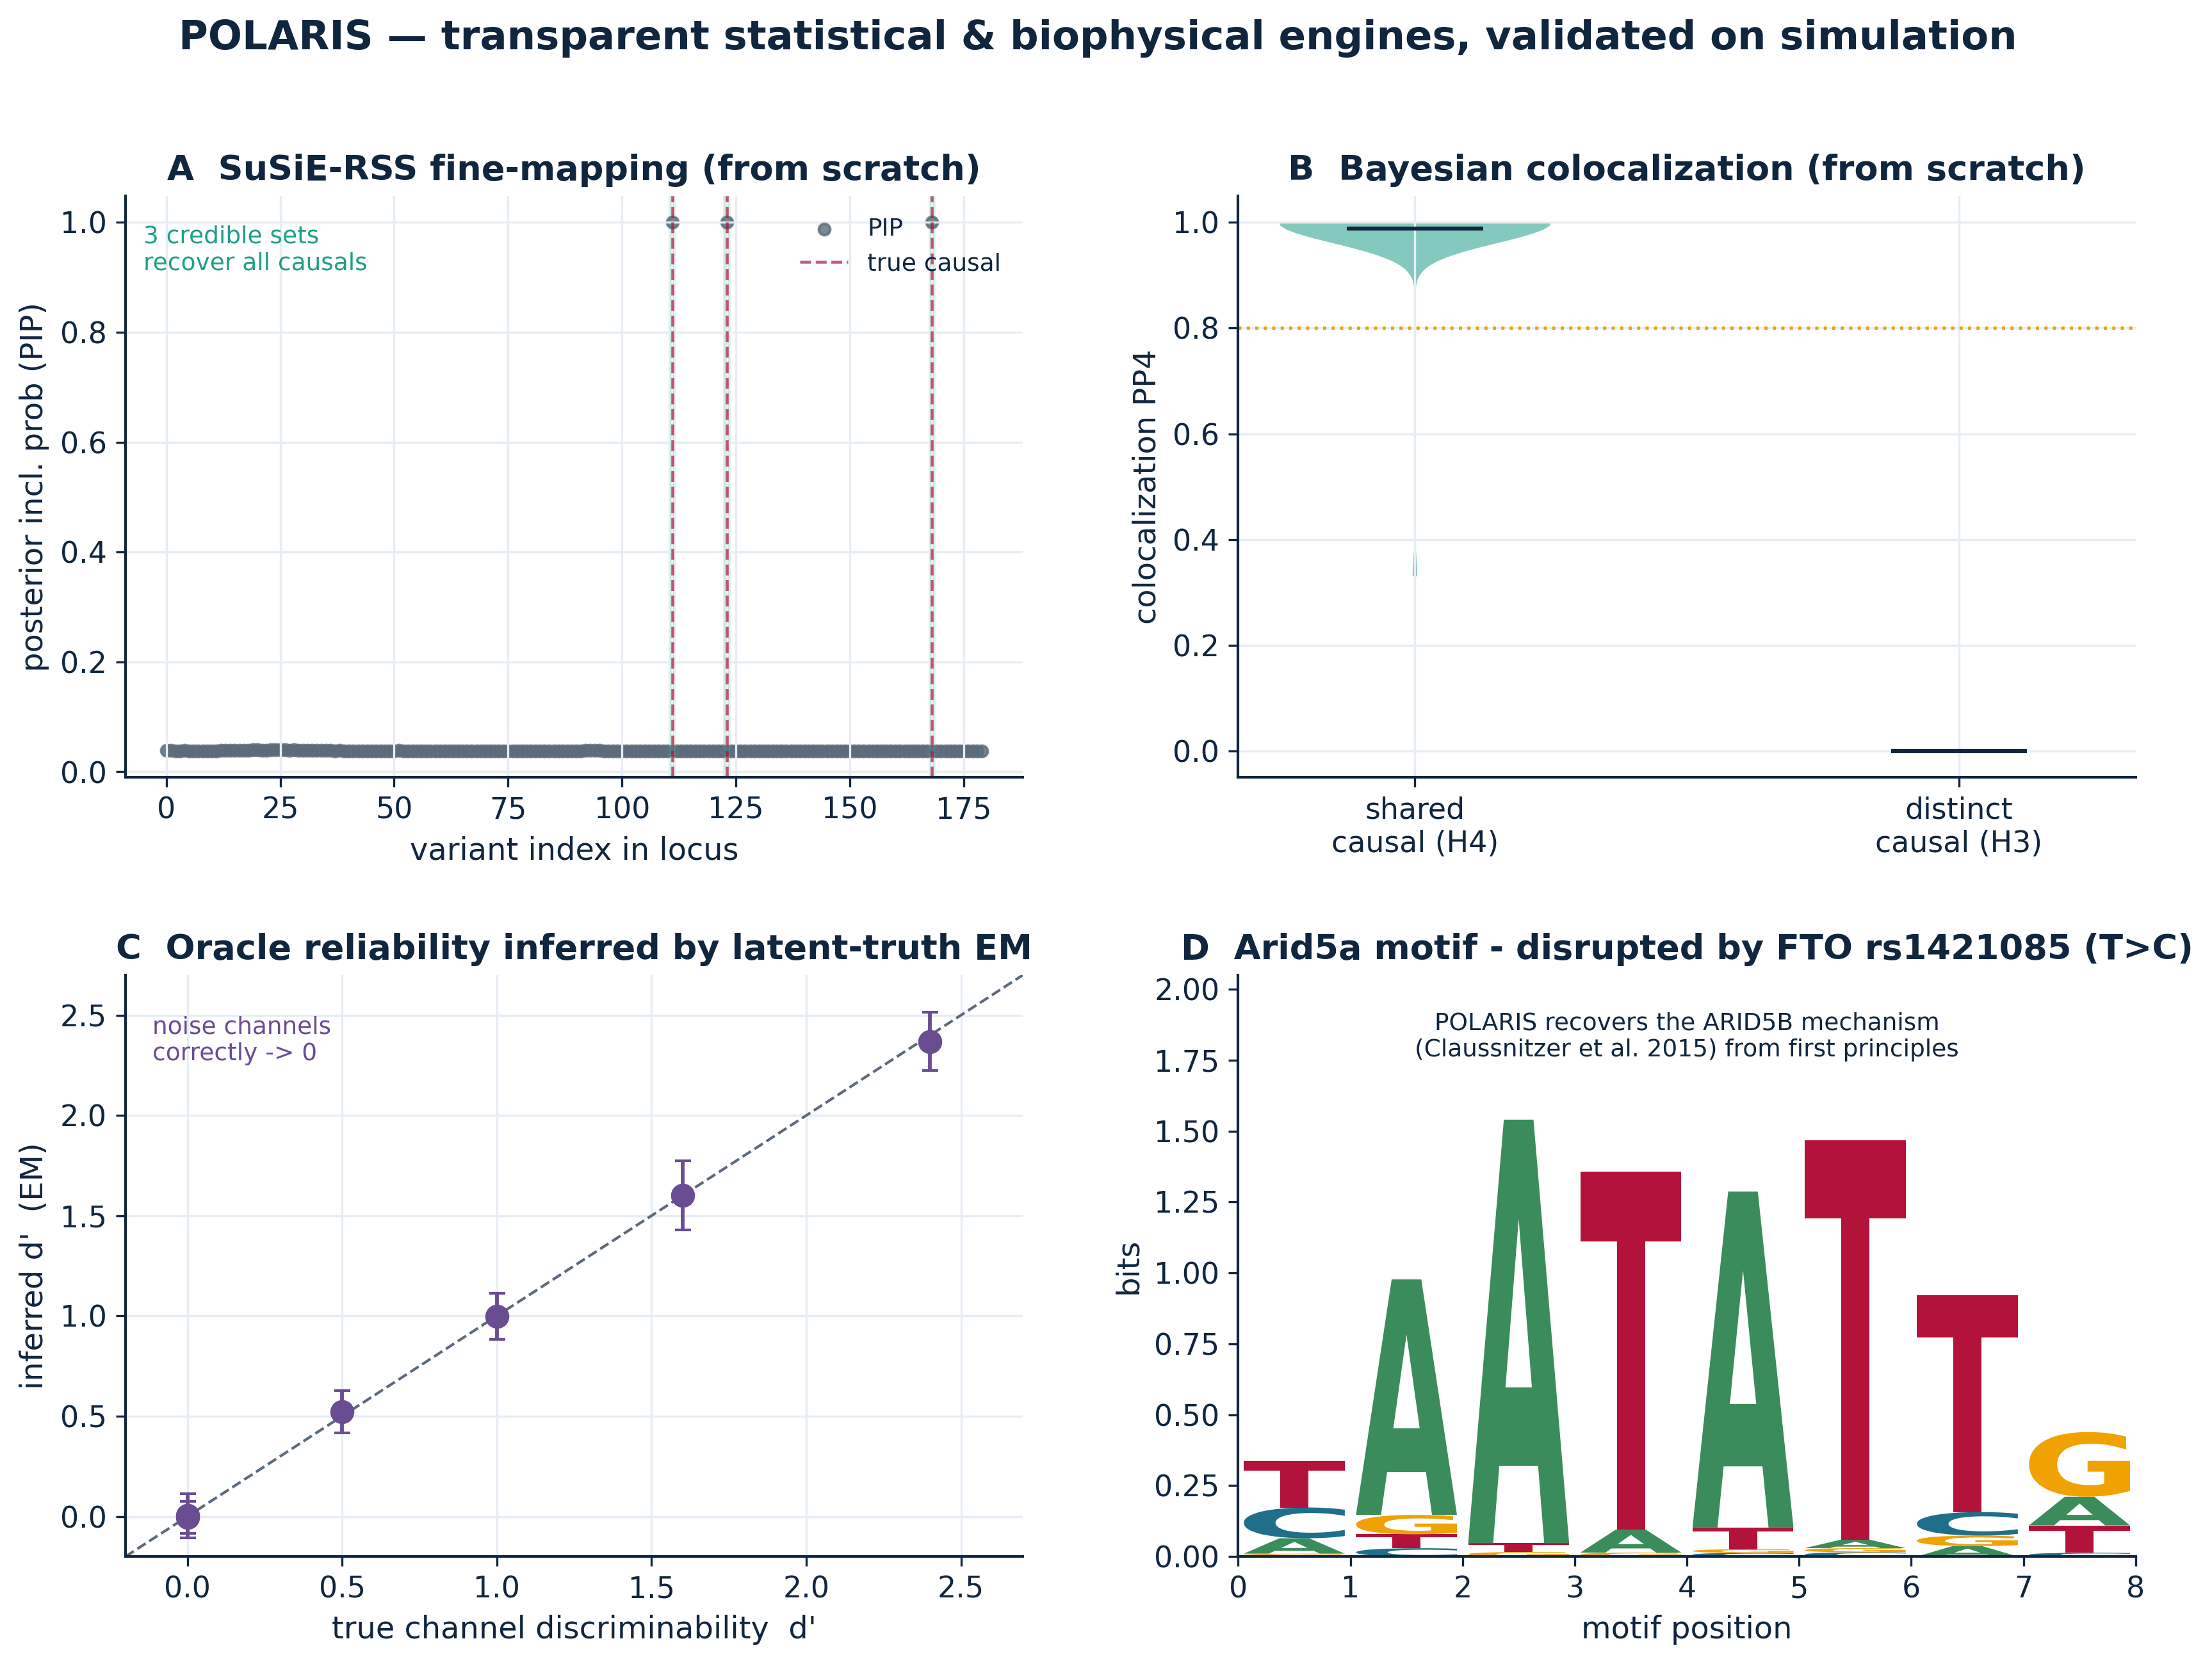
Every engine built from scratch and validated
from-scratch statistical & biophysical engines
SuSiE fine-mapping, Bayesian coloc, reliability EM, and the information-theoretic motif logo — all validated

Slide 5
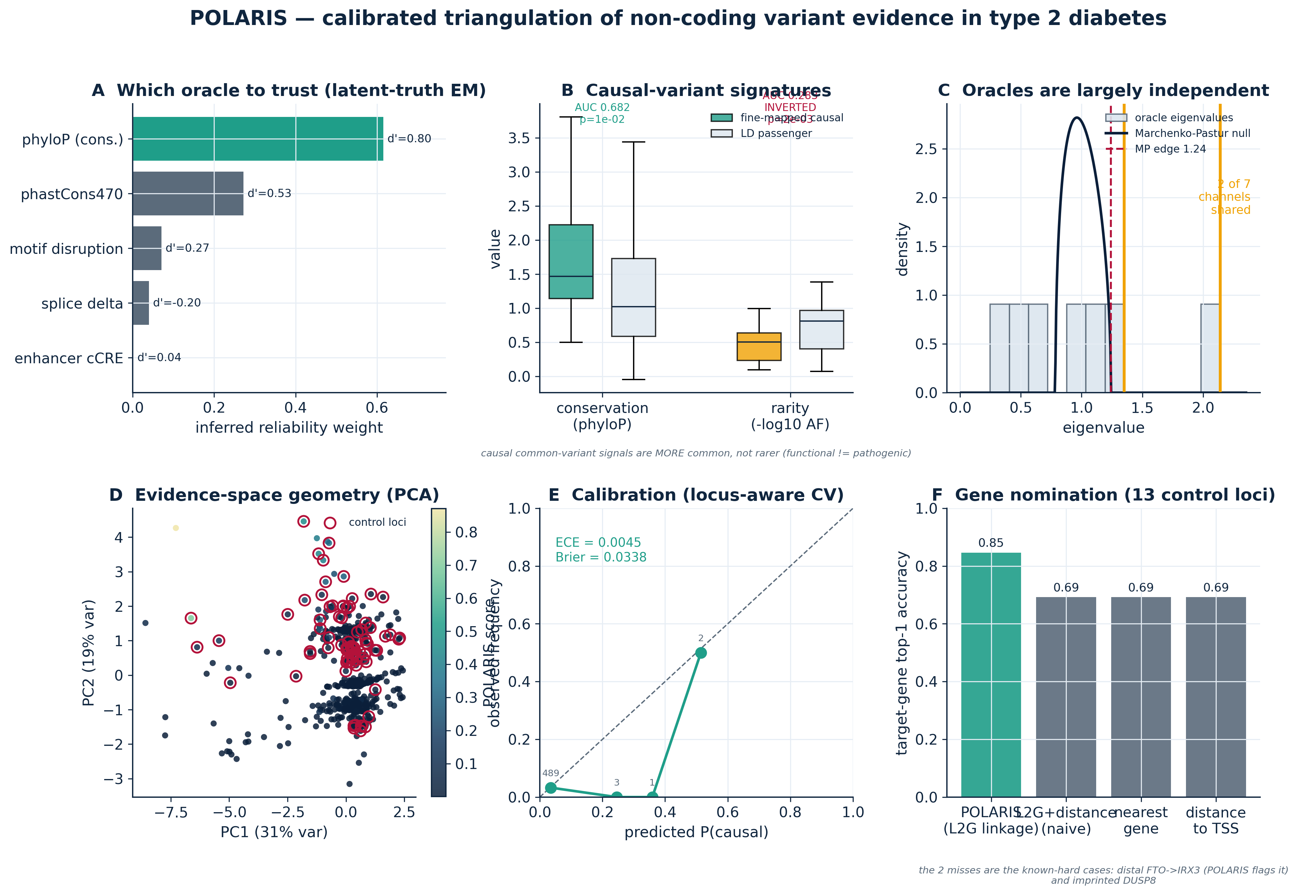
Calibrated triangulation in type 2 diabetes
The EM learns conservation is most reliable; causal variants are conserved but NOT rare; channels independent; ECE = 0.005

Slide 6
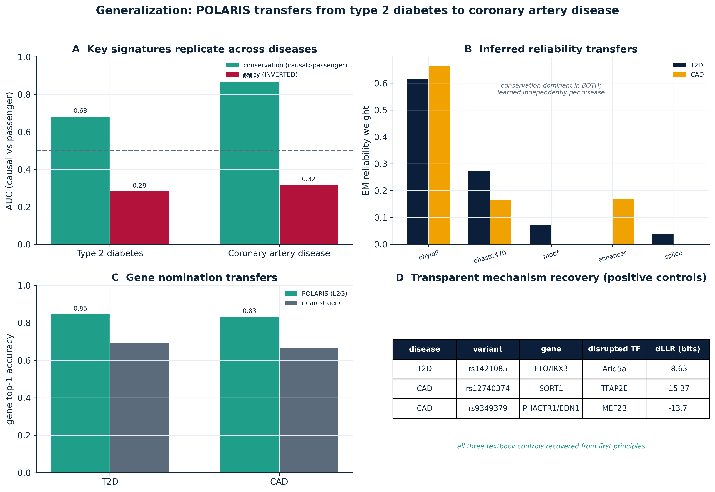
Generalization — the same behavior transfers to a second disease
T2D → coronary artery disease
Conservation enrichment, rarity inversion, reliability ordering, and gene nomination all replicate in CAD

Slide 7
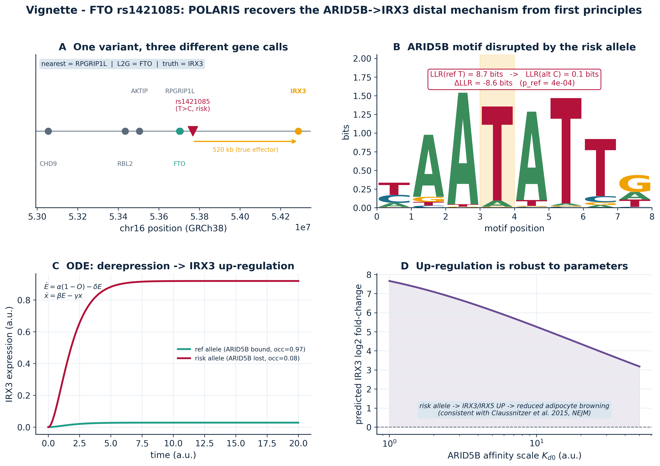
Vignette — FTO rs1421085 → ARID5B → IRX3
biophysics → dynamics → calibrated hypothesis
One variant, three gene calls. POLARIS recovers the textbook distal mechanism from first principles

Slide 8
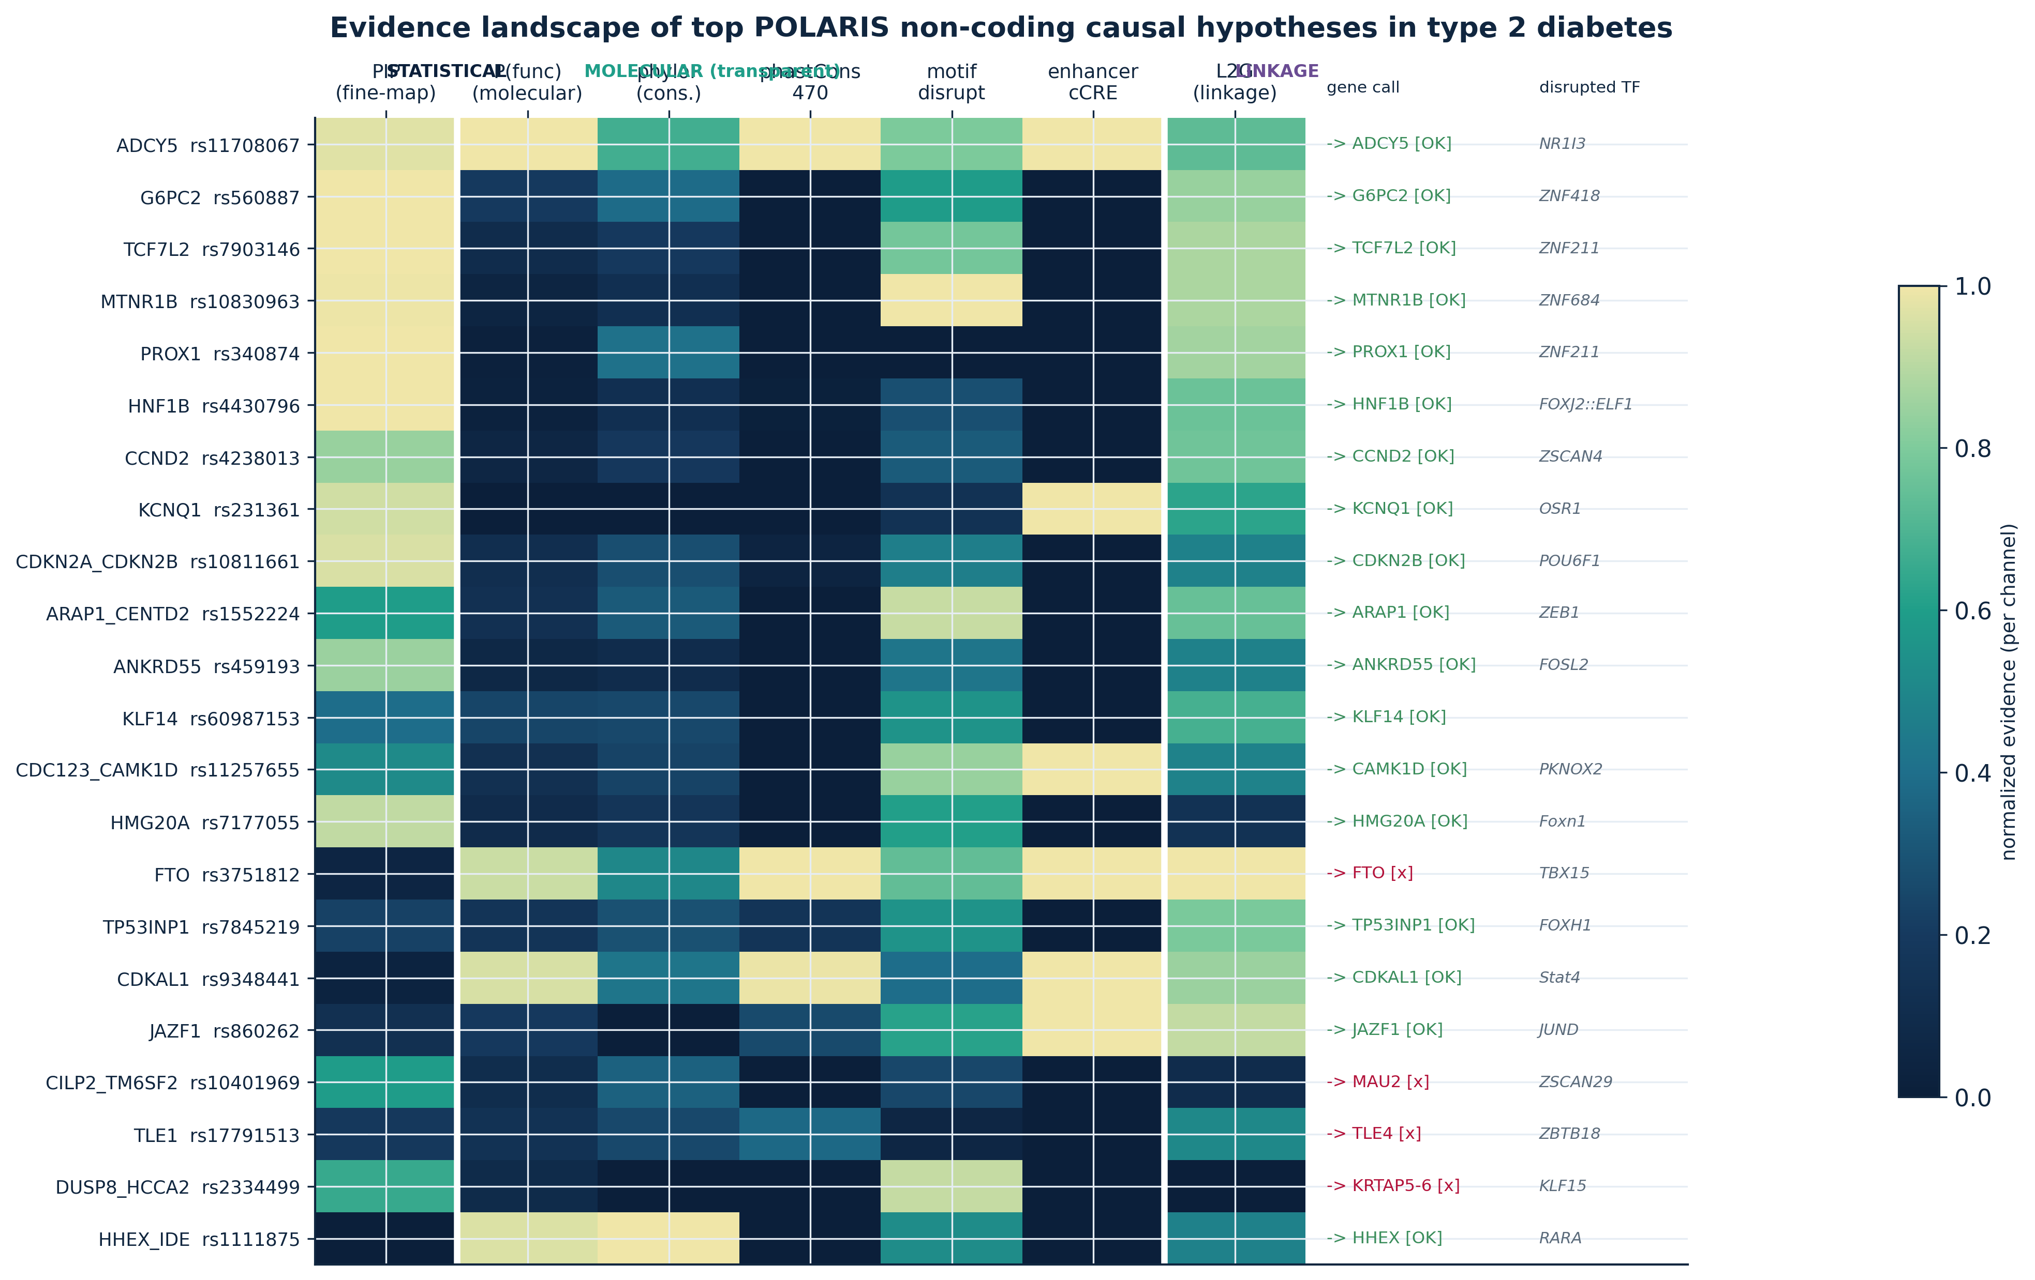
The evidence landscape of top hypotheses
18 of 22 gene calls correct; the misses are the known-hard distal/imprinted loci, each with a transparent mechanism

Slide 9
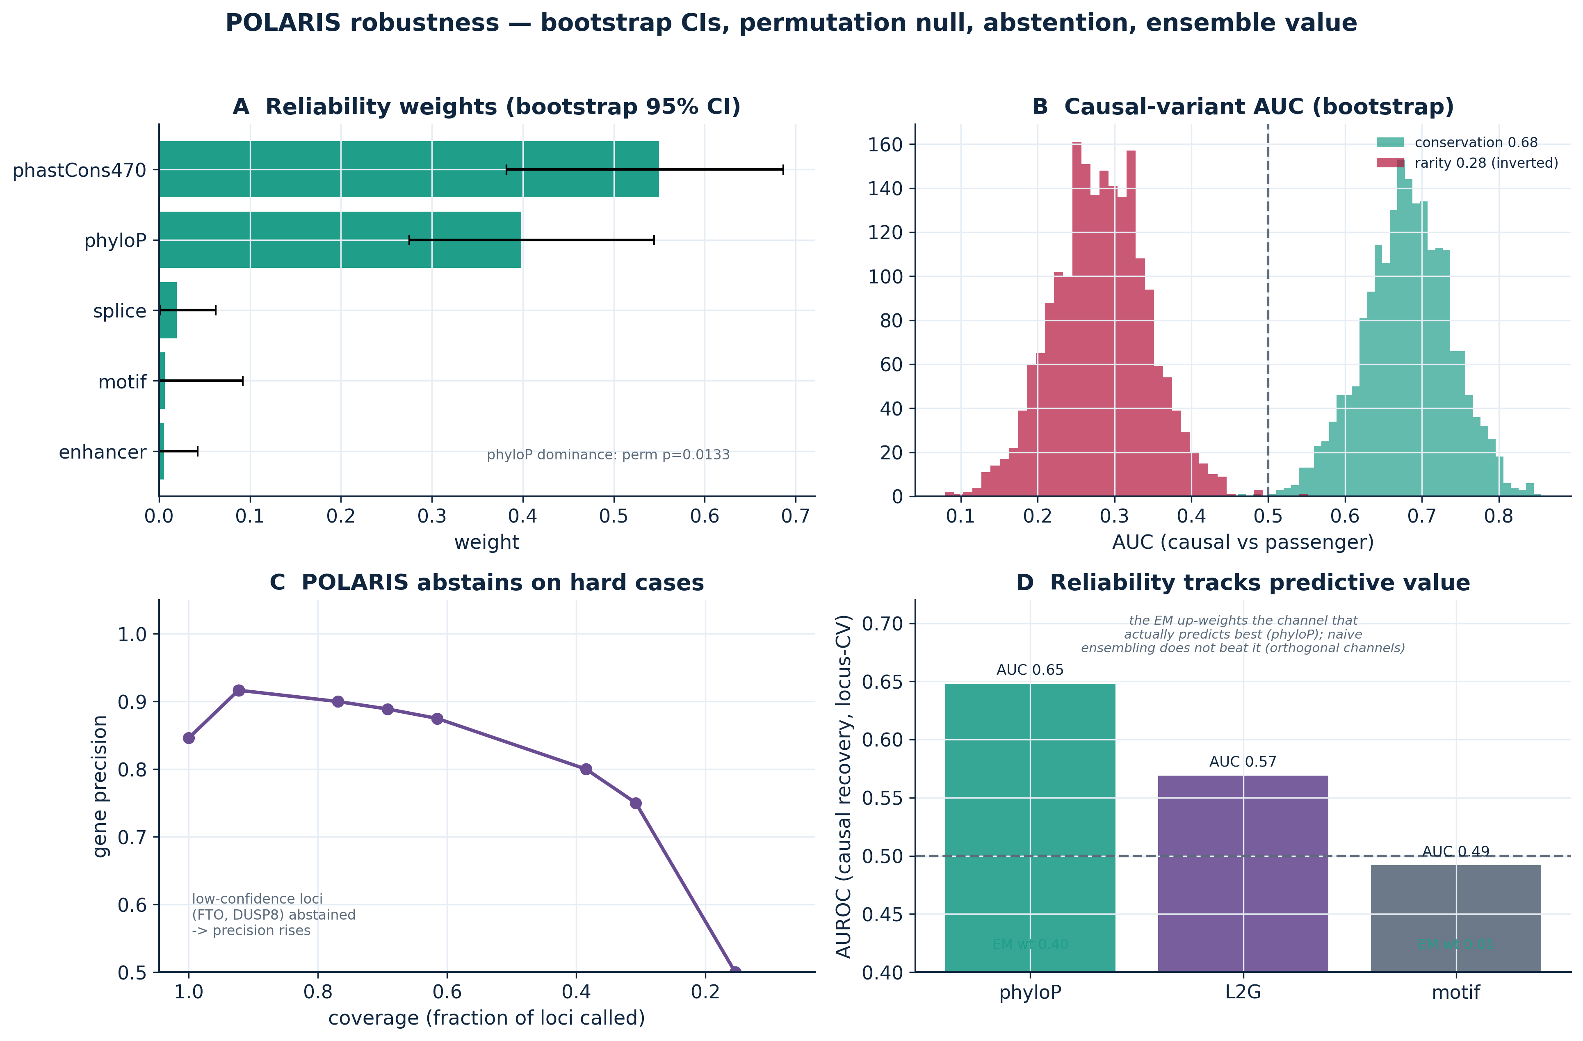
Statistical rigor — bootstrap, permutation, abstention
phyloP dominance is significant (perm p = 0.013); confidence-stratified abstention raises gene precision to 0.89

Slide 10
By the numbers
85%
gene top-1 (control loci)
569 + 260
fine-mapped variants (T2D+CAD)
0.0045
calibration error (ECE)
0.68 / 0.87
conservation AUC (T2D / CAD)
5/7
independent evidence channels
p = 0.013
phyloP reliability (permutation)

Slide 11
POLARIS
• Credibility = calibrated convergence across independent, fallible evidence — not any single oracle
• Transparent biophysics recovers textbook mechanisms (ARID5B, SORT1) from first principles
• Oracle-agnostic: black boxes like AlphaGenome can be calibrated, not blindly trusted
Candidate A · GWAS hit → mechanistic hypothesis

