Slide 1
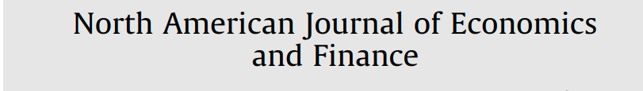
Pair Trading Based on Quantile Forecasting of Smooth Transition GARCH Models
Cathy W.S. Chen, Zona Wang,
Songsak Sriboonchitta, Sangyeol Lee
施冠宇
劉沛岑
林雅琪
Jan 4, 2022
Notes:
Today’s report will focus on what I had done this week.

Slide 2
Pair Trading Procedure
資料
  來源：yahoo finance
  Daily
  36 stocks
    'MMM', 'AA','AAPL', 'AXP', 'T','BAC', 'BA','CAT','CVX','CSCO',
    'KO', 'DD', 'HD', 'INTC','IBM','JNJ', 'JPM','LOW','MCD', 'MRK',
    'MSFT','PEP', 'PFE', 'PG','TRV','UNH','UTX.VI', 'VZ','WMT', 'DIS',
    'APO','XOM', 'GE','GOOGL', 'GS','HPQ'
挑選配對
  標準化股價
  MSD(Manhattan Square Distance)
    挑選較小距離之股票, 進行Pair Trading
計算 Return Spread
Notes:
First, recap. Last week, we know PSM correlated parity portfolio proposed in this paper can import the initial volatility parity portfolio.

Slide 3
Pair Trading Procedure
策略一
  用MCMC得到GARCH模型的參數估出Volatility
  估計Return Spread
Goal : 減少交易成本
策略二
  同上
  估計Return Spread 的分配, 再用標準差法（20%, 80%）求出上下界之VaR
策略三
  同上
  估計Return Spread 的分配, 再用標準差法（10%, 90%）求出上下界之VaR
求出Sharpe後, 進行 Wald Test
Notes:
First, recap. Last week, we know PSM correlated parity portfolio proposed in this paper can import the initial volatility parity portfolio.

Slide 4
Thanks!
施冠宇
劉沛岑
林雅琪
Jan 4, 2022
Notes:
Today’s topic is “Portfolio Decisions within a Generalized Funding Ratio Framework”. This paper is published on JPM in April,2022.

