Slide 1
3D reflection maps from tetrahedron maps
Combinatorial Representation Theory
and Connections with Related Fields@2021/10/19
Akihito Yoneyama
Institute of Physics, University of Tokyo, Komaba
Based on: AY, Math. Phys. Anal. Geom. 24 21 (2021)

Slide 2
Outline
Introduction: Reflection maps from Yang-Baxter maps
Main part: 3D reflection maps from tetrahedron maps
Examples
  Birational transition map
  Sergeev’s electrical solution
  Two-component solution associated with soliton equation
P.3~8
P.10~23
P.25~29

Slide 3
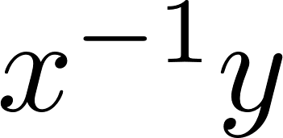

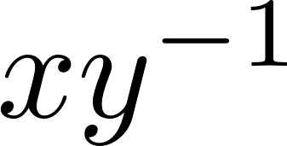



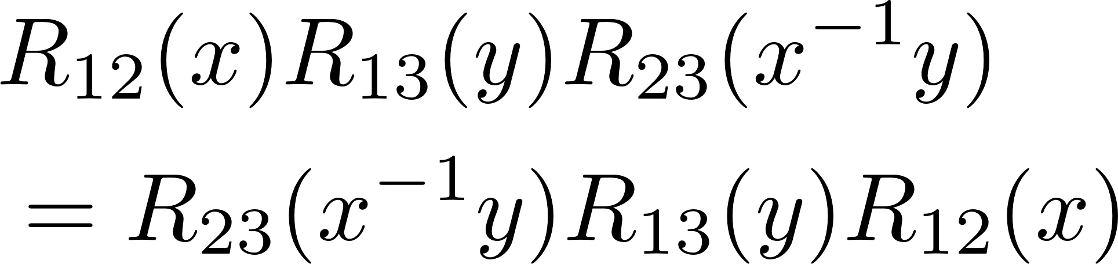
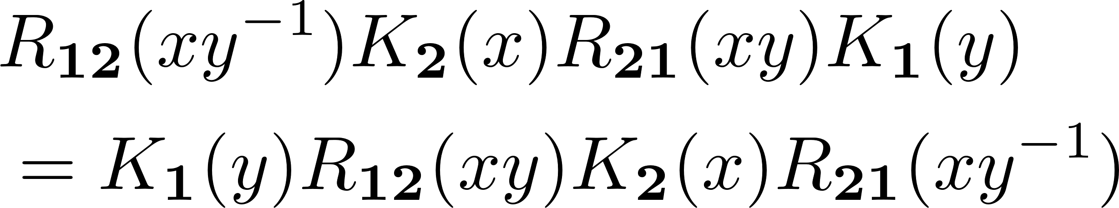
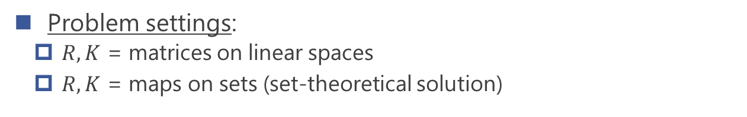
Integrability in 2D
Bulk: Yang-Baxter equation
Boundary: Reflection equation
Problem settings:
  $R,K$ = matrices on linear spaces
  $R,K$ = maps on sets (set-theoretical solution)
[Drinfeld92]

Slide 4
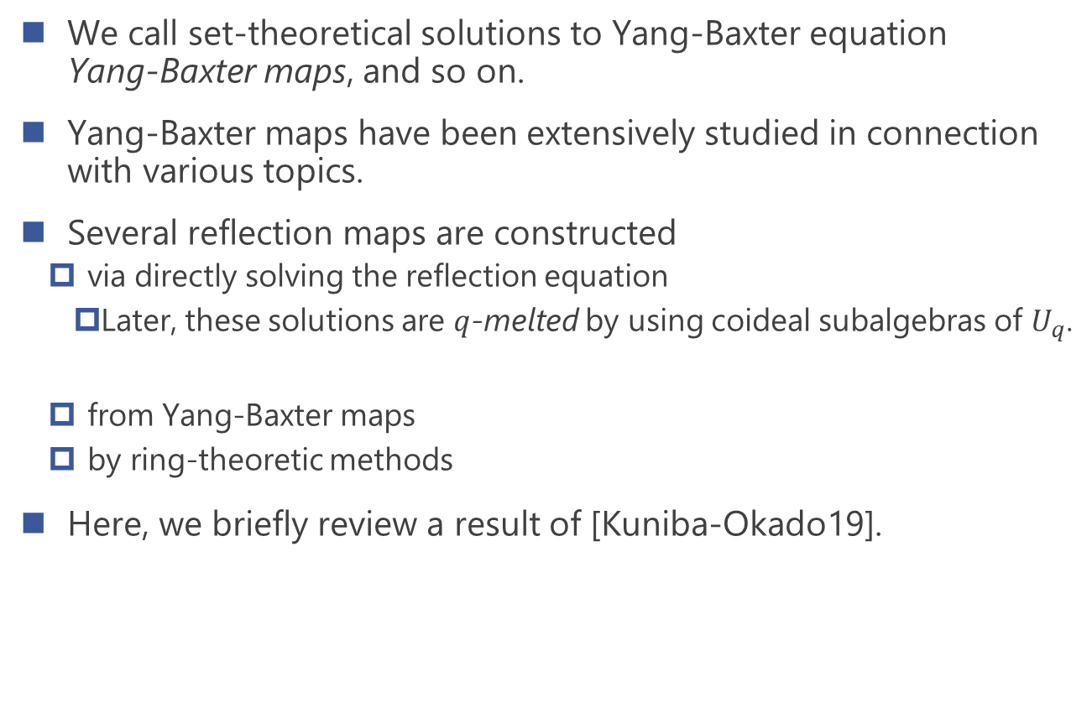
Yang-Baxter maps & reflection maps
We call set-theoretical solutions to Yang-Baxter equation
Yang-Baxter maps, and so on.
Yang-Baxter maps have been extensively studied in connection with various topics.
Several reflection maps are constructed
  via directly solving the reflection equation
    Later, these solutions are $q$-melted by using coideal subalgebras of $U_{q}$.
  from Yang-Baxter maps
  by ring-theoretic methods
Here, we briefly review a result of [Kuniba-Okado19].
[Veselov07]
[Kuniba-Okado-Yamada05]
[Kuniba-Okado-Y19], [Kusano-Okado20]
[Caudrelier-Zhang14], [Kuniba-Okado19]
[Smoktunowicz-Vendramin-Weston20]

Slide 5



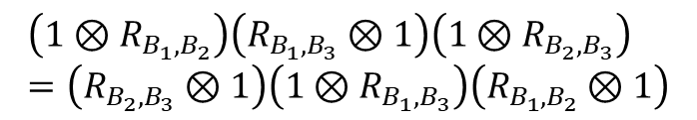


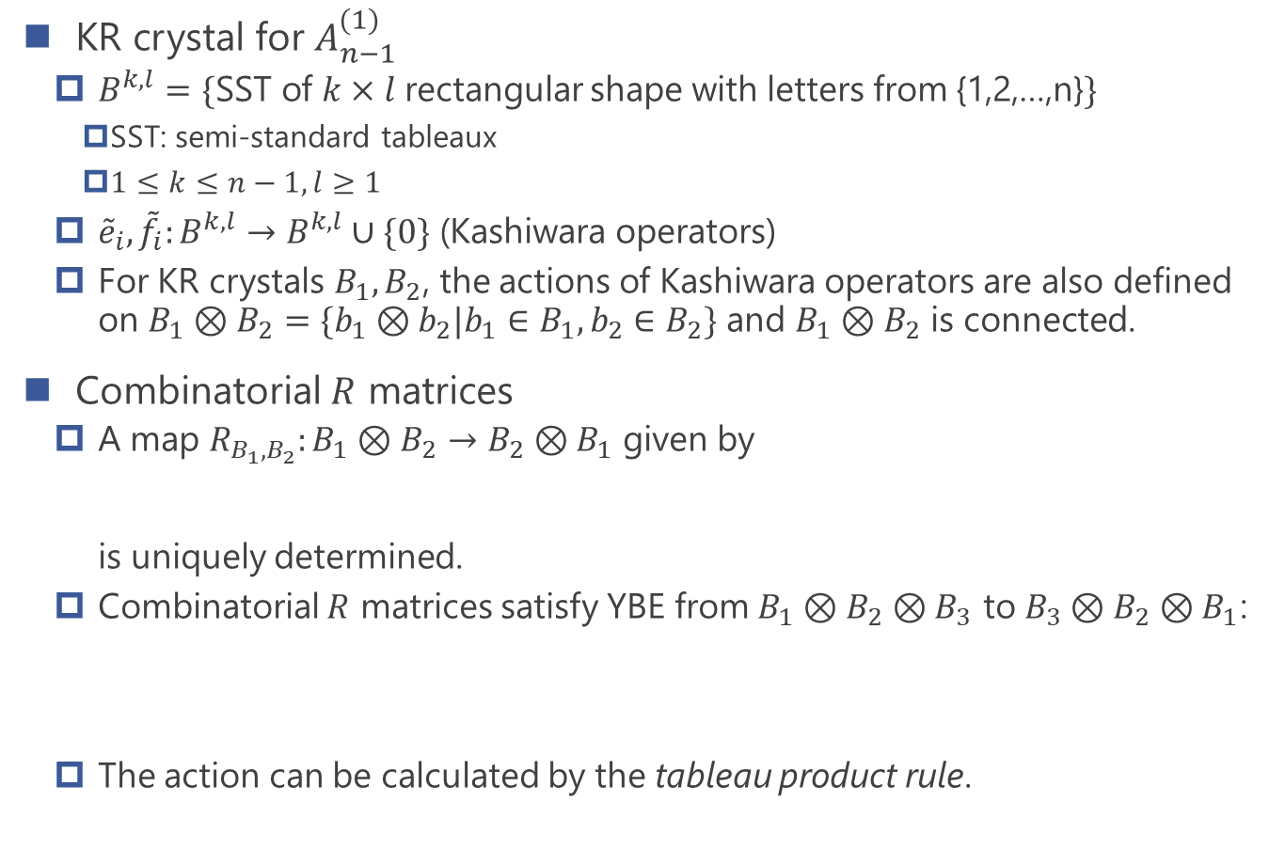

Combinatorial $R$ matrices
KR crystal for $A_{n−1}^{(1)}$
  $B^{k,l}=\{$SST of $k×l$ rectangular shape with letters from {1,2,…,n}$\}$
    SST: semi-standard tableaux
    $1≤k≤n−1, l≥1$
  ${\tilde{e}}_{i},{\tilde{f}}_{i}:B^{k,l}→B^{k,l}∪\{0\}$ (Kashiwara operators)
  For KR crystals $B_{1},B_{2}$, the actions of Kashiwara operators are also defined on $B_{1}⊗B_{2}=\{b_{1}⊗b_{2}|b_{1}∈B_{1}, b_{2}∈B_{2}\}$ and $B_{1}⊗B_{2}$ is connected.
Combinatorial $R$ matrices
  A map $R_{B_{1}, B_{2}}:B_{1}⊗B_{2}→B_{2}⊗B_{1}$ given by
  is uniquely determined.
  Combinatorial $R$ matrices satisfy YBE from $B_{1}⊗B_{2}⊗B_{3}$ to $B_{3}⊗B_{2}⊗B_{1}$:
  The action can be calculated by the tableau product rule.
1 | 1 | 3
2 | 4 | 6
$$≤$$
$$≤$$
e.g.
$$<$$
$$<$$
$$<$$
$R_{B_{1},B_{2}}\left({\tilde{k}}_{i}\left(b_{1}⊗b_{2}\right)\right)={\tilde{k}}_{i}(R_{B_{1},B_{2}}(b_{1}⊗b_{2}))$ (${\tilde{k}}_{i}={\tilde{e}}_{i},{\tilde{f}}_{i}$)
$$\left(1⊗R_{B_{1},B_{2}}\right)\left(R_{B_{1},B_{3}}⊗1\right)\left(1⊗R_{B_{2},B_{3}}\right) \\ =\left(R_{B_{2},B_{3}}⊗1\right)\left(1⊗R_{B_{1},B_{3}}\right)\left(R_{B_{1},B_{2}}⊗1\right)$$

Slide 6


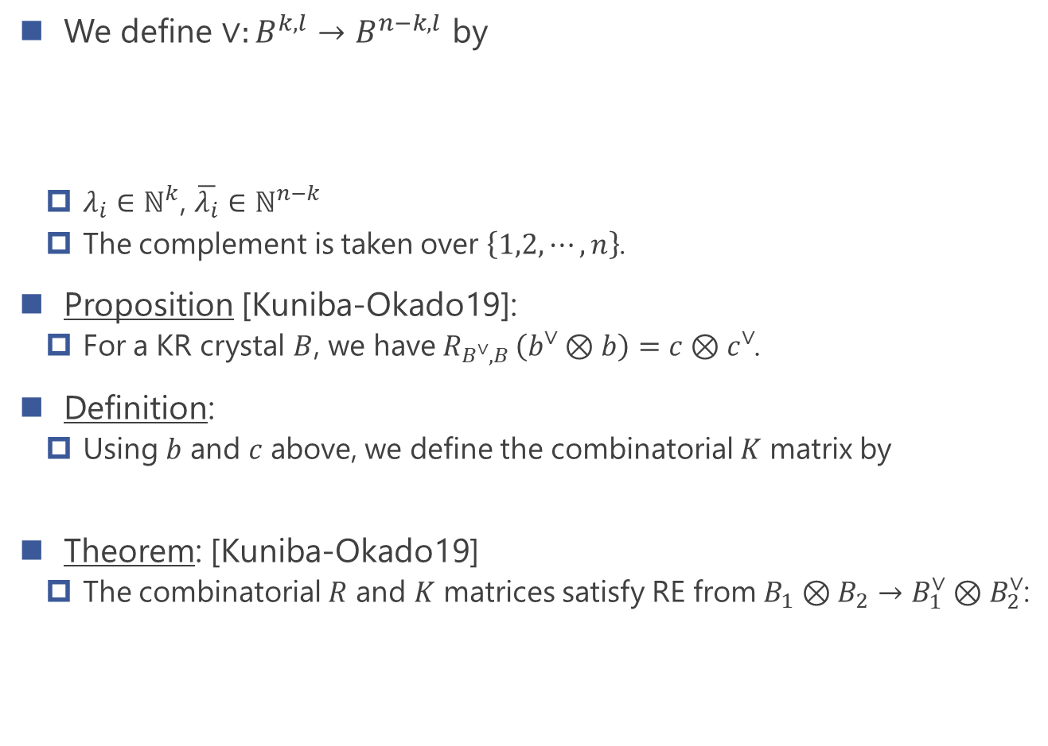
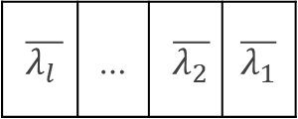



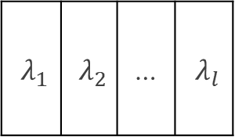





Combinatorial $K$ matrices
We define $∨:B^{k,l}→B^{n−k,l}$ by
  $λ_{i}∈ℕ^{k}$, $\overline{λ_{i}}∈ℕ^{n−k}$
  The complement is taken over $\left\{1,2,⋯, n\right\}$.
Proposition [Kuniba-Okado19]:
  For a KR crystal $B$, we have $R_{B^{∨},B }\left(b^{∨}⊗b\right)=c⊗c^{∨}$.
Definition:
  Using $b$ and $c$ above, we define the combinatorial $K$ matrix by
Theorem: [Kuniba-Okado19]
  The combinatorial $R$ and $K$ matrices satisfy RE from $B_{1}⊗B_{2}→B_{1}^{∨}⊗B_{2}^{∨}$:
$λ_{1}$ | $λ_{2}$ | … | $λ_{l}$
$\overline{λ_{l }}$ | … | $\overline{λ_{2}}$ | $$\overline{λ_{1}}$$
$$b^{∨}=$$
$$n−k$$
for $b=$
$$k$$
$$c$$
$$c^{∨}$$
$$b^{∨}$$
$$b$$
$K_{B}:B→B^{∨},$ $b→c^{∨}$
$R_{B_{2}^{∨},B_{1}^{∨}}(K_{B_{2}}⊗1)R_{B_{1}^{∨},B_{2}}\left(K_{B_{1}}⊗1\right)=\left(K_{B_{1}}⊗1\right)$ $R_{B_{2}^{∨},B_{1}}\left(K_{B_{2}}⊗1\right)R_{B_{1},B_{2}}$

Slide 7







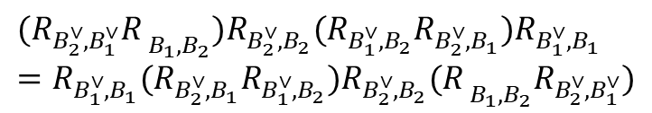

Key lemma for reflection equation
Lemma:
Proof:
  By repeated uses of YBE, we have the above equation.
=
$$B_{2}^{∨}$$
$$B_{2}$$
$$B_{2}^{∨}$$
$$B_{2}$$
$$B_{1}^{∨}$$
$$B_{1}$$
$$B_{1}^{∨}$$
$$B_{1}$$
$$(R_{B_{2}^{∨},B_{1}^{∨}}{R_{ }}_{B_{1},B_{2}})R_{B_{2}^{∨},B_{2}}(R_{B_{1}^{∨},B_{2}}R_{B_{2}^{∨},B_{1}})R_{B_{1}^{∨},B_{1}}$$
$$=R_{B_{1}^{∨},B_{1}}({R_{B_{2}^{∨},B_{1}}R}_{B_{1}^{∨},B_{2}})R_{B_{2}^{∨},B_{2}}({R_{ }}_{B_{1},B_{2}}R_{B_{2}^{∨},B_{1}^{∨}})$$

Slide 8



































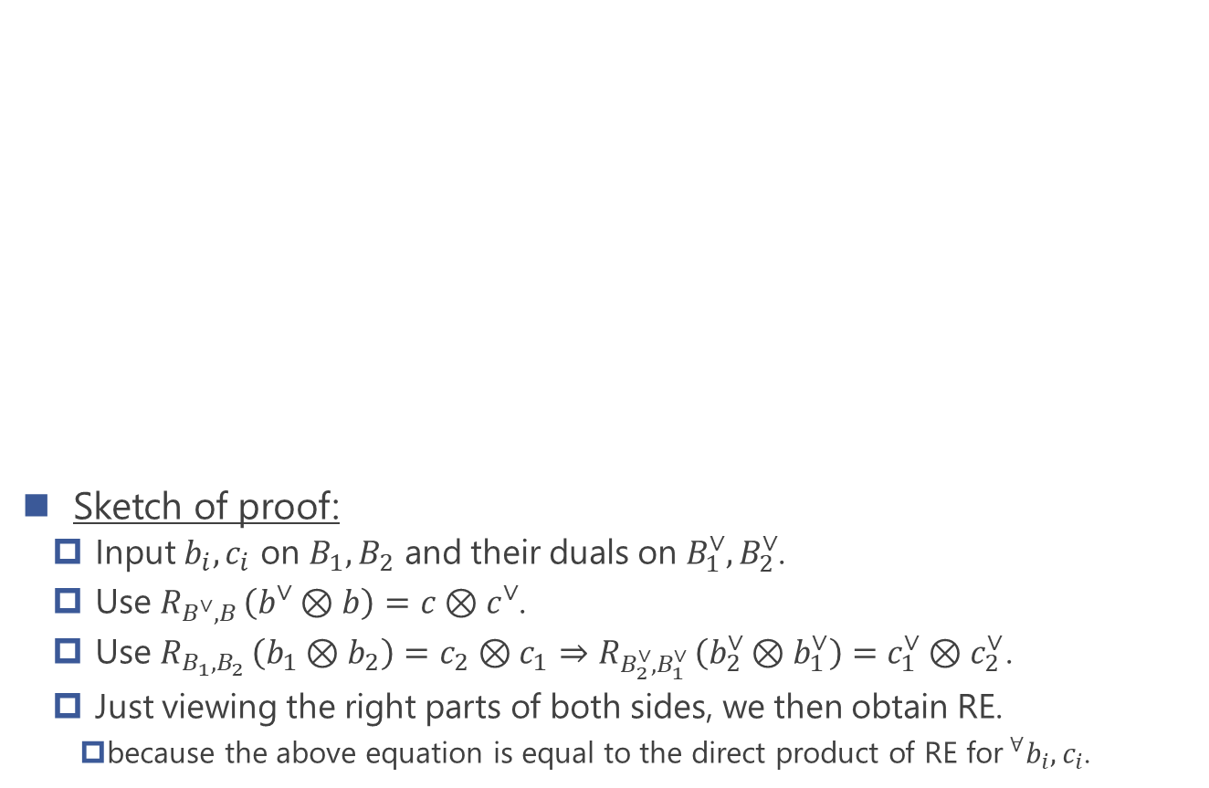





Proof of reflection equation
$$b_{o}$$
$$b_{o}^{∨}$$
$$b_{o}$$
$$b_{o}^{∨}$$
Sketch of proof:
  Input $b_{i},c_{i}$ on $B_{1},B_{2}$ and their duals on $B_{1}^{∨},B_{2}^{∨}$.
  Use $R_{B^{∨},B }\left(b^{∨}⊗b\right)=c⊗c^{∨}$.
  Use $R_{B_{1},B_{2} }\left(b_{1}⊗b_{2}\right)=c_{2}⊗c_{1}⇒R_{B_{2}^{∨},B_{1}^{∨} }\left(b_{2}^{∨}⊗b_{1}^{∨}\right)=c_{1}^{∨}⊗c_{2 }^{∨}$.
  Just viewing the right parts of both sides, we then obtain RE.
    because the above equation is equal to the direct product of RE for$^{∀}b_{i},c_{i}$.
$$c_{o}$$
$$c_{o}^{∨}$$
$$c_{2}$$
$$c_{2}^{∨}$$
$$b_{2}$$
$$c_{o}$$
$$c_{o}^{∨}$$
$$b_{2}^{∨}$$
$$b_{4}^{∨}$$
$$b_{4}$$
$$c_{1}^{∨}$$
$$c_{1}$$
=
$$c_{4}$$
$$c_{4}^{∨}$$
$$b_{1}$$
$$b_{1}^{∨}$$
$$b_{3}^{∨}$$
$$b_{3}$$
$$B_{2}^{∨}$$
$$c_{i}^{∨}$$
$$c_{i}$$
$$B_{2}$$
$$c_{3}^{∨}$$
$$c_{3}$$
$$B_{2}^{∨}$$
$$c_{i}^{∨}$$
$$c_{i}$$
$$B_{2}$$
$$b_{i}^{∨}$$
$$b_{i}$$
$$b_{i}^{∨}$$
$$b_{i}$$
$$B_{1}^{∨}$$
$$B_{1}$$
$$B_{1}^{∨}$$
$$B_{1}$$

Slide 9
Outline
Introduction: Reflection maps from Yang-Baxter maps
Main part: 3D reflection maps from tetrahedron maps
Examples
  Birational transition map
  Sergeev’s electrical solution
  Two-component solution associated with soliton equation
P.3~8
P.10~23
P.25~29

Slide 10
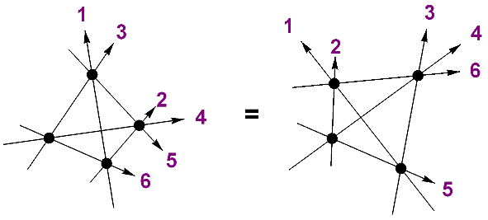
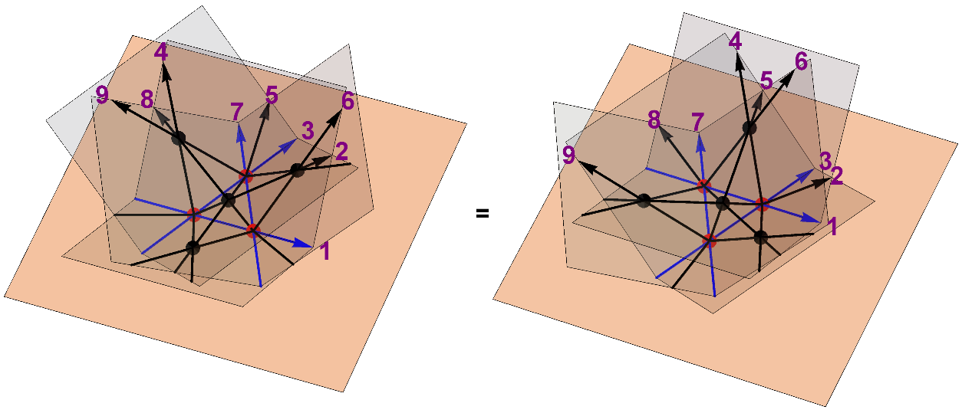
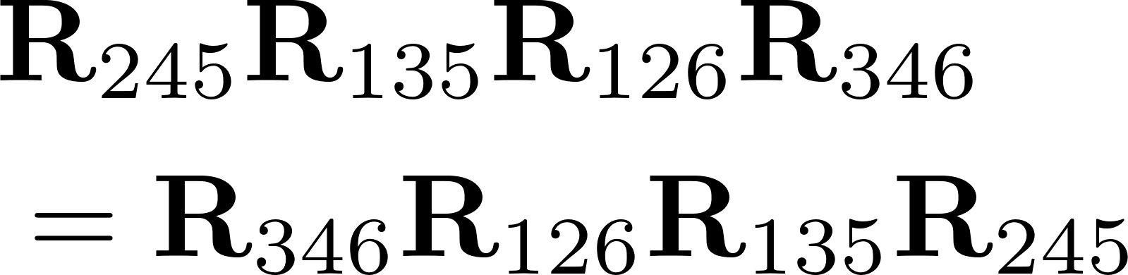
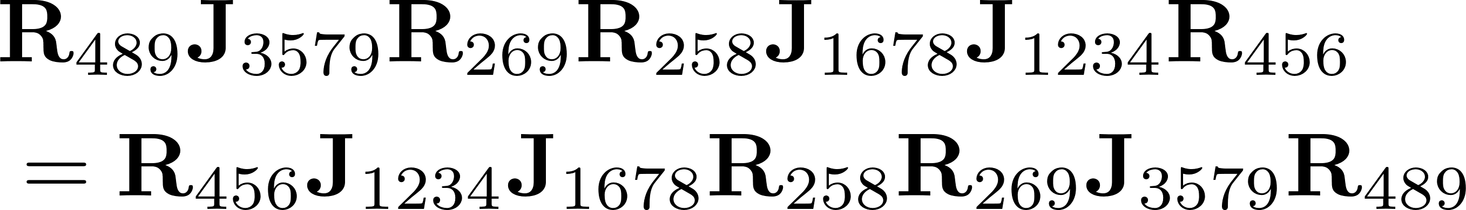
Integrability in 3D
Bulk: Tetrahedron equation
Boundary: 3D reflection equation
Tetrahedron and 3D reflection equation are conditions for factorization of string scattering amplitude in 2+1D.
[Zamolodchikov80]
[Isaev-Kulish97]
 | Bulk | Boundary
2D | Yang-Baxter eq. | Reflection eq.
3D | Tetrahedron eq. | 3D Reflection eq.

Slide 11


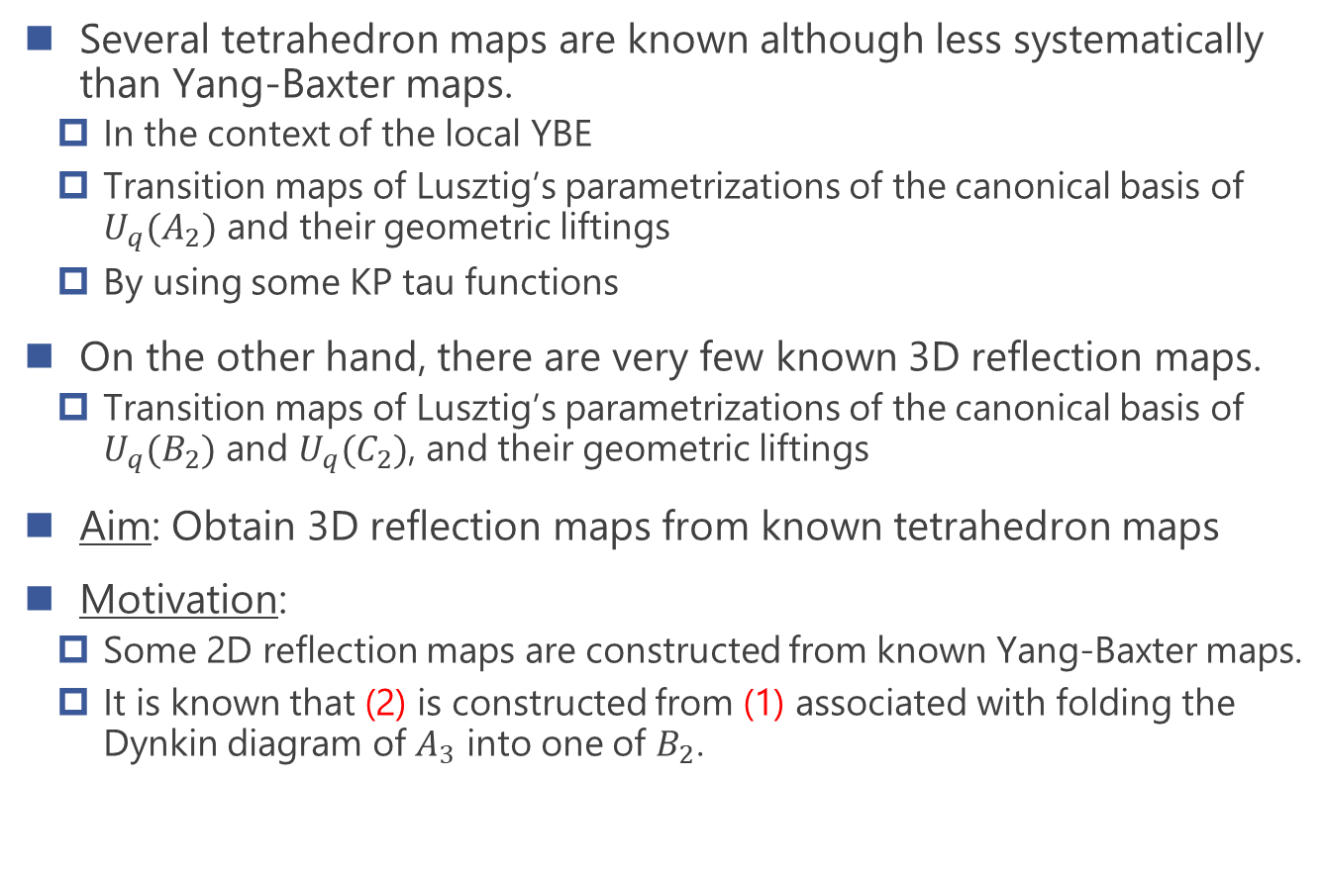
Motivation & Aim
Several tetrahedron maps are known although less systematically than Yang-Baxter maps.
  In the context of the local YBE
  Transition maps of Lusztig’s parametrizations of the canonical basis of $U_{q}(A_{2})$ and their geometric liftings
  By using some KP tau functions
On the other hand, there are very few known 3D reflection maps.
  Transition maps of Lusztig’s parametrizations of the canonical basis of $U_{q}(B_{2})$ and $U_{q}(C_{2})$, and their geometric liftings
Aim: Obtain 3D reflection maps from known tetrahedron maps
Motivation:
  Some 2D reflection maps are constructed from known Yang-Baxter maps.
  It is known that (2) is constructed from (1) associated with folding the Dynkin diagram of $A_{3}$ into one of $B_{2}$.
[Sergeev98]
[Kuniba-Okado12]
[Kassotakis-Nieszporski-Papageorgiou-Tongas19]
[Kuniba-Okado12]
[Berenstein-Zelevinsky01], [Lusztig11]

Slide 12

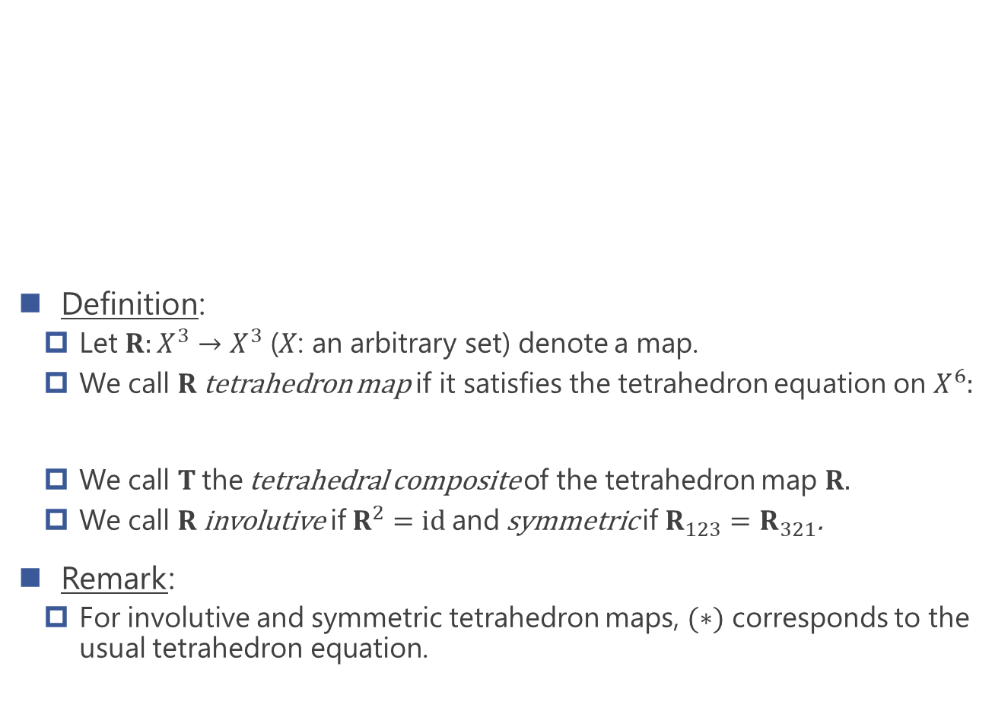
Tetrahedron maps
Definition:
  Let $R:X^{3}→X^{3}$ ($X$: an arbitrary set) denote a map.
  We call $R$ tetrahedron map if it satisfies the tetrahedron equation on $X^{6}$:
  We call $T$ the tetrahedral composite of the tetrahedron map $R$.
  We call $R$ involutive if $R^{2}=id$ and symmetric if $R_{123}=R_{321}$.
Remark:
  For involutive and symmetric tetrahedron maps, $(∗)$ corresponds to the usual tetrahedron equation.

Slide 13
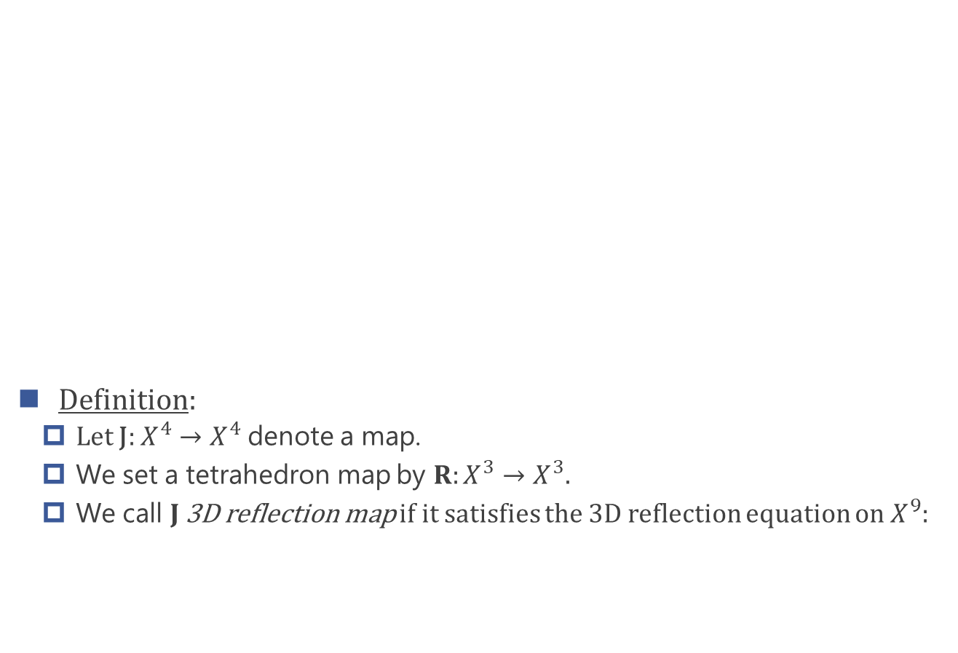
3D reflection maps
Definition:
  Let J$:X^{4}→X^{4}$ denote a map.
  We set a tetrahedron map by $R:X^{3}→X^{3}$.
  We call $J$ 3D reflection map if it satisfies the 3D reflection equation on $X^{9}$:
[Isaev-Kulish97]

Slide 14
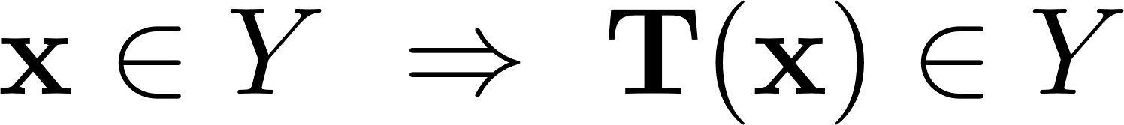

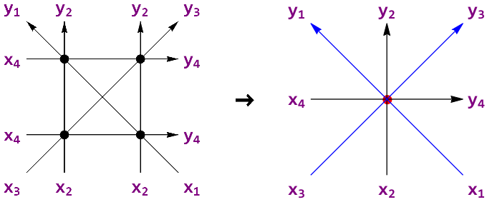
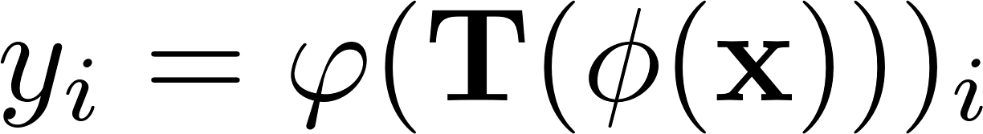
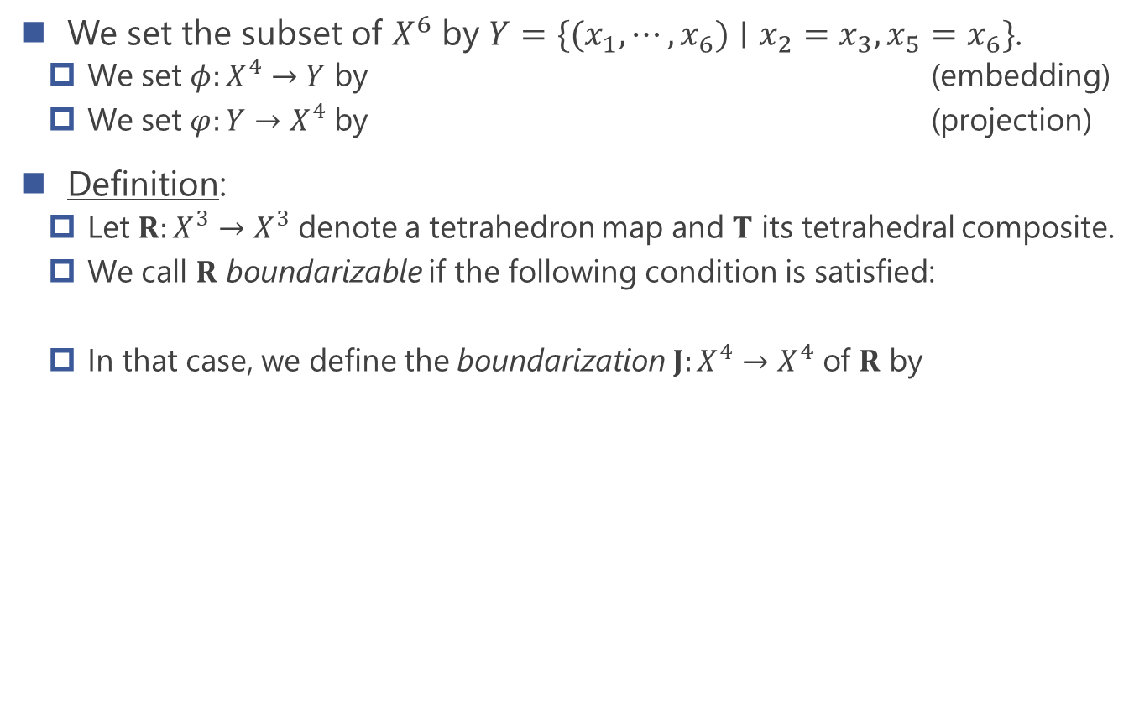
Boundarization
We set the subset of $X^{6}$ by $Y=\{(x_{1},⋯,x_{6})∣x_{2}=x_{3},x_{5}=x_{6}\}$.
  We set $φ:X^{4}→Y$ by (embedding)
  We set $φ:Y→X^{4}$ by (projection)
Definition:
  Let $R:X^{3}→X^{3}$ denote a tetrahedron map and $T$ its tetrahedral composite.
  We call $R$ boundarizable if the following condition is satisfied:
  In that case, we define the boundarization $J:X^{4}→X^{4}$ of $R$ by

Slide 15
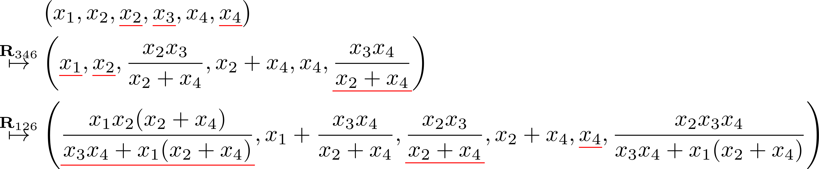
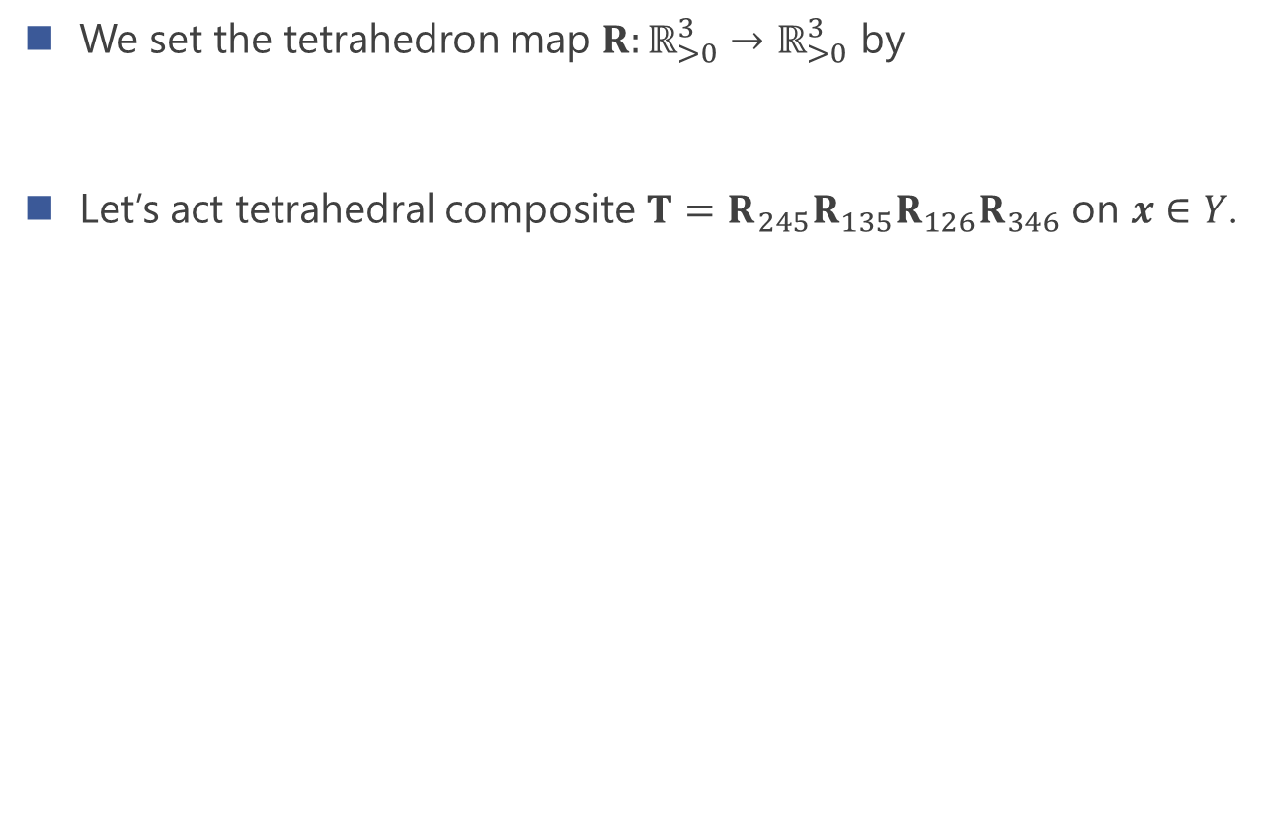
Example for boundarization
We set the tetrahedron map $R:ℝ_{>0}^{3}→ℝ_{>0}^{3}$ by
Let’s act tetrahedral composite $T=$ $R_{245}R_{135}R_{126}R_{346}$ on $x∈Y$.

Slide 16
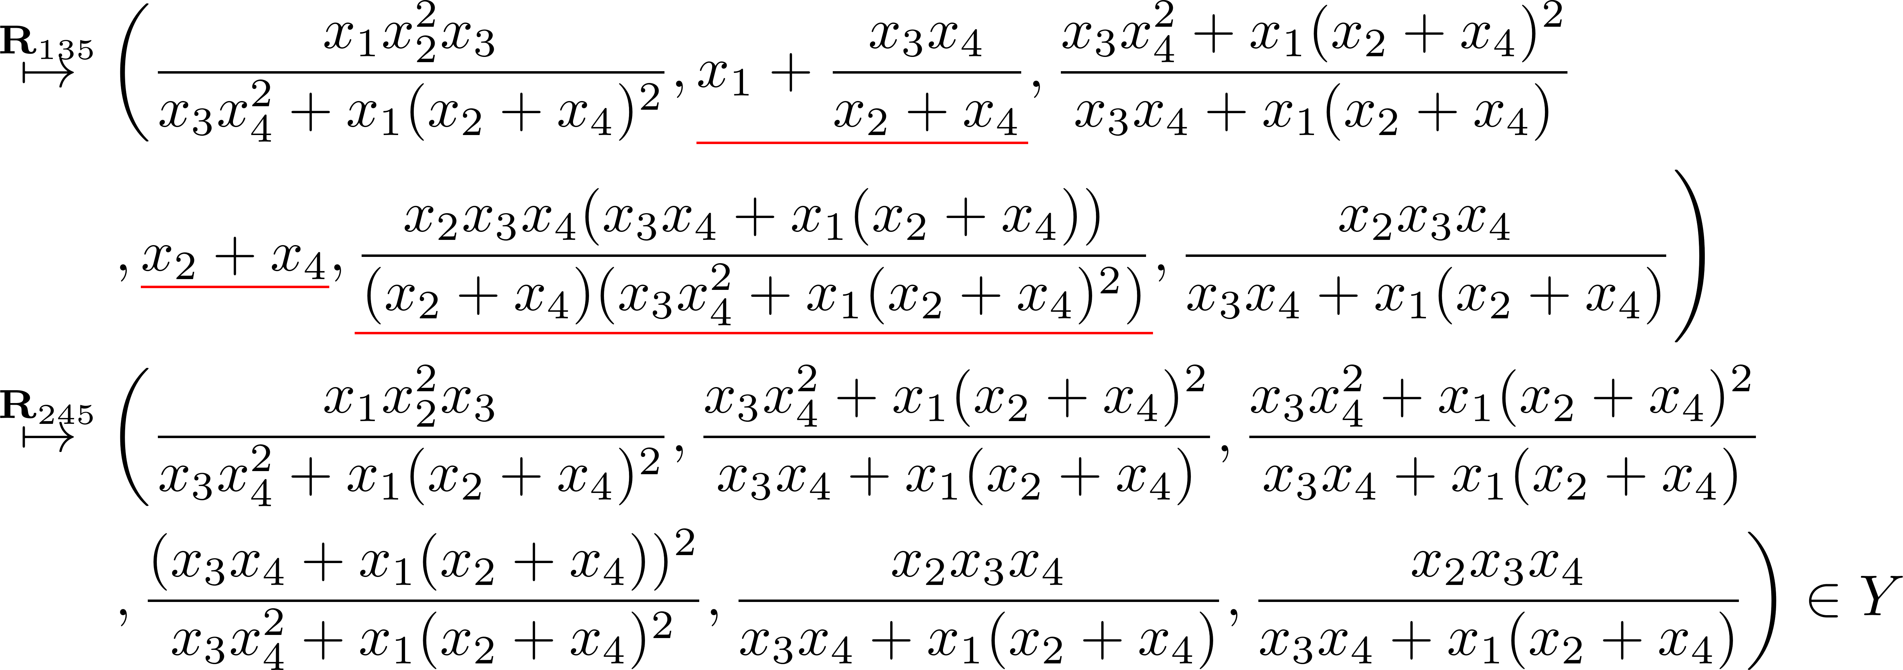
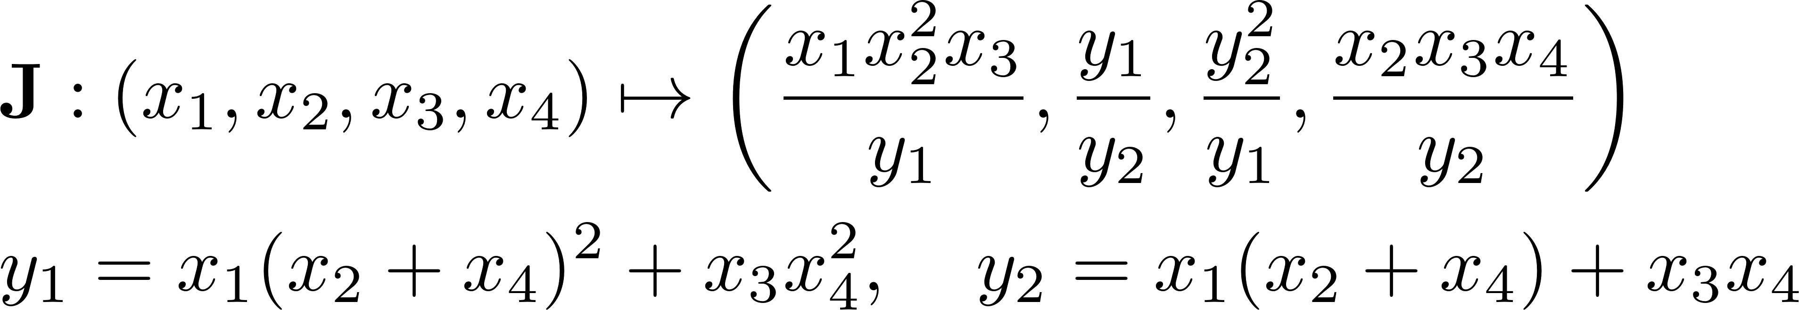
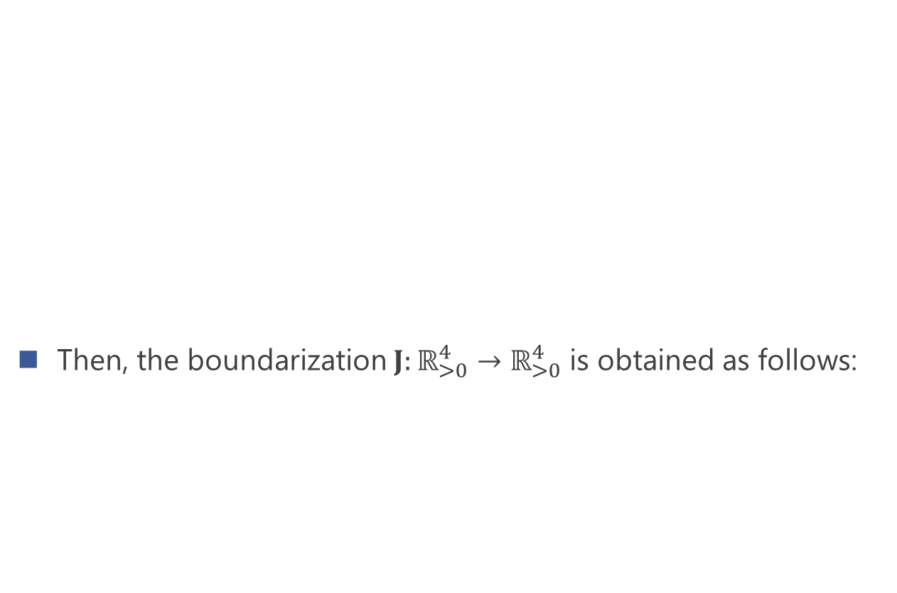
Example for boundarization
Then, the boundarization $J:ℝ_{>0}^{4}→ℝ_{>0}^{4}$ is obtained as follows:

Slide 17
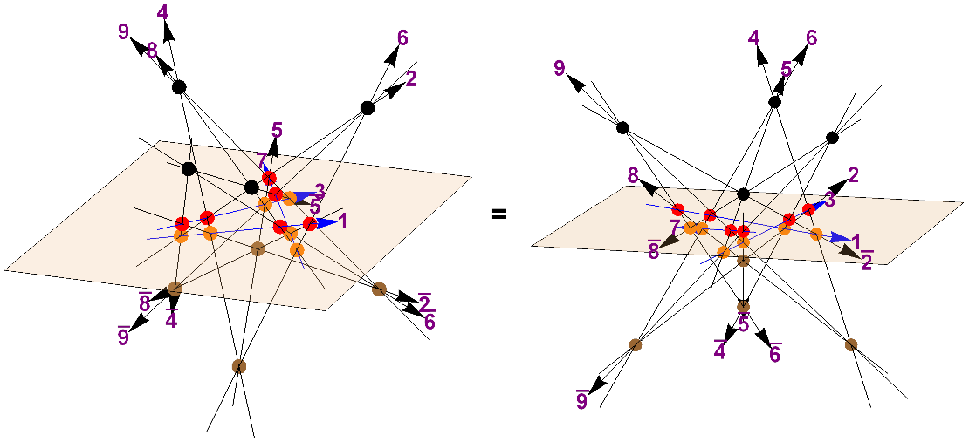
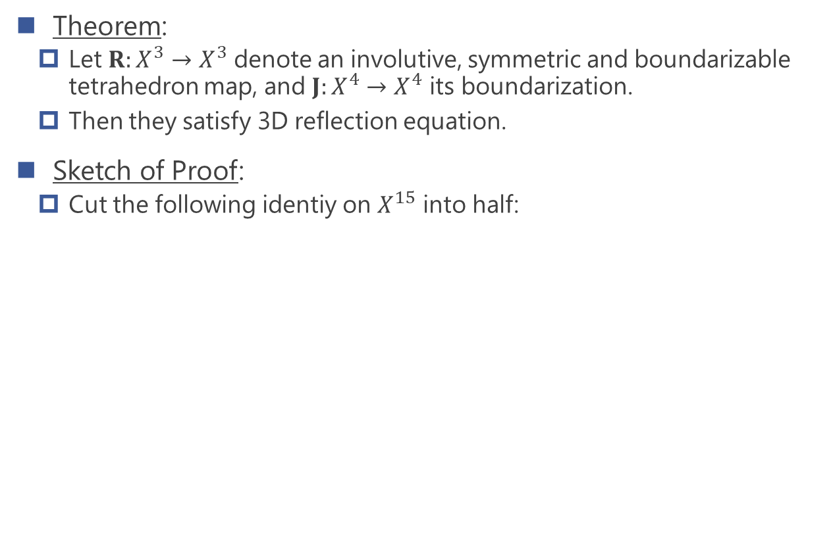
Main theorem
Theorem:
  Let $R:X^{3}→X^{3}$ denote an involutive, symmetric and boundarizable tetrahedron map, and $J:X^{4}→X^{4}$ its boundarization.
  Then they satisfy 3D reflection equation.
Sketch of Proof:
  Cut the following identiy on $X^{15}$ into half:

Slide 18
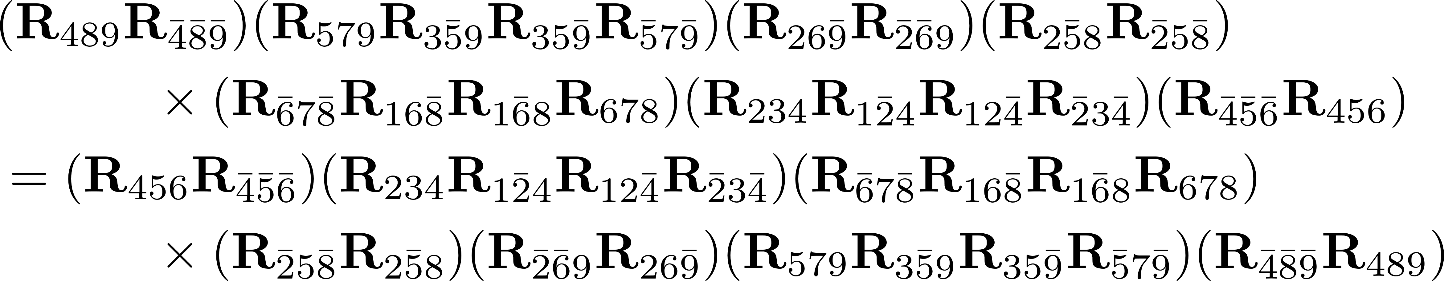
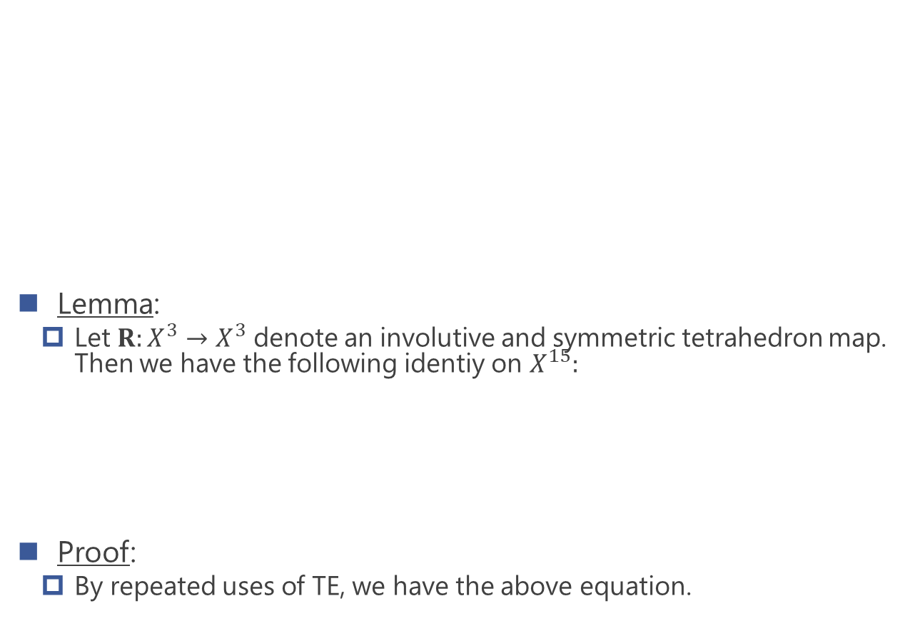

Key lemma for main theorem
Lemma:
  Let $R:X^{3}→X^{3}$ denote an involutive and symmetric tetrahedron map. Then we have the following identiy on $X^{15}:$
Proof:
  By repeated uses of TE, we have the above equation.
$̅$ : mirrored space

Slide 19
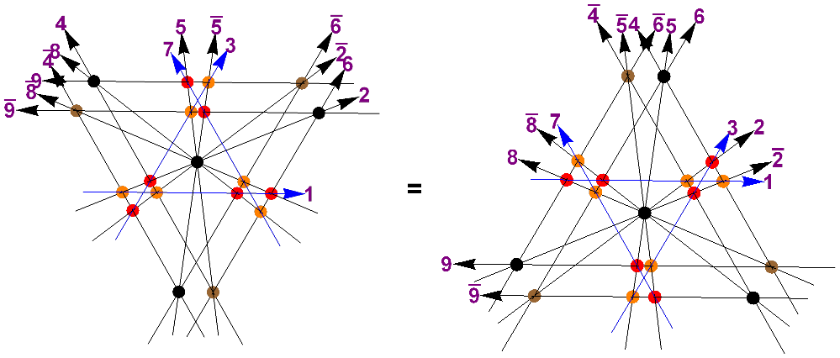

Figure for the identity on $X^{15}$

Slide 20
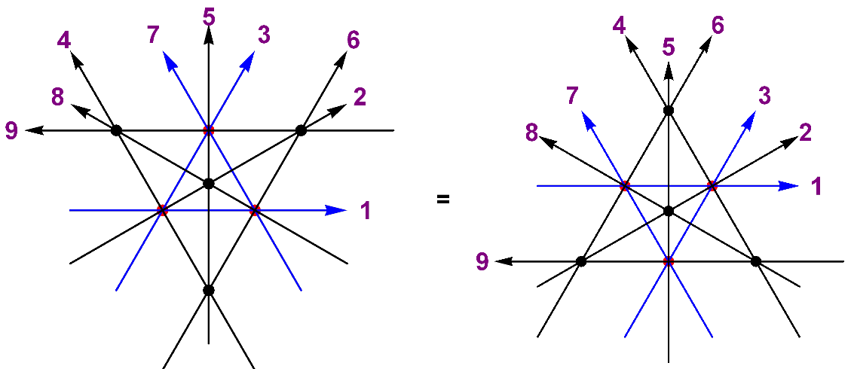
Figure for 3D reflection equation

Slide 21
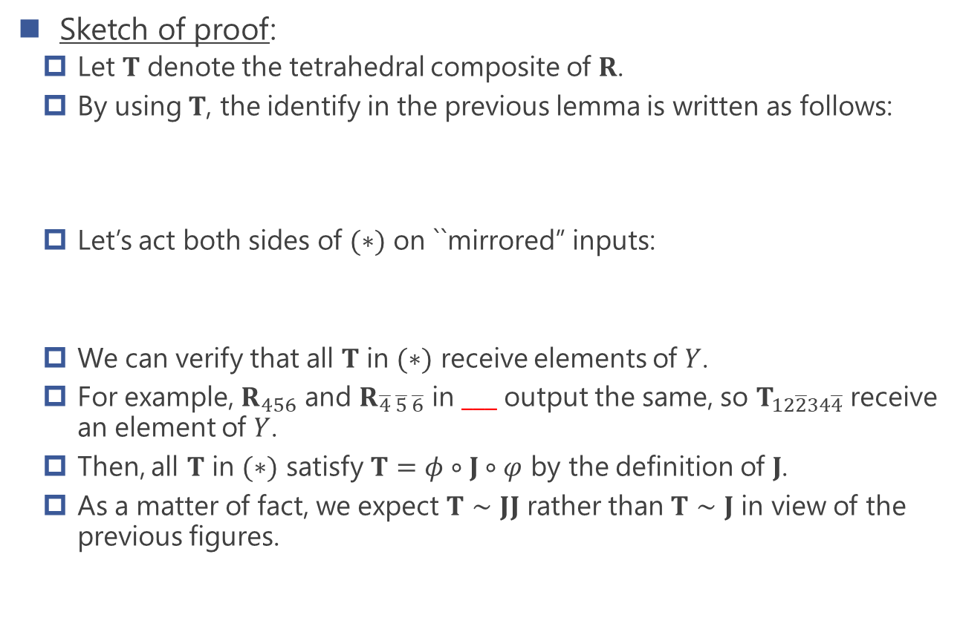
Proof of main theorem
Sketch of proof:
  Let $T$ denote the tetrahedral composite of $R$.
  By using $T$, the identify in the previous lemma is written as follows:
  Let’s act both sides of $(∗)$ on ``mirrored” inputs:
  We can verify that all $T$ in $(∗)$ receive elements of $Y$.
  For example, $R_{456}$ and $R_{\overline{4} \overline{5} \overline{6}}$ in ___ output the same, so $T_{12\overline{2}34\overline{4}}$ receive an element of $Y$.
  Then, all $T$ in $(∗)$ satisfy $T=φ∘J∘φ$ by the definition of $J$.
  As a matter of fact, we expect $T∼JJ$ rather than $T∼J$ in view of the previous figures.

Slide 22
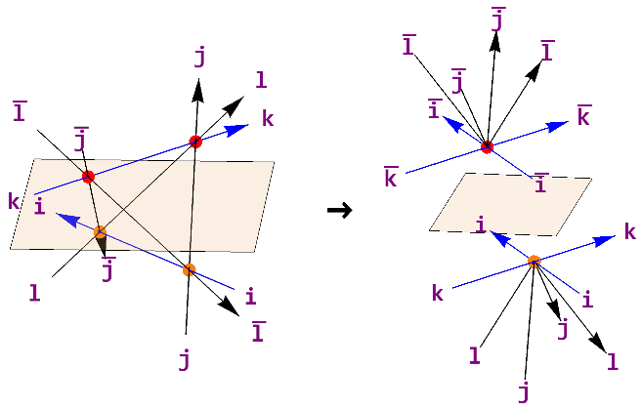
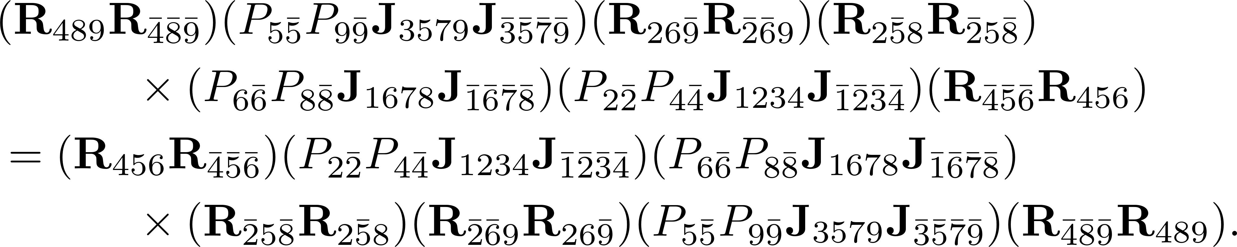
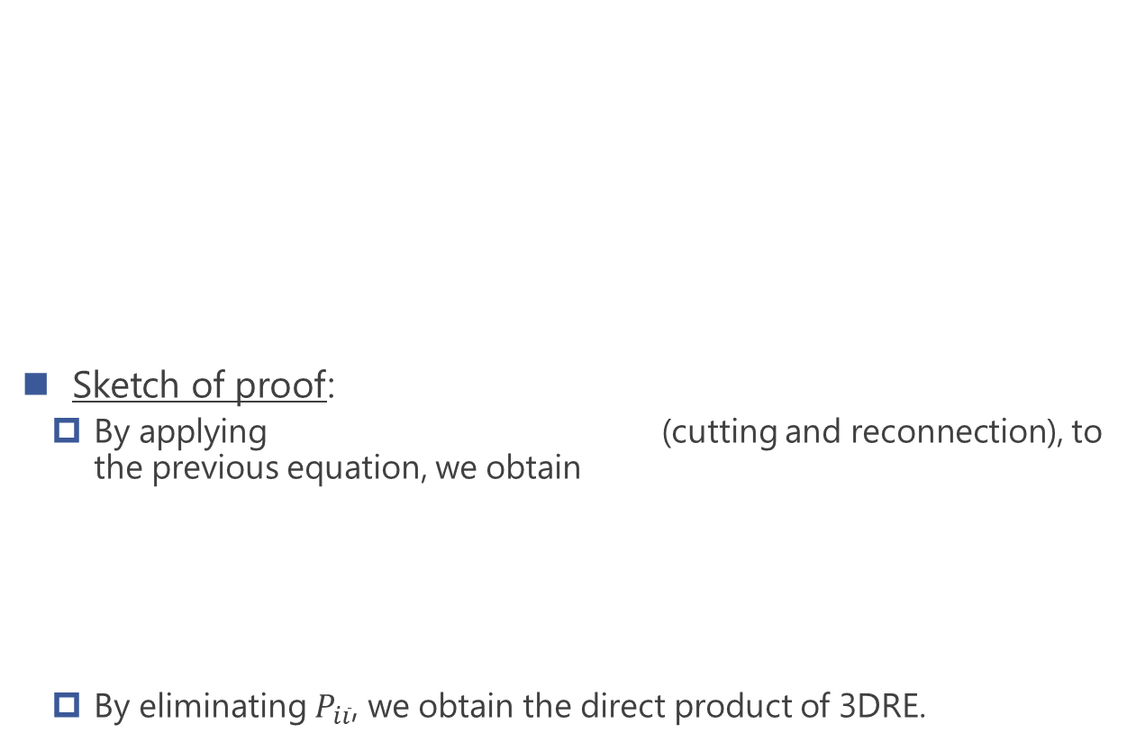
Proof of main theorem
Sketch of proof:
  By applying (cutting and reconnection), to the previous equation, we obtain
  By eliminating $P_{i\overline{i}}$, we obtain the direct product of 3DRE.
(15+1+1+1=9+9)

Slide 23
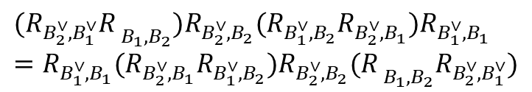
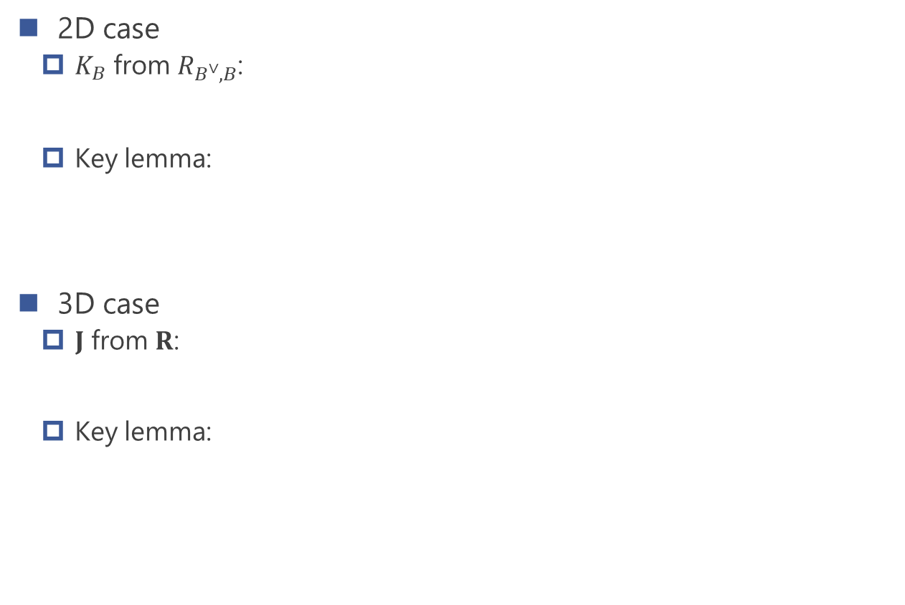
Overview of analogous results
2D case
  $K_{B}$ from $R_{B^{∨},B}$:
  Key lemma:
3D case
  $J$ from $R$:
  Key lemma:
$K_{B}:B→B^{∨},$ $b→c^{∨}$ $R_{B^{∨},B }\left(b^{∨}⊗b\right)=c⊗c^{∨}$
$$(R_{B_{2}^{∨},B_{1}^{∨}}{R_{ }}_{B_{1},B_{2}})R_{B_{2}^{∨},B_{2}}(R_{B_{1}^{∨},B_{2}}R_{B_{2}^{∨},B_{1}})R_{B_{1}^{∨},B_{1}}$$
$$=R_{B_{1}^{∨},B_{1}}({R_{B_{2}^{∨},B_{1}}R}_{B_{1}^{∨},B_{2}})R_{B_{2}^{∨},B_{2}}({R_{ }}_{B_{1},B_{2}}R_{B_{2}^{∨},B_{1}^{∨}})$$

Slide 24
Outline
Introduction: Reflection maps from Yang-Baxter maps
Main part: 3D reflection maps from tetrahedron maps
Examples
  Birational transition map
  Sergeev’s electrical solution
  Two-component solution associated with soliton equation
P.3~8
P.10~23
P.25~29

Slide 25
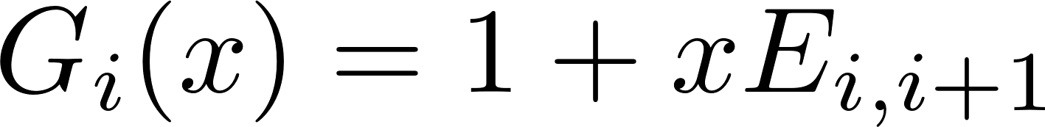
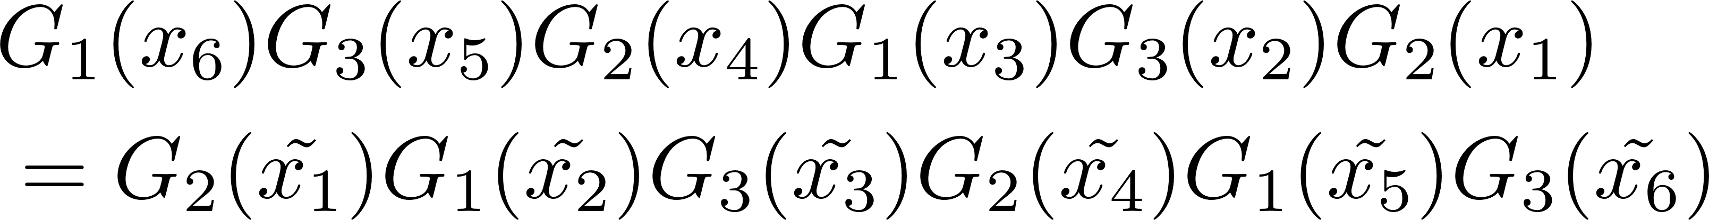
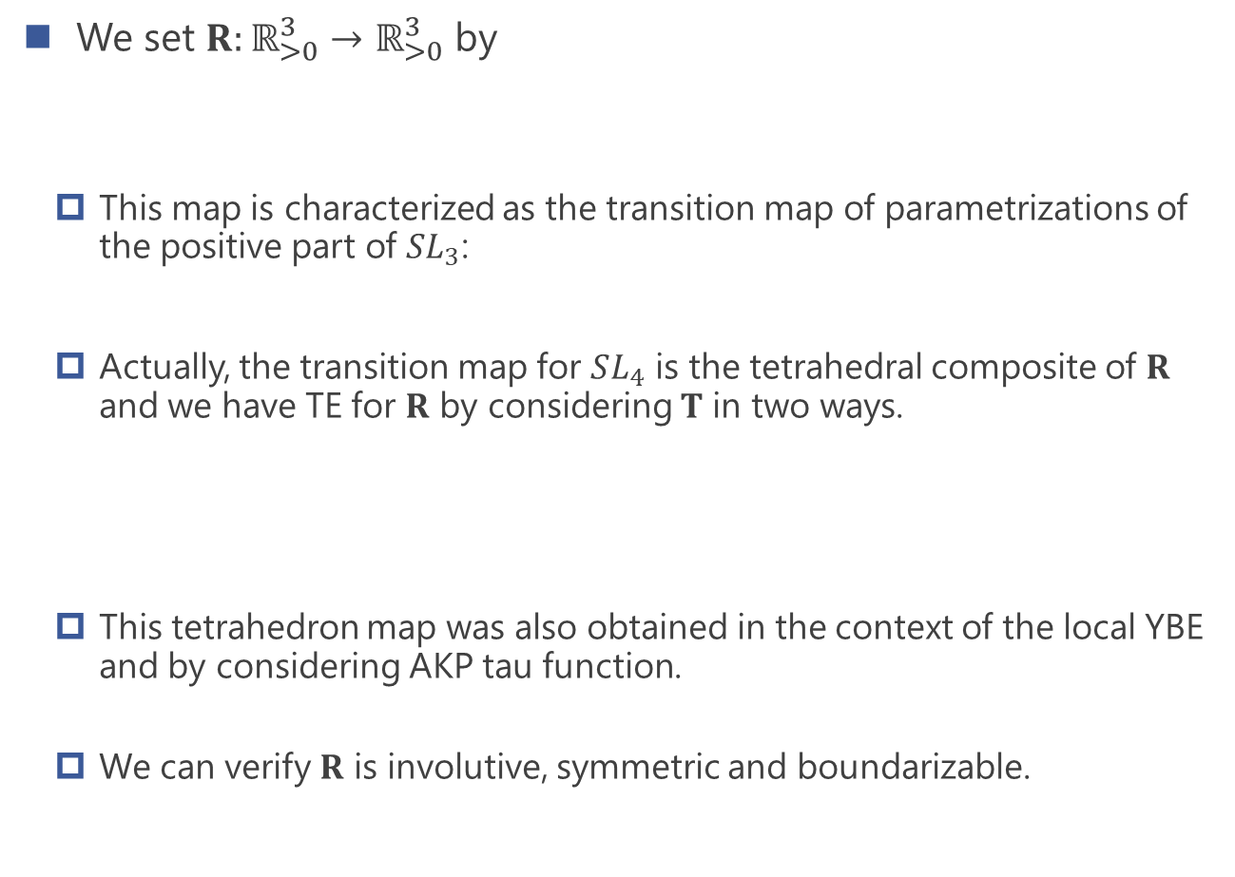
Example1: birational transition map
We set $R:ℝ_{>0}^{3}→ℝ_{>0}^{3}$ by
  This map is characterized as the transition map of parametrizations of the positive part of $SL_{3}$:
  Actually, the transition map for $SL_{4}$ is the tetrahedral composite of $R$ and we have TE for $R$ by considering $T$ in two ways.
  This tetrahedron map was also obtained in the context of the local YBE and by considering AKP tau function.
  We can verify $R$ is involutive, symmetric and boundarizable.
[Lusztig94]
[Kuniba-Okado12]
[Sergeev98], [Kassotakis-Nieszporski-Papageorgiou-Tongas19]

Slide 26
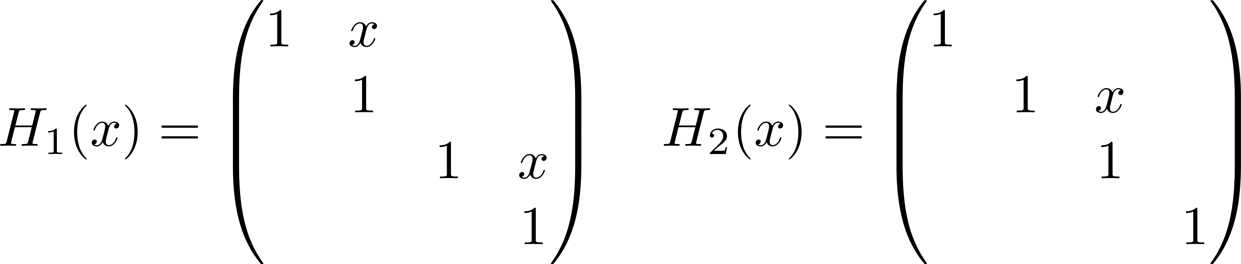
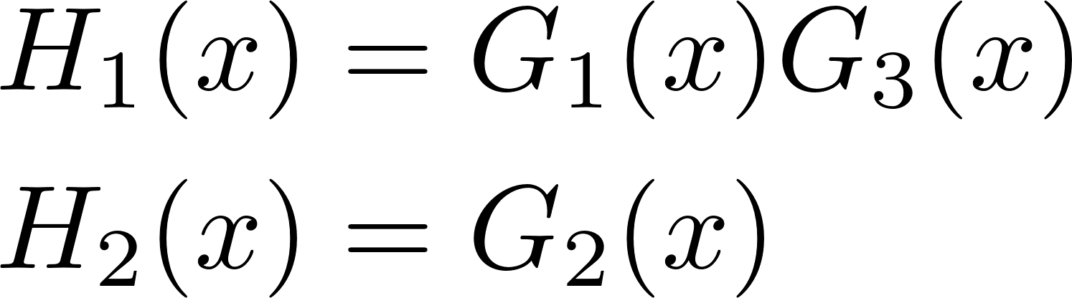
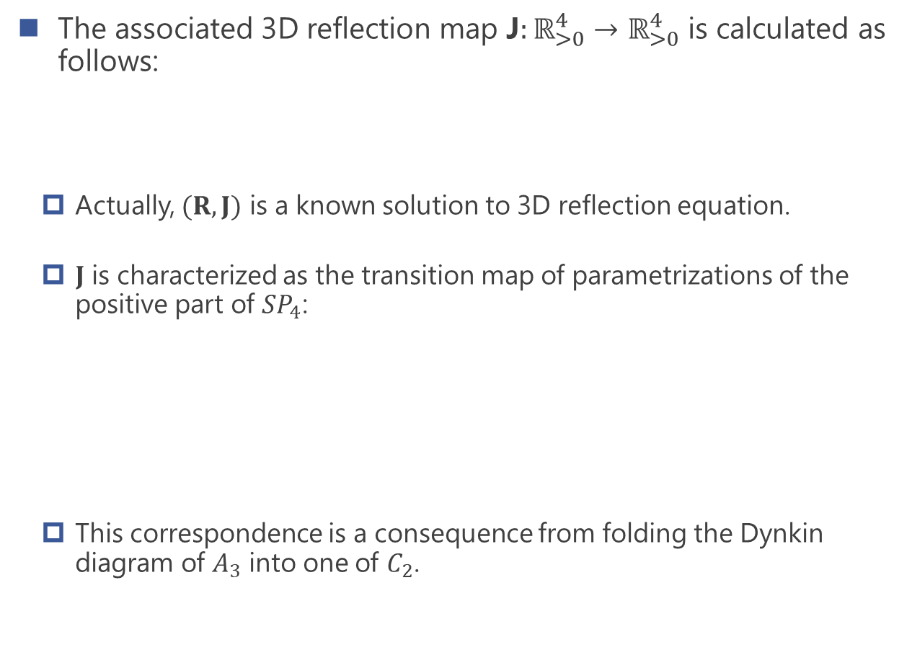
Example1: birational transition map
The associated 3D reflection map J$:ℝ_{>0}^{4}→ℝ_{>0}^{4}$ is calculated as follows:
  Actually, $(R,J)$ is a known solution to 3D reflection equation.
  $J$ is characterized as the transition map of parametrizations of the positive part of $SP_{4}$:
  This correspondence is a consequence from folding the Dynkin diagram of $A_{3}$ into one of $C_{2}$.
[Kuniba-Okado12]
[Berenstein-Zelevinsky01], [Lusztig11]

Slide 27
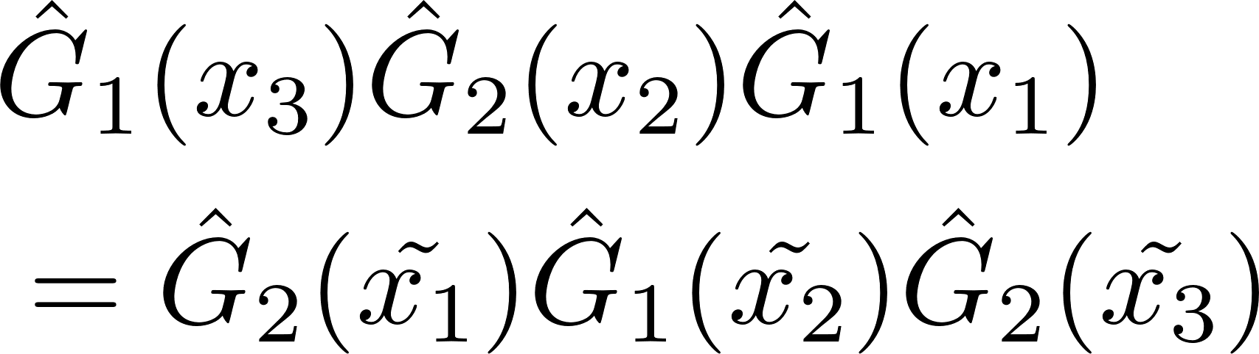
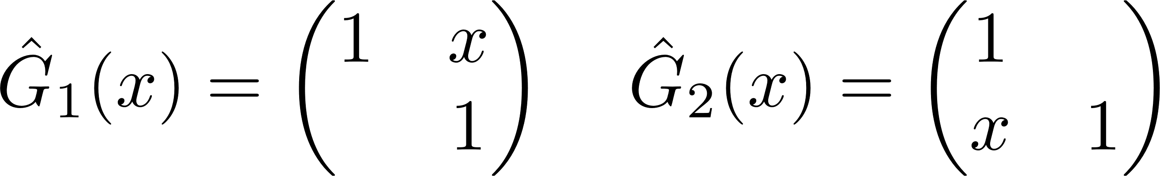
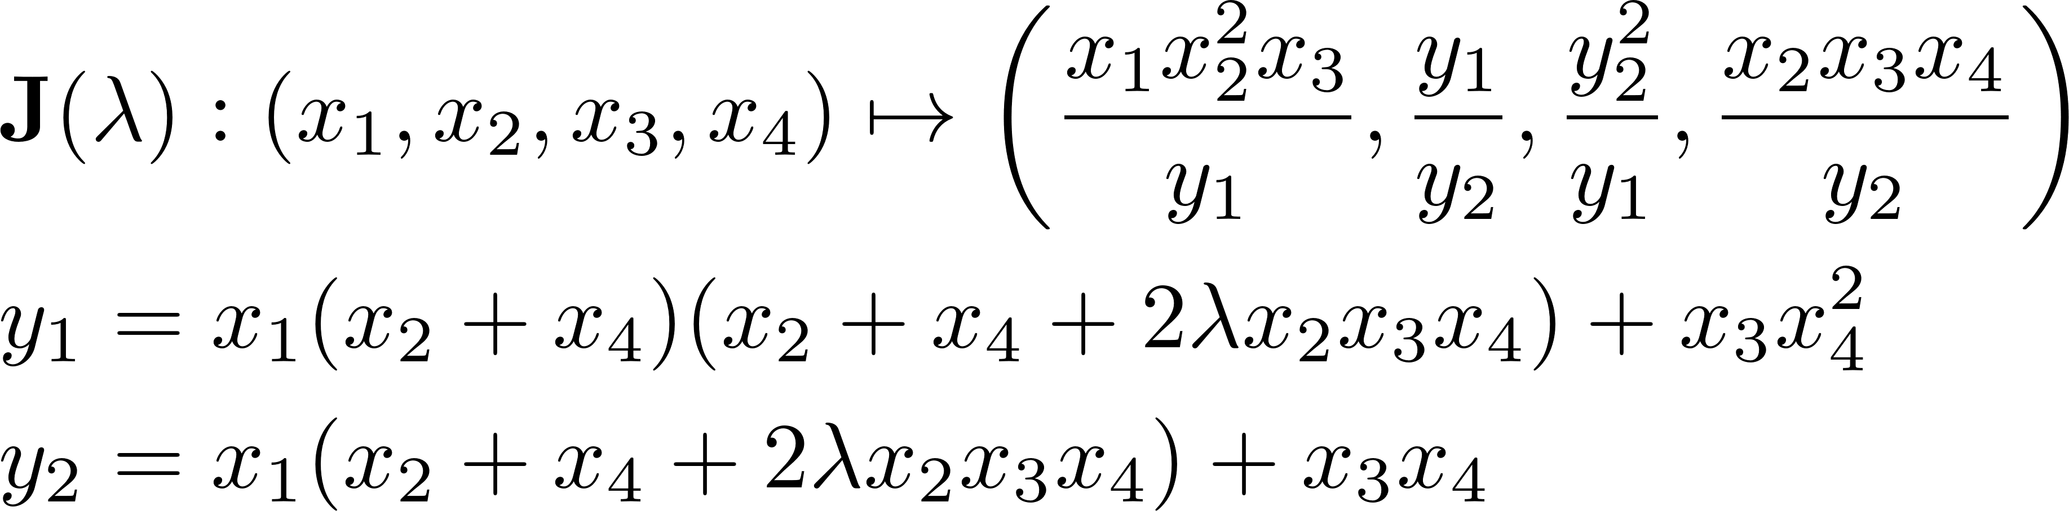

Example2: Sergeev’s electrical solution
For $λ∈ℂ$, we set the tetrahedron map $R(λ):ℂ^{3}→ℂ^{3}$ by
  This solution was obtained in the context of the local YBE and by considering BKP tau function.
  $R(λ=1)$ is also characterized as the relation which elements of the positive part of electorical Lie groups of type A satisfy:
  We can verify $R(λ)$ is involutive, symmetric and boundarizable.
The associated 3D reflection map $J(λ):ℂ^{4}→ℂ^{4}$ is calculated as follows:
[Lam-Pylyavskyy15]

Slide 28


Example3: Two component solution
We set the tetrahedron map $R:{(ℂ^{2})}^{3}→{(ℂ^{2})}^{3}$ by
  This solution was obtained by considering modified KP tau function.
  This gives the previous birational transition map when we set $y_{i}=1$.
  We can verify $R$ is involutive, symmetric and boundarizable.
[Kassotakis-Nieszporski-Papageorgiou-Tongas19]

Slide 29



Example3: Two component solution
The associated 3D reflection map J$:{(ℂ^{2})}^{4}→{(ℂ^{2})}^{4}$ is calculated as follows:

Slide 30
Concluding remarks
Summary:
  We present a method for obtaining 3D reflection maps by using known tetrahedron maps. The theorem is an analog of the results in 2D.
  Our method is a kind of generalization of the relation by Berenstein and Zelevinsky and gives 3D interpretation to their relation.
  By applying our theorem to known tetrahedron maps, we obtain several 3D reflection maps which include new solutions.
Remark:
  Our theorem can be extended to inhomogeneous cases, that is, the case tetrahedron maps are defined on direct product of different sets.

