Slide 1
Outline
Milestone | Date
basic web design | Feb 15 – Feb 20
have to prepare my midterm | Feb 21 – Feb 29
home page design | Mar 1 – Mar 15
Blog and digital resources refinement | Mar 16 – Mar 31
Email list, Facebook, Twitter, Linkedin | April 1 – April 5
have to prepare my final | April 6 – April 20
finalize our product | April 22 – April 30
software development (big project) | May
front-end (design UI, another webpage) | May
back-end (coding, which language) | June -

Slide 2
Mar 1 – Mar 15: HOME page
Mar 1 – Mar 5:
More attractive
Need some suggestions or feedback in designing
HOME page

Slide 3
Mar 1 – Mar 15: HOME page
Mar 6 – Mar 15:
Coding and implementation

Slide 4
Mar 16 – Mar 31: Blog and digital resources refinement
Mar 16 – Mar 20:
Need some suggestions or feedback in designing
Style consistence.
ESSAY

Slide 5

Mar 16 – Mar 31: Blog and digital resources refinement
Mar 21 – Mar 31:
Coding and implementation
IDEA: Continuity

Slide 6
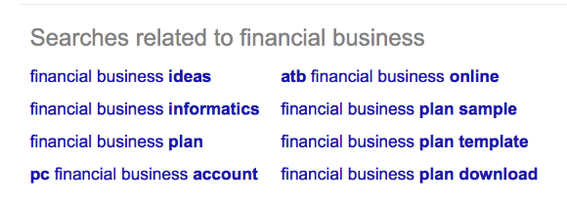
Mar 16 – Mar 31: Blog and digital resources refinement
IDEA: relationship among essays

Slide 7
April 1 – April 5: Email list, Facebook, Twitter, Linkedin
Email list doesn’t work now (PHP)
IDEA:
- Company email address?
- Brief but attractive
- Low frequency (i.e. Once a week)

Slide 8
April 1 – April 5: Email list, Facebook, Twitter, Linkedin
Linkedin ( professional, most important, since our potential customer is financial advisors. )
IDEA:
- Provide some own idea about future market movement.
- Show some result of our market analysis.

Slide 9
April 1 – April 5: Email list, Facebook, Twitter, Linkedin
Twitter & Facebook (work with Laila)
IDEA
- Using plain words to explain some hard economic theory.
- Share some interesting historical event about financial market.
- More details please visit www.emergingstar.ca.
- What we want is that the investors to recommend our website to
their financial advisor.

Slide 10
Apr 22 – Apr 30: Front End
Big project
Front-end
- Fully understand the needing, reduce the workload of back-end
development.
- Implementation.
- Portal device friendly.

Slide 11
Apr 22 – Apr 30: Front End
Wolfarm beta

Slide 12
May: Software Development (big project)
Back-end
- Wrap the research result and convert them to our software.
- Optimize the running time.
Connect front-end and back-end
- Pressure test (stable connection).

