Slide 1
Electronic Devices (Section: H )
Project Presentation (Semester: Summer 2024-2025 )
Project Title : Universal Analog Component Tester
Group No : 01
Submission Date : 09-September-2025
Group Members:
Roll No. | Student ID | Student Name
01 | 19-41217-2 | ISLAM, MD. HASIBUL
07 | 23-52989-3 | ANUAR, MD SAKIL
08 | 23-52996-3 | OSMANI, AKIB
09 | 23-53015-3 | ASHHAB, SYED ALI
15 | 23-53408-3 | SHADHIN, MD. RASHEDUL ISLAM
Lab Instructor: Dr Nadia Afroze
Lab Demonstrator: MD. Shahin Islam

Slide 2
Outlines of the project
Aims & Objectives
Introduction
Methodology
Results
Discussion
Conclusion
References

Slide 3
1. Aims & Objectives
Primary Aim: To design and develop a universal analog component tester capable of identifying and testing various electronic components.
Objectives:
  Create a cost-effective testing solution for analog components
  Implement LED & Buzzer -based visual indication system for component status
  Design a simple and user-friendly testing interface
  Ensure accurate detection of component functionality

Slide 4
2. Introduction
Analog component testing is crucial in electronics troubleshooting and quality control
Problem Statement: Need for a simple, portable device to quickly test analog components without expensive equipment
Project Scope:
  Focuses on testing common analog components ( Resistors, Capacitors, Diodes, Transistors)
  Utilizes basic electronic principles for component verification
  Employs visual LED indicators for result display
Applications: Electronics labs, repair shops, educational institutions, hobbyist projects

Slide 5
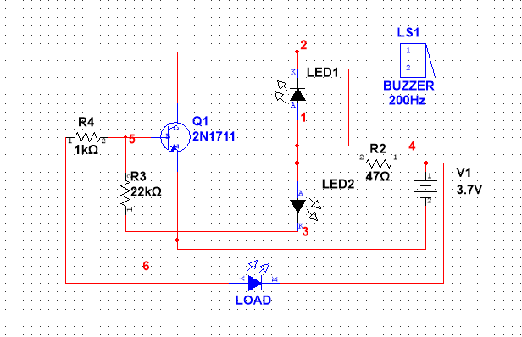
3. Methodology
Circuit Design Approach:
• Used ( ) transistor as switching element
• Implemented LED indicators (LED1, LED2,
LED3) for status display
• Incorporated buzzer (200Hz) for audio feedback
• Added current limiting resistors (R2: 47Ω,
R3: 22kΩ, R4: 1kΩ)
Figure 01 : Circuit Diagram for Universal Analog Component Tester
Testing Principle:
  Component under test connected via ____ terminals
  Circuit analyzes electrical characteristics
  Results displayed through LED pattern combinations
Power Supply: 10V battery system for portability

Slide 6
4. Results
Instructions:
Please use only key points & align them as a bullet.
All Figures must have proper number & caption.
Total slide number must be 10, any slide can’t be added or deleted.

Slide 7
5. Discussion
Advantages:
  Cost-effective solution compared to commercial testers
  Portable and battery-operated design
  Simple operation requiring minimal training
Limitations:
  Limited to basic analog components
  Cannot provide precise measurements
  Accuracy depends on component tolerance

Slide 8
6. Conclusion

Slide 9
7. References

Slide 10

Thanks for listening

