Slide 1
Six Attributes of Unhealthy Conversations
Name
ID
1. K M Tahzeem Zaman
2. Md Sadman Hasan
3. T.I.M. Sakir Safkat
4. Akib Ahmed
17101212
17101413
17201112
19101477
Presented By

Slide 2
INTRODUCTION
Comments compiled in UCC(Universal Comments Corpus).
Six sub-attributes identified among unhealthy online conversations.
Results in Online Bullying and reduced online participation.
Objective of the research is to encourage a safer digital space for users through NLP.

Slide 3
Literature Review
The datasets deployed in the research are namely- UCC (Universal Comments Corpus) and SFU Comments Corpus.
Comments selected from Globe Mail News site (sample of SFU and UCC) (Kolhatkar et al.,2019).
Comments of 250 characters or less selected at a random for further annotation and scoring for Unhealthy Sub-attributes.
Use of the BERT model ( Devil et al., 2019) to produce refined classifiers with incremental results.

Slide 4
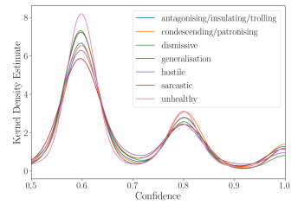
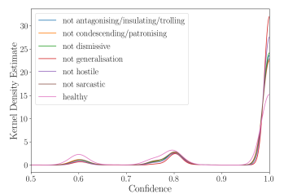
DATASET ANALYSIS
Attribute | Proportion
Antagonistic/Insulting/Trolling Condescending/Patronising Dismissive (Unfair) Generalisation Hostile Sarcastic Unhealthy | 4.7% 5.5% 3.1% 2% 2.5% 4.3% 7.5%
The Dataset comprises of 44,355 comments.
confidence scores
labelled as ’yes’
confidence scores labelled as ’no’

Slide 5
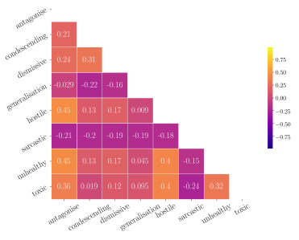
Inter-attribute correlations
Attribute | K-α
Antagonistic/Insulting/Trolling Condescending/Patronising Dismissive (Unfair) Generalisation Hostile Sarcastic Unhealthy | 0.39 0.36 0.31 0.35 0.36 0.34 0.26
Krippendorff’s alpha by attribute

Slide 6
Models and Results
A pre-trained machine learning model BERT and fine-tuning on the dataset
Comparison of BERT model with human model
Estimate variability of judgements and average the results
Attribute | Human AUC | BERT AUC
Antagonistic Condescending Dismissive Generalisation Hostile Sarcastic Unhealthy | 0.71 0.72 0.68 0.73 0.76 0.72 0.62 | 0.82 0.78 0.82 0.74 0.84 0.64 0.69

Slide 7
Conclusion
Practical efficiency of the research
Exploring unintended biases
Future works on detecting early signs of conversational failure

