Slide 1

ViaX
Practice with
your own notes
An open-source AI study companion
Notes:
ViaX product overview. Source: repository README.md and application source. The cover is AI-generated photographic artwork, not an app screenshot or real event.

Slide 2
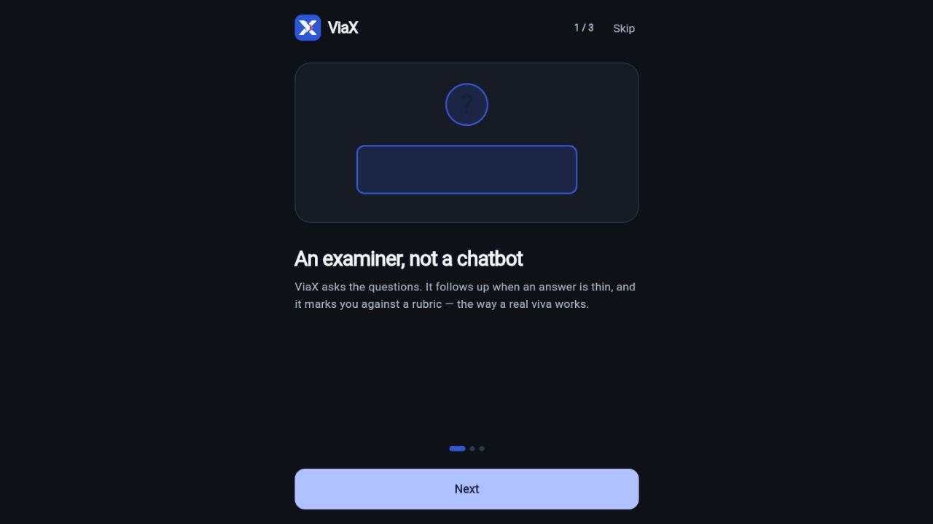
Your notes become a study base
Upload
Add a document under a subject.
Understand
Extract passages and supported concepts.
Practice
Try viva questions, flashcards, or quizzes.
Review
Return to gaps using revision and mastery.
Actual app onboarding, dark mode
Notes:
Sources: mobile/lib/screens/subjects/subject_detail_screen.dart, supabase/functions/ingest/index.ts, README.md. Screenshot captured from https://viax-iota.vercel.app on 16 October 2026. AI extraction requires selectable document text and a configured provider.

Slide 3
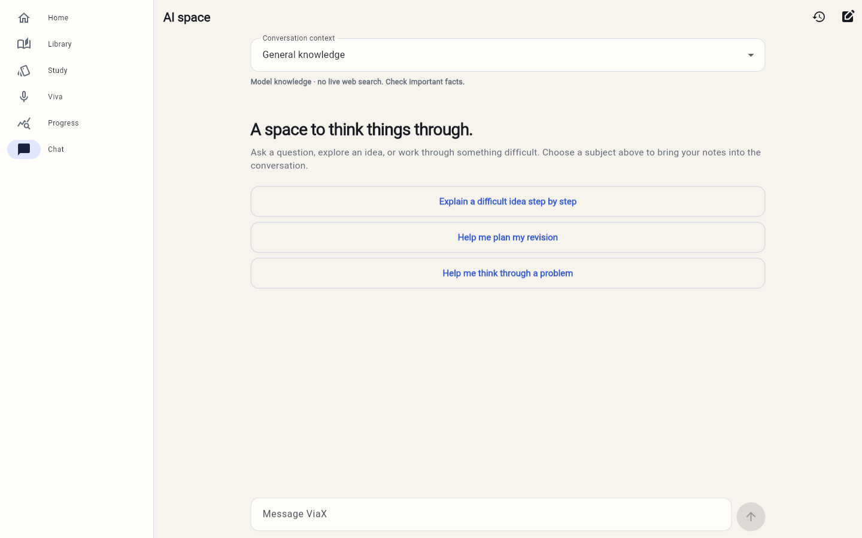
A dedicated AI conversation space
General questions or context from a selected subject
Notes:
Actual app capture on 15 October 2026 in light mode. Source: mobile/lib/screens/chat/chat_screen.dart and supabase/functions/chat/index.ts. Empty state shown. General chat does not provide live web search.

Slide 4
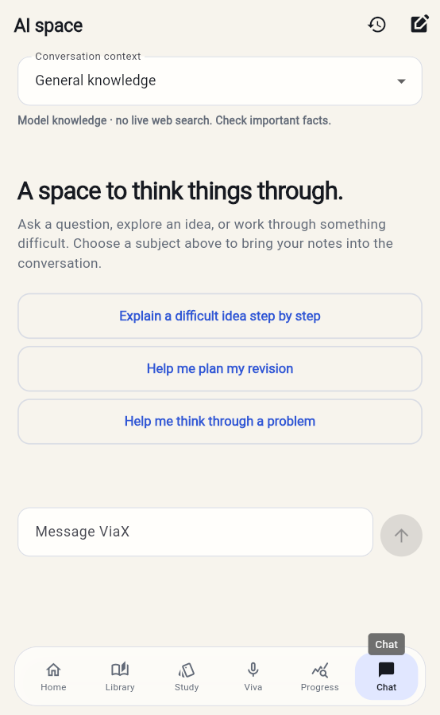
A conversation you can carry
General knowledge
Explore an idea or ask for a step-by-step explanation.
Your study notes
Choose a subject to bring saved material into the conversation.
Notes:
Actual mobile viewport capture on 15 October 2026. Conversation context is fixed after the first message. Retrieval uses saved source passages. Check important facts and source passages because AI answers may be wrong.

Slide 5
The technology behind ViaX
Flutter
Responsive application for web and mobile.
Supabase
Authentication, private document storage, database and Edge Functions.
NVIDIA
Chat generation and 1024-dimension document and query embeddings.
Source grounding
Passages connect extracted concepts to the uploaded material.
Notes:
Sources: mobile/pubspec.yaml; supabase/functions/_shared/llm.ts; supabase/functions/ingest/index.ts; supabase/functions/examine/index.ts. NVIDIA embedding model: nvidia/llama-nemotron-embed-vl-1b-v2 with dimensions=1024. API keys remain in server-side secrets. The separate Python service is optional for the deployed Flutter/Supabase path.

Slide 6
Open source.
Ready to explore.
MIT-licensed source, database migrations,
and setup instructions are on GitHub.
github.com/Akibly/viax
Try the app: viax-iota.vercel.app
Notes:
Source: LICENSE and README.md at https://github.com/Akibly/viax. Public deployment: https://viax-iota.vercel.app. Self-hosting needs a Supabase project and provider credentials. Third-party software and services retain their own licenses and terms.

