Slide 1
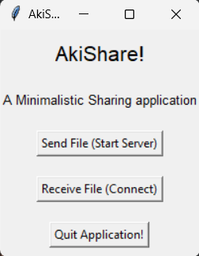
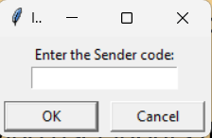
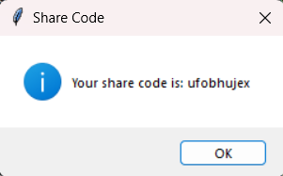
AkiShare
A Minimalistic File-Sharing Application
Computer Networks Assignment
Akhilesh R
B.Tech ECE (CPS) – 126160001
SASTRA DEEMED UNIVERSITY

Slide 2
Abstract
This project aims to develop a minimalistic file-sharing application, "AkiShare," enabling simple and secure transfer of files between devices using an encrypted, human-readable code to represent IP addresses and ports. The application converts IP addresses and port numbers into two-letter English word combinations to create an easy-to-share code, facilitating secure and accessible file sharing without requiring detailed technical knowledge from users. The system is implemented using Python with Tkinter for the GUI and sockets for networking.

Slide 3
Methodology
IP & Port Conversion
A pre-defined list of two-letter combinations is mapped to each possible octet value in an IP address (0-255), and a limited number of port numbers (8000-8010) are mapped to unique characters.
This mapping allows conversion of IP addresses and ports into short, readable character codes for easy sharing.
Functions “ip_to_characters” and “characters_to_ip” handle the conversion between IP/port and the readable code.

Slide 4
Methodology
File Transmission
Server-Side: When a user selects a file, the application initiates a server on a random port within a defined range, listens for client connections, and sends the selected file in chunks.
Client-Side: The receiving user inputs the provided readable code, which is converted back to the original IP address and port. A socket connection is established to download the file, saving it to a user-specified location.

Slide 5
Methodology
User Interface
A GUI is built using Tkinter, with options for sending a file, receiving a file, and quitting the application.
Message boxes and file dialogs provide user-friendly interactions for file selection, displaying codes, and confirming downloads.

Slide 6
Discussion
Advantages
User-Friendly Interface: The GUI, created with Tkinter, is simple and intuitive, allowing users with minimal technical knowledge to easily share and receive files.
IP and Port Abstraction : By converting IP addresses and ports to readable two-letter codes, AkiShare makes sharing connection details easier and more accessible for users who may not be familiar with IP addresses or port numbers.
Local Network File Transfer : AkiShare provides a fast and reliable way to transfer files over a local network without needing to rely on external servers, making it suitable for quick, private transfers within a secure network.
Lightweight and Portable : The application is implemented entirely in Python, making it lightweight and compatible with multiple platforms where Python is supported.
Offline and Secure : Because it doesn’t require an internet connection, file transfers are more private, reducing exposure to online security risks.

Slide 7
Discussion
Disadvantages
Limited Security : The readable code is a convenient representation but does not offer encryption or additional security measures for file contents. Sensitive files are vulnerable to interception if the network isn’t secure.
Limited Port Range : The application currently only maps 11 port numbers (8000–8010) to characters. This restricts scalability and limits the number of concurrent file transfers that can take place on the same network without port conflicts.
Basic Error Handling : The application would benefit from enhanced error handling to manage network failures, incomplete file transfers, or incorrect input codes. Currently, limited error handling may result in unexpected behavior if connectivity is disrupted.
No File Type Filtering or Size Limitation : The application does not impose restrictions on file type or size, which could lead to issues if users try to send large files over limited bandwidth or incompatible file formats.
No Automated Device Discovery : Users must manually share and input IP codes, as there’s no built-in network discovery. This could be cumbersome in environments where users are not familiar with networking concepts.

Slide 8
Conclusion
AkiShare is effective for simple, secure local file transfers, making it ideal for environments where users prioritize ease of use and local security. However, its limitations in security, scalability, and remote capabilities suggest that it is best suited for low-risk, small-scale sharing. To make AkiShare more versatile, future versions could focus on enhancing security, extending the port mapping, and adding support for encrypted remote file transfers.

