Slide 1

Week 2 — TPRM Planning: Johns Hopkins Hospital
Define scope, roles, and vendor prioritization. Deliverables: Project Charter, Vendor Criticality Matrix, RACI Chart.

Slide 2

Project Overview & Goal
Overview
Goal
Enhance JHH Third-Party Risk Management to protect patient data, clinical operations, and reputation in a regulated healthcare environment.
Establish a robust, standardized, continuously monitored TPRM framework to identify, assess, and mitigate third‑party risks across JHH.

Slide 3
Scope — In & Out
In-Scope
Out-of-Scope
All third parties accessing systems, networks, facilities, or handling JHH data (including ePHI).
Vendor criticality matrix & risk classification methodology.
Due diligence and ongoing monitoring processes.
Integration with existing GRC functions.
Internal JHH operational risks not related to third parties.
Procurement/contract negotiation (TPRM provides input).
Direct post-contract vendor relationship management (TPRM monitors performance).

Slide 4

Key Objectives
01
Standardize Assessments
Implement consistent vendor risk evaluation across departments and service lines.
02
Regulatory Compliance
Achieve and maintain compliance with HIPAA, HITECH, HITRUST, NIST SP 800-53, and ISO 27001 where applicable.
03
Enhance Data Protection
Strengthen controls for ePHI and other sensitive data handled by vendors.
04
Improve Resilience
Minimize vendor-induced disruptions to clinical and administrative functions.

Slide 5



Vendor Classification
High Risk
Medium Risk
Low Risk
EHR, cloud hosting, billing vendors — critical for patient care and ePHI handling.
Medical devices, labs — interact with clinical workflows and patient data.
Facilities or non-IT vendors with limited data/system access.

Slide 6
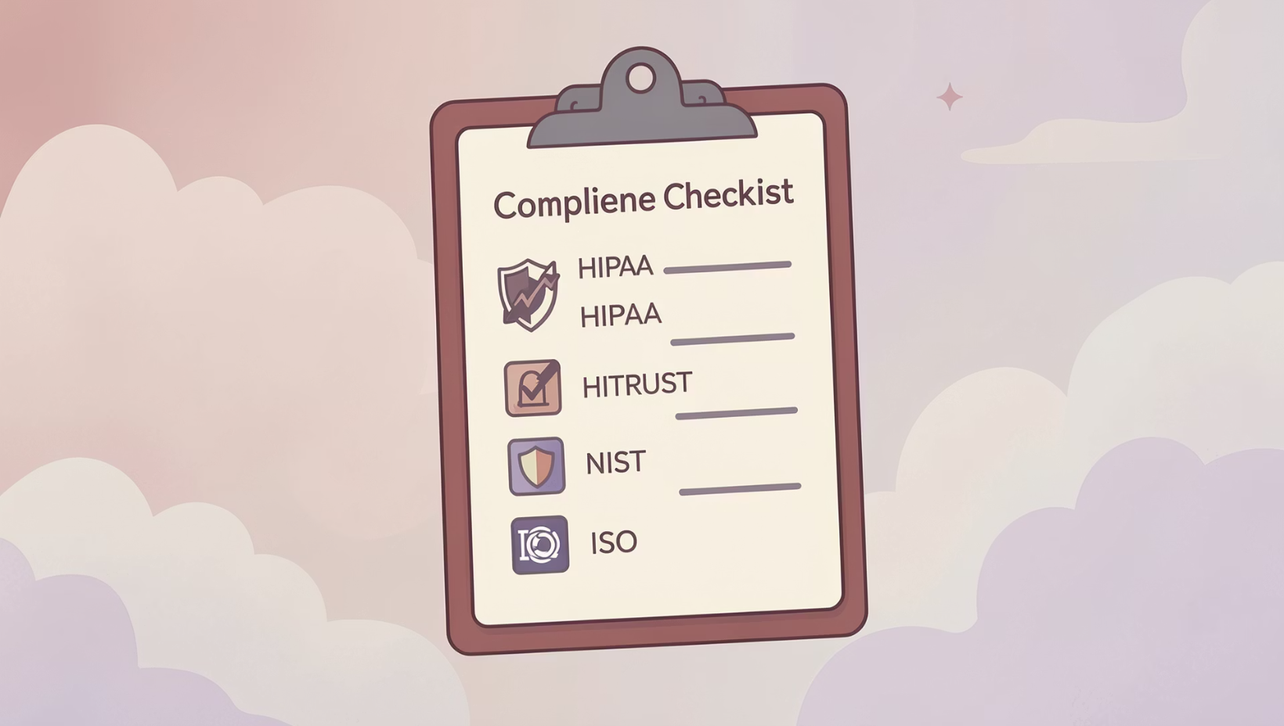
Framework Mapping
Mapping Rules
HIPAA → all vendors handling ePHI.
HITRUST → cloud & EHR vendors.
NIST / ISO → infrastructure & SaaS vendors.
Using this mapping to prioritize assessments and control baselines per vendor type.

Slide 7




RACI — Roles & Responsibilities
GRC / Compliance
IT / Information Security
Accountable for regulatory adherence, BAA management, and policy oversight.
Responsible for technical risk assessments and control validation.
Clinical Operations
Procurement
Consulted on patient safety, clinical workflow continuity, and device integration.
Responsible for vendor selection and contracting inputs; informed on assessments.
RACI clarifies who owns each TPRM activity across JHH departments.

Slide 8
RACI Chart in Action
This chart details specific responsibilities for key TPRM activities.
Activity
GRC / Compliance
IT / InfoSec
Clinical Operations
Procurement
Define TPRM Policy & Procedures
A
R
C
I
Vendor Classification & Tiers
A
R
I
C
Vendor Risk Assessment Execution
C
R
I
I
Business Associate Agreement Review
R
C
I
A
Ongoing Vendor Monitoring
A
R
C
I
Roles are defined as: Responsible, Accountable, Consulted, Informed.

Slide 9


Approvals & Next Steps
Approval signatures indicate stakeholder commitment. Required approvers include:
Chief Information Security Officer
Chief Compliance Officer
Chief Medical Officer
Chief Financial Officer
Next immediate steps: finalize Project Charter, produce Vendor Criticality Matrix, publish RACI chart — all deliverables for Week 2.
This concise Week 2 package prepares JHH to begin risk assessments and due diligence in Week 3.

