Slide 1



JOHNS HOPKINS MEDICINE
Week 1 Initiation: Third-Party Risk Management
Understanding the TPRM Landscape in Clinical, Research, and Administrative Environments
Healthcare GRC / Vendor Risk Analyst Intern
Week 1 Initiation Project | April 2026

Slide 2





Week 1 Goal: Establishing the TPRM Foundation for JHH
Objective: Understand the TPRM lifecycle within Johns Hopkins Hospital’s clinical, research, and administrative environment.
Policy Review
Vendor ID
Stakeholder Map
Regulatory Review
Analyze JHH Vendor Management and Information Security policies (FIN150 & TECH001).
Identify 10 strategic healthcare vendors across clinical, cloud, and IT domains.
Identify internal stakeholders across InfoSec, Compliance, Clinical, and IT Engineering.
Assess obligations under HIPAA, HITECH, HITRUST, NIST, and ISO standards.
WEEK 1: INITIATION PHASE | ROADMAP & OBJECTIVES

Slide 3



JHH Vendor Management & InfoSec Policy Framework
Vendor Policy (FIN150)
InfoSec Policy (TECH001)
Classification:
Data Tiers:
Defines four levels of on-site access for clinical and non-clinical vendors.
Establishes Restricted, Confidential, and Internal data classification levels.
Credentialing:
Encryption:
Mandatory background checks and ID registration for all Level 1-3 vendors.
Mandatory AES-256 encryption for all ePHI and restricted data.
Governance:
Audit Rights:
Prohibits unauthorized medical products without Supply Chain approval.
JHH reserves the right to perform annual security reviews of critical vendors.
Priority: Patient safety and data protection are the primary drivers for all vendor risk assessments at JHH.

Slide 4

HIPAA Privacy & Security Rule Obligations for JHH Vendors
HIPAA
BAA CONTRACTS
SECURITY RULE
PRIVACY RULE
Mandatory Agreements: All vendors handling ePHI must sign a Business Associate Agreement (BAA) defining liability and reporting duties.
Safeguards: Vendors must implement administrative, physical, and technical controls to ensure ePHI integrity and availability.
Minimum Necessary: Access to PHI must be limited to the absolute minimum required to perform the contracted service.
Compliance Note: JHH requires vendors to report any suspected ePHI breach within 24 hours of discovery.

Slide 5


Strategic Healthcare Vendor Inventory (Top 10)
VENDOR NAME
CATEGORY
PRIMARY RISK DOMAIN
CRITICALITY
Epic Systems
Electronic Health Records (EHR)
ePHI / Clinical Continuity
HIGH
AWS / Azure
Cloud Hosting Provider
Data Integrity / Availability
HIGH
Philips / GE
Medical Device Vendors
Patient Safety / IoT Security
HIGH
Zoom for Healthcare
Telehealth Platform
Privacy / HIPAA Compliance
MEDIUM
Change Healthcare
Revenue Cycle & Billing
Financial / ePHI Security
HIGH
Okta
Identity & Access (IAM)
Authentication / PII
HIGH
ServiceNow
ITSM / GRC Platform
Operational Resilience
MEDIUM
Medtronic
Networked Medical Devices
Patient Safety / ePHI
HIGH
Experian Health
Eligibility & Billing
Financial / PII
MEDIUM
Doxy.me
Telehealth Platform
ePHI / HIPAA Compliance
MEDIUM
Strategic vendors are tiered based on their access to ePHI and their direct impact on JHH clinical operations.

Slide 6






Cross-Functional Internal Stakeholders for TPRM Oversight
Effective TPRM at JHH is a shared responsibility across clinical, technical, legal, and security departments.
Information Security
Compliance & Privacy
Leads technical risk assessments and control validation.
→
Manages Business Associate Agreements (BAAs).
→
Manages security due diligence and vulnerability reviews.
→
Ensures alignment with HIPAA and HITECH regulations.
→
Oversees vendor access governance and MFA enforcement.
→
Oversees privacy impact assessments for new vendors.
→
JHH TPRM PROGRAM
Clinical Operations
IT & Biomedical Engineering
Defines system criticality for patient care continuity.
→
Focuses on security of networked medical devices.
→
Evaluates direct impact of vendor services on safety.
→
Oversees device patching and network segmentation.
→
Manages clinical workflow integrations and uptime SLAs.
→
Maintains accurate medical asset and software inventory.
→

Slide 7
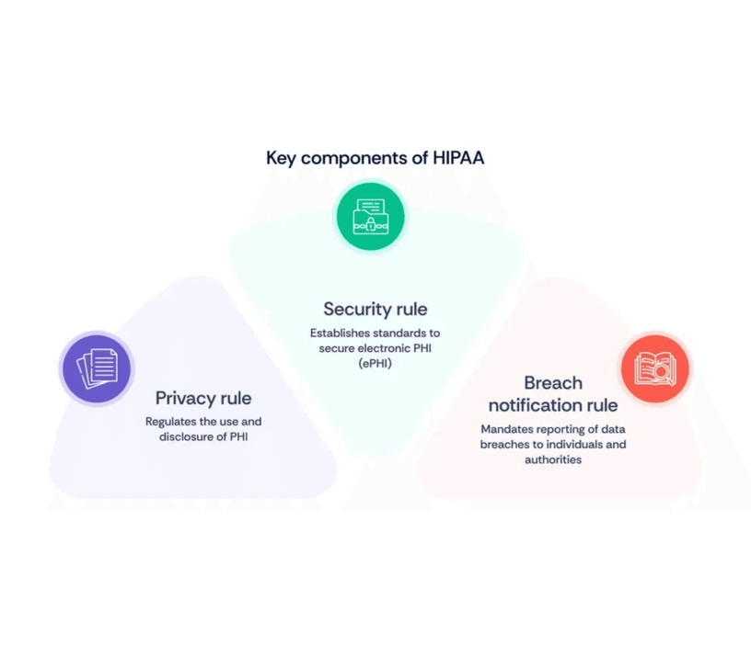




Regulatory Frameworks Governing JHH Vendor Risk
HIPAA / HITECH
HITRUST CSF
The federal legal foundation for protecting ePHI. Mandates Business Associate Agreements (BAAs) and breach notification protocols.
A certifiable framework that harmonizes HIPAA, NIST, and ISO standards into a single healthcare-specific security baseline.
NIST SP 800-53
ISO/IEC 27001
The technical catalog of security and privacy controls used to assess vendor technical safeguards and risk posture.
The international standard for Information Security Management Systems (ISMS), focusing on continuous risk management.
Layered Defense-in-Depth Model
WEEK 1: INITIATION PHASE | REGULATORY ALIGNMENT & COMPLIANCE

Slide 8





Summary: Week 1 Deliverables and Accomplishments
Week 1 has successfully established the vendor inventory, policy alignment, and stakeholder framework necessary for deep-dive assessments.
Week 1 Accomplishments
Strategic Vendor Inventory:
Identified and tiered top 10 healthcare partners.
Strategic Value
Policy Alignment:
This foundation ensures that Johns Hopkins Hospital can scale its digital operations and research initiatives while maintaining the highest standards of patient safety and data privacy. By standardizing the initiation phase, we mitigate inherent risks before they impact clinical workflows.
Mapped JHH FIN150 and TECH001 to vendor requirements.
Regulatory Mapping:
Integrated HIPAA, HITRUST, NIST, and ISO standards.
Stakeholder Framework:
Defined cross-functional roles for risk oversight.
JOHNS HOPKINS MEDICINE
WEEK 1 INITIATION PHASE | COMPLETED

