Slide 1
UI Presentation on BOI POKA
A Book Review and Discussion Platform
Student ID: 1605095
1605100
1605116

Slide 2
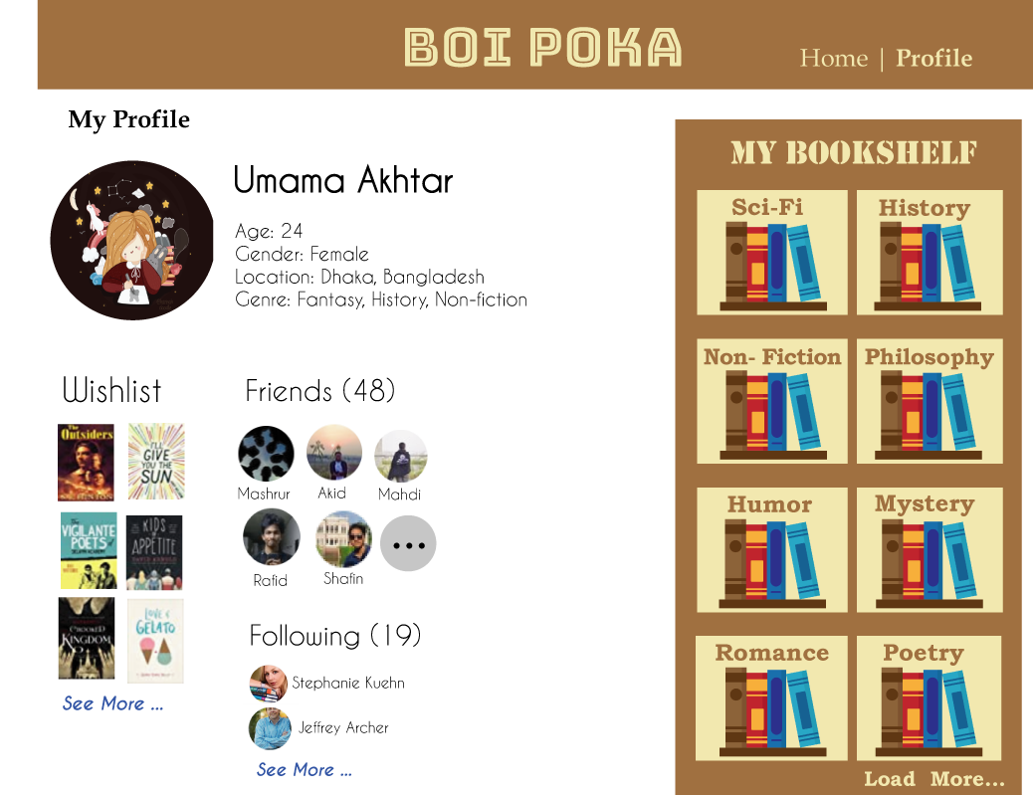

Slide 3
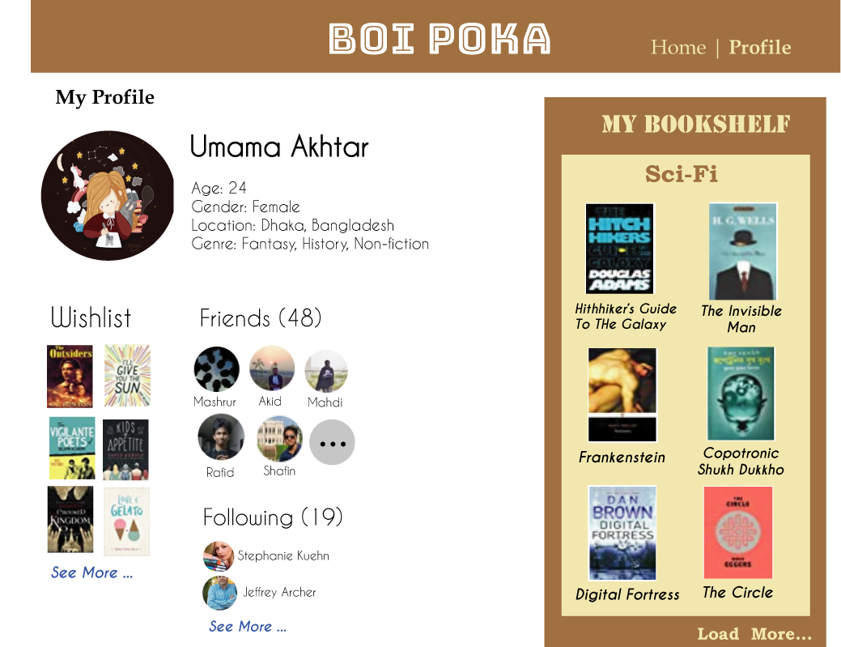

Slide 4


Slide 5
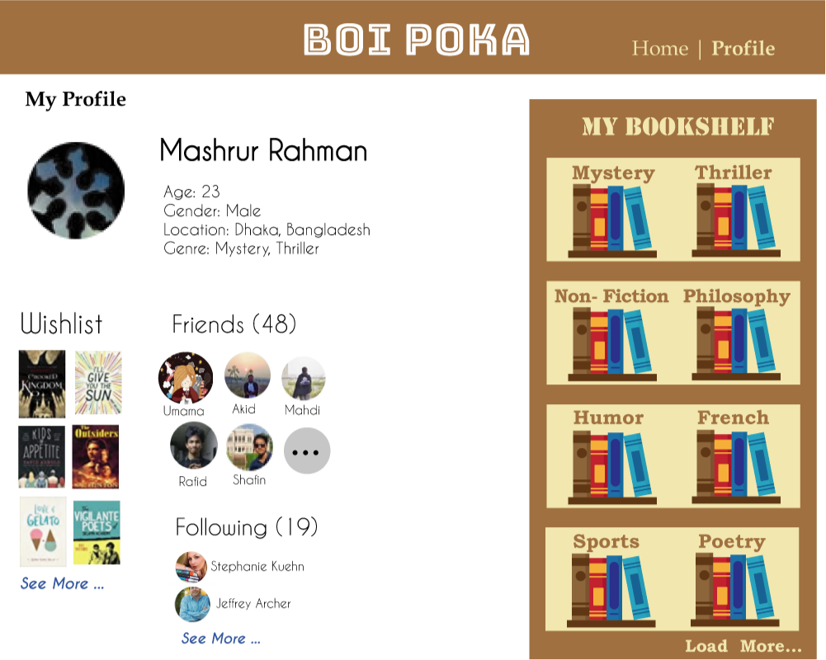

Slide 6

Add To
Wishlist

Slide 7
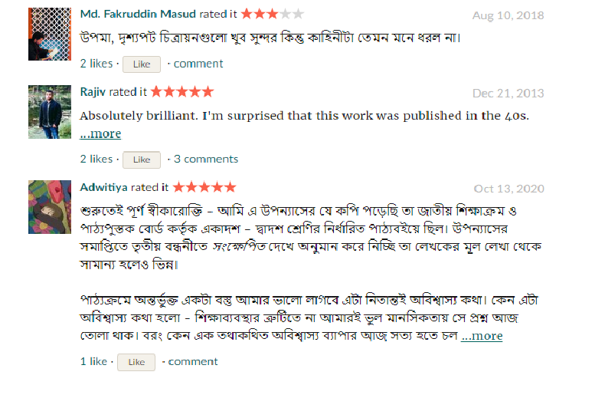

Slide 8
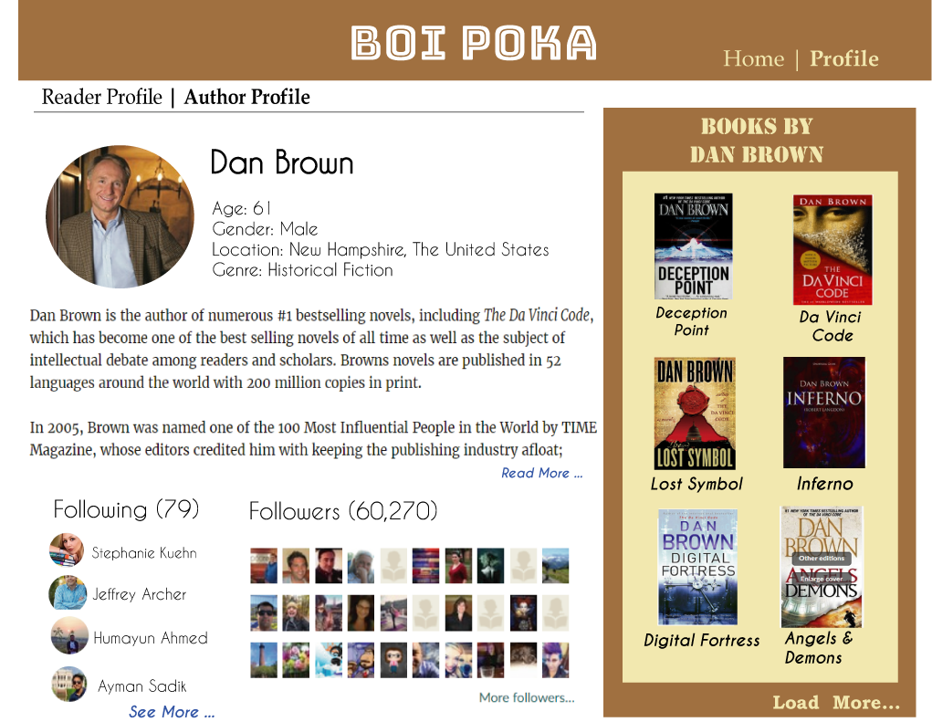

Slide 9
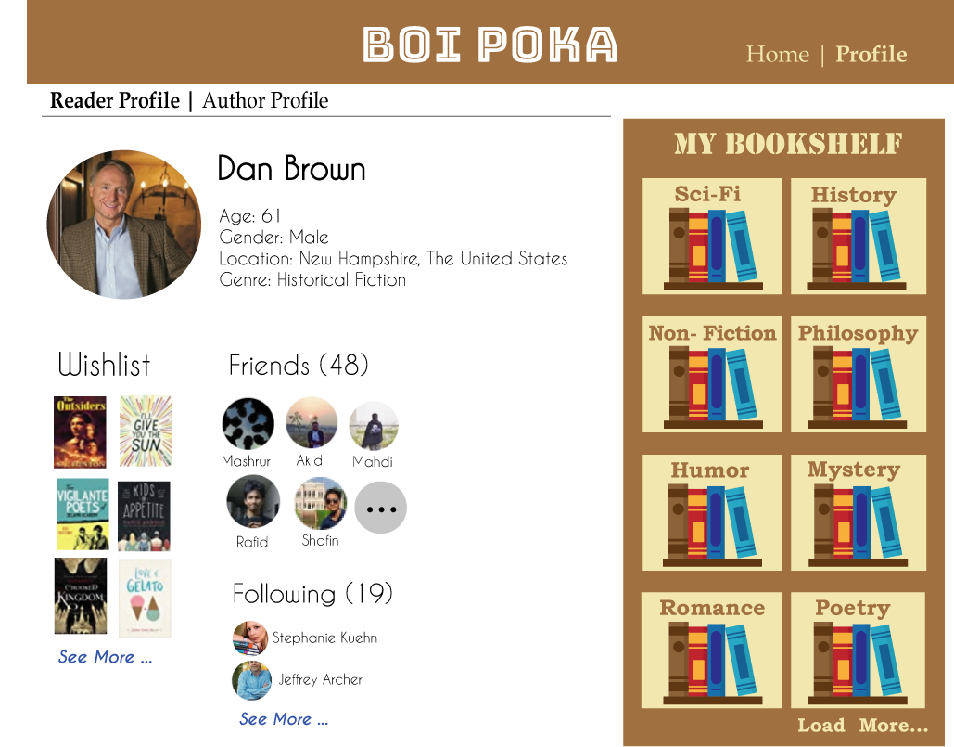

Slide 10
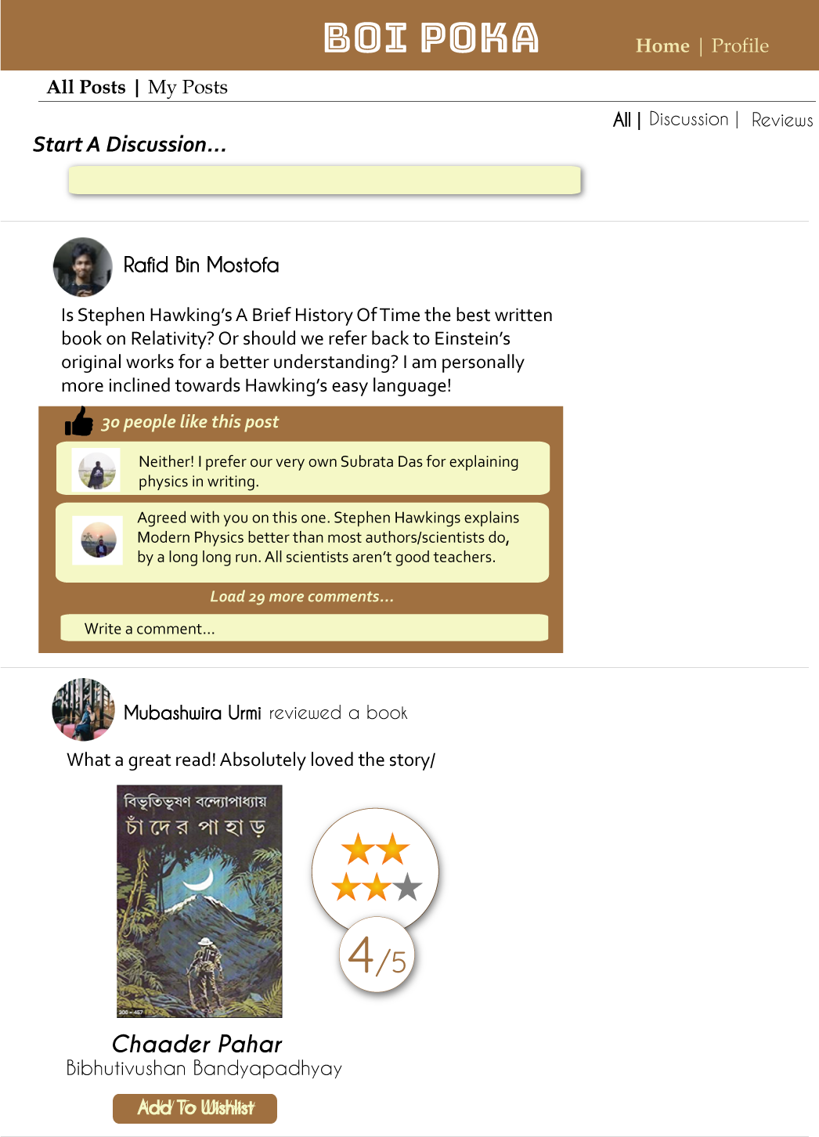


Post

Slide 11
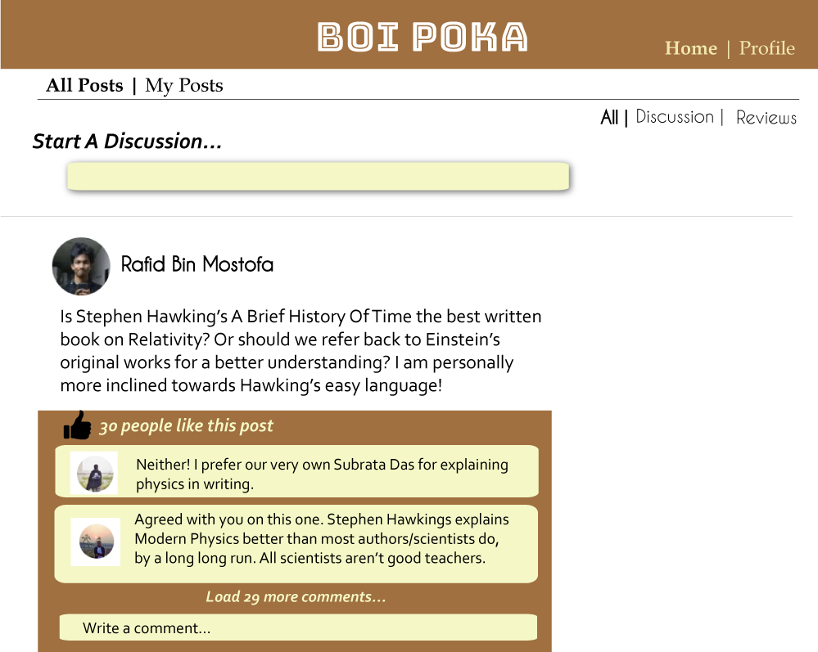
Post

Slide 12
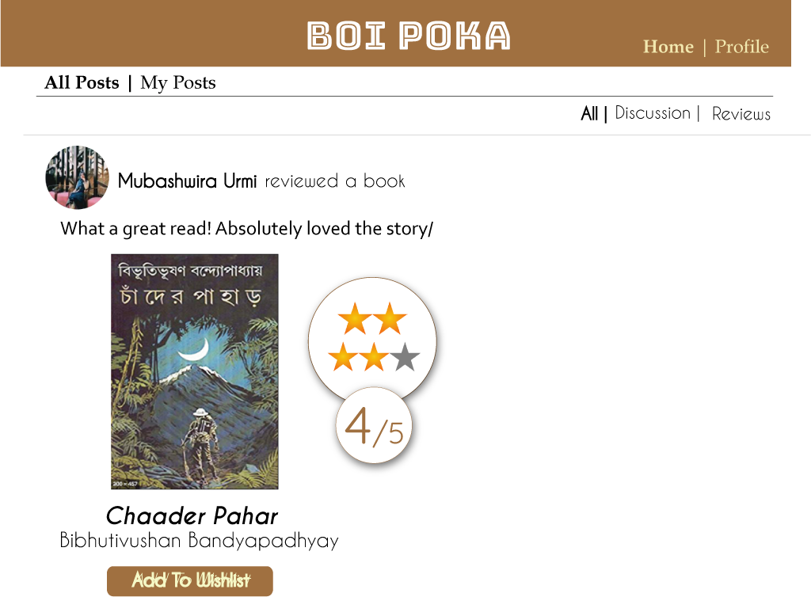

Slide 13
THANK YOU !

