Slide 1
Recursion

Slide 2
Computing Factorial
factorial(0) = 1;
factorial(n) = n*factorial(n-1);

Slide 3
Computing Factorial
animation
factorial(0) = 1;
factorial(n) = n*factorial(n-1);
factorial(3)

Slide 4
Computing Factorial
animation
factorial(0) = 1;
factorial(n) = n*factorial(n-1);
factorial(3) = 3 * factorial(2)

Slide 5
Computing Factorial
animation
factorial(0) = 1;
factorial(n) = n*factorial(n-1);
factorial(3) = 3 * factorial(2)
= 3 * (2 * factorial(1))

Slide 6
Computing Factorial
animation
factorial(0) = 1;
factorial(n) = n*factorial(n-1);
factorial(3) = 3 * factorial(2)
= 3 * (2 * factorial(1))
= 3 * ( 2 * (1 * factorial(0)))

Slide 7
Computing Factorial
animation
factorial(0) = 1;
factorial(n) = n*factorial(n-1);
factorial(3) = 3 * factorial(2)
= 3 * (2 * factorial(1))
= 3 * ( 2 * (1 * factorial(0)))
= 3 * ( 2 * ( 1 * 1)))

Slide 8
Computing Factorial
animation
factorial(0) = 1;
factorial(n) = n*factorial(n-1);
factorial(3) = 3 * factorial(2)
= 3 * (2 * factorial(1))
= 3 * ( 2 * (1 * factorial(0)))
= 3 * ( 2 * ( 1 * 1)))
= 3 * ( 2 * 1)

Slide 9
Computing Factorial
animation
factorial(0) = 1;
factorial(n) = n*factorial(n-1);
factorial(3) = 3 * factorial(2)
= 3 * (2 * factorial(1))
= 3 * ( 2 * (1 * factorial(0)))
= 3 * ( 2 * ( 1 * 1)))
= 3 * ( 2 * 1)
= 3 * 2

Slide 10
Computing Factorial
animation
factorial(0) = 1;
factorial(n) = n*factorial(n-1);
factorial(3) = 3 * factorial(2)
= 3 * (2 * factorial(1))
= 3 * ( 2 * (1 * factorial(0)))
= 3 * ( 2 * ( 1 * 1)))
= 3 * ( 2 * 1)
= 3 * 2
= 6

Slide 11

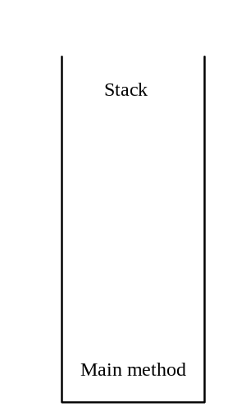
Trace Recursive factorial
animation
Executes factorial(4)

Slide 12

Trace Recursive factorial
animation
Executes factorial(3)

Slide 13
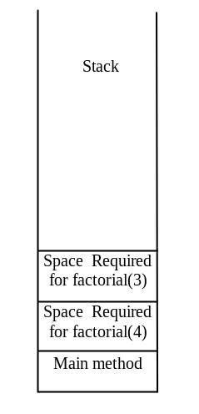
Trace Recursive factorial
animation
Executes factorial(2)

Slide 14
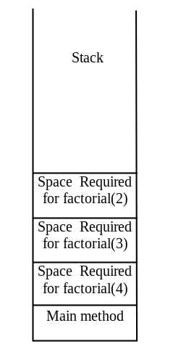
Trace Recursive factorial
animation
Executes factorial(1)

Slide 15
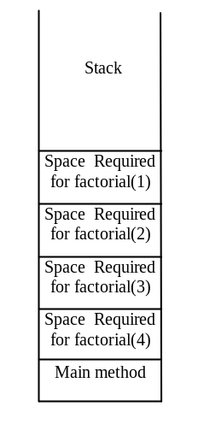
Trace Recursive factorial
animation
Executes factorial(0)

Slide 16
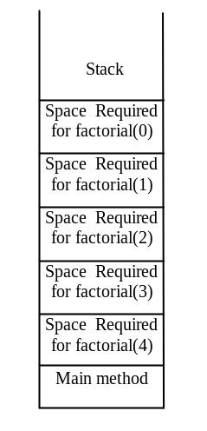
Trace Recursive factorial
animation
returns 1

Slide 17
Trace Recursive factorial
animation
returns factorial(0)

Slide 18
Trace Recursive factorial
animation
returns factorial(1)

Slide 19
Trace Recursive factorial
animation
returns factorial(2)

Slide 20
Trace Recursive factorial
animation
returns factorial(3)

Slide 21
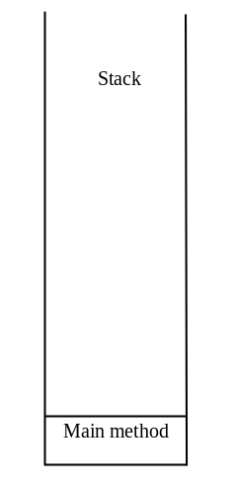
Trace Recursive factorial
animation
returns factorial(4)

Slide 22

factorial(4) Stack Trace

Slide 23
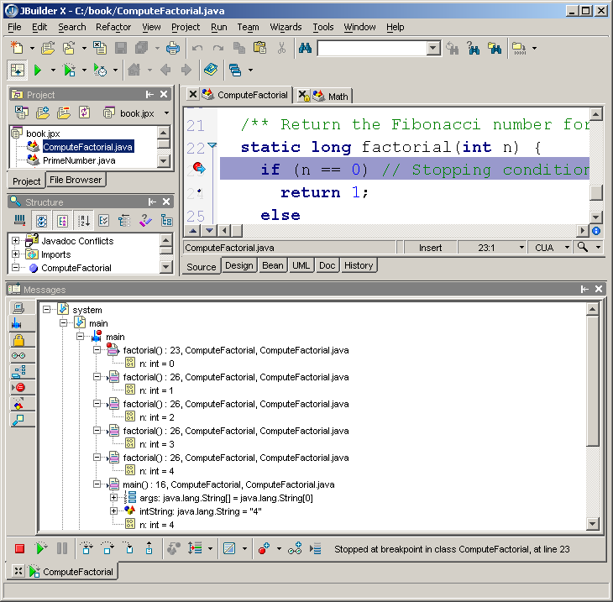
See Recursive Calls in JBuilder Debugger
You can see the chain of recursive method invocations in the stack view of the JBuilder debugger.
Stack view
Invoke factorial(0)
Invoke factorial(1)
Invoke factorial(2)
Invoke factorial(3)
Invoke factorial(4)
Invoke main method

Slide 24
Other Examples
f(0) = 0;
f(n) = n + f(n-1);

Slide 25
Fibonacci Numbers
Finonacci series: 0 1 1 2 3 5 8 13 21 34 55 89…
indices: 0 1 2 3 4 5 6 7 8 9 10 11
fib(0) = 0;
fib(1) = 1;
fib(index) = fib(index -1) + fib(index -2); index >=2
fib(3) = fib(2) + fib(1) = (fib(1) + fib(0)) + fib(1) = (1 + 0) +fib(1) = 1 + fib(1) = 1 + 1 = 2

Slide 26

Fibonnaci Numbers, cont.

Slide 27
Characteristics of Recursion
All recursive methods have the following characteristics:
  One or more base cases (the simplest case) are used to stop recursion.
  Every recursive call reduces the original problem, bringing it increasingly closer to a base case until it becomes that case.
In general, to solve a problem using recursion, you break it into subproblems. If a subproblem resembles the original problem, you can apply the same approach to solve the subproblem recursively. This subproblem is almost the same as the original problem in nature with a smaller size.

Slide 28
Problem Solving Using Recursion
Let us consider a simple problem of printing a message for n times. You can break the problem into two subproblems: one is to print the message one time and the other is to print the message for n-1 times. The second problem is the same as the original problem with a smaller size. The base case for the problem is n==0. You can solve this problem using recursion as follows:
public static void nPrintln(String message, int times) {
if (times >= 1) {
System.out.println(message);
nPrintln(message, times - 1);
} // The base case is n == 0
}

Slide 29
Think Recursively
Many of the problems presented in the early chapters can be solved using recursion if you think recursively. For example, the palindrome problem in Listing 7.1 can be solved recursively as follows:
public static boolean isPalindrome(String s) {
if (s.length() <= 1) // Base case
return true;
else if (s.charAt(0) != s.charAt(s.length() - 1)) // Base case
return false;
else
return isPalindrome(s.substring(1, s.length() - 1));
}

Slide 30
Recursive Helper Methods
The preceding recursive isPalindrome method is not efficient, because it creates a new string for every recursive call. To avoid creating new strings, use a helper method:
public static boolean isPalindrome(String s) {
return isPalindrome(s, 0, s.length() - 1);
}
public static boolean isPalindrome(String s, int low, int high) {
if (high <= low) // Base case
return true;
else if (s.charAt(low) != s.charAt(high)) // Base case
return false;
else
return isPalindrome(s, low + 1, high - 1);
}

Slide 31
Recursive Binary Search
Case 1: If the key is less than the middle element, recursively search the key in the first half of the array.
Case 2: If the key is equal to the middle element, the search ends with a match.
Case 3: If the key is greater than the middle element, recursively search the key in the second half of the array.
RecursiveBinarySort

Slide 32
Recursive Implementation
Optional
/** Use binary search to find the key in the list */
public static int recursiveBinarySearch(int[] list, int key) {
int low = 0;
int high = list.length - 1;
return recursiveBinarySearch(list, key, low, high);
}
/** Use binary search to find the key in the list between
list[low] list[high] */
public static int recursiveBinarySearch(int[] list, int key,
int low, int high) {
if (low > high) // The list has been exhausted without a match
return -low - 1;
int mid = (low + high) / 2;
if (key < list[mid])
return recursiveBinarySearch(list, key, low, mid - 1);
else if (key == list[mid])
return mid;
else
return recursiveBinarySearch(list, key, mid + 1, high);
}

Slide 33
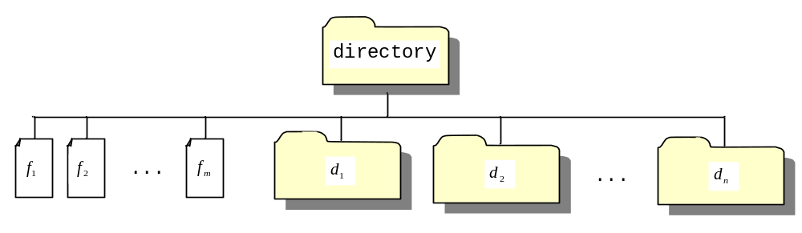
Directory Size
The preceding examples can easily be solved without using recursion. This section presents a problem that is difficult to solve without using recursion. The problem is to find the size of a directory. The size of a directory is the sum of the sizes of all files in the directory. A directory may contain subdirectories. Suppose a directory contains files , , ..., , and subdirectories , , ..., , as shown below.

Slide 34
Directory Size
The size of the directory can be defined recursively as follows:

Slide 35
Towers of Hanoi
There are n disks labeled 1, 2, 3, . . ., n, and three towers labeled A, B, and C.
No disk can be on top of a smaller disk at any time.
All the disks are initially placed on tower A.
Only one disk can be moved at a time, and it must be the top disk on the tower.

Slide 36
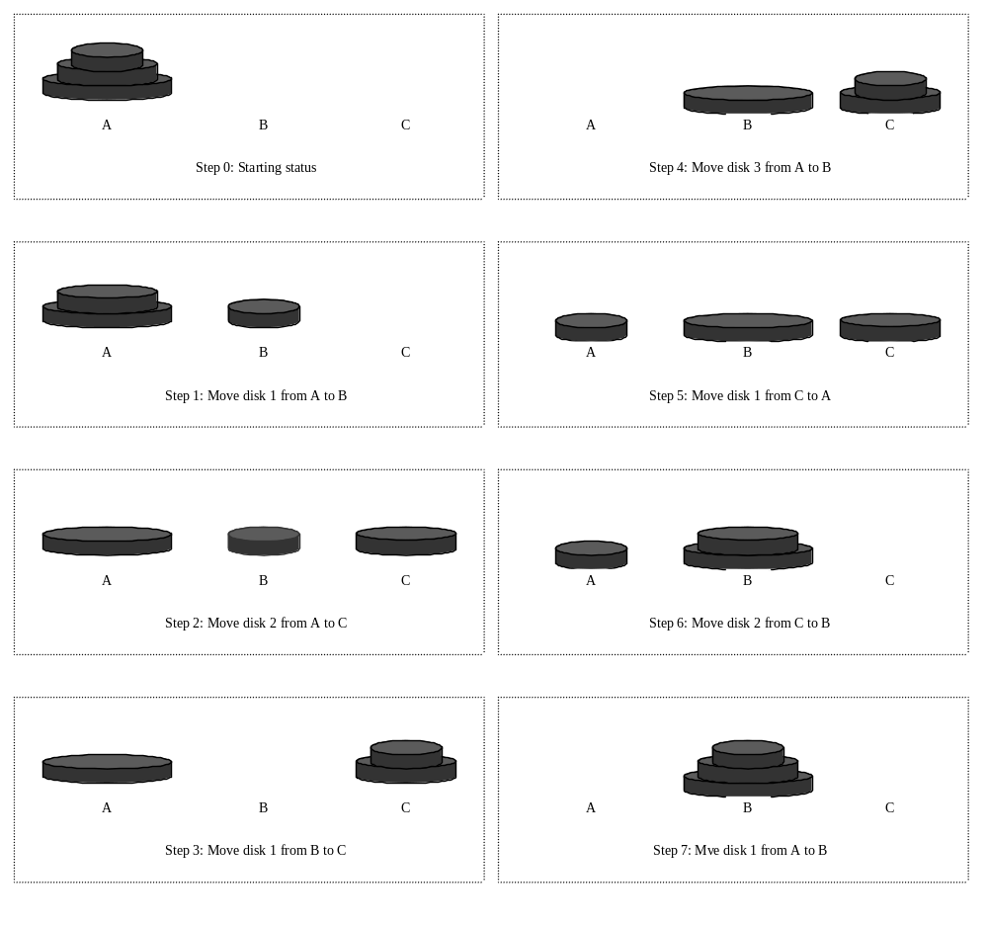
Towers of Hanoi, cont.

Slide 37
Solution to Towers of Hanoi
Move the first n - 1 disks from A to C with the assistance of tower B.
Move disk n from A to B.
Move n - 1 disks from C to B with the assistance of tower A.

Slide 38
Exercise 19.3 GCD
gcd(2, 3) = 1
gcd(2, 10) = 2
gcd(25, 35) = 5
gcd(205, 301) = 5
gcd(m, n)
Approach 1: Brute-force, start from min(n, m) down to 1, to check if a number is common divisor for both m and n, if so, it is the greatest common divisor.
Approach 2: Euclid’s algorithm
Approach 3: Recursive method

Slide 39
Approach 2: Euclid’s algorithm
// Get absolute value of m and n;
t1 = Math.abs(m); t2 = Math.abs(n);
// r is the remainder of t1 divided by t2;
r = t1 % t2;
while (r != 0) {
t1 = t2;
t2 = r;
r = t1 % t2;
}
// When r is 0, t2 is the greatest common
// divisor between t1 and t2
return t2;

Slide 40
Approach 3: Recursive Method
gcd(m, n) = n if m % n = 0;
gcd(m, n) = gcd(n, m % n); otherwise;

