Slide 1
TermComp 2016 Participant: NaTT
Akihisa Yamada (University of Innsbruck)
* Supported by FWF Y757

Slide 2
NaTT
stands for
Nagoya Termination Tool (given by M. Sakai)

Slide 3
NaTT
stands for
Nagoya Termination Tool (given by M. Sakai)
New alps Termination Tool (given by N. Hirokawa)

Slide 4
NaTT
stands for
Nagoya Termination Tool (given by M. Sakai)
New alps Termination Tool (given by N. Hirokawa)
supports
TRS/SRS standard
"weighted path order" [Yamada PhD '14]
TRS/SRS relative
"relative termination via dependency pairs" [Iborra+ JAR '16]
TRS Equational
"AC dependency pairs revisited" [Yamada+ CSL '16]

Slide 5
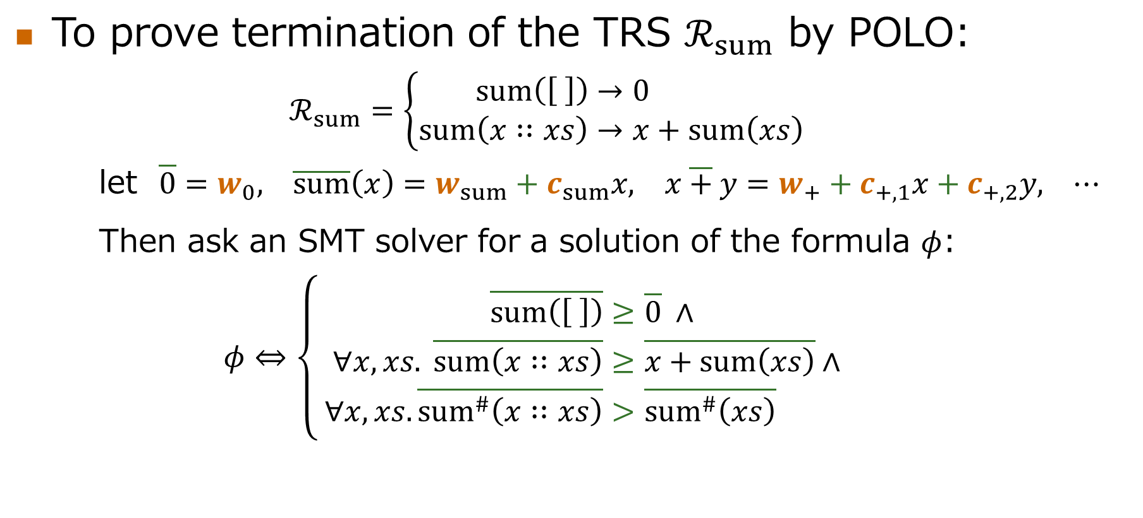
SMT for termination
To prove termination of the TRS $ℛ_{sum}$ by POLO:
$$ℛ_{sum}=\left\{\begin{aligned}sum\left(\left[ \right]\right)&→0 \\ sum\left(x∷xs\right)&→x+sum\left(xs\right)\end{aligned}\right.$$
let $\overline{0}=w_{0}, \overline{sum}\left(x\right)=w_{sum}+c_{sum}x, x \overline{+} y=w_{+}+c_{+,1}x+c_{+,2}y, ⋯$
Then ask an SMT solver for a solution of the formula $φ$:
$$φ⇔\left\{ \begin{aligned}\overline{sum\left(\left[ \right]\right)}&≥\overline{0} ∧ \\ ∀x,xs. \overline{sum\left(x∷xs\right)}&≥\overline{x+sum\left(xs\right)}∧ \\ ∀x,xs. \overline{{sum}^{\#}\left(x∷xs\right)}&>\overline{{sum}^{\#}\left(xs\right)}\end{aligned}\right.$$
non-linear SMT solving is needed (which is not easy)...

Slide 6
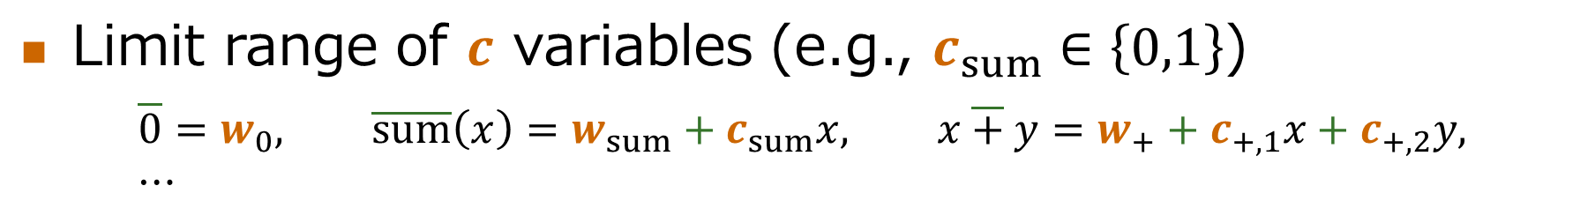

"if-then-else" blasting
Limit range of $c$ variables (e.g., $c_{sum}∈\left\{0,1\right\}$)
$$\overline{0}=w_{0}, \overline{sum}\left(x\right)=w_{sum}+c_{sum}x, x \overline{+} y=w_{+}+c_{+,1}x+c_{+,2}y, ⋯$$
$w_{sum}+\left(if b_{sum} then 0 else 1\right)⋅x$
$w_{sum}+\left(if b_{sum} then 0 else x\right)$
Linear!
$$if b_{sum} then w_{sum} else w_{sum}+x$$

Slide 7











Very incremental SMT encoding
(potential) usable rules graph
$$l_{1}→r_{1}$$
$$l_{2}→r_{2}$$
$$l_{3}→r_{3}$$
$$l_{4}→r_{4}$$
$$l_{5}→r_{5}$$
$$ℛ$$
$$DP\left(ℛ\right)$$
$$s_{1}^{\#}→t_{1}^{\#}$$
$$s_{2}^{\#}→t_{2}^{\#}$$
$$s_{3}^{\#}→t_{3}^{\#}$$
$$s_{4}^{\#}→t_{4}^{\#}$$
dependency graph

Slide 8

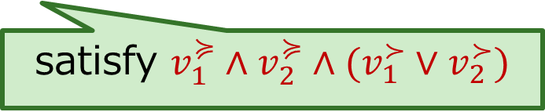









Very incremental SMT encoding
Usability encoded as $u_{i}$
$$u_{1}⇒l_{1}≽r_{1}$$
$$u_{2}⇒l_{2}→r_{2}$$
$$l_{3}→r_{3}$$
$$l_{4}→r_{4}$$
$$l_{5}→r_{5}$$
$$ℛ$$
$$DP\left(ℛ\right)$$
$$v_{1}^{≽}⇒s_{1}^{\#}≽t_{1}^{\#}$$
$$v_{2}^{≽}⇒s_{2}^{\#}≽t_{2}^{\#}$$
$$s_{3}^{\#}→t_{3}^{\#}$$
$$s_{4}^{\#}→t_{4}^{\#}$$
satisfy $v_{1}^{≽}∧v_{2}^{≽}∧(v_{1}^{≻}∨v_{2}^{≻})$

Slide 9

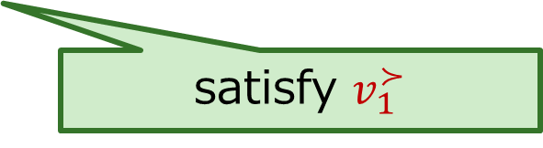


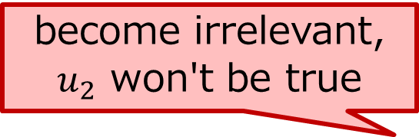
Very incremental SMT encoding
become irrelevant,
$u_{2}$ won't be true
$$u_{1}⇒l_{1}≽r_{1}$$
$$u_{2}⇒l_{2}→r_{2}$$
$$l_{3}→r_{3}$$
$$l_{4}→r_{4}$$
$$l_{5}→r_{5}$$
$$ℛ$$
$$DP\left(ℛ\right)$$
✓
$$v_{1}^{≽}⇒s_{1}^{\#}≽t_{1}^{\#}$$
$$v_{2}^{≽}⇒s_{2}^{\#}≽t_{2}^{\#}$$
$$s_{3}^{\#}→t_{3}^{\#}$$
$$s_{4}^{\#}→t_{4}^{\#}$$
satisfy $v_{1}^{≻}$

Slide 10


Very incremental SMT encoding
$$u_{1}⇒l_{1}≽r_{1}$$
$$u_{2}⇒l_{2}→r_{2}$$
$$l_{3}→r_{3}$$
$$l_{4}→r_{4}$$
$$l_{5}→r_{5}$$
$$ℛ$$
$$DP\left(ℛ\right)$$
✓
✓
$$v_{1}^{≽}⇒s_{1}^{\#}≽t_{1}^{\#}$$
$$v_{2}^{≽}⇒s_{2}^{\#}≽t_{2}^{\#}$$
$$s_{3}^{\#}→t_{3}^{\#}$$
$$s_{4}^{\#}→t_{4}^{\#}$$

Slide 11

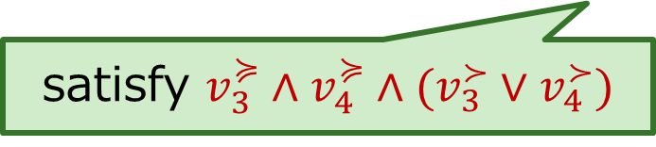




Very incremental SMT encoding
become relevant again,
no new formula generated
$$u_{1}⇒l_{1}≽r_{1}$$
$$u_{2}⇒l_{2}→r_{2}$$
$$u_{3}⇒l_{3}→r_{3}$$
$$u_{4}⇒l_{4}→r_{4}$$
$$l_{5}→r_{5}$$
$$ℛ$$
$$DP\left(ℛ\right)$$
✓
✓
$$v_{1}^{≽}⇒s_{1}^{\#}≽t_{1}^{\#}$$
$$v_{2}^{≽}⇒s_{2}^{\#}≽t_{2}^{\#}$$
$$v_{3}^{≽}⇒s_{3}^{\#}≽t_{3}^{\#}$$
$$v_{4}^{≽}⇒s_{4}^{\#}≽t_{4}^{\#}$$
satisfy $v_{3}^{≽}∧v_{4}^{≽}∧(v_{3}^{≻}∨v_{4}^{≻})$

Slide 12

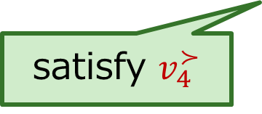



Very incremental SMT encoding
$$u_{1}⇒l_{1}≽r_{1}$$
$$u_{2}⇒l_{2}→r_{2}$$
$$u_{3}⇒l_{3}→r_{3}$$
$$u_{4}⇒l_{4}→r_{4}$$
$$l_{5}→r_{5}$$
$$ℛ$$
$$DP\left(ℛ\right)$$
✓
✓
✓
$$v_{1}^{≽}⇒s_{1}^{\#}≽t_{1}^{\#}$$
$$v_{2}^{≽}⇒s_{2}^{\#}≽t_{2}^{\#}$$
$$v_{3}^{≽}⇒s_{3}^{\#}≽t_{3}^{\#}$$
$$v_{4}^{≽}⇒s_{4}^{\#}≽t_{4}^{\#}$$
satisfy $v_{4}^{≻}$

Slide 13

Very incremental SMT encoding
$$u_{1}⇒l_{1}≽r_{1}$$
$$u_{2}⇒l_{2}→r_{2}$$
$$u_{3}⇒l_{3}→r_{3}$$
$$u_{4}⇒l_{4}→r_{4}$$
$$l_{5}→r_{5}$$
$$ℛ$$
$$DP\left(ℛ\right)$$
✓
✓
✓
✓
$$v_{1}^{≽}⇒s_{1}^{\#}≽t_{1}^{\#}$$
$$v_{2}^{≽}⇒s_{2}^{\#}≽t_{2}^{\#}$$
$$v_{3}^{≽}⇒s_{3}^{\#}≽t_{3}^{\#}$$
$$v_{4}^{≽}⇒s_{4}^{\#}≽t_{4}^{\#}$$

